Slide 1
⚡
GREEN CHARGE
MMU SUSTAINABLE COMPUTING HACKATHON · 2026
What does it cost the planet to charge your stuff?
A carbon-aware calculator for the everyday charge — phone, tablet, laptop — using live UK National Grid data.
SHARIA ALAM
ID 25937881 · Manchester Metropolitan University · greencompute.uk

Slide 2
MOTIVATION · WHAT WE BUILT AND WHY
Carbon calculators talk about flights and meat. Nobody talks about the everyday charge.
EVERYBODY DOES IT
GRID CARBON CHANGES HOURLY
NO STUDENT-FACING TOOL
Daily
5–10×
Nothing
Phones, laptops, tablets — multiple times a day, every day.
UK grid CO₂/kWh swings through the day: wind at night, solar at noon, gas at peak.
Most tools target enterprise. Students charge ten devices and never see the cost.
Why this, why now: students charge constantly, the UK grid is suddenly very transparent (free public API), and behaviour change needs personal numbers — not a lecture.
GREEN CHARGE · MMU Sustainable Computing Hackathon · 2026
2 / 9

Slide 3
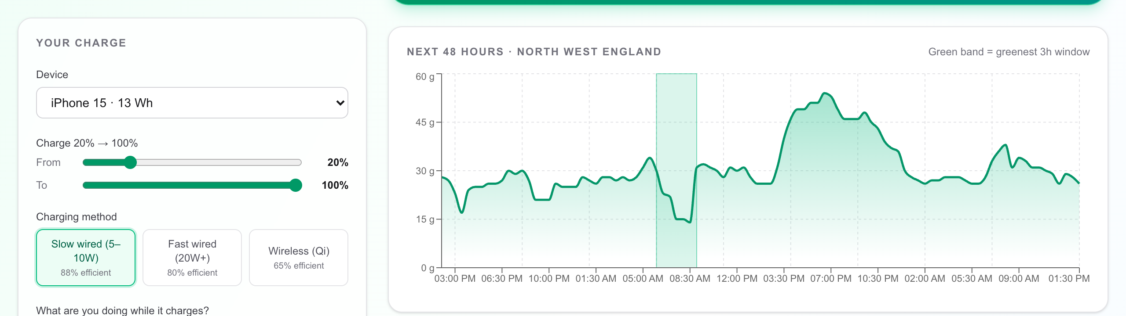
REAL-TIME DATA
Live UK grid · half-hour resolution · 48-hour forecast
How it works
National Grid ESO
Carbon Intensity API — free, public, no key.
By postcode → regional gCO₂/kWh forecast
for the next 48 hours.
Dominant fuel + index
(very-low → very-high)
Green band = greenest charge window for the current charge length.
GREEN CHARGE · MMU Sustainable Computing Hackathon · 2026
3 / 9

Slide 4
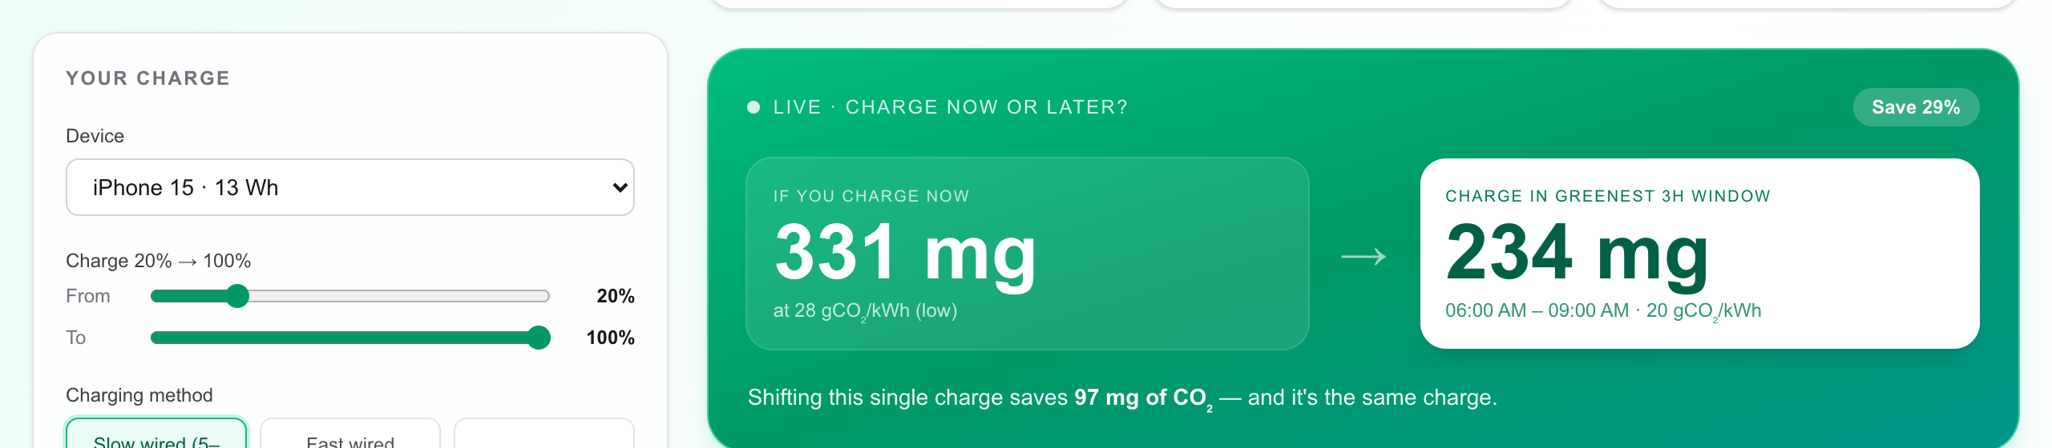
THE HEADLINE FEATURE
Same charge. Same battery. Different carbon.
70–83%
Live
0
CO₂ saved per charge
UK Carbon Intensity API
extra hardware
by shifting to greenest window
updates every 30 minutes
just a postcode
GREEN CHARGE · MMU Sustainable Computing Hackathon · 2026
4 / 9

Slide 5
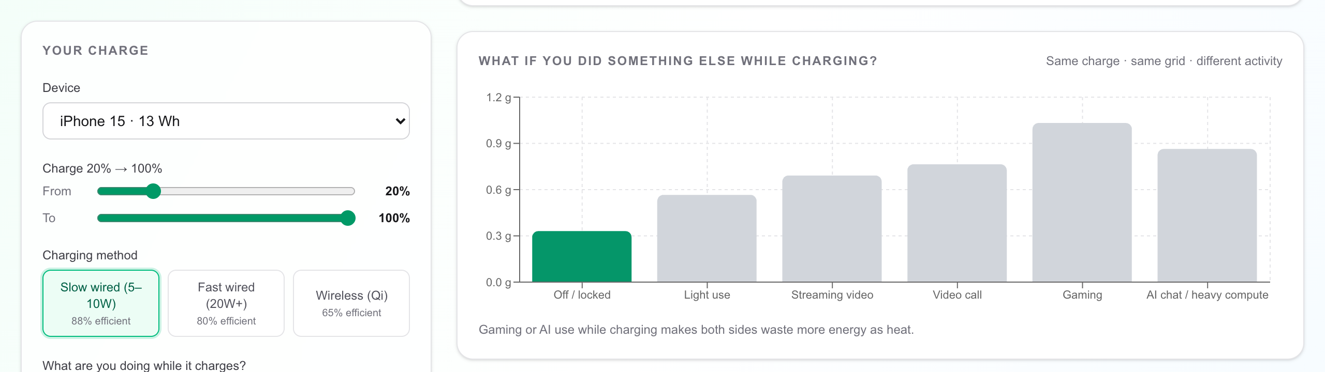
WHAT EVERY APP MISSES
Using your phone while it charges wastes more energy than you think.
Why it matters
Heat = wasted energy.
Active use heats the battery and chipset — charging becomes less efficient.
Gaming while charging: +25%
AI chat while charging: +18%
Charge first, scroll later.
Same battery delta · same charger · only the activity changes.
GREEN CHARGE · MMU Sustainable Computing Hackathon · 2026
5 / 9

Slide 6
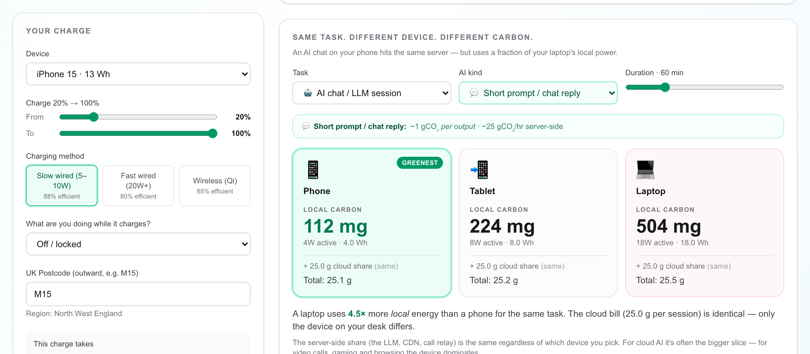
ASKED BY OUR FACULTY · TWO LEVERS
Same AI task. Different device — and different kind of AI.
Two levers
Which device:
Laptop uses 4.5× more local energy than a phone.
Which AI:
chat ~1g · long ctx ~12g · image ~3g · video ~90g per output.
Phone + chat reply. Video gen sparingly.
Server share also swings 30× across AI types — from short chat (~25 g/hr) to video gen (~900 g/hr). Picker reveals it live.
GREEN CHARGE · MMU Sustainable Computing Hackathon · 2026
6 / 9

Slide 7
GUESSTIMATE OF POSITIVE ENVIRONMENTAL IMPACT
If everyone shifted one daily charge to the greenest window…
ONE STUDENT
25,000 MMU STUDENTS
1.5M UK UNI STUDENTS
~250 g
4 – 8 t
~250 t
CO₂ / year saved
CO₂ / year saved
CO₂ / year saved
≈ 1.5 km driven (petrol car)
≈ 3 – 5 UK cars off the road
≈ 150 UK cars off the road
Same charge. Same battery. Same device. Only the timing changes.
Method · Per-charge saving averaged at 0.7 g CO₂ (iPhone-class, NW England grid, shifted from peak to greenest 3 h window). Scaled linearly.
GREEN CHARGE · MMU Sustainable Computing Hackathon · 2026
7 / 9

Slide 8
CHALLENGES · LESSONS LEARNED
What was hard, what surprised us, what we&#x2019;d do next.
CHALLENGES
SURPRISES
LESSONS
Modelling heat losses
No clean public dataset for the &#x201C;while-charging penalty.&#x201D; We landed on industry ranges (15-30%) and made the assumption explicit in the UI.
Cloud dominates for AI
We expected device choice to swing AI carbon. The server side is ~50&#x202F;g/hr — bigger than any device. Reframed the message.
Embodied beats operational
Manufacturing one phone &#x2248; 2-3 years of green charging. The biggest behaviour change is keeping devices longer.
Next.js 16 is brand new
Fetch is no longer cached by default, app router patterns shifted — had to read the in-tree docs before writing UI code.
Per-charge numbers are tiny
An iPhone charge is &lt; 1&#x202F;g CO&#x2082;. The story isn&#x2019;t a single charge — it&#x2019;s 25k students &#xD7; 365 days.
Timing &gt; efficiency
A 5% efficiency tweak loses to a well-timed 80% grid shift. The grid is the lever.
Calibrating per-device specs
Manufacturer-published battery Wh, charging power and idle draw don&#x2019;t always agree. We picked conservative middle values.
Saving 80%+ is realistic
Manchester grid swings from ~17 to ~100&#x202F;gCO&#x2082;/kWh in a day. Timing alone gets you most of the win.
Personal numbers move people
&#x201C;Your phone, your postcode, right now&#x201D; lands harder than a global stat. We&#x2019;d build a PWA notification next.
Honest scope: this tool covers operational charging carbon — not embodied device carbon, not networking. We surface those caveats in the UI.
GREEN CHARGE · MMU Sustainable Computing Hackathon · 2026
8 / 9

Slide 9
TRY IT
Green Charge is running right now.
http://localhost:3000
10 devices
phones, tablets, MacBooks, ThinkPads, XPS …
6 activities
off · light · streaming · call · gaming · AI
48 h forecast
live UK regional grid carbon
Questions?
SHARIA ALAM
GREEN CHARGE · MMU Sustainable Computing Hackathon · 2026
9 / 9
ID 25937881 · Manchester Metropolitan University

