Slide 1
I/O Streams

Slide 2
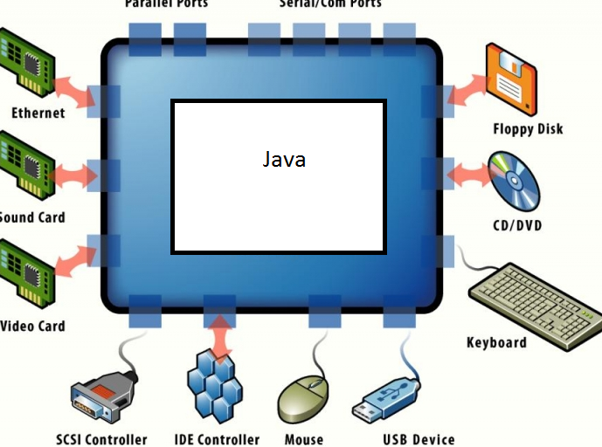

Why I/O Streams? Ans: This is the method by which java knows to communicate with I/O devices

Slide 3
I thought File class can read and write Files?
NO! File class does not have any methods to read or write data to a external file.
It only has methods to create files and folders and to perform operations on the metadata of the file.
Like: it can check if file exists, does this user who logged in have permissions to read and write on the file, available space etc.

Slide 4
Streams
FileInputStream
FileOutputStream
DataInputStream
DataOutputStream
ObjectOutputStream
ObjectInputSteam

Slide 5
I/O Streams throw Compile time (checked) exceptions
Thus we need to handle exceptions. – Very important

Slide 6
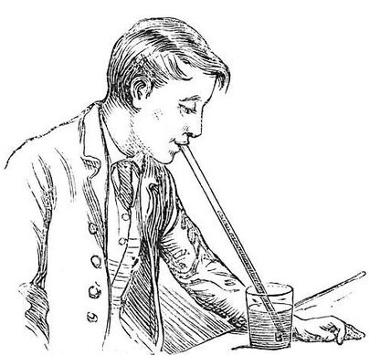
How to imagine and write streaming?
3) Same as straw.read()
The only difference is that if this guy sucks from straw he gets liquid , but when java program does read it gets int values.
Java Program
2) FileInputStream straw = new FileInputStream(glass)
1) File glass = new File(“C:\Folder_with_Files\Glass.txt”)

Slide 7

What is actually happening when you say File glass = new File(“C:\Folder_with_Files\Glass.txt”)
Invisible connection NOTE: this is not the stream
glass
Stack
Object
Heap

Slide 8
What is actually happening when you say FileInputStream straw = new FileInputStream(glass)
Straw
This is the stream object
glass
Stack
Glass files
Heap

Slide 9
Simlarly FileOutputStream straw = new FileOputStream(mouth)
Strawm
mouth
Straw
glass
Stack
Mouth
Glass files
Heap

Slide 10
int juice = straw.read() retruns -1 is file is empty
juice
Strawm
mouth
Straw
glass
Stack
Mouth
Glass files
Heap

Slide 11
Strawm.write(juice)
juice
Strawm
mouth
Straw
glass
Stack
Mouth
Glass files
Heap

Slide 12
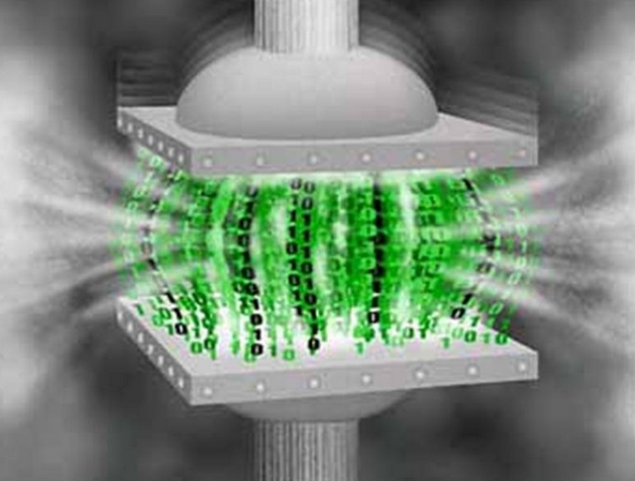
Serialization

Slide 13
Serialization
Why is it required?
To store an object into file, to persist the object.
How can a class be made serializable?
That class should implement an interface called serializable.
Serializable interface is a MarkerInterface (meaning : this interface does not have any methods)

Slide 14
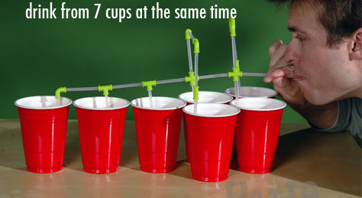
Sequence Input Stream

Slide 15
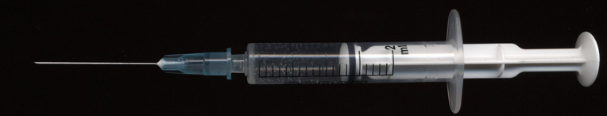
BufferedReader – Works much like a pipette (or ink filler)
What is the advantage?
It reads many time but writes once for every line or when ever you want to write. Unlike readers which read and write for every byte, thus time reduces by nealy 50%

