Slide 1
Threads

Slide 2
Processes
“Processes” in most operating systems demand complete resources and do not share resources. They are like Monarchs. So for a process to run it would reload the memory and registers every single time they run, which is very inefficient
Example of process is MS Word or MS Excel running on a system

Slide 3
Threads
Share resources, while performing their tasks individually.
What does that mean?
Faster
Space efficiency due to shared code areas
Easier sharing of resources, with implicit shared memory
Allows program execution to overlap with I/O
Example of a thread is a spell checker and grammar checkers which are running simultaneously on MS Word Document
Most operating systems allow user to control threads related their application.

Slide 4
Power comes with responsiblity
Taking control of threads could lead into highly complicated and often erroneous results which might only show up in production because of large volumes. Unless the situation really demands it, one must not attempt to take control.

Slide 5
How often do we need to write threaded programs in Java
Not very often because of the complexity they bring in.
Most of the predefined classes are thread safe meaning even if system runs multiple threads they will not get into complicated issues related to threads. This is because of the way they are defined.

Slide 6
Ways to Create threads in Java
Either extend the thread class or implement the Runnable interface
It is better to implement the Runnable interface, thus leaving the option open to derive from another class. For example:
Public class specialTask extends GeneralTask implements Runnable

Slide 7
Life Time of Thread
NEW
Sleep
Dead
Start()
Sleep()
Run() completes
Runnable
Scheduler
Running
Wait()
Lock Available
Synchronized()
Blocked in lock pool
Blocked in wait Pool
Notify()

Slide 8

Fist an object is Created
Human human = new Human();

Slide 9


This object is runnable only if:
It does the following:
Implement runnable and provide body for run() method or
Extends thread and provide body for run() method
Runnable object
Class Human implements Runnable

Slide 10

This is when a thread is Created
NEW
Ex: Thread runner = new Thread(human)
Here runner is a thread of human object.

Slide 11


Runnable state
NEW
runner.Start()
OS
Start()
Runable
State of the object
Up on calling start the thread gets ready to run i.e. it becomes runnable. But Wait for OS which actually schedules the thread. Just like a judge schedules a runner.

Slide 12

Scenario 1 - Running
NEW
Start()
Runnable
Scheduler
Running
Represents all the actions thread does while awake and alive

Slide 13
Scenario 1 – Go to Sleep
NEW
Sleep
Start()
Sleep()
baby.sleep()
Runnable
Scheduler
Running
Thread will pause running for specified amount of time.

Slide 14
Scenario 1 – Come out of sleep
NEW
Sleep
Start()
Sleeping()
completed
Sleep()
Runnable
Scheduler
Running

Slide 15
Yeild
NEW
Yeild
Start()
Sleeping()
completed
Sleep()
Runnable
Scheduler
Running

Slide 16
Join
NEW
Join
Start()
Sleeping()
completed
Sleep()
Runnable
Scheduler
Running

Slide 17
Scenario 2 - Running
NEW
Start()
Runnable
Scheduler
Running

Slide 18
Scenario 2 - Running
NEW
Dead
Start()
Run() completes
Runnable
Scheduler
Running

Slide 19
Killing a Thread in right way
NEW
Boolen Stop = false;
Void run(){
If(stop) return;
}
Start()
Runnable
Scheduler
Running
Define a boolean variable stop in the class of the object of which the thread belongs
Write a condition like if(stop) return in the run() method to kill thread gracefully

Slide 20

Iblis - Satan

Slide 21

Deamon Threads
The term was coined by the programmers of MIT's Project MAC. They took the name from Maxwell's demon, an imaginary being from a famous thought experiment that constantly works in the background, sorting molecules.^{[2]}
Unix systems inherited this terminology. Daemons are also characters in Greek mythology, some of whom handled tasks that the gods could not be bothered with

Slide 22

Maxwell's demon
Something that works in the back ground continuously to get the work done

Slide 23
Scenario 3 – Youth Thread
NEW
Start()
Runnable
Scheduler
Running

Slide 24

Scenario 3 – Youth Threads
Threads
This is a Synchronized block
Lock pool

Slide 25
Scenario 3 – Youth Threads
NEW
Start()
Runnable
Scheduler
Running

Slide 26
Scenario 3
NEW
Start()
Runnable
Scheduler
Running
Synchronized()
Blocked in lock pool

Slide 27
Scenario 3
NEW
Start()
Runnable
Scheduler
Running
Lock Available
Synchronized()
Blocked in lock pool

Slide 28
Scenario 4
NEW
Start()
Runnable
Scheduler
Running

Slide 29

Scenario 4 – GrandMa Thread
I don’t care , I will wait until all of them are done
Notify me when your are done boarding

Slide 30
Scenario 4 – GrandMa Thread
NEW
Start()
Runnable
Scheduler
Running

Slide 31
Scenario 4 – GrandMa Thread
NEW
Start()
Runnable
Scheduler
Running
Wait()
Blocked in wait Pool

Slide 32
Scenario 4 – GrandMa Thread
NEW
Start()
Runnable
Scheduler
Running
Wait()
Blocked in lock pool
Blocked in wait Pool
Notify()

Slide 33
Scenario 4 – GrandMa Thread
NEW
Start()
Runnable
Scheduler
Running
Wait()
Lock Available
Blocked in lock pool
Blocked in wait Pool
Notify()

Slide 34
Life Time of Thread
NEW
Sleep
Dead
Start()
Sleep()
Run() completes
Runnable
Scheduler
Running
Wait()
Lock Available
Synchronized()
Blocked in lock pool
Blocked in wait Pool
Notify()

Slide 35



Executor: Threads Features of 1.5
You will be feeding your runnables objects into executor
Thus enabling you to use the features of executor like:
Fixed-size thread pool
Single thread
Cached thread pool
How to achive this? See below :
exc
ExecutorService exc = Executors.newChachedThreadPool();
Human human= new Human();
exc.execute(baby);

Slide 36
Why Executor?
Exector uses an optimized thread pool, more flexible than using Thread

Slide 37
Call(): Java 1.5’s equvalent of run()
Similar to run(), but allows the task to return a value

Slide 38
Callable: Java 1.5 equvalent of runnable
A callable object is same as runnable object the only difference is that runnable method will have run() method in it, while the callable object will have call method in it.

Slide 39
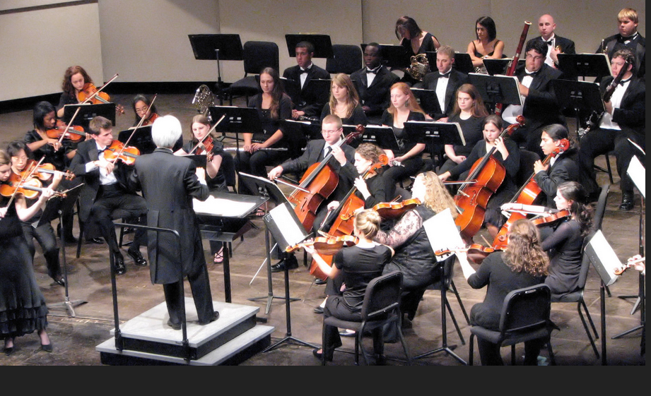
JVM Scheduler is preemptive approach

