Slide 1
Web Basics and Servlets
By Sai

Slide 2
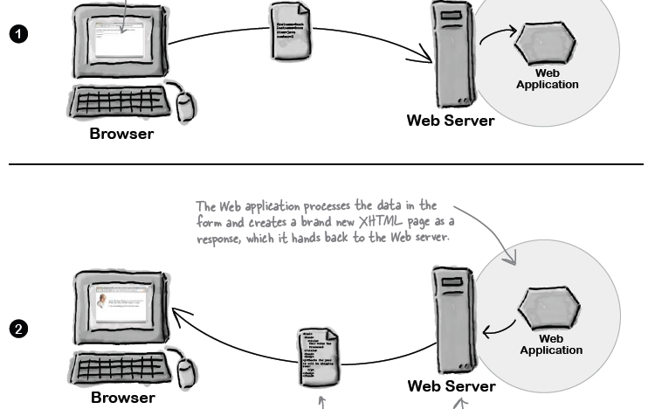
How web works?
Request
Response

Slide 3
How HTML Forms Work

Slide 4
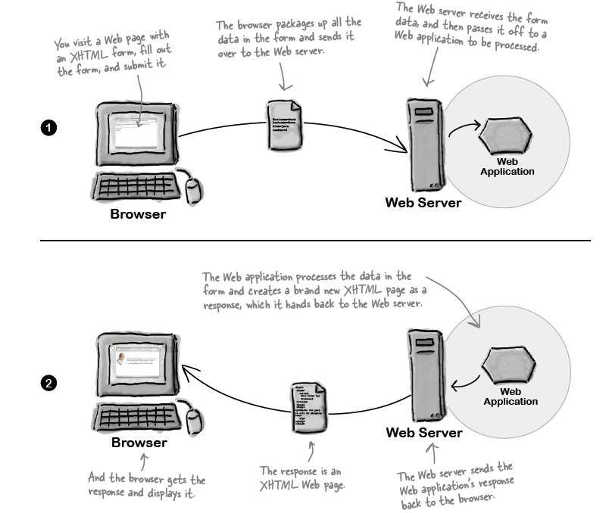
How Form Works?

Slide 5
How Form Works
The browser loads the page with controls: when browser loads the page when it encounters form elements, it creates controls on the page like submit.
You enter data
You submit the form: The browser will package up all the data and send that data off to the server.
The server responds

Slide 6
<!DOCTYPE>
The <!DOCTYPE> declaration must be the very first thing in your HTML document, before the <html> tag.
The <!DOCTYPE> declaration is not an HTML tag; it is an instruction to the web browser about what version of HTML the page is written in.

Slide 7
http-equiv
Syntax
<meta http-equiv="content-type|default-style|refresh">
Attribute Values
Value | Description
content-type | Specifies the character encoding for the document.Example: <meta http-equiv="content-type" content="text/html; charset=UTF-8">
default-style | Specified the preferred style sheet to use.Example: <meta http-equiv="default-style" content="id_of_link_element">
refresh | Defines a time interval for the document to refresh itself.Example: <meta http-equiv="refresh" content="300"> Note: The value "refresh" should be used carefully, as it takes the control of a page away from the user. Using "refresh" will cause a failure in W3C's Web Content Accessibility Guidelines.

Slide 8
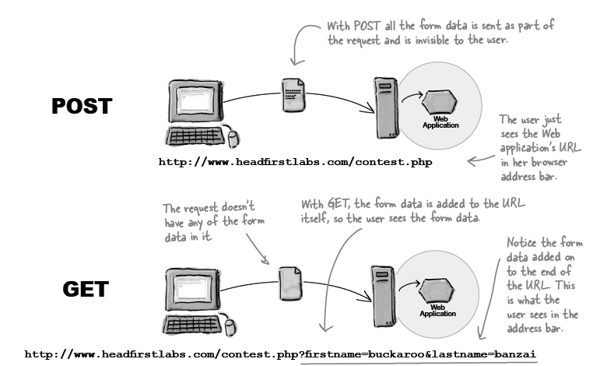
Post and Get

Slide 9
Difference between post and get
Get
When you say Get the
browser is just going
about and getting a web
page in normal way,
except that in the case of
a form it has appended
some more doata to the
end of the url.
Post
When you say Post the
browser actually creates a
little data package and
sends it to the server.

Slide 10
When to use what
Get
Post
If you want users to be able to bookmark pages that are the result of submitting a form, then you have to use GET
Should not use when sending personal info to server
Should not be used is a text with size more than 256 characters. Note this limit is for total number characters that you can send in the request
There is no way to bookmark results returned when using post, like you can not book mark your bank login page
Should always be used to send personal info
Should be used while sending large amounts of data since post has no limit on the size of data package you send.

Slide 11
Look at example to make sure we understand how HTML form works and also discuss why a server is needed at all.

Slide 12
How this works?
Tomcat
Web application 1
Browser
Web application 2
03FirstServlet
Hello

Slide 13

Because of http:// protocol our url knows how to navigate through web
URL= http://localhost:8080/03FirstServlet/Hello
Sai’s Tomcat
Yahoo Server
XYZ’s JBoss
Browser
URL
ABC’s JBoss
Aaa’s Tomcat
Google Server
This is like ablility to move around the world

Slide 14
Because of localhost url know which host to go to, this is same as ip address.
URL= http://localhost:8080/03FirstServlet/Hello
Sai’s Tomcat
Yahoo Server
XYZ’s JBoss
Browser
URL
ABC’s JBoss
Aaa’s Tomcat
Google Server
This is like spotting the exact city

Slide 15
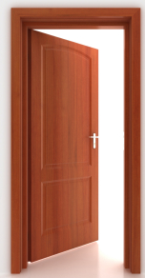
Because of port 8080 system spots the exact house number
Sai’s Tomcat
URL= http://localhost:8080/03FirstServlet/Hello
Apps through port 9080
9080
Browser
URL
Apps through port 8080
8080
Apps through port 8090
8090
This is like spotting the exact house

Slide 16
Since URL made it in, Tomcat will create a Request object and a response object. First It will take the input params from the url and stores it in Request object
Tomcat
Web application 1
Request
Browser
Web application 2
Response
03FirstServlet
Web.xml or
Annotations

Slide 17
Then it makes a call to servlet which has pattern as Hello in 03FirstServlet and assigns the input Request object to the corresponding class
Tomcat
URL= http://localhost:8080/03FirstServlet/Hello
Web application 1
Browser
Web application 2
03FirstServlet
Request
Web.xml or
Annotations
Response
“/Hello”

Slide 18
Servlet performs its own actions on the input request and assigns the response back to reponse object, this could be a html or anything else.
Tomcat
URL= http://localhost:8080/03FirstServlet/Hello
Web application 1
Browser
Web application 2
03FirstServlet
Request
Web.xml or
Annotations
Response
“/Hello”

Slide 19
Finally tomcat knows how to send this response back to the browser which made this request.
Tomcat
Web application 1
Browser
Web application 2
03FirstServlet
Request
Web.xml or
Annotations
Response
“/Hello”

Slide 20
Look at the code to make sure we understand how code handles this scenario

Slide 21
Tomcat which is an Application Server containts Coyote(web-server) and Catalina(Servlet Containter)
Catalina
(Servlet-Container)
Coyote
(Web-Server)
Request
Servlet
Tomcat
Response
(Application Server)

Slide 22
Closer look at Tomcat
Catalina
Servlet-Container
Hands over the request to catalina
http Request
Browser
Coyote
Web-Server
Request
Servlet
Response
Servlet-Container creates request and response object and passes it over to the corresponding servlet.

Slide 23
Closer look at Tomcat
Catalina
Servlet-Container
Servlet Container hand it over to WebServer
Browser
Coyote
Web-Server
Request
The Web-Server send it over to the browser who made the request
Servlet
Response
The servlet performs the logic what ever we wrote in either doGet or doPost and stores the result in response object

Slide 24
Tomcat - Wiki
Catalina
Catalina is Tomcat's servlet container. Catalina implements Sun Microsystems specifications for servlet and JavaServer Pages (JSP). In Tomcat, a Realm element represents a "database" of usernames, passwords, and roles (similar toUnix groups) assigned to those users. Different implementations of Realm allow Catalina to be integrated into environments where such authentication information is already being created and maintained, and then use that information to implement Container Managed Security as described in the Servlet Specification
Coyote
Coyote is Tomcat's HTTP Connector component that supports the HTTP 1.1 protocol for the web server or application container. Coyote listens for incoming connections on a specific TCP port on the server and forwards the request to the Tomcat Engine to process the request and send back a response to the requesting client.
Jasper
Jasper is Tomcat's JSP Engine. Jasper parses JSP files to compile them into Java code as servlets (that can be handled by Catalina). At runtime, Jasper detects changes to JSP files and recompiles them.
Cluster
This component has been added to manage large applications. It is used for Load balancing that can be achieved through many techniques. Clustering support currently requires the JDK version 1.5 or later.

Slide 25
CGI versus Servlet
CGI
Servlet
Written in C and Perl which are platform dependant
Multi process based, Creates a process for every input request.
Since context switching which takes places with processes no hard ware can handle, when Million requests are made at a time because that required million process.
Written in Java thus it is portable
Servlets are threads.
(By default they are multithreaded)
3. Since threads do not perform context switching and since they share resources instead, any well designed hardware (unix box, windows box) can handle million requests if it is thread based

Slide 26
Closer look at Servlet-Container (The table looks as below when you start it)
Catalina
Servlet-Container
App1
Servlet1
App2
Incoming URL | Servlet Associated | Loaded/ Instantiated
/app1/Servlet1 | Servlet1 | FALSE
/app1/Servlet2 | Servlet2 | FALSE
/app1/Servlet3 | Servlet3 | FALSE
Servlet2
App3
Servlet3

Slide 27
When first Call is made to the Servlet1 of app1 the servlet class is loaded (indicated by purple color) and an instance is created and the indicator is made as true. And a thread is created to perform the requested action by the user
Catalina
Servlet-Container
Request
App1
Thread for user 1
Servlet1
Response
App2
Incoming URL | Servlet Associated | Loaded/ Instantiated
/app1/Servlet1 | Servlet1 | TRUE
/app1/Servlet2 | Servlet2 | FALSE
/app1/Servlet3 | Servlet3 | FALSE
Servlet2
App3
Servlet3

Slide 28
When second Call is made to the Servlet1 of app1 then a second thread is created by passing the same servlet object with different input params.
Catalina
Servlet-Container
Request2
Request
App1
Thread for user 1
Servlet1
Thread for user 2
Response
App2
Incoming URL | Servlet Associated | Loaded/ Instantiated
/app1/Servlet1 | Servlet1 | TRUE
/app1/Servlet2 | Servlet2 | FALSE
/app1/Servlet3 | Servlet3 | FALSE
Response
Servlet2
App3
Servlet3

Slide 29
Conclusion
Thus Servlets are multi threaded and can handle Millions or even billions or request. Because they are not creating a process for every user instead they are creating threads for every request.
Threads share resource, but process do not. Process do context switching instead.

Slide 30
LifeCycle of Servlet
This is a public method in HttpServlet which actually creates request object and reponse object and then calls doGet or doPost() accordingly
Service()
Class is loaded, instance of servlet is created
Init()
destroy()
Ready state
Destroy is called when you perform a stop on the server . This frees up all the resources that app was using
doGet()
doPost()
These are methods which the threads actually run on to perform the requested action

