Slide 1
Advanced Interactive Dashboard Summary
Includes graphics, icons, and sample charts

Slide 2
Dashboard Elements & Icons
Sample Icons and Graphics Used in Dashboards:
Sales
Profit
Growth
Segments

Slide 3
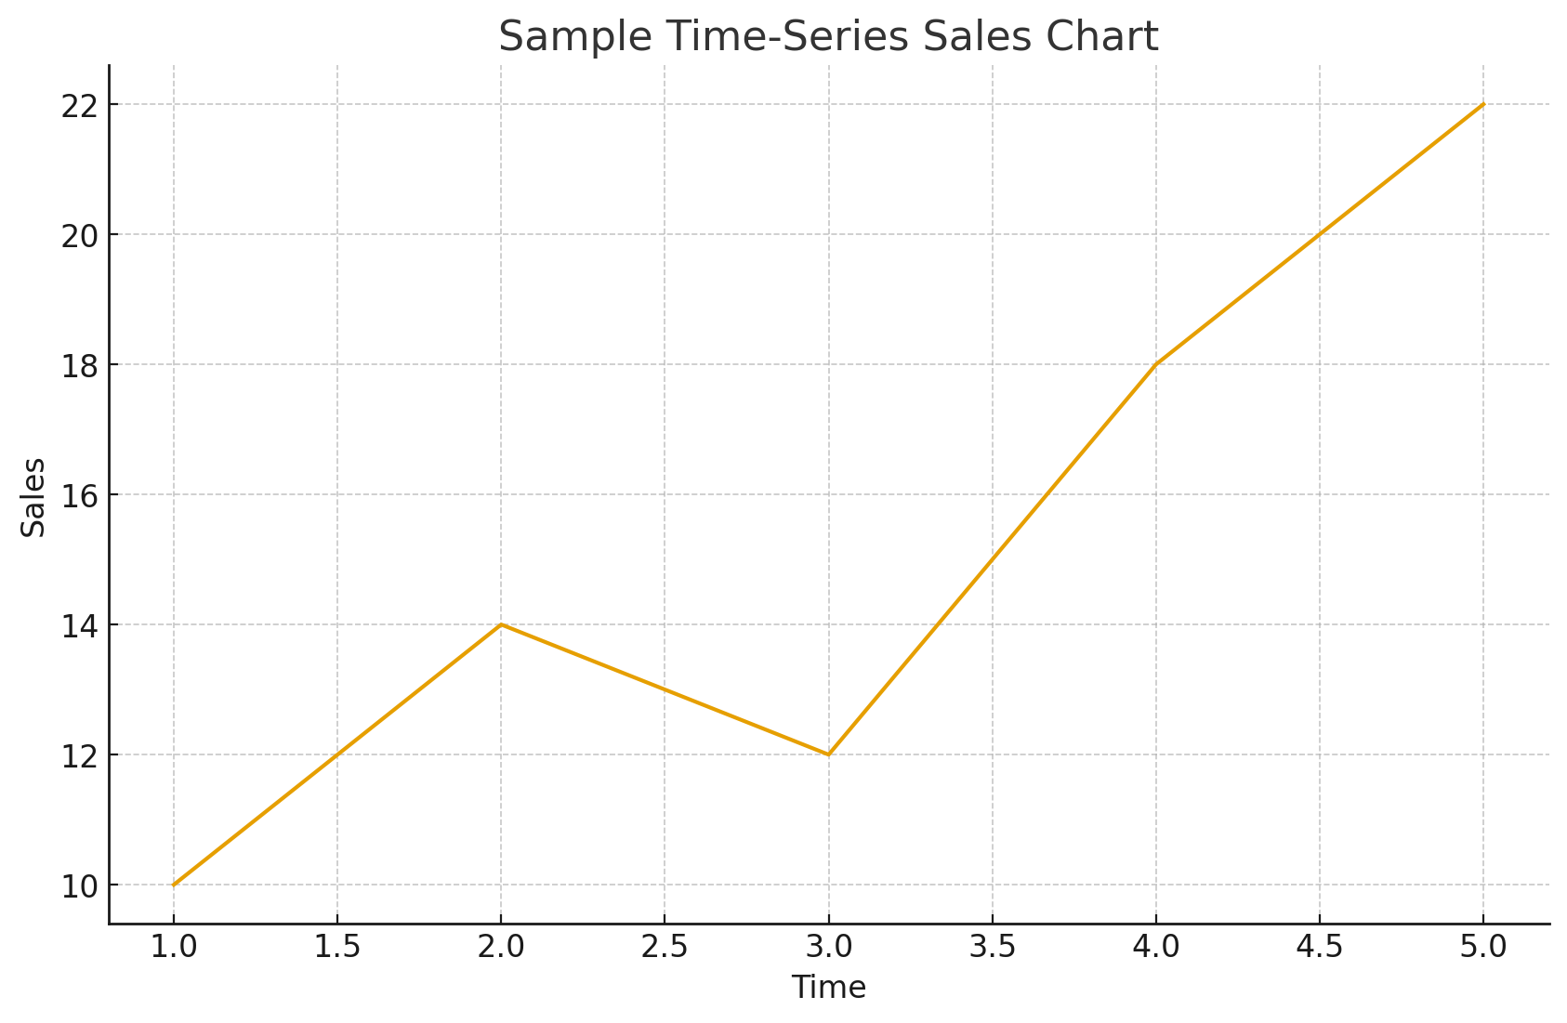
Sample Time-Series Chart

Slide 4
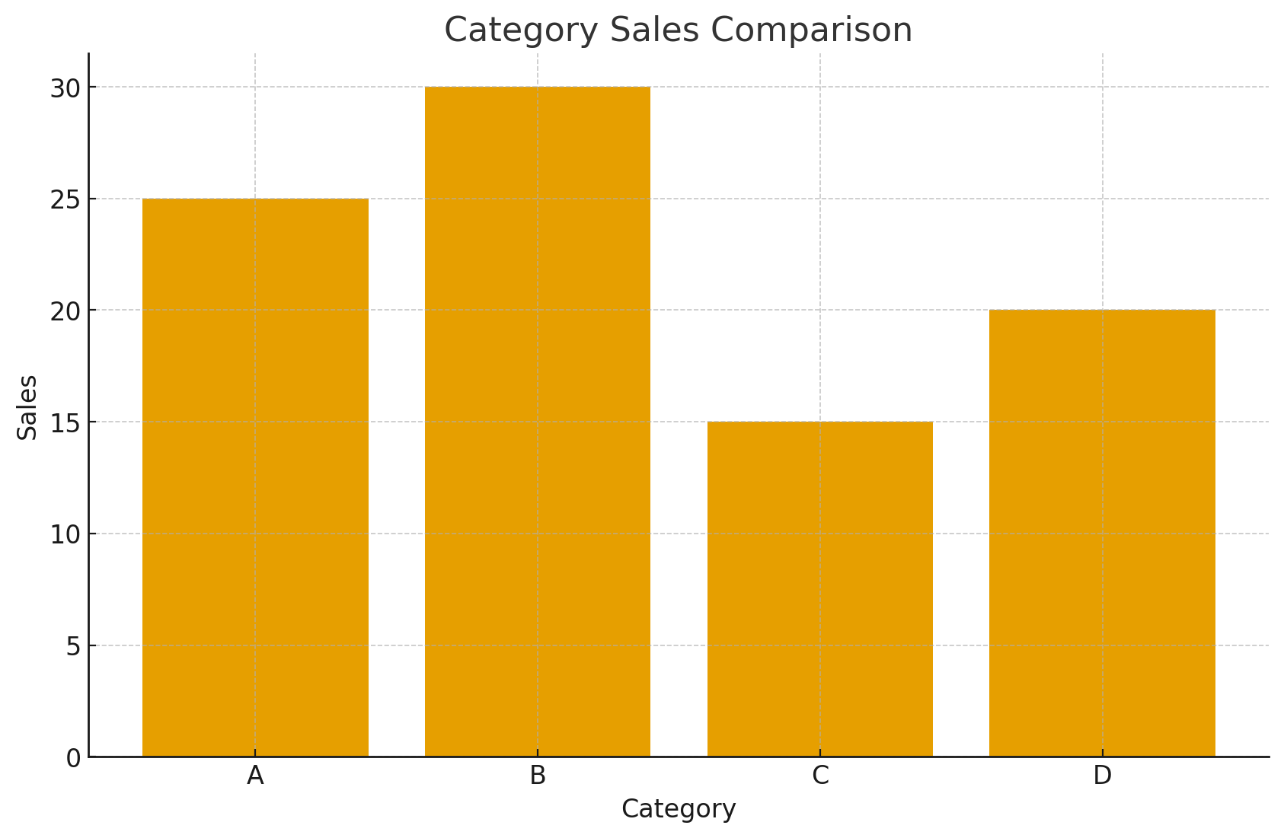
Sample Category Bar Chart

