Slide 1
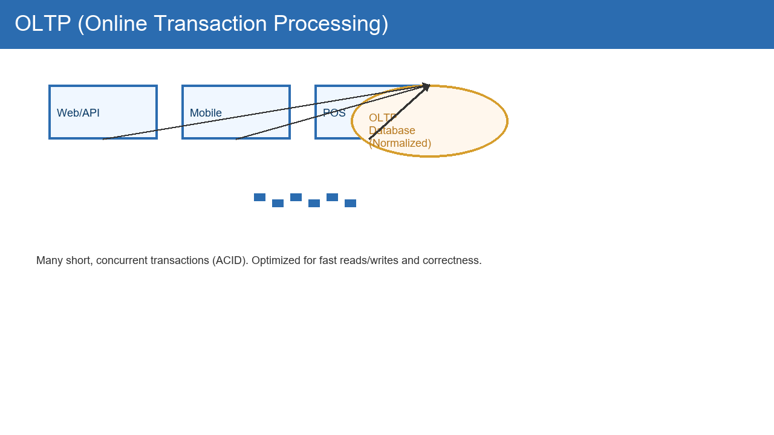
OLTP — Everyday Transactions (Beginner)
What: Systems that record everyday actions (buying, paying, updating).
Example: When you buy something online, the order and payment are stored here.
Key idea: Many small, fast operations that must be correct each time.
Why it matters: Keeps live business data accurate (stock, balances).
Typical design: uses many small tables to avoid duplicated data.

Slide 2
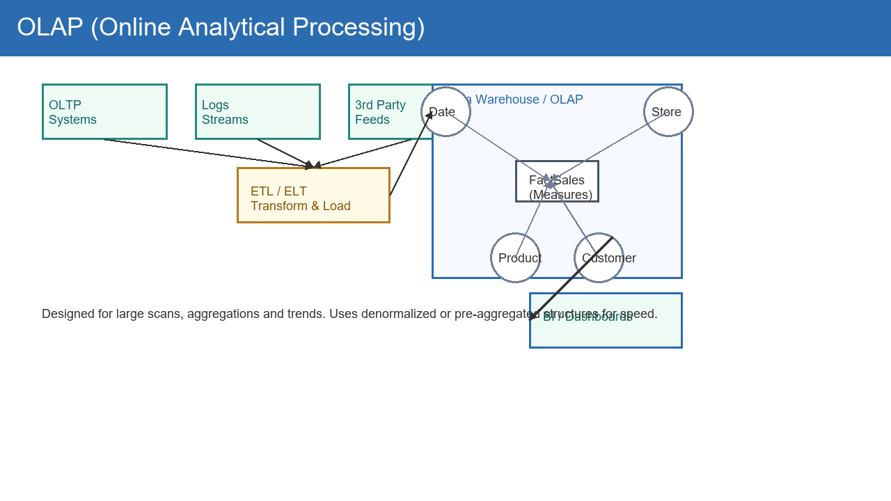
OLAP — Analysis & Reports (Beginner)
What: Systems used to answer big questions (sales by month, trends).
Example: A dashboard that shows last year's sales by product.
Key idea: Reads lots of historical data, runs slow but powerful queries.
Why it matters: Helps businesses make decisions from past data.
Typical design: stores summarized or flattened data for faster reports.

Slide 3
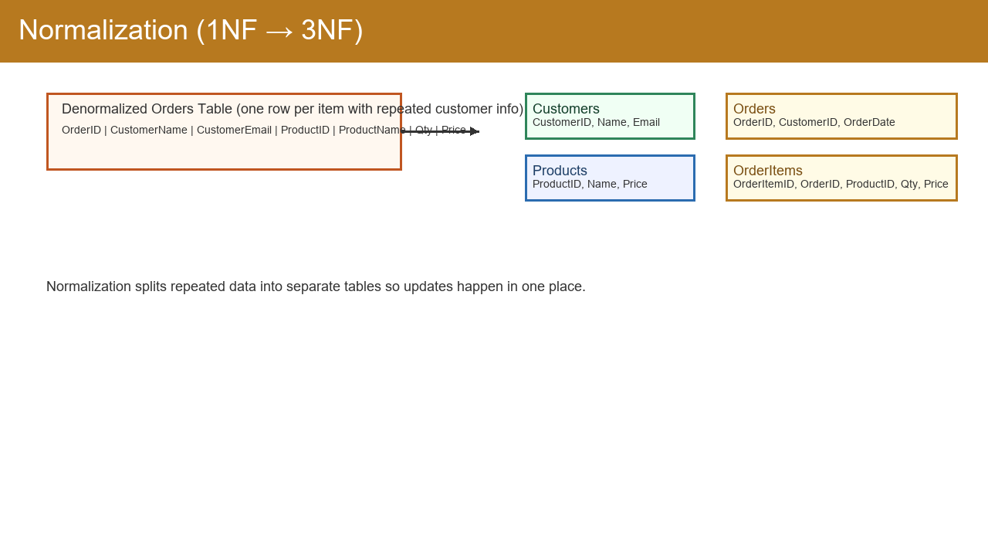
Normalized Data — Simple Explanation
What: Data split into small tables so each fact is stored once.
Analogy: One address book instead of copying addresses everywhere.
Benefit: Easy and safe to update (no conflicting copies).
Trade-off: Need to join tables to get full info (a bit slower to read).
When used: Most transaction systems (OLTP).

Slide 4
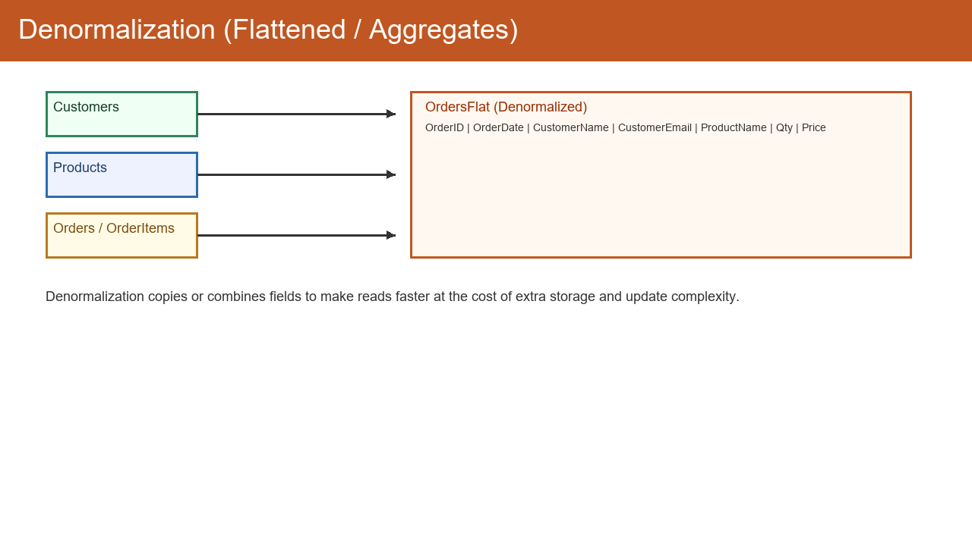
Denormalized Data — Simple Explanation
What: Data copied/flattened to make reading fast and simple.
Analogy: A single printed report with everything on one page.
Benefit: Very fast for reports and dashboards (fewer joins).
Trade-off: Harder to keep updates consistent; uses more space.
When used: Reporting systems (OLAP) and caches.

Slide 5
What is a Database? — Beginner
What: A digital place that stores and organizes data safely.
Analogy: A filing cabinet with rules for adding and finding papers.
Types: Relational (tables), column stores (analytics), NoSQL (flexible).
Why it matters: Lets apps remember users, orders, history securely.
Quick tip: Use relational DBs for transactions, data warehouses for reports.

