Slide 1
GSM Signal Denoising and Modulation Classification for Rural Uganda
Final Year Project Presentation
Department of Electrical and Electronics Engineering
Kyambogo University
Ssemujju Sharif Abdukarim | 18/U/ETD/181/GV
Kisige Tom Derrick | 22/U/ETD/0953/GV
Supervisor: Dr. Dickson Mugerwa
Project title
Final Year Project | 1

Slide 2
PROJECT CONTEXT
Introduction / Background
Local service reality
Engineering interpretation
• Basic GSM services still matter for ordinary users: voice, SMS, USSD, and Mobile Money (Uganda Communications Commission, 2025).
• At the cell edge, a phone may show signal bars but still suffer noisy or unstable service (Uganda Communications Commission, 2022).
• Weak I/Q structure makes reliable modulation interpretation difficult under low SNR (O'Shea et al., 2018).
• The project treats weak service as a signal-quality problem, not only a coverage-map problem.
• Denoising is placed before classification so the AMC stage sees a cleaner signal representation (An & Lee, 2023).
• The same logic can support troubleshooting, spectrum monitoring, and rural service planning (Uganda Communications Commission, 2024).
GSM-family I/Q
DAE + AMC
Rural use case
Working signal model
Core technical pipeline
Project motivation
Baseband windows test noisy edge-of-coverage conditions.
Denoising front end followed by automatic modulation classification.
Weak-signal interpretation can support practical network decisions.
Introduction / Background
Final Year Project | 2

Slide 3
WHAT THE PROJECT ADDRESSES
Problem statement
Rural GSM users may experience unreliable service even where a network signal is visible. UCC service-quality and market evidence shows that access must be judged by usable service, not signal presence alone (Uganda Communications Commission, 2022, 2025). At the edge of coverage, low SNR, interference, fading, and unstable propagation can make AMC decisions unreliable (O'Shea et al., 2018).
Technical gap
Project question
• Classical signal-processing filters are useful, but are usually fixed to known noise assumptions.
• Deep-learning AMC can classify raw I/Q samples, but low-SNR interference still reduces reliability (O'Shea et al., 2018).
• A denoising front end may recover useful signal structure before classification (An & Lee, 2023).
• Can denoising improve modulation classification under controlled low-SNR GSM-family conditions?
• Which SNR ranges benefit most from denoising-assisted classification?
• How should the results be interpreted for rural weak-service analysis?
Problem statement
Final Year Project | 3

Slide 4
MAIN AND SPECIFIC OBJECTIVES
Aim and objectives
Main objective: design and evaluate a denoising-assisted automatic modulation classification pipeline for noisy GSM-family I/Q signals in rural Uganda weak-service scenarios.
Specific objectives
• Define GSM-family low-SNR and interference scenarios for controlled evaluation (O'Shea et al., 2018).
• Design a denoising front end that reconstructs cleaner I/Q representations.
• Train and evaluate an AMC stage on raw noisy and denoised signal features.
• Compare baseline and denoising-assisted performance using accuracy, macro F1, confusion behavior, and signal plots (DeepSig, 2018).
• Interpret the findings for weak-service troubleshooting and rural connectivity planning.
Objectives
Final Year Project | 4

Slide 5
PROJECT VALUE AND BOUNDARIES
Justification, Significance and Scope of the Project
Justification
Significance
Scope
• Rural weak service is a practical problem for ordinary users and for network planning (Uganda Communications Commission, 2025).
• Denoising before classification gives a measurable way to test whether useful signal structure can be recovered.
• The method is software-side and can be evaluated without transmitting or interfering with licensed networks.
• Supports better interpretation of noisy edge-of-coverage signals (Uganda Communications Commission, 2022).
• Gives supervisors and reviewers visible before/after signal evidence.
• Creates a foundation for future Android/SDR receive-only prototype work (An & Lee, 2023).
• Controlled simulation and offline I/Q evaluation.
• GSM-family/proxy modulation classes used for AMC validation.
• No claim of completed field deployment or live service improvement.
Receive-only
Offline first
Prototype path
Safety boundary
Evaluation boundary
Next step
The project does not transmit into licensed spectrum.
The current results are controlled simulation outputs.
Android/SDR demonstration remains a future validation pathway.
Justification, significance, and scope
Final Year Project | 5

Slide 6
EVIDENCE BASE
Literature Review
Classical AMC
Deep-learning AMC
Denoising front ends
• Uses likelihood rules, moments, cyclostationary features, and engineered descriptors.
• Can be interpretable, but becomes fragile when assumptions about noise and channel conditions break.
• Useful as a baseline for explaining what the ML pipeline improves (O'Shea et al., 2018).
• Learns discriminative patterns directly from raw or transformed I/Q samples (O'Shea et al., 2018).
• Modern CNN and sequence models perform well when trained on representative SNR conditions.
• Performance still drops when signal structure is buried under low-SNR and interference.
• Denoising autoencoders and related methods reconstruct cleaner signals before downstream tasks (An & Lee, 2023).
• The key research question is not only whether the signal looks cleaner, but whether classification improves.
• This project evaluates denoising as a preprocessing block for AMC under weak-service conditions.
Gap: few student-level implementations connect denoising, AMC metrics, and rural GSM weak-service interpretation in one reproducible pipeline.
Literature review
Final Year Project | 6

Slide 7
DENOISING-ASSISTED AMC SIGNAL CHAIN
Methodology
1
I/Q source
2
Impairment
3
Denoising
4
AMC
5
Metrics
→
→
→
→
Synthetic GSM-family or public I/Q windows (DeepSig, 2018).
Low SNR, narrowband interference, fading, phase/frequency offset.
Reconstruct cleaner signal representation before classification.
Classify modulation from raw/noisy or denoised features.
Accuracy, macro F1, confusion matrix, and signal plots.
Evaluation comparison
• Baseline path: noisy I/Q features -> AMC classifier.
• Denoising-assisted path: impaired I/Q -> denoising front end -> AMC classifier.
• Both paths are evaluated under the same SNR levels and classes (O'Shea et al., 2018).
• This makes the difference attributable to the denoising front end.
Methodology
Final Year Project | 7

Slide 8
RESULTS BASIS
Results: Controlled Simulation Setup
4
4
1,920
20260524
Modulation classes
SNR levels
Test windows
Random seed
GMSK-like, QPSK, 8PSK, and 16QAM.
-8, -4, 0, and 4 dB controlled impairment settings.
240 held-out windows per SNR and pipeline comparison.
The run is deterministic and reproducible.
What was simulated
What was not claimed
• Baseband I/Q windows with GSM-family/proxy modulation structure (DeepSig, 2018).
• Low-SNR AWGN, narrowband interference, mild fading, and phase/frequency offset.
• A denoising-assisted path compared against a noisy baseline path (An & Lee, 2023).
• No field capture result is claimed in this slide deck.
• No live call, SMS, USSD, or Mobile Money improvement is claimed.
• No physical tower range extension is claimed.
Results
Final Year Project | 8

Slide 9
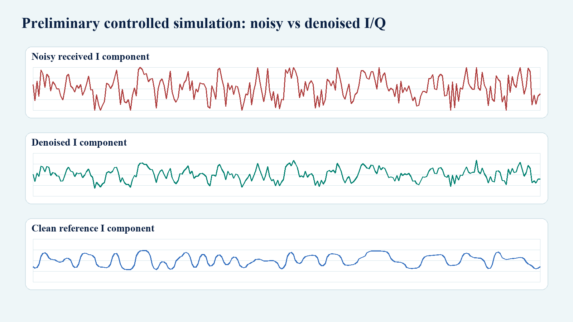
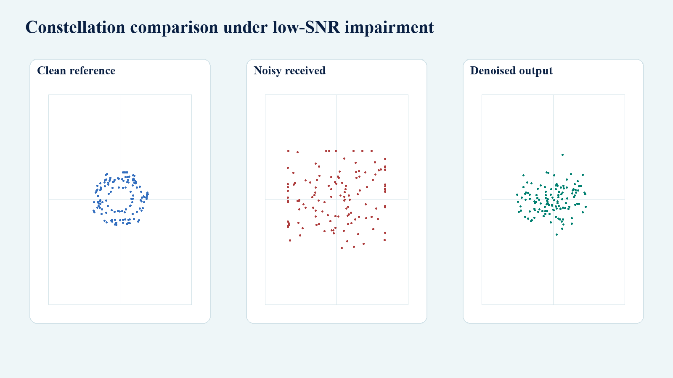
CONTROLLED SIMULATION
Results: Signal Denoising Output
Noisy, denoised, and clean reference waveform comparison
Constellation comparison at a low-SNR operating point
Interpretation: this controlled simulation is not final DAE performance; it shows why denoising before AMC is worth completing (An & Lee, 2023; Ssemujju & Kisige, 2026).
Results
Final Year Project | 9

Slide 10
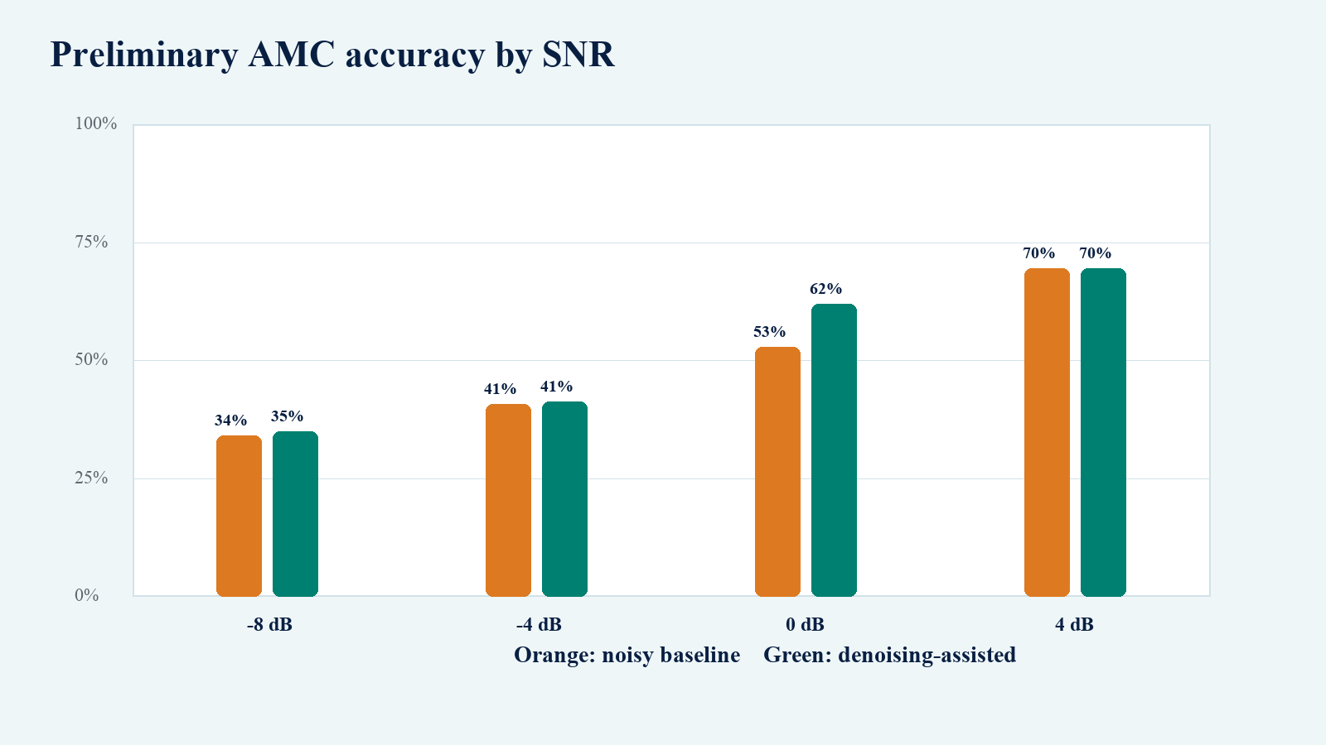
CONTROLLED SIMULATION
Results: Classification Performance
49.4%
Noisy baseline
Mean accuracy across controlled SNR levels.
52.0%
Denoising-assisted
Mean accuracy with the denoising-assisted path.
+9.2 pts
Accuracy by SNR: noisy baseline versus denoising-assisted AMC
Largest observed gain
At 0 dB in this preliminary controlled run.
Result status: preliminary controlled simulation, not final field validation (Ssemujju & Kisige, 2026).
Results
Final Year Project | 10

Slide 11
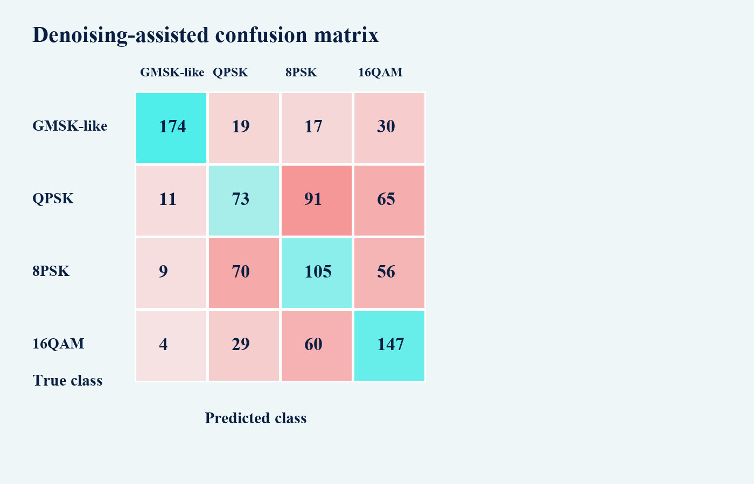
INTERPRETATION
Discussion of Results
Observed pattern
• The denoising-assisted path improves the controlled run overall (Ssemujju & Kisige, 2026).
• The clearest gain appears around the difficult 0 dB condition.
• Cleaner SNR conditions do not require aggressive denoising, so adaptive bypass is sensible (An & Lee, 2023).
Limitations
• The samples are synthetic and should be replaced or supplemented with stronger datasets.
• The denoising block is preliminary; final DAE training remains the next technical step.
• The results do not prove live service improvement or physical coverage extension.
Denoising-assisted confusion matrix across controlled SNR levels
Discussion of results
Final Year Project | 11

Slide 12
FINAL POSITION
Conclusion and recommendations
Conclusion
Recommendations
• Weak rural GSM service can be studied through noisy I/Q signal interpretation, not only through coverage-map labels.
• The proposed DAE-AMC chain is technically coherent: denoise first, classify second, evaluate across SNR (O'Shea et al., 2018; An & Lee, 2023).
• Preliminary controlled simulation results support continuing the denoising-assisted AMC implementation (Ssemujju & Kisige, 2026).
• Complete the full trained DAE and AMC implementation with stronger dataset coverage.
• Report results by SNR band using accuracy, macro F1, confusion matrices, and signal-quality plots.
• Use receive-only validation only; do not transmit, decode private content, or claim live-service gains without evidence.
Next 4 weeks
Final output
Safety
Implementation focus
Expected deliverable
Operating boundary
DAE training, AMC benchmarking, final report update, and presentation rehearsal.
A reproducible denoising-assisted AMC evaluation for weak GSM-family signals.
Receive-only, offline-first validation unless formal approval changes the scope.
Conclusion and recommendations
Final Year Project | 12

Slide 13
KEY SOURCES AND PROVENANCE
References
• Uganda Communications Commission. (2025). UCC market report for Q4 2024.
• Uganda Communications Commission. (2024). UCC cracks down on illegal and non-compliant broadcasters.
• Uganda Communications Commission. (2022). QoS publication: December 2021 mobile voice/data benchmark measurements.
• O'Shea, T. J., Roy, T., & Clancy, T. C. (2018). Over-the-air deep learning based radio signal classification. IEEE Journal of Selected Topics in Signal Processing, 12(1), 168-179. https://doi.org/10.1109/JSTSP.2018.2797022
• DeepSig. (2018). RadioML 2018.01A [Data set]. Kaggle.
• An, T. T., & Lee, B. M. (2023). Robust automatic modulation classification in low signal to noise ratio. IEEE Access, 11, 7860-7872. https://doi.org/10.1109/ACCESS.2023.3238995
• Ssemujju, S. A., & Kisige, T. D. (2026). Preliminary controlled DAE-AMC simulation artifacts. final-year-project/reports/preliminary_simulation_2026_05_24.
Provenance note: result slides use controlled simulation outputs from the project workspace. They are not presented as field deployment, live-service, or tower-range-extension evidence.
Thank you.
References
Final Year Project | 13

