Slide 1
Chapter 3
Vectors

Slide 2
Vectors
Vector quantities
Physical quantities that have both numerical and directional properties
Mathematical operations of vectors in this chapter
Addition
Subtraction
Multiplication
Introduction

Slide 3
Coordinate Systems
Used to describe the position of a point in space
Common coordinate systems are:
Cartesian
Polar
Section 3.1

Slide 4
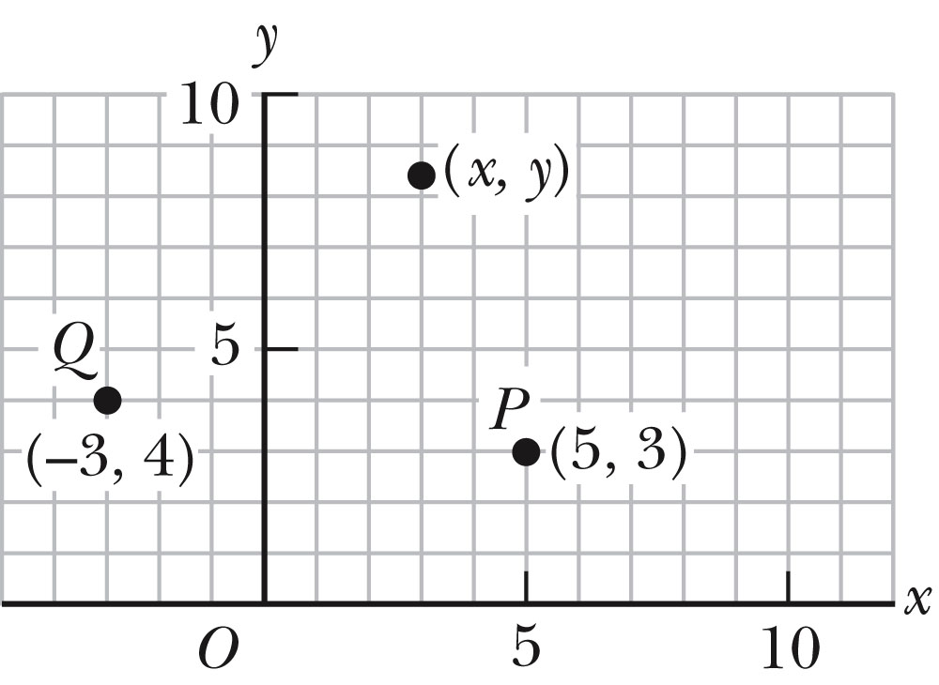
Cartesian Coordinate System
Also called rectangular coordinate system
x- and y- axes intersect at the origin
Points are labeled (x,y)
Section 3.1

Slide 5
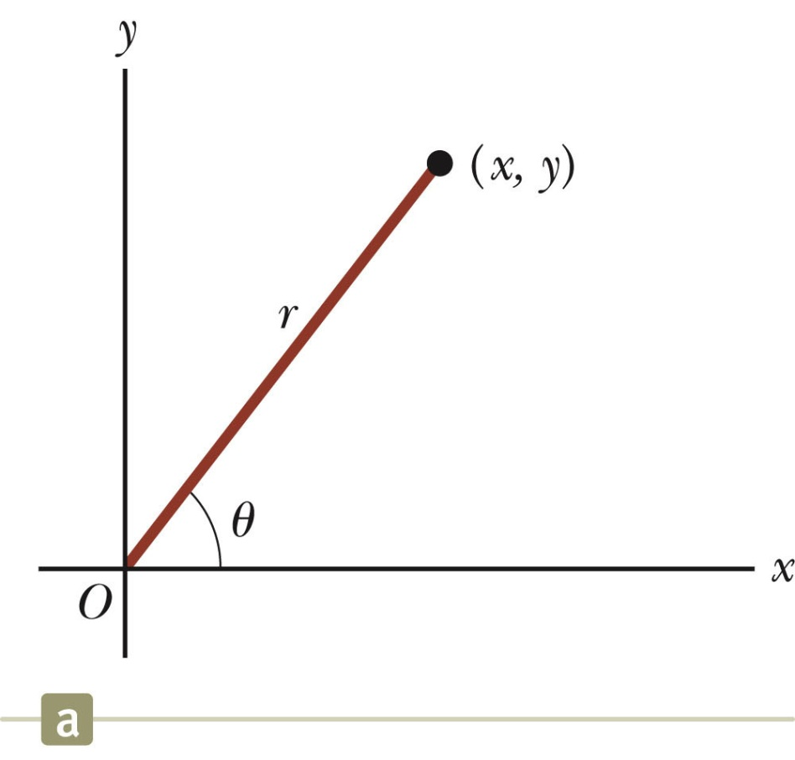
Polar Coordinate System
Origin and reference line are noted
Point is distance r from the origin to the point in the direction of angle θ, from reference line
The reference line is often the positive x-axis andθ is usually measured counterclockwise .
Points are labeled (r,θ)
Section 3.1

Slide 6
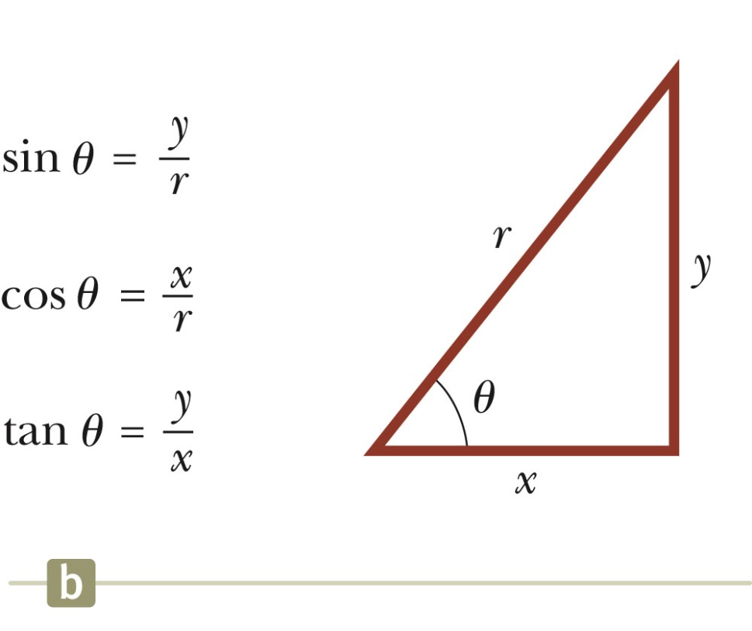
Polar to Cartesian Coordinates
Based on forming a right triangle from r and θ
x = r cos θ
y = r sin θ
If the Cartesian coordinates are known:
Section 3.1

Slide 7
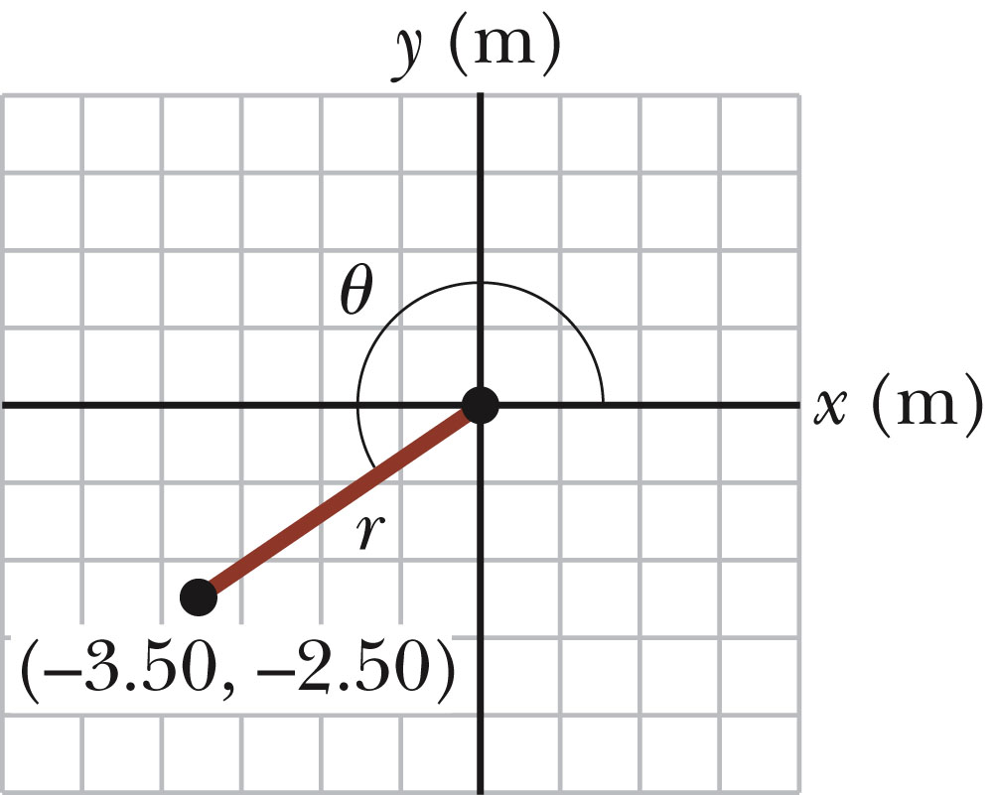
Example 3.1
The Cartesian coordinates of a point in the xy plane are (x,y) = (-3.50, -2.50) m, as shown in the figure. Find the polar coordinates of this point.
Solution: From Equation 3.4,
and from Equation 3.3,
Section 3.1

Slide 8
Vectors and Scalars
A scalar quantity is completely specified by a single value with an appropriate unit and has no direction.
Many are always positive
Some may be positive or negative
Rules for ordinary arithmetic are used to manipulate scalar quantities.
A vector quantity is completely described by a number and appropriate units plus a direction.
Section 3.2

Slide 9
Scalar
A scalar quantity
is any quantity in
physics that has magnitude only
MAGNITUDE ONLY
Scalar Example pl | MagnitudeMagnitude
Speed | 35 m/s
Distance | 25 meters
Age | 16 years
Number value
with units

Slide 10
VECTOR
Vector Example | Magnitude and Direction
Velocity | 35 m/s, North
Acceleration | 10 m/s², South
Displacement | 20 m, East
A VECTOR quantity
is any quantity in
physics that has
BOTH MAGNITUDE
and DIRECTION

Slide 11
Quick Quiz 3.1:
Which of the following are vector quantities and which are scalar quantities?
Your age
Acceleration
Velocity
Speed
mass

Slide 12
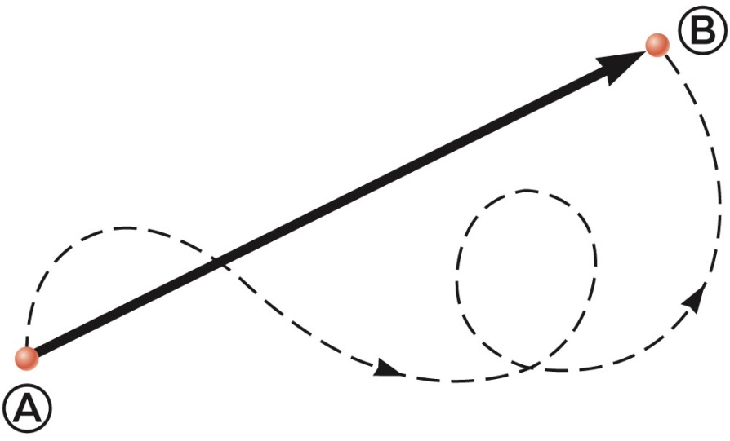
Vector Example
A particle travels from A to B along the path shown by the broken line.
This is the distance traveled and is a scalar.
The displacement is the solid line from A to B
The displacement is independent of the path taken between the two points.
Displacement is a vector.
Section 3.2

Slide 13
Vector Notation
Text uses bold with arrow to denote a vector:
Also used for printing is simple bold print: A
When dealing with just the magnitude of a vector in print, an italic letter will be used: A or | |
The magnitude of the vector has physical units.
The magnitude of a vector is always a positive number.
When handwritten, use an arrow:
Section 3.2

Slide 14
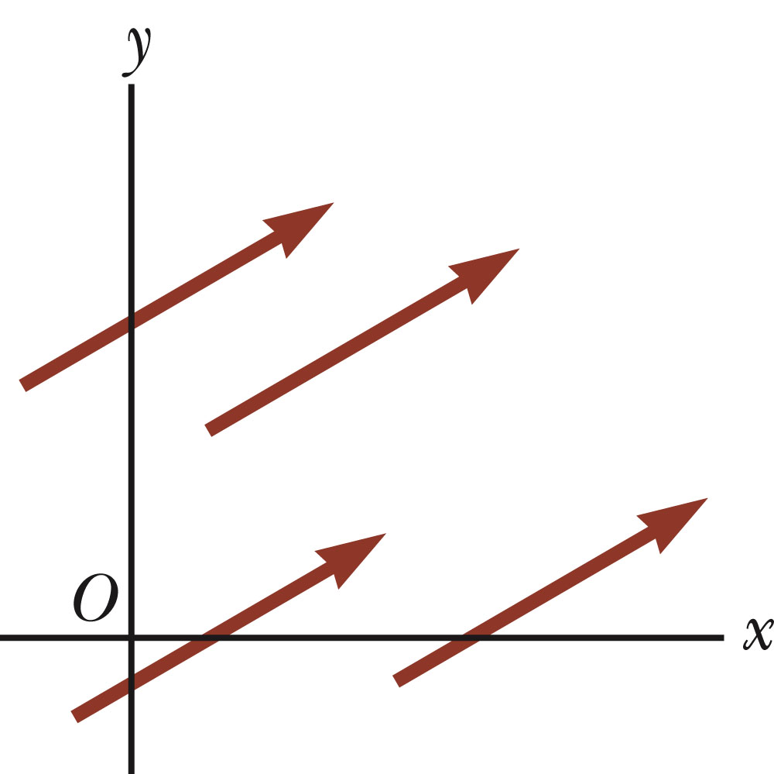
Equality of Two Vectors
Two vectors are equal if they have the same magnitude and the same direction.
if A = B and they point along parallel lines
All of the vectors shown are equal.
Allows a vector to be moved to a position parallel to itself
Section 3.3

Slide 15
Adding Vectors
Vector addition is very different from adding scalar quantities.
When adding vectors, their directions must be taken into account.
Units must be the same
Graphical Methods
Use scale drawings
Algebraic Methods
More convenient
Section 3.3

Slide 16
Adding Vectors Graphically
Choose a scale.
Draw the first vector, , with the appropriate length and in the direction specified, with respect to a coordinate system.
Draw the next vector with the appropriate length and in the direction specified, with respect to a coordinate system whose origin is the end of vector and parallel to the coordinate system used for .
Section 3.3

Slide 17
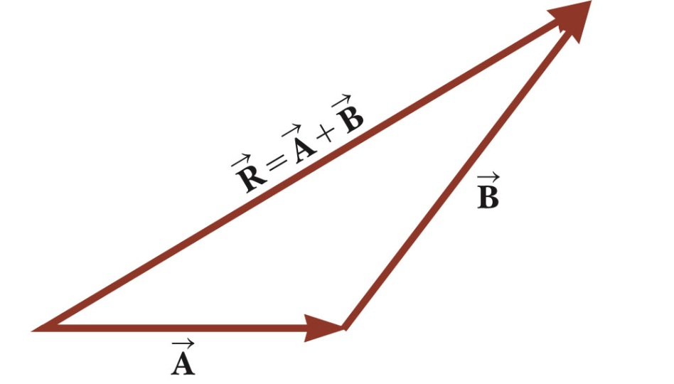
Adding Vectors Graphically, cont.
Continue drawing the vectors “tip-to-tail” or “head-to-tail”.
The resultant is drawn from the origin of the first vector to the end of the last vector.
Measure the length of the resultant and its angle.
Use the scale factor to convert length to actual magnitude.
Section 3.3

Slide 18
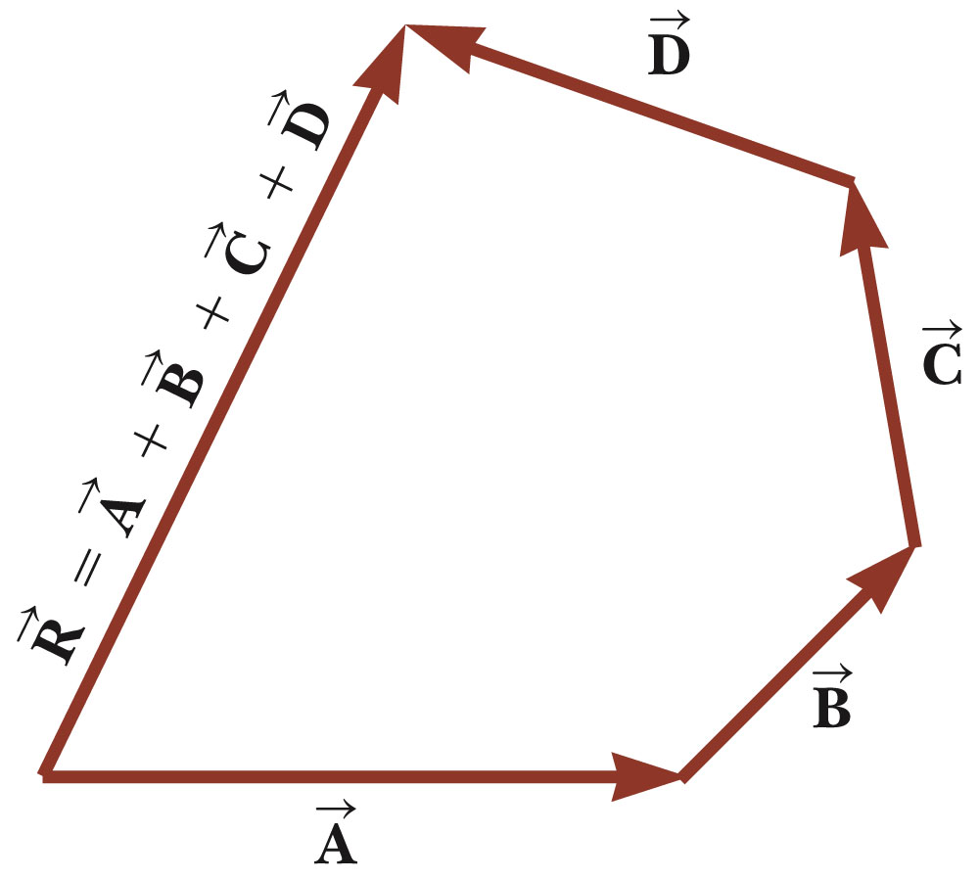
Adding Vectors Graphically, final
When you have many vectors, just keep repeating the process until all are included.
The resultant is still drawn from the tail of the first vector to the tip of the last vector.
Section 3.3

Slide 19
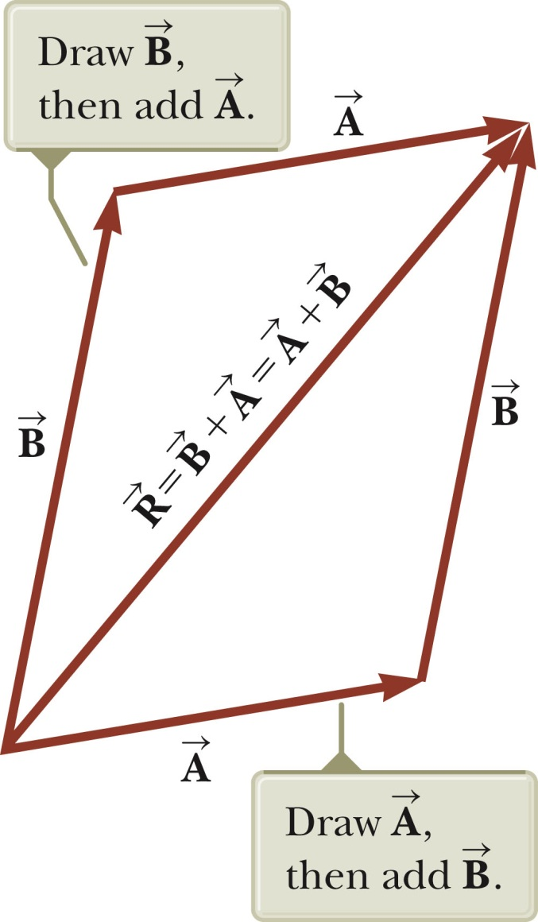
Adding Vectors, Rules
When two vectors are added, the sum is independent of the order of the addition.
This is the Commutative Law of Addition.
Section 3.3

Slide 20
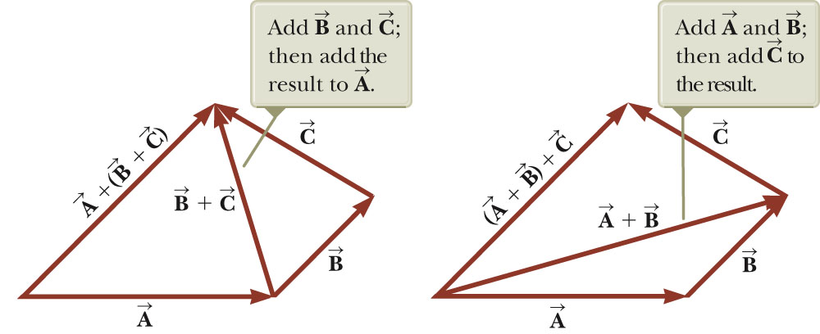
Adding Vectors, Rules cont.
When adding three or more vectors, their sum is independent of the way in which the individual vectors are grouped.
This is called the Associative Property of Addition.
Section 3.3

Slide 21
Adding Vectors, Rules final
When adding vectors, all of the vectors must have the same units.
All of the vectors must be of the same type of quantity.
For example, you cannot add a displacement to a velocity.
Section 3.3

Slide 22
Negative of a Vector
The negative of a vector is defined as the vector that, when added to the original vector, gives a resultant of zero.
Represented as
The negative of the vector will have the same magnitude, but point in the opposite direction.
Section 3.3

Slide 23
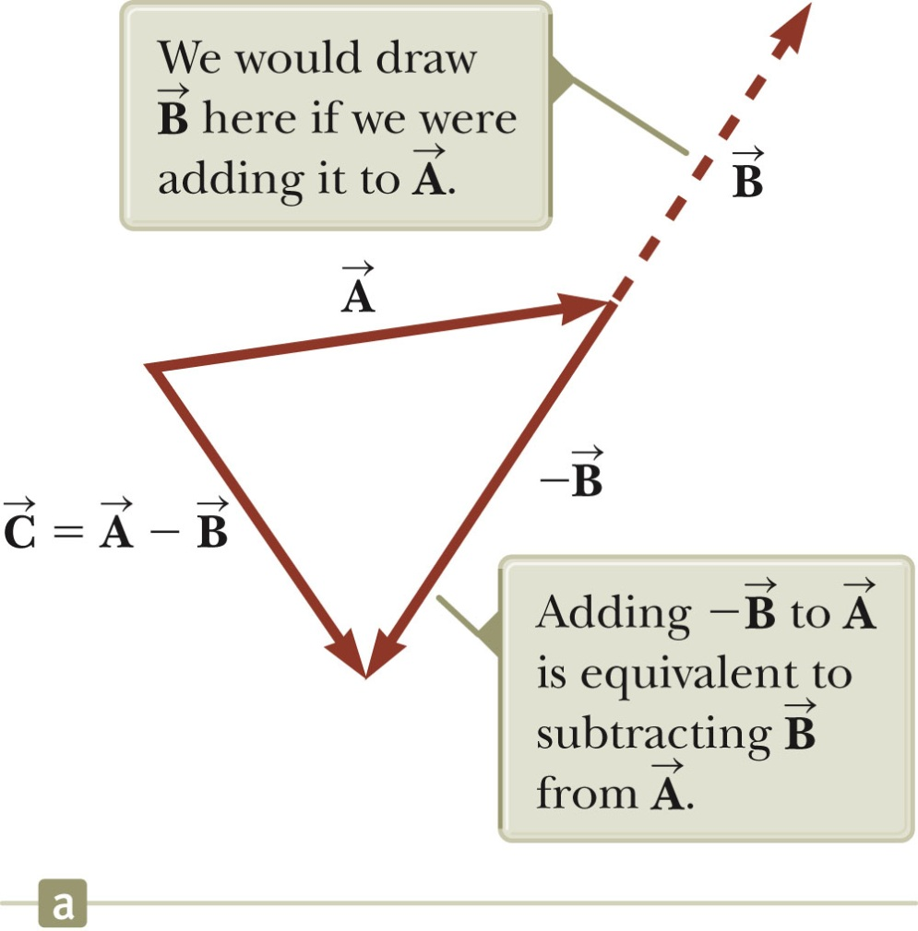
Subtracting Vectors
Special case of vector addition:
If , then use
Continue with standard vector addition procedure.
Section 3.3

Slide 24
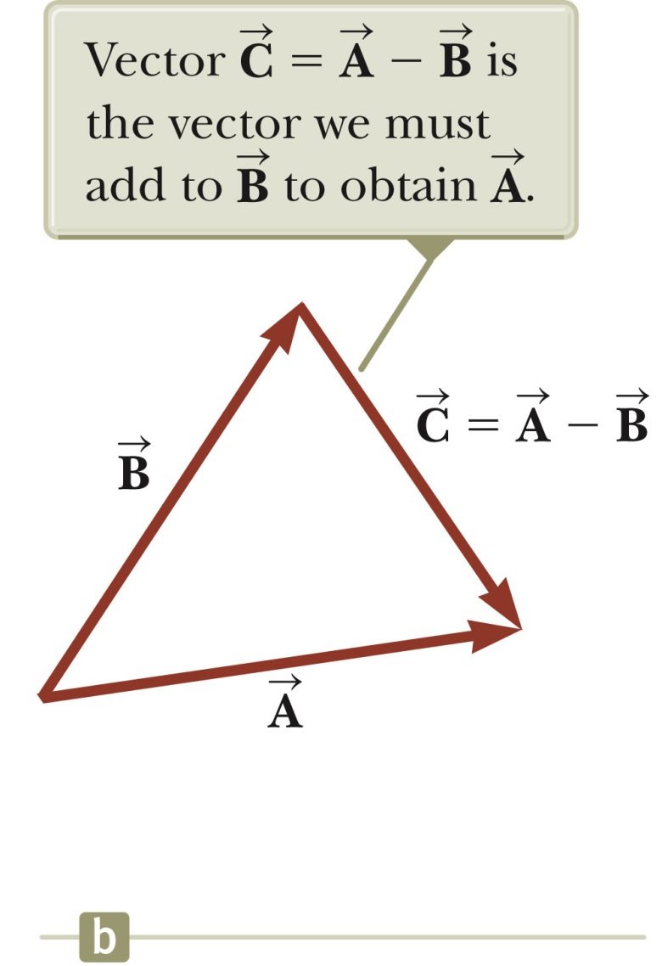
Subtracting Vectors, Method 2
Another way to look at subtraction is to find the vector that, added to the second vector gives you the first vector.
As shown, the resultant vector points from the tip of the second to the tip of the first.
Section 3.3

Slide 25
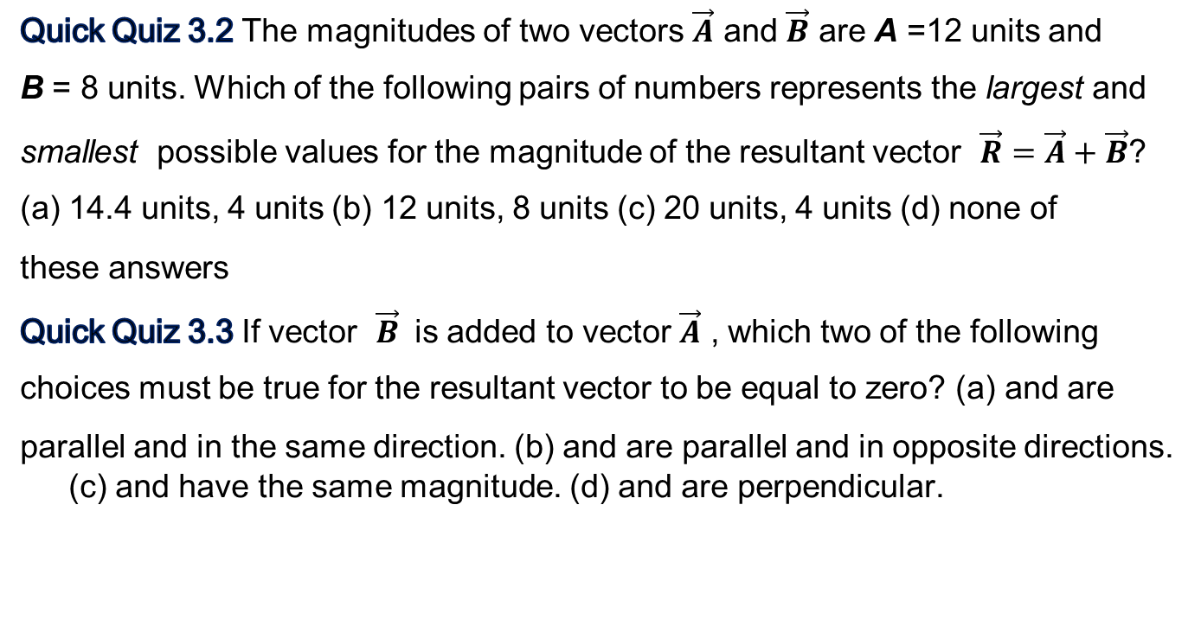
Quick Quiz 3.2 The magnitudes of two vectors $\vec{A}$ and $\vec{B}$ are A =12 units and
B = 8 units. Which of the following pairs of numbers represents the largest and
smallest possible values for the magnitude of the resultant vector $\vec{R}=\vec{A}+\vec{B}$?
(a) 14.4 units, 4 units (b) 12 units, 8 units (c) 20 units, 4 units (d) none of
these answers
Quick Quiz 3.3 If vector $\vec{B}$ is added to vector $\vec{A}$ , which two of the following
choices must be true for the resultant vector to be equal to zero? (a) and are
parallel and in the same direction. (b) and are parallel and in opposite directions. (c) and have the same magnitude. (d) and are perpendicular.

Slide 26
Multiplying or Dividing a Vector by a Scalar
The result of the multiplication or division of a vector by a scalar is a vector.
The magnitude of the vector is multiplied or divided by the scalar.
If the scalar is positive, the direction of the result is the same as of the original vector.
If the scalar is negative, the direction of the result is opposite that of the original vector.
Section 3.3

Slide 27
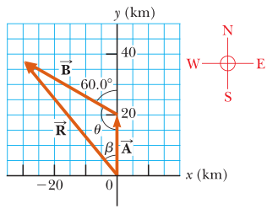
Problem 3.2
A car travels 20.0 km due north and then 35.0 km in a direction 60.0°west of north as shown in Figure 3.11a. Find the magnitude and direction of the car’s resultant displacement.

Slide 28

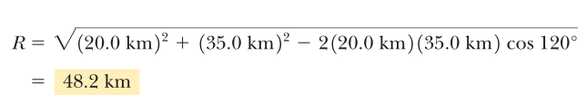
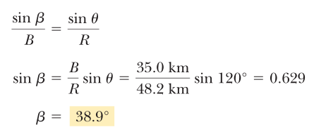
Solution:
Use law of cosine:
For direction use law od Sines:
The resultant displacement of the car is 48.2 km in a direction 38.9° west of north.

Slide 29
Component Method of Adding Vectors
Graphical addition is not recommended when:
High accuracy is required
If you have a three-dimensional problem
Component method is an alternative method
It uses projections of vectors along coordinate axes
Section 3.4

Slide 30
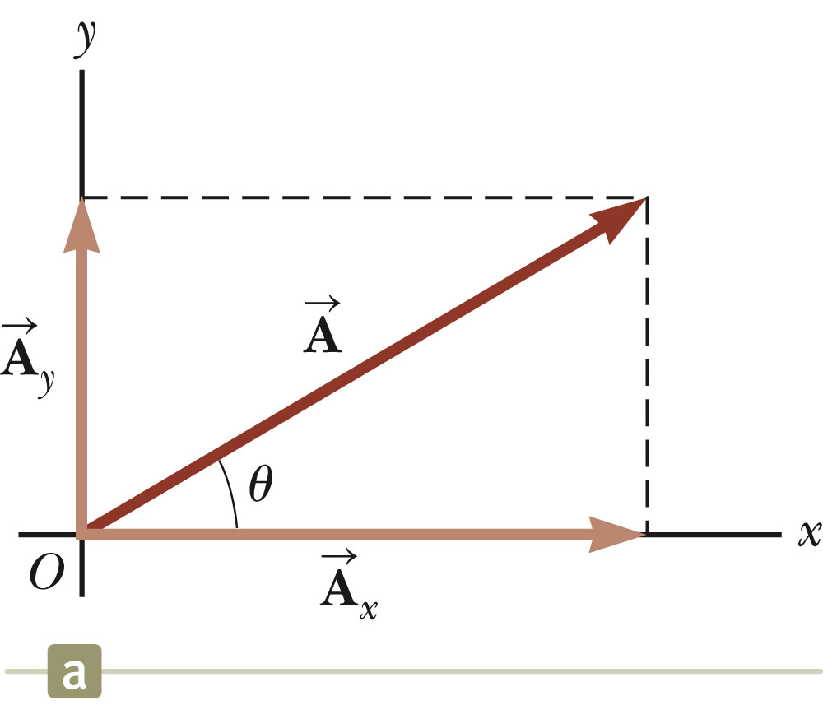
Components of a Vector, Introduction
A component is a projection of a vector along an axis.
Any vector can be completely described by its components.
It is useful to use rectangular components.
These are the projections of the vector along the x- and y-axes.
Section 3.4

Slide 31
Vector Component Terminology
are the component vectors of .
They are vectors and follow all the rules for vectors.
A_{x} and A_{y} are scalars, and will be referred to as the components of .
Section 3.4

Slide 32
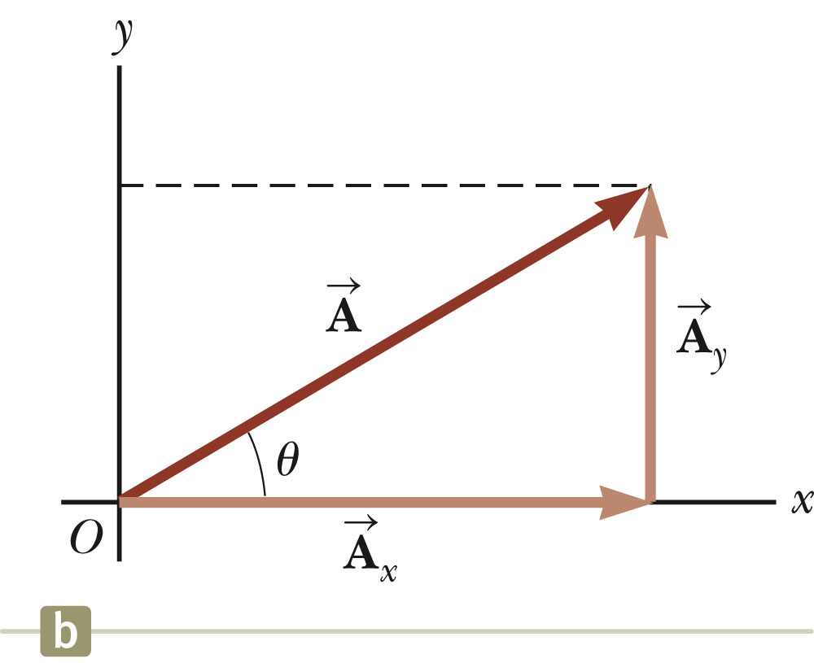
Components of a Vector
Assume you are given a vector
It can be expressed in terms of two other vectors, and
These three vectors form a right triangle.
Section 3.4

Slide 33
Components of a Vector, 2
The y-component is moved to the end of the x-component.
This is due to the fact that any vector can be moved parallel to itself without being affected.
This completes the triangle.
Section 3.4

Slide 34
Components of a Vector, 3
The x-component of a vector is the projection along the x-axis.
The y-component of a vector is the projection along the y-axis.
This assumes the angle θ is measured with respect to the x-axis.
If not, do not use these equations, use the sides of the triangle directly.
Section 3.4

Slide 35
Components of a Vector, 4
The components are the legs of the right triangle whose hypotenuse is the length of A.
May still have to find θ with respect to the positive x-axis
In a problem, a vector may be specified by its components or its magnitude and direction.
Section 3.4

Slide 36
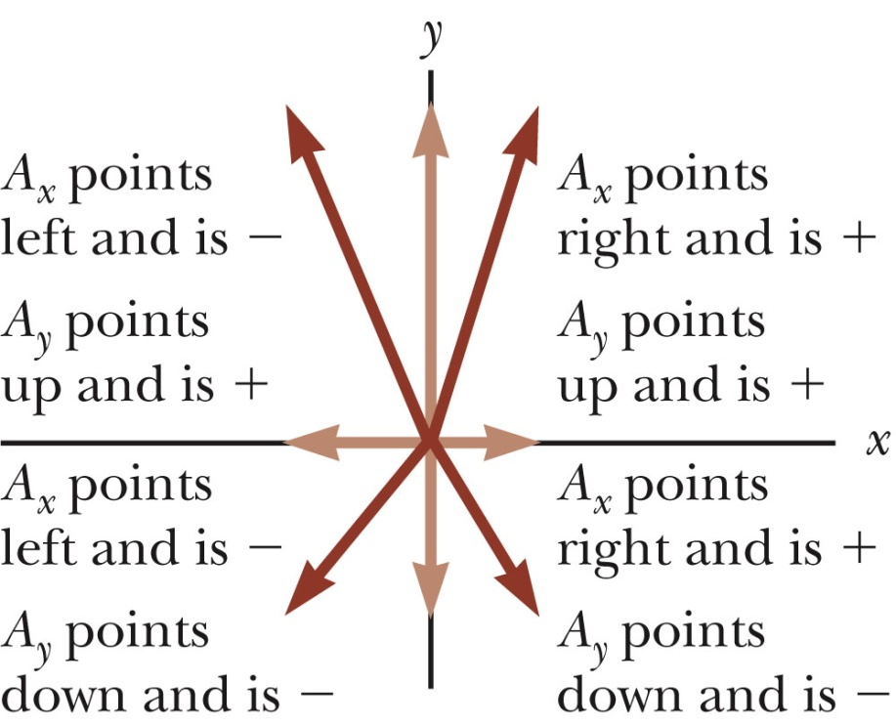
Components of a Vector, final
The components can be positive or negative and will have the same units as the original vector.
The signs of the components will depend on the angle.
Section 3.4

Slide 37
WHAT ABOUT DIRECTION?
If it is asked for direction in problem, E.g. DISPLACEMENT since it is a VECTOR quantity, we need to report its direction.
N
W of N
E of N
N of E
N of W
N of E
W
E
S of W
S of E
NOTE: When drawing a right triangle that conveys some type of motion, you MUST draw your components HEAD TO TOE.
W of S
E of S
S

Slide 38
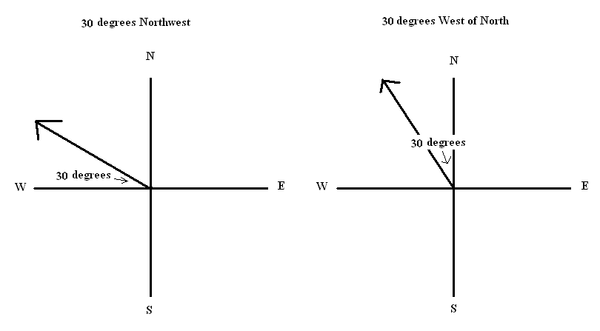
Directions
There is a difference between Northwest and West of North

Slide 39
Unit Vectors
A unit vector is a dimensionless vector with a magnitude of exactly 1.
Unit vectors are used to specify a direction and have no other physical significance.
Section 3.4

Slide 40
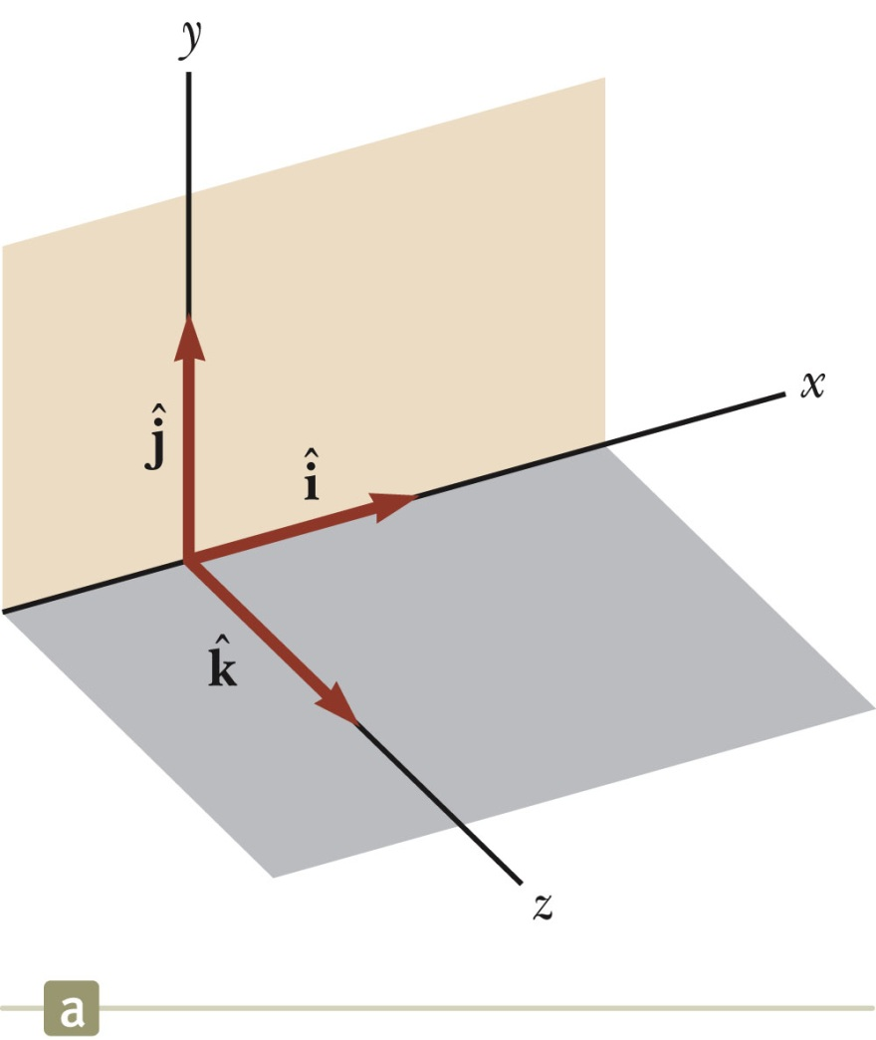
Unit Vectors, cont.
The symbols
represent unit vectors
They form a set of mutually perpendicular vectors in a right-handed coordinate system
The magnitude of each unit vector is 1
Section 3.4

Slide 41
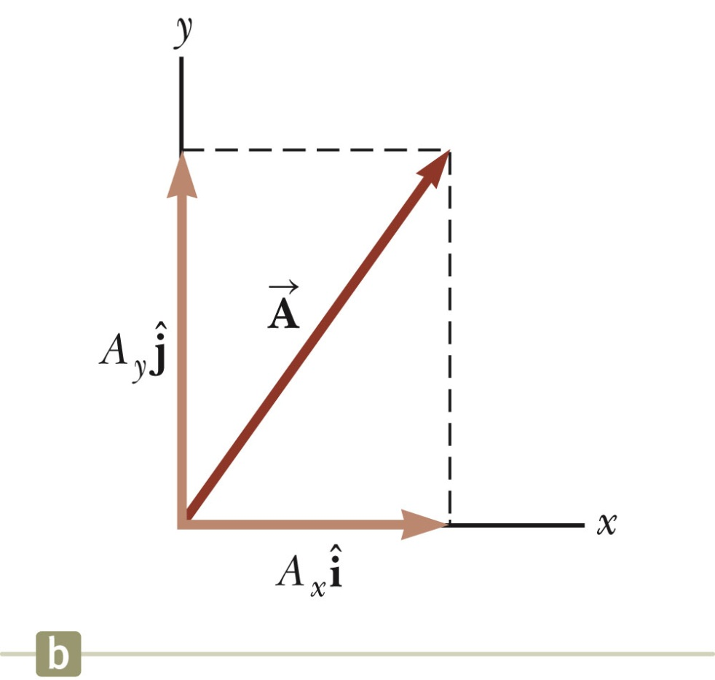
Unit Vectors in Vector Notation
A_{x} is the same as A_{x} and A_{y} is the same as A_{y} etc.
The complete vector can be expressed as:
Section 3.4

Slide 42
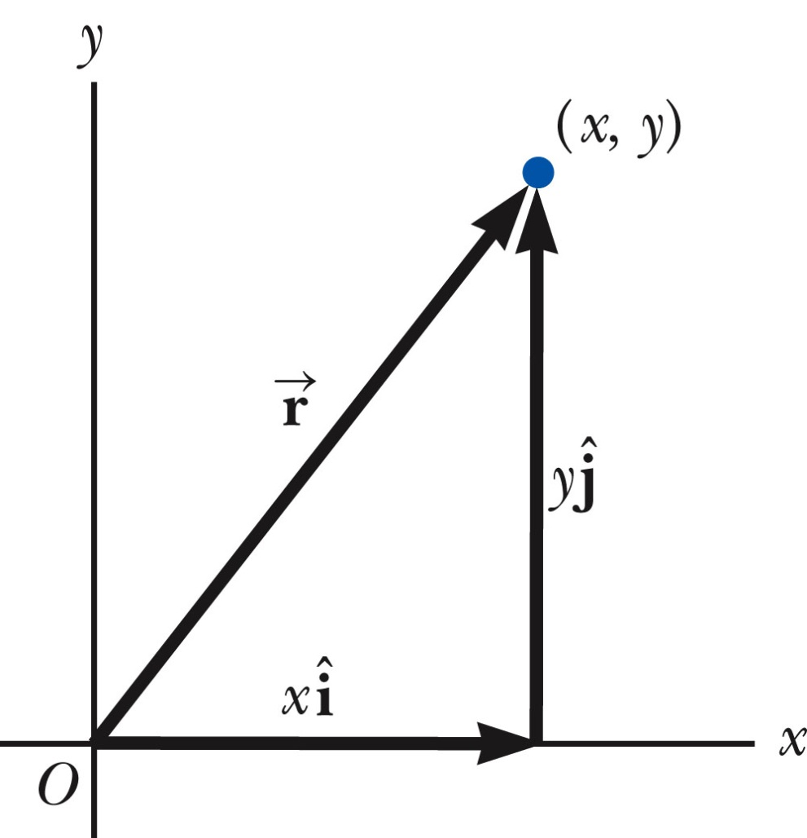
Position Vector, Example
A point lies in the xy plane and has Cartesian coordinates of (x, y).
The point can be specified by the position vector.
This gives the components of the vector and its coordinates.
Section 3.4

Slide 43
Adding Vectors Using Unit Vectors
Using
Then
So R_{x} = A_{x} + B_{x} and R_{y} = A_{y} + B_{y}
Section 3.4

Slide 44
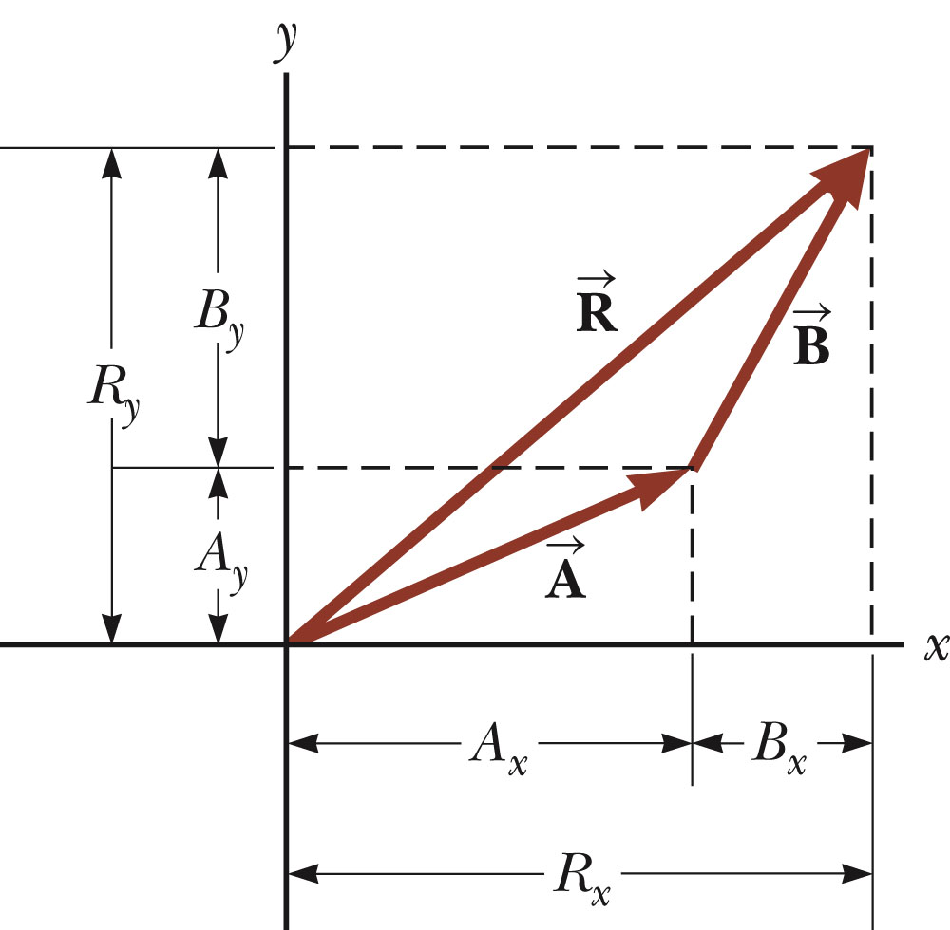
Adding Vectors with Unit Vectors
Note the relationships among the components of the resultant and the components of the original vectors.
R_{x} = A_{x} + B_{x}
R_{y} = A_{y} + B_{y}
Section 3.4

Slide 45
Three-Dimensional Extension
Using
Then
So R_{x}= A_{x}+B_{x}, R_{y}= A_{y}+B_{y}, and R_{z} = A_{z}+B_{z}
Section 3.4

Slide 46
Adding Three or More Vectors
The same method can be extended to adding three or more vectors.
Assume
And
Section 3.4

Slide 47
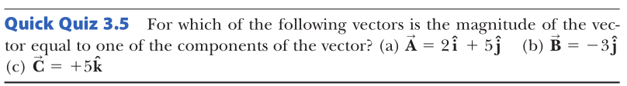

Slide 48
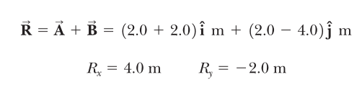
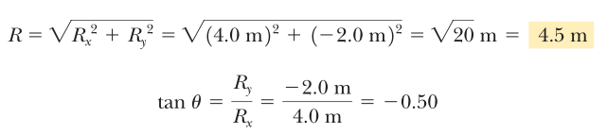


Example 3.3:
Find the sum of two vectors $\vec{A} and \vec{B}$ lying in the xy plane and given by
$$\vec{A}=\left(2.0 \hat{i}+2.0 \hat{j}\right)m and \vec{B}=\left(2.0\hat{i}−4.0\hat{j}\right)m$$
Angle with +x axis for this vector is θ = 333°

Slide 49
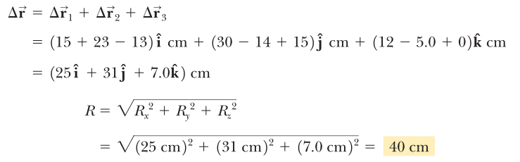
Problem 3.4: The Resultant Displacement
A particle undergoes three consecutive displacements:
Find the components of the resultant displacement and its magnitude.
Solution:

Slide 50
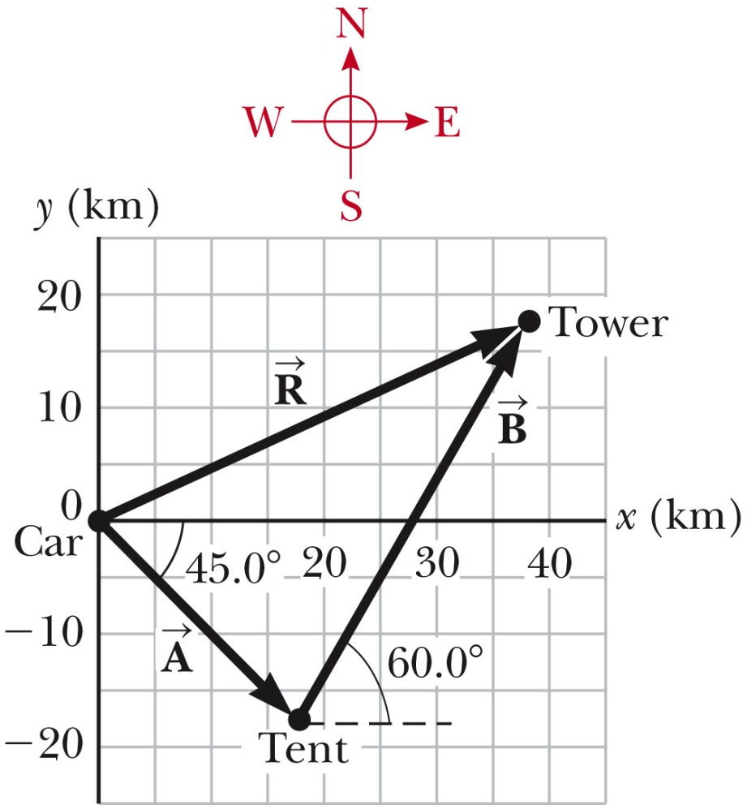
Example 3.5 – Taking a Hike
A hiker begins a trip by first walking 25.0 km southeast from his car. He stops and sets up his tent for the night. On the second day, he walks 40.0 km in a direction 60.0° north of east, at which point he discovers a forest ranger’s tower.
(A) Determine the components of the hiker’s displacement for each day.
Section 3.4

Slide 51
Example 3.5 – Solution, Analysis
The first displacement has a magnitude of 25.0 km and is directed 45.0° below the positive x axis.
Its components are:
Section 3.4

Slide 52
Example 3.5 – Solution, Analysis 2
The second displacement has a magnitude of 40.0 km and is 60.0° north of east.
Its components are:
Section 3.4

Slide 53
Example 3.5 – Solution, Analysis 3
The negative value of A_{y} indicates that the hiker walks in the negative y direction on the first day.
The signs of A_{x} and A_{y} also are evident from the figure.
The signs of the components of B are also confirmed by the diagram.
Section 3.4

Slide 54
Example 3.5 – Analysis, 4
Determine the components of the hiker’s resultant displacement for the trip.
Find an expression for the resultant in terms of unit vectors.
The resultant displacement for the trip has components given by
R_{x} = A_{x} + B_{x} = 17.7 km + 20.0 km = 37.7 km
R_{y} = A_{y} + B_{y} = -17.7 km + 34.6 km = 16.9 km
In unit vector form
Section 3.4

Slide 55
Example 3.5 – Solution, Finalize
The resultant vector has a magnitude of 41.3 km and is directed 24.1° north of east.
The units of are km, which is reasonable for a displacement.
From the graphical representation , estimate that the final position of the hiker is at about (38 km, 17 km) which is consistent with the components of the resultant.
Section 3.4

Slide 56
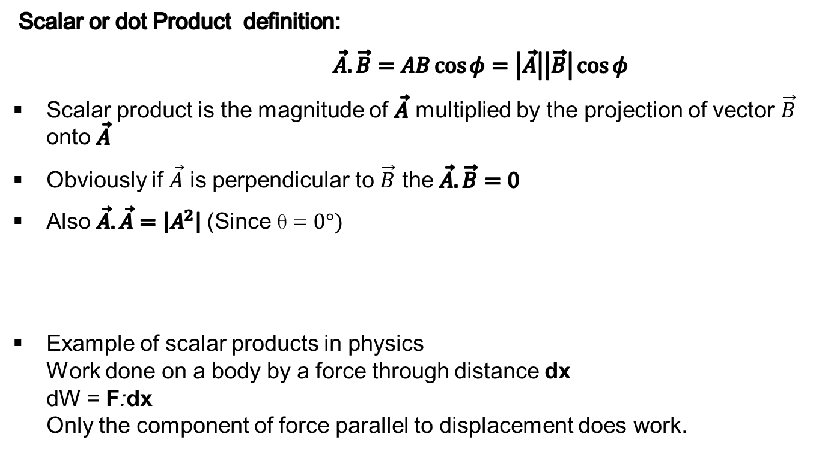
Vector Multiplication: Scalar and Vector Products
Scalar or dot Product definition:
$\vec{A}.\vec{B}=AB\cos{φ}=\left|\vec{A}\right|\left|\vec{B}\right|\cos{φ}$
Scalar product is the magnitude of $\vec{A}$ multiplied by the projection of vector $\vec{B}$ onto $\vec{A}$
Obviously if $\vec{A}$ is perpendicular to $\vec{B}$ the $\vec{A}.\vec{B}=0$
Also $\vec{A}.\vec{A}=\left|A^{2}\right|$(Since θ = $0°)$
Example of scalar products in physics Work done on a body by a force through distance dx dW = F:dx Only the component of force parallel to displacement does work.

Slide 57
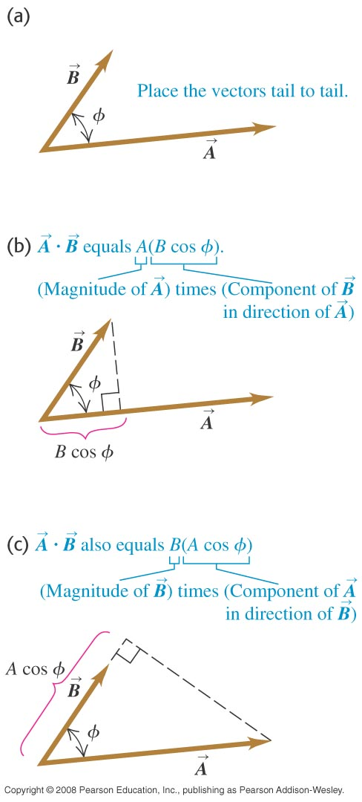
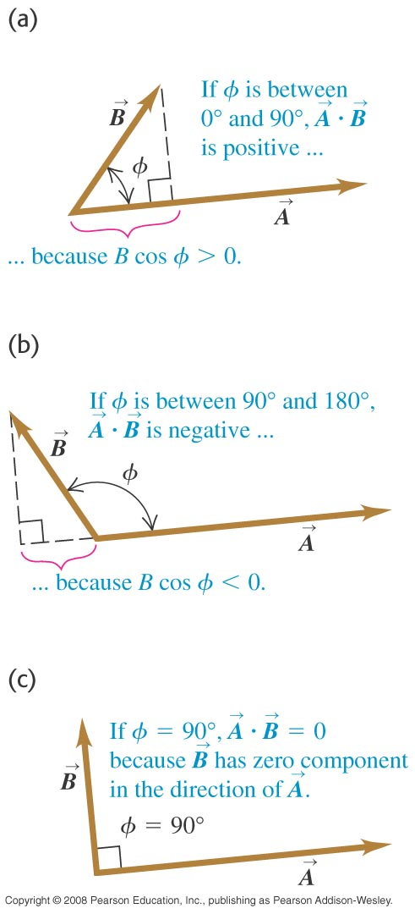
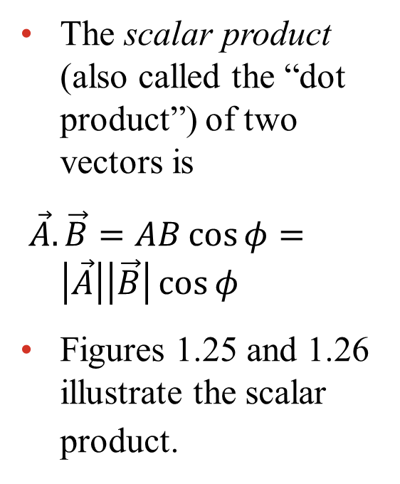
The scalar product
The scalar product (also called the “dot product”) of two vectors is
$\vec{A}.\vec{B}=AB\cos{φ}=\left|\vec{A}\right|\left|\vec{B}\right|\cos{φ}$
Figures 1.25 and 1.26 illustrate the scalar product.

Slide 58
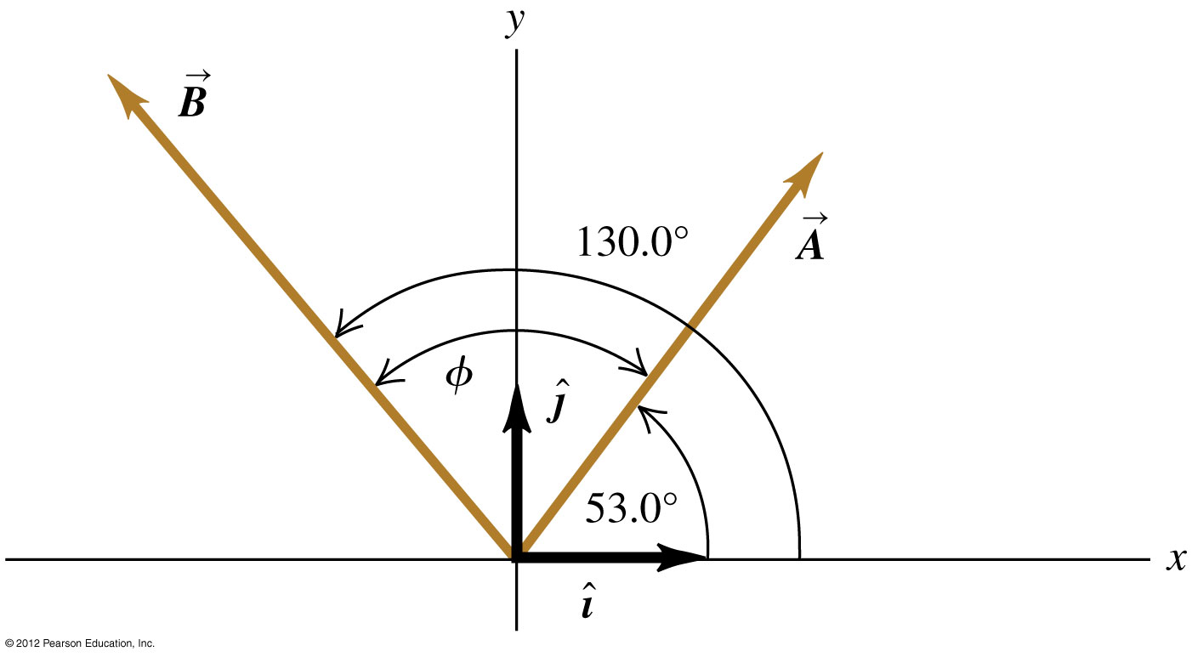
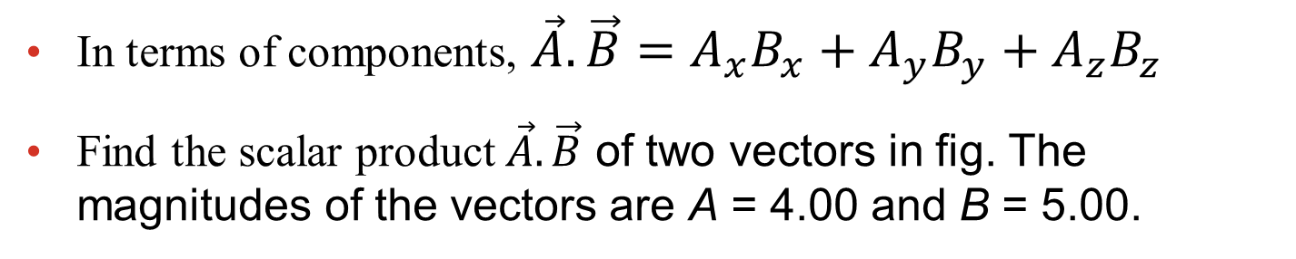
Calculating a scalar product
In terms of components, $\vec{A}.\vec{B}=A_{x}B_{x}+A_{y}B_{y}+A_{z}B_{z}$
Find the scalar product $\vec{A}.\vec{B}$ of two vectors in fig. The magnitudes of the vectors are A = 4.00 and B = 5.00.
[Insert figure 1.27 here]

Slide 59

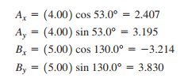



Slide 60

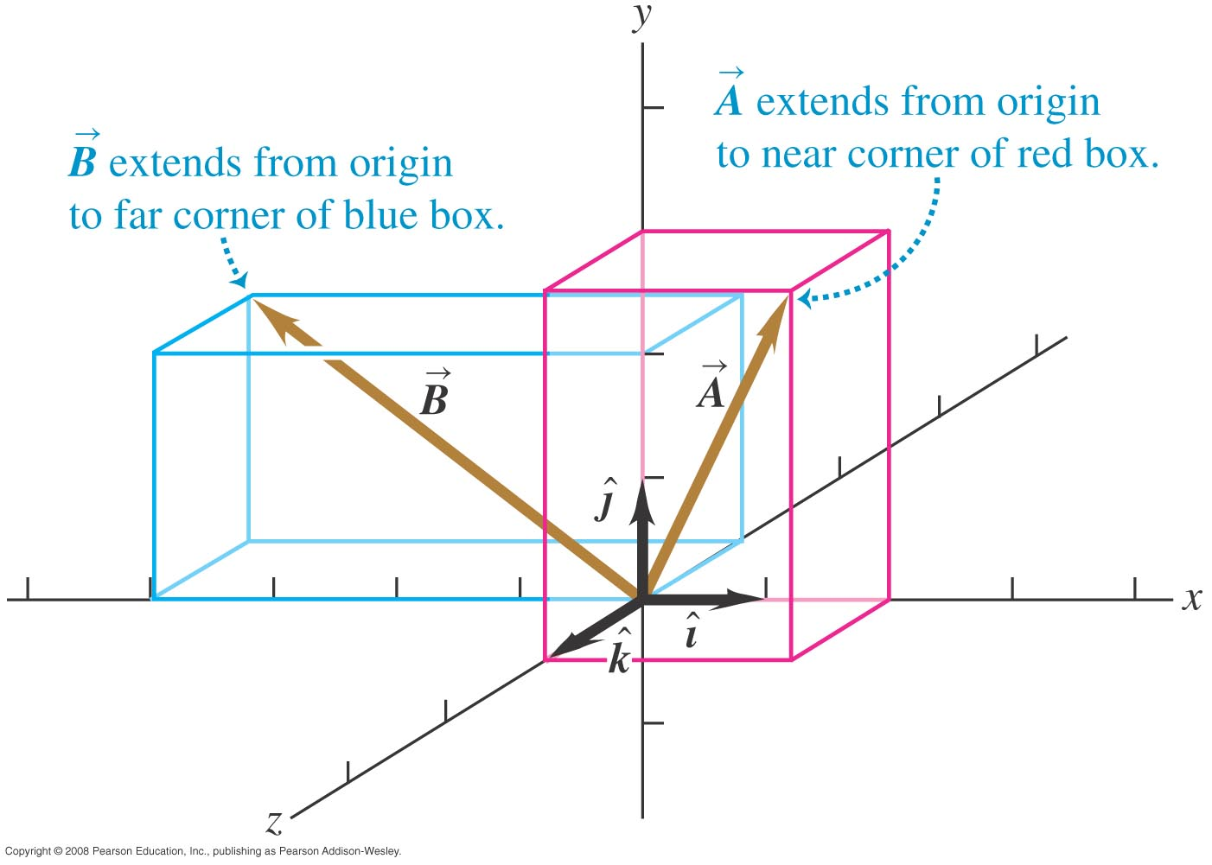
Problem 1.11 Finding an angle with the scalar product (University Physics)
Find the angle between the vectors

Slide 61

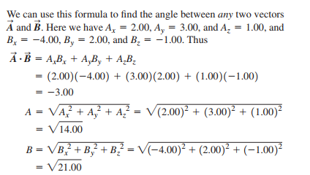

Solution:

Slide 62
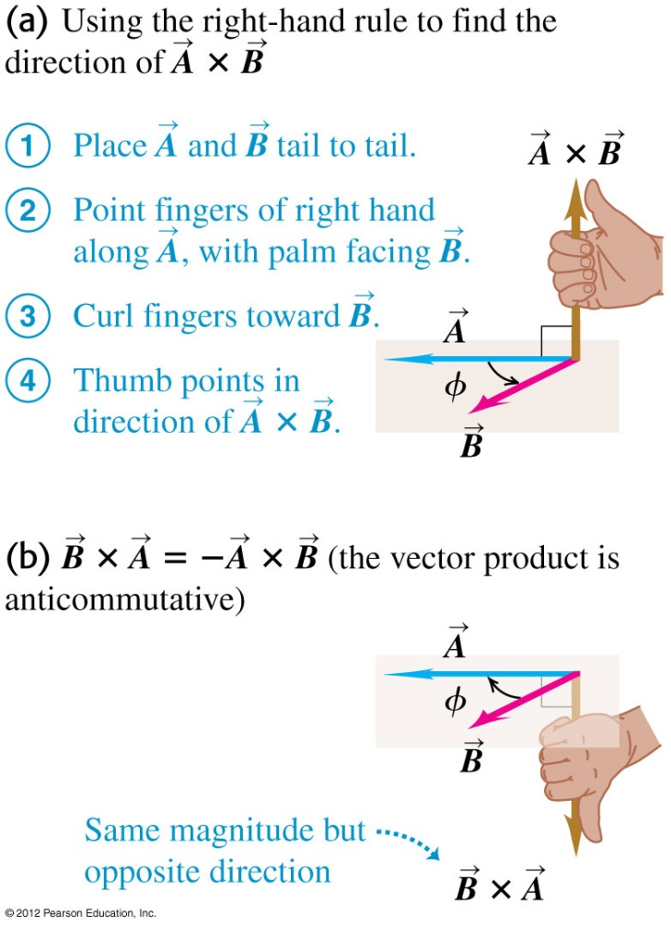
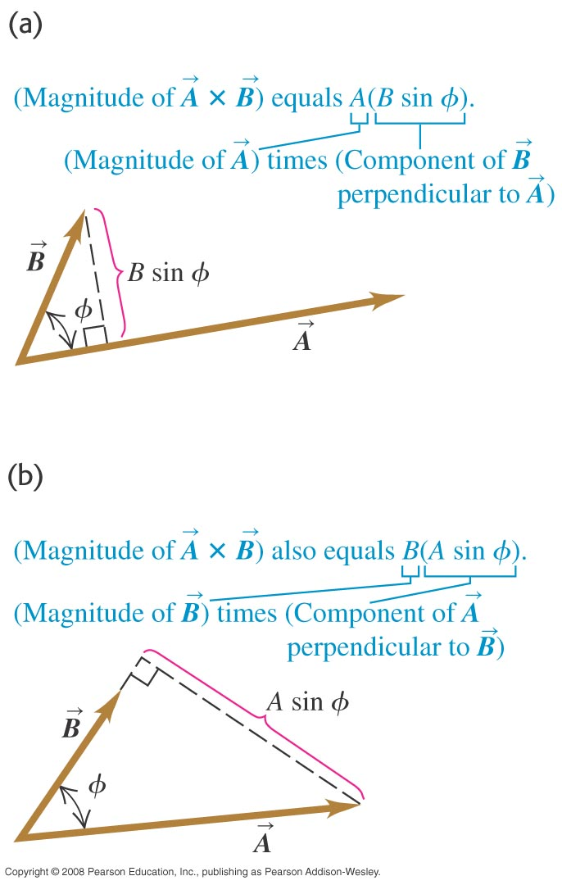
The vector or cross product
The vector product (“cross product”) of two vectors has magnitude
and the right-hand rule gives its direction. See Figures 1.29 and 1.30.

Slide 63

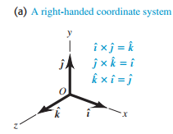
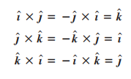
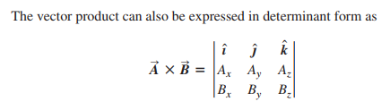
Properties of Cross product

Slide 64

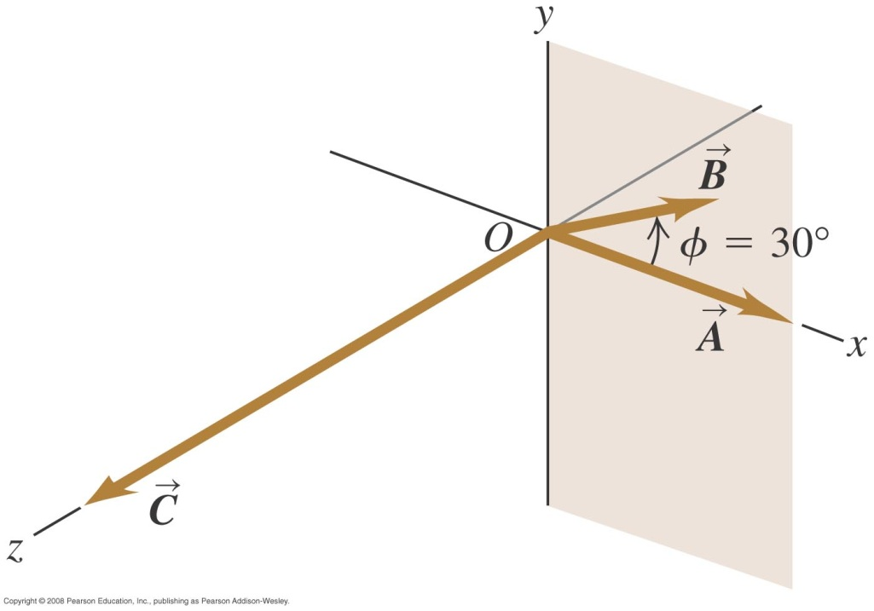
Problem 1.12 Calculating a vector product

Slide 65
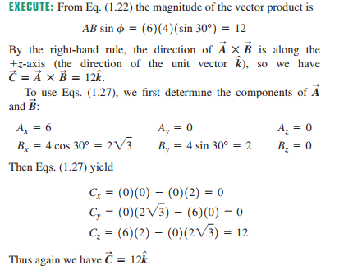

Solution:

