Slide 1
CS118 - Programming Fundamentals Lecture#02
Waqas Ali
Lecturer (CS)
National University of Computer and Emerging Sciences
waqas.ali@nu.edu.pk

Slide 2
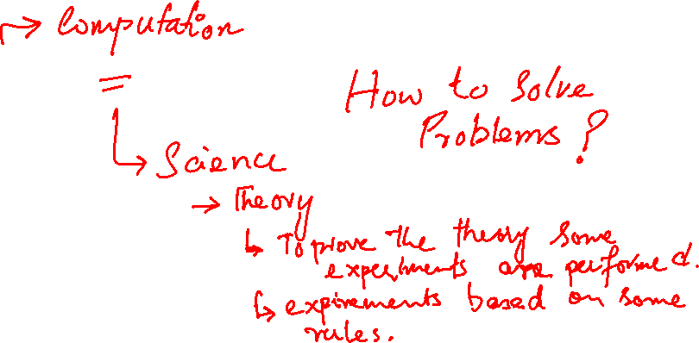
What is Computer Science
Computer Science

Slide 3
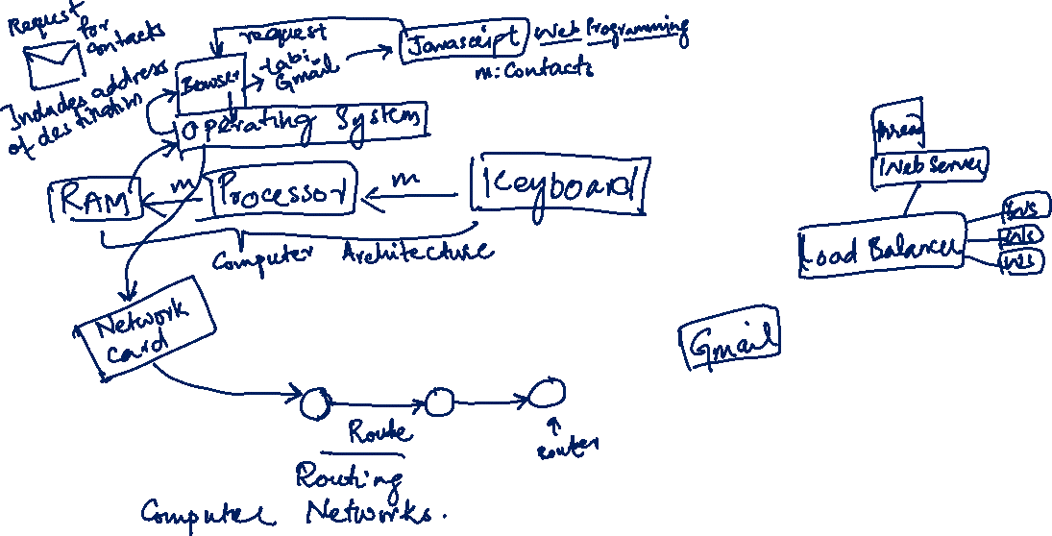
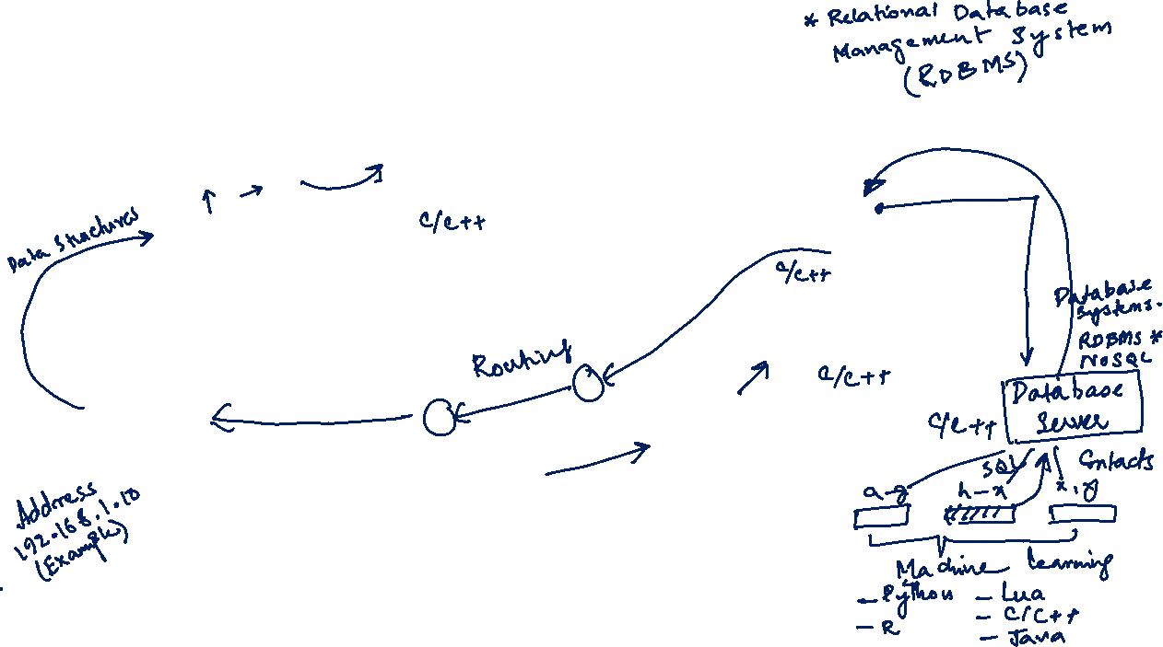
Case Study: Round-trip web request

