Slide 1
CS118 - Programming Fundamentals Lecture#02
Waqas Ali
Lecturer (CS)
National University of Computer and Emerging Sciences
waqas.ali@nu.edu.pk

Slide 2
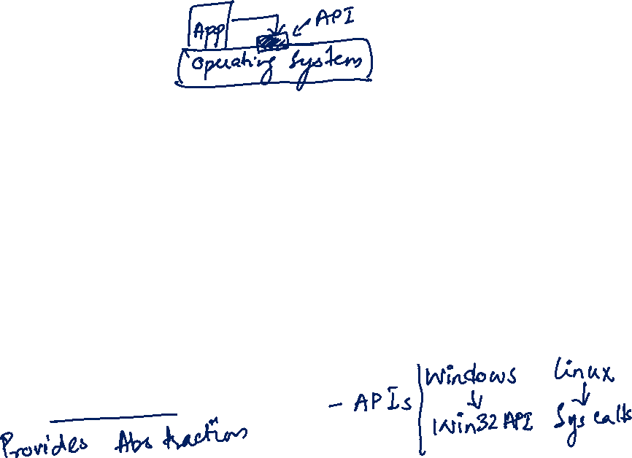
Operating Systems
An Operating System is an interface between a user and the computer hardware.
They decide the behavior of computers and the interactions you have with them.
For instance, if you are a Windows user – normal mode of interaction is a GUI.
For Linux users, the shell (command line) is much more common.
What do operating systems do?
System calls and Application Programming Interface

Slide 3

The Role of an Operating System
Physical Machine
Operating System
Application 1
Application 2
…
Device Driver

Slide 4
The social computer
Computers do not operate in isolation
Some computer are good at one function, others at some different one
For instance, one computer might have a very good CPU/GPU while another might have more storage capacity

Slide 5
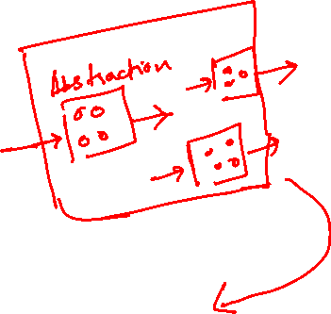
Cloud Computing
You might have heard about super computers
The immense power of super computers can be emulated with the concepts of High Performance Computing
Cluster computing and grid computing put several computers together to create extremely powerful functions
Amazon (among others) created such a large computing base for their online shop that they were not using all of the power!
They decided to rent it out thus giving rise to the concept of cloud computing

Slide 6
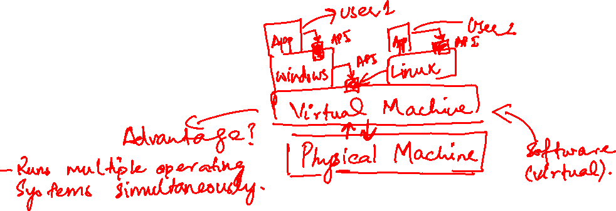
The truth behind cloud computing
Recall what a “machine” does
What is stopping you from writing a machine that acts like the hardware you have
This is called a virtual machine!

Slide 7
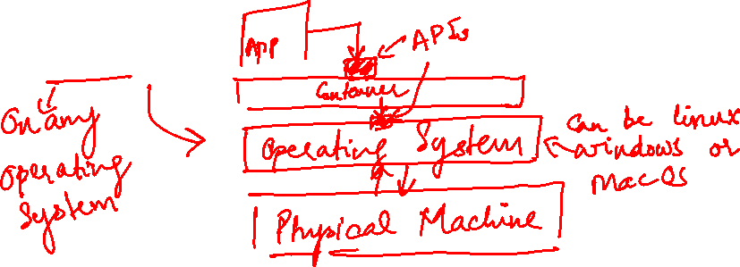
VMs versus containers
Containers (see Docker) are light weight virtual machines (sort of)
Why containers?
Create once, deploy everywhere

Slide 8
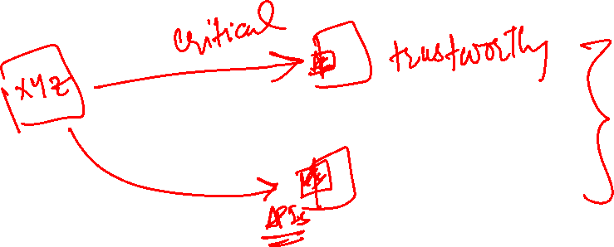
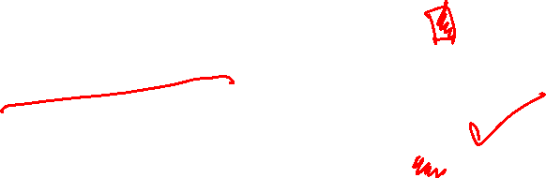
But I don’t want to offload all computation
There are computation concerns as well as those related to security and privacy
Also, businesses can’t rely full on other businesses for the their operations
Networked APIs

Slide 9
Workflow in production Environment

