Slide 1
CS118 - Programming Fundamentals Lecture#04: Programming Introduction
Waqas Ali
Lecturer (CS)
National University of Computer and Emerging Sciences
waqas.ali@nu.edu.pk

Slide 2
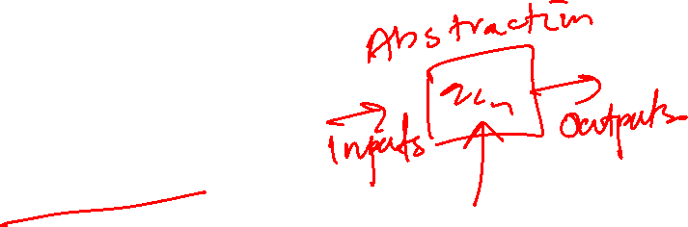
Recall from last time
Computer Science is about problem solving
To solve problems, we first need to be able to formalize it

Slide 3
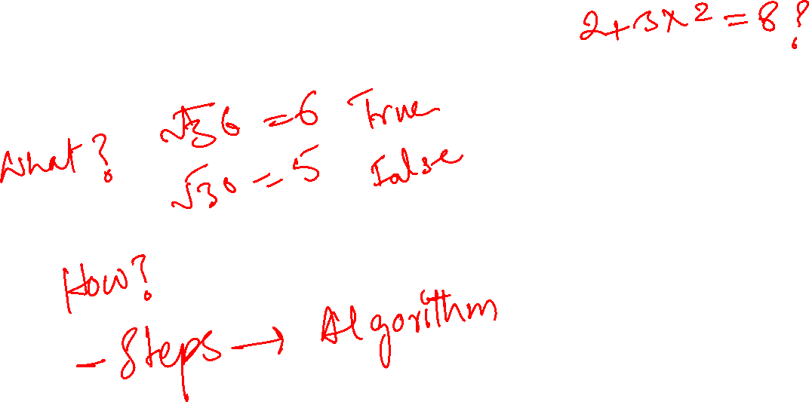
Types of knowledge
Declarative
Imperative

Slide 4

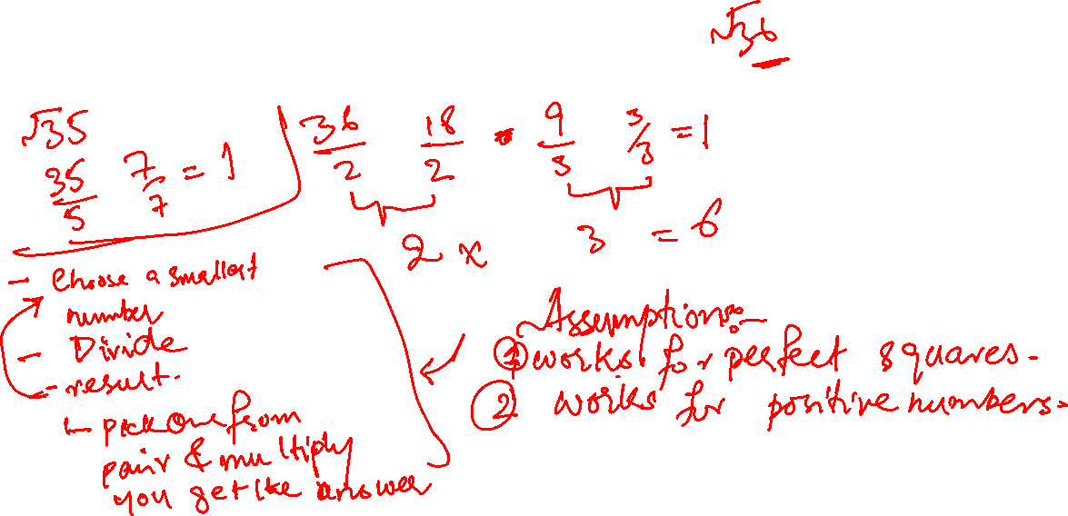
Case study: square roots
How do you calculate the square root?

Slide 5
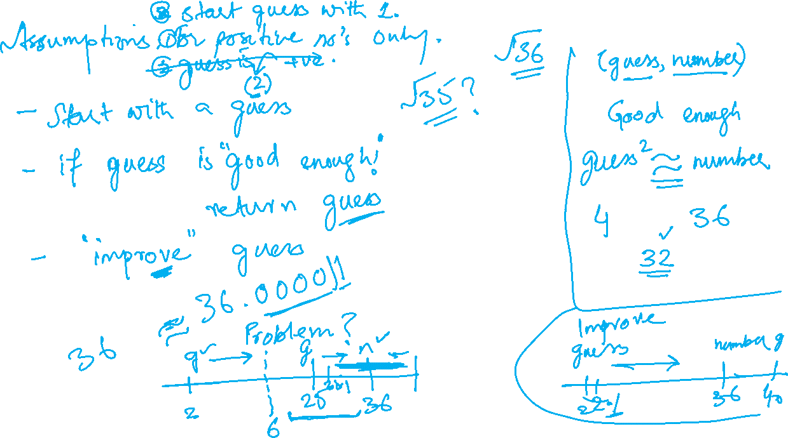


Slide 6
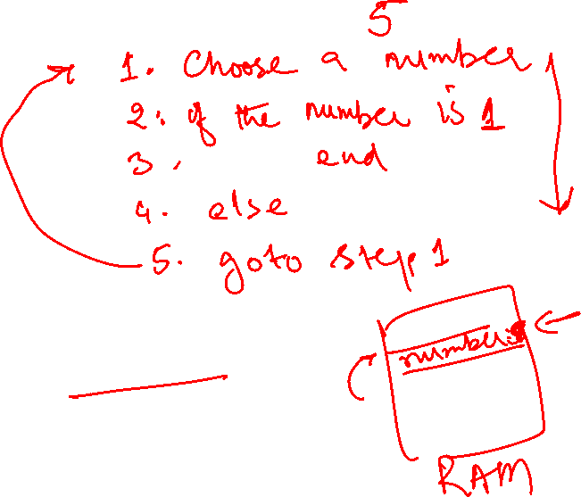
How to talk to computers
Programming languages
Interpreter
Flow of control
Instructions (steps) modify data in locations

Slide 7
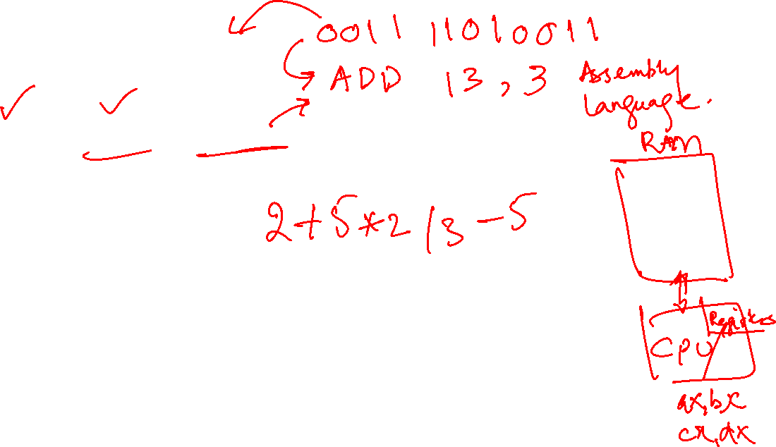
Machine Language
Memory, registers, instructions, parameters
1. …
2. mov ax, 5
…
15. jmp top

Slide 8
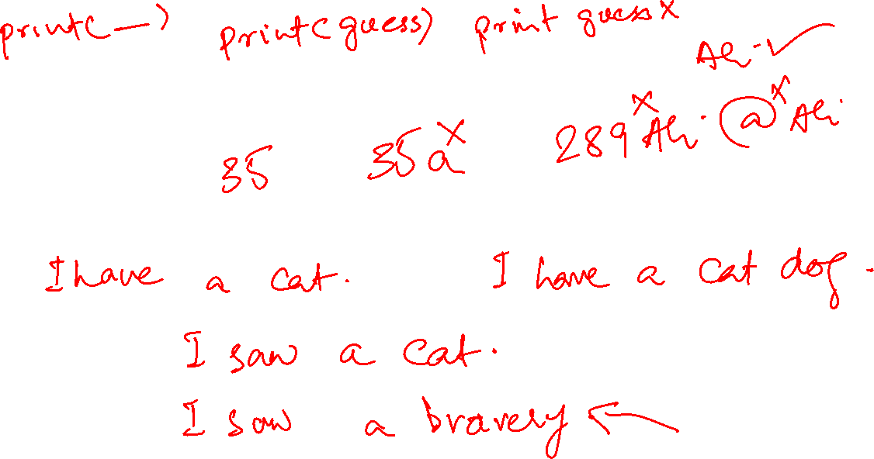
Meaning in a language
Syntax
Static Semantics
Semantics

Slide 9
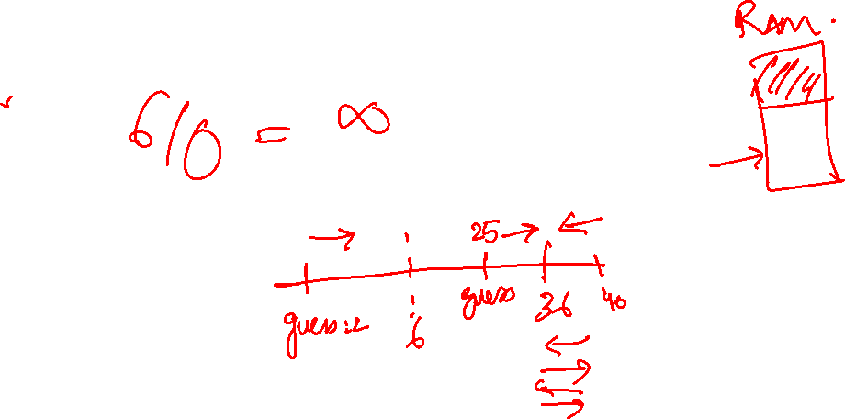
Semantic Errors
Crash
Run to infinity
Run and produce an output (without assurance of correctness)
Let’s eat, grandpa
Let's eat grandpa

Slide 10
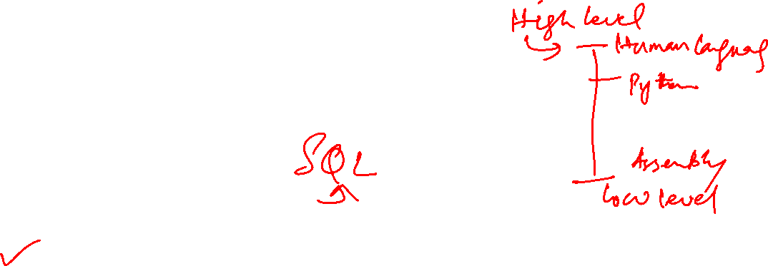
Categorization of Languages
Low-level versus high level
General versus domain specific
Interpreted versus compiled
Source code
Machine code

Slide 11
Python
High level language
General Purpose
Interpreted
Scripts, programs, shell

Slide 12
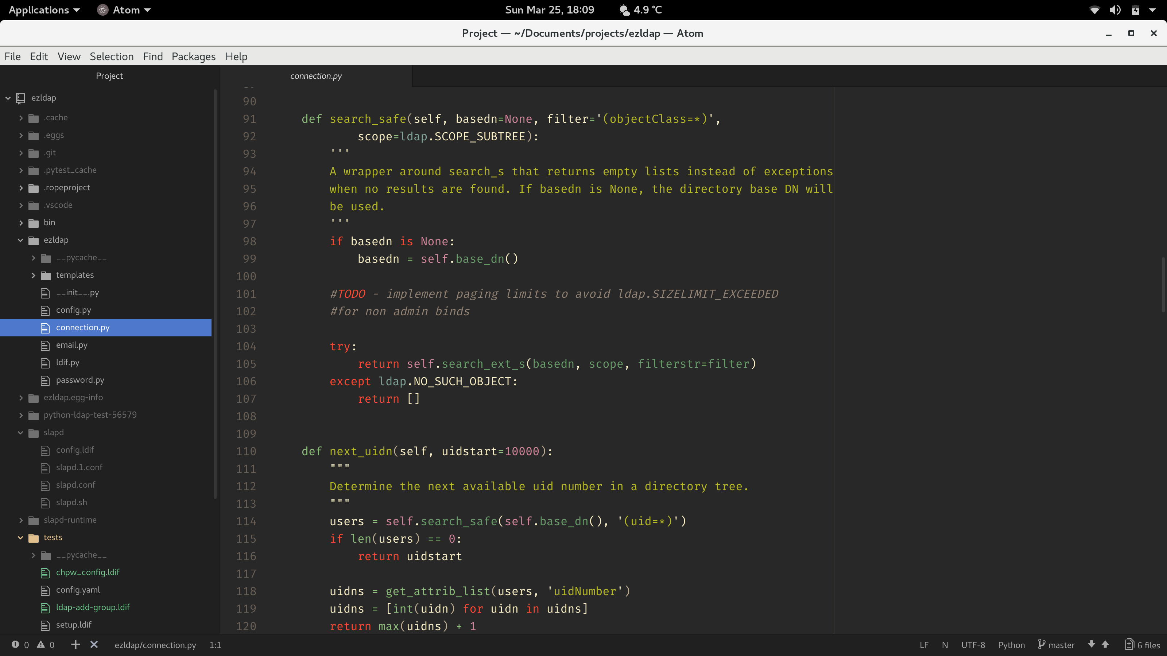
Python Script
Text Editors
Notepad
Atom
Notepad++
Sublime Text

Slide 13
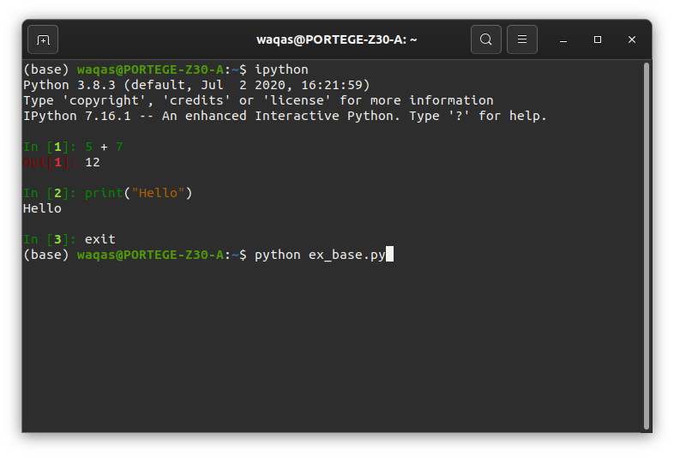
Python Shell

Slide 14
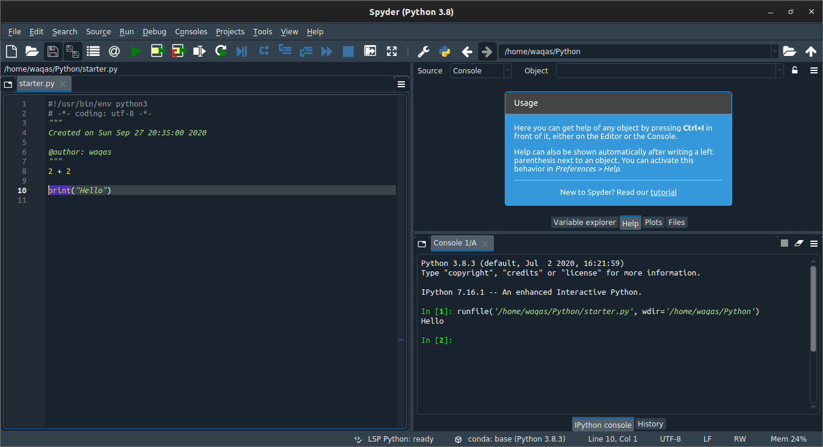
Python IDE

Slide 15
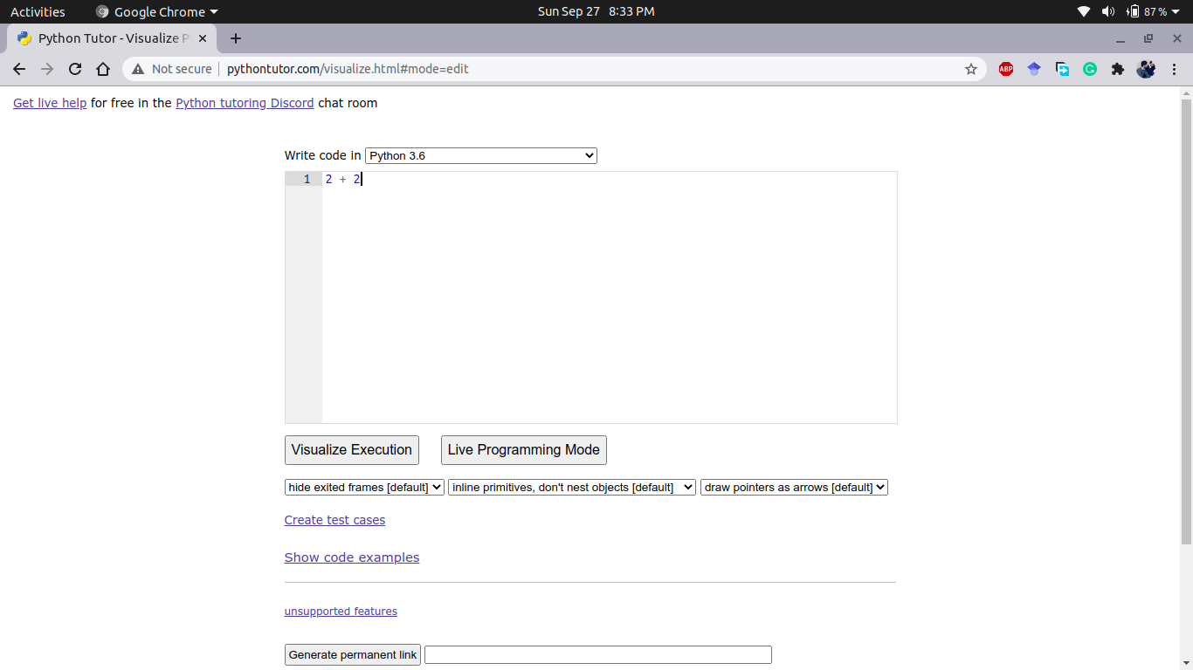
Python Tutor

Slide 16
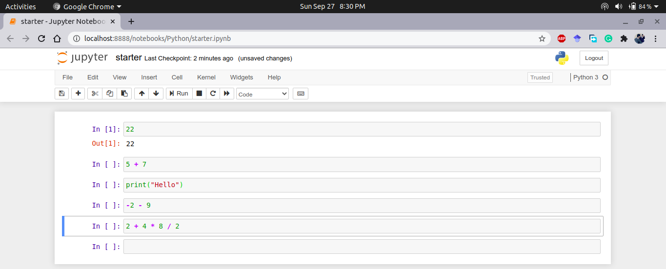
Notebook

