Slide 1
CS118 - Programming Fundamentals Lecture#04: Getting Started with Code
Waqas Ali
Lecturer (CS)
National University of Computer and Emerging Sciences
waqas.ali@nu.edu.pk

Slide 2
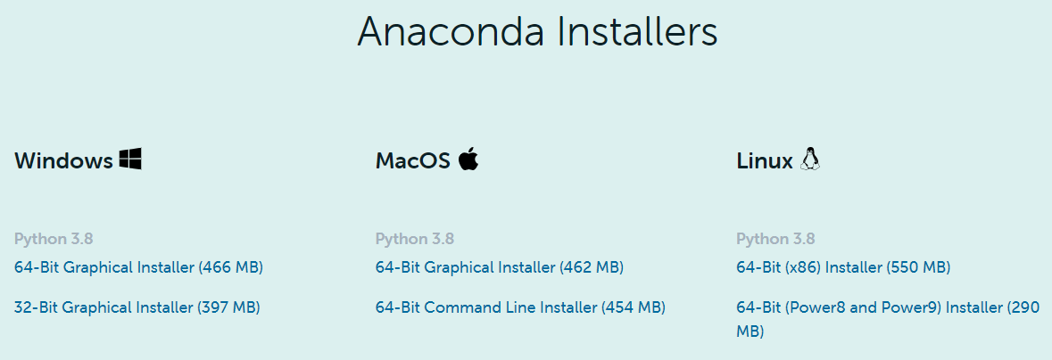
Install Python

Slide 3
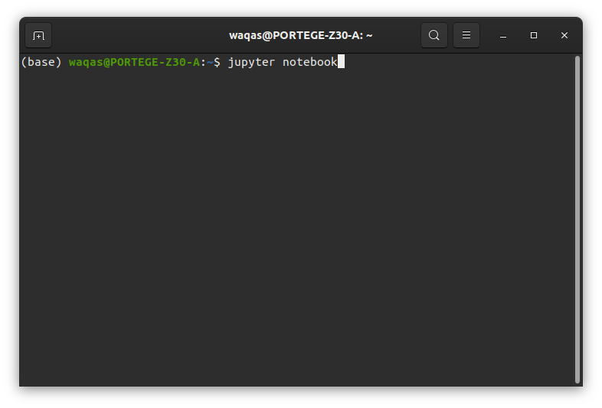
Starting your notebook server

Slide 4
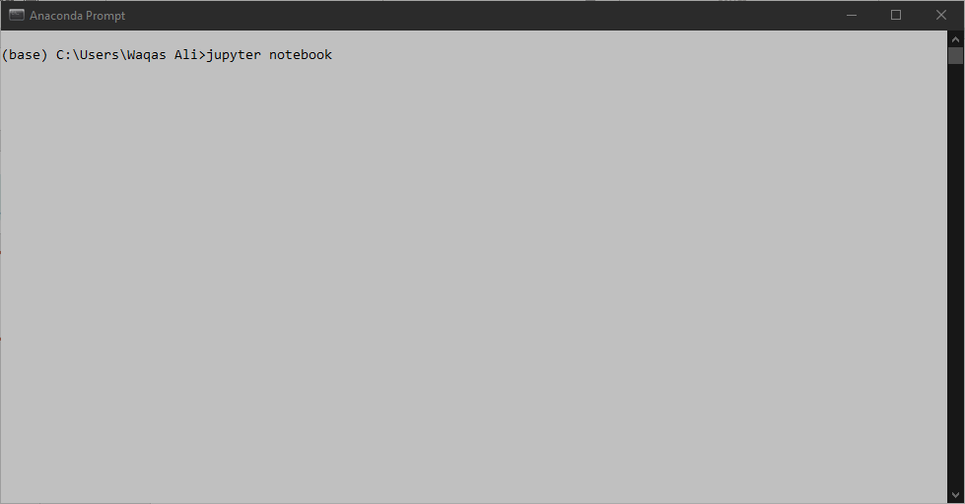
Starting your notebook server

Slide 5
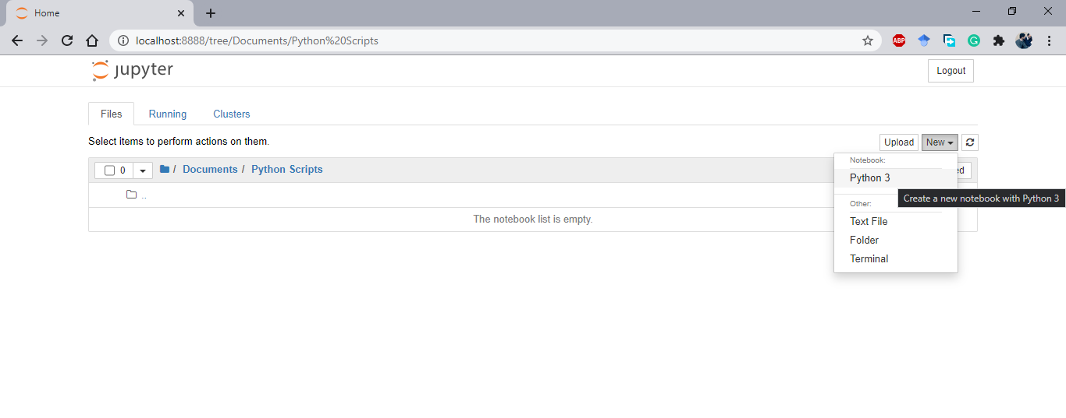
Creating a notebook

Slide 6
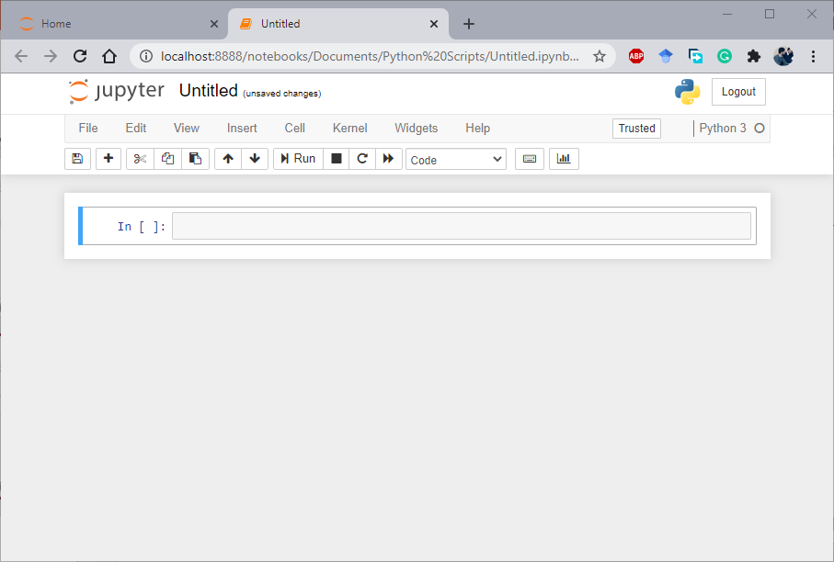
Notebook view

Slide 7
Expressions
-2 + 15

Slide 8
Precedence
2 + 2 * 2

Slide 9
Prefix
max ( 7 , 9 )

Slide 10
Prefix (with evaluation)
max ( 2+5 , 9 )

Slide 11
Nesting
max( min(1, -2), min( pow(3, 5) ,-4))

