Slide 1
CS118 - Programming Fundamentals Lecture#06: Functions
Waqas Ali
Lecturer (CS)
National University of Computer and Emerging Sciences
waqas.ali@nu.edu.pk

Slide 2
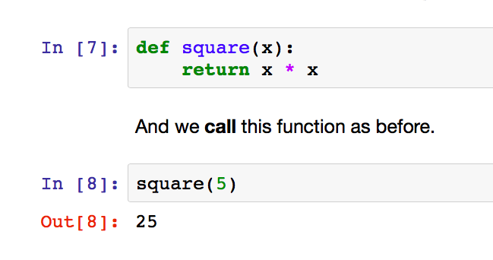



Function definitions

Slide 3
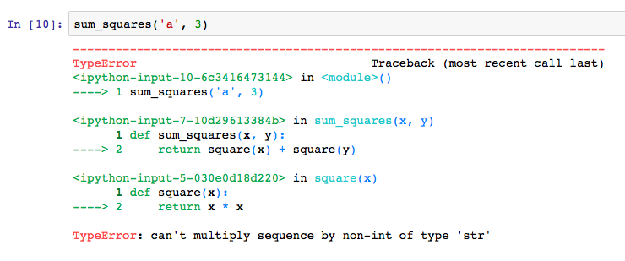



Trace

