Slide 1
KERBEROS
Computer-network authentication protocol
BY ABUBAKER ATTIQUE
SHAREEF ALI

Slide 2
CONTENTS
What is Kerberos ?
Why Kerberos ?
Key Distribution
Advantages
Disadvantages
Conclusion
Demo

Slide 3
INTRODUCTION
What is Kerberos ?
Why Kerberos ?
Key Distribution
Advantages
Disadvantages
Conclusion
Demo
WHAT IS KERBEROS ?
Network Authentication Protocol :
Kerberos is a network authentication protocol designed for secure communication in distributed systems.
Ticket-Based System :
It uses a ticket-based system involving an Authentication Server (AS) and a Ticket-Granting Service (TGS) to grant clients secure access to services.

Slide 4
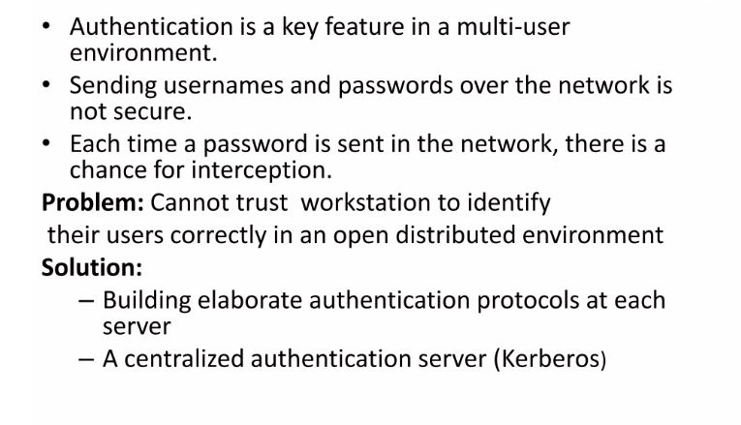
WHY KERBEROS ?
What is Kerberos ?
Why Kerberos ?
Key Distribution
Advantages
Disadvantages
Conclusion
Demo

Slide 5
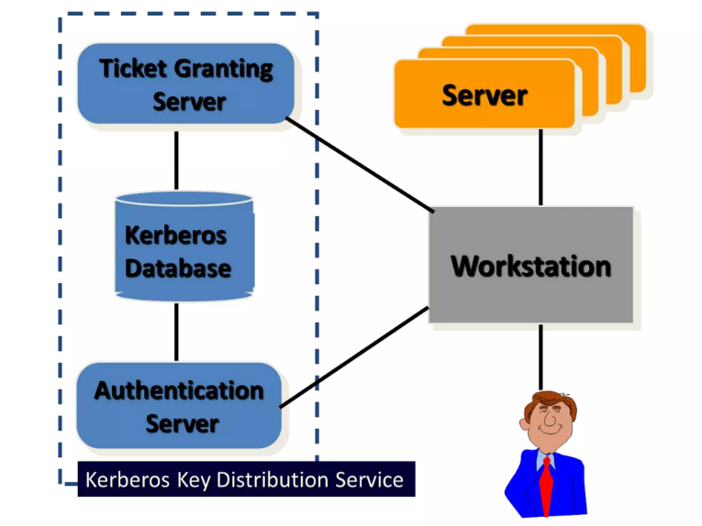
KEY DISTRIBUTION SERVICE
What is Kerberos ?
Why Kerberos ?
Key Distribution
Advantages
Disadvantages
Conclusion
Demo

Slide 6
ADVANTAGES
What is Kerberos ?
Why Kerberos ?
Key Distribution
Advantages
Disadvantages
Conclusion
Demo
Mutual Authentication: Ensures both client and server verify identities.
Single Sign-On (SSO): Enables seamless access to multiple services after initial authentication.
Ticket-Based Security: Uses encrypted and time-stamped tickets, reducing password exposure.
Efficient Key Distribution: Centralized Key Distribution Center (KDC) simplifies key management.
Scalability: Handles authentication requests efficiently in large networks.
Session Key Security: Provides secure session keys for encrypted communication.

Slide 7
DRAWBACKS
What is Kerberos ?
Why Kerberos ?
Key Distribution
Advantages
Disadvantages
Conclusion
Demo
Single Point of Failure: The Key Distribution Center (KDC) is a single point of failure. If it becomes unavailable, authentication and access to services may be disrupted.
Clock Synchronization: Kerberos relies on accurate time synchronization between entities. Inconsistent clocks can lead to authentication failures or security issues.
3.Ticket Expiry and Renewal: The time-limited nature of tickets may lead to occasional re-authentication, impacting the user experience. Renewing tickets requires additional steps.
4. Potential for Replay Attacks: In some situations, there is a risk of replay attacks where an attacker intercepts and reuses valid authentication messages to gain unauthorized access.

Slide 8
CONCLUSION
What is Kerberos ?
Why Kerberos ?
Key Distribution
Advantages
Disadvantages
Conclusion
Demo
1.Robust Security Foundation:
Kerberos provides a strong security foundation with features like mutual authentication, encrypted ticket-based communication, and session key security.
2.Centralized Key Distribution:
The Key Distribution Center (KDC) efficiently manages and distributes symmetric keys, simplifying key management in large-scale environments.
3.Scalability:
Designed for scalability, Kerberos efficiently handles authentication requests in large networks, making it suitable for enterprise-level implementations.
4.Ticket-Based Security:
The use of tickets, encrypted with symmetric keys, reduces the risk of password exposure during communication, enhancing overall security.

Slide 9
PRACTICAL DEMO
What is Kerberos ?
Why Kerberos ?
Key Distribution
Advantages
Disadvantages
Conclusion
Demo

Slide 10
THANKYOU

