Slide 1
Sequential Matrix Multiplication
Sharif Ahmed

Slide 2
Introduction
C program to compute C = C + A * B
where A, B, C are NXN matrices
N = {10, 20, 30, 40, 50, 60, 70, 80, 90, 100, 200, 300, 400, 500, 600, 700, 800, 900, 1000}
6 ways to compute: ijk, ikj, jik, jki, kij, kji
Calculate and compare execution time and floating point operation per second (flop/s)
Use PAPI library to analyze the reason

Slide 3
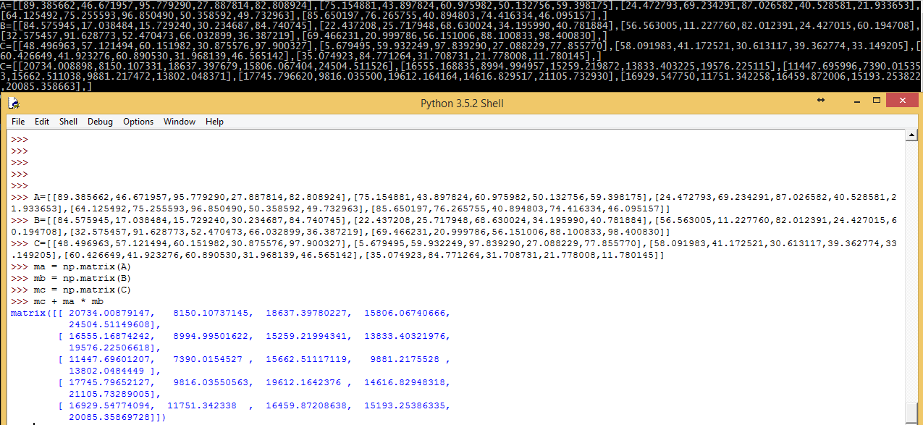
Initialization & Computation
A, B, C matrices are dynamically memory allocated and randomly initialized for various values of N
They are initialized as 1D or linearly to get better performance
To test the correctness of the code, python’s numpy package is used and compared side by side for each combination for small N

Slide 4
Execution Time
For each combination, the function is called several times to get the average execution time for that combination of any specific N
To get better precision, PAPI library’s time function is utilized
N | IJK | IKJ | JIK | JKI | KIJ | KJI
10 | 0.000002 | 0.000001 | 0.000002 | 0.000001 | 0.000002 | 0.000001
20 | 0.000008 | 0.000009 | 0.000008 | 0.000009 | 0.000008 | 0.000008
30 | 0.000029 | 0.000027 | 0.000028 | 0.000027 | 0.000028 | 0.000027
40 | 0.000054 | 0.000066 | 0.000054 | 0.000064 | 0.000054 | 0.000066
50 | 0.000107 | 0.000133 | 0.000107 | 0.000133 | 0.000107 | 0.000133
60 | 0.000168 | 0.000237 | 0.000163 | 0.000226 | 0.000162 | 0.000226
70 | 0.000296 | 0.00037 | 0.000265 | 0.000365 | 0.000265 | 0.000359
80 | 0.000396 | 0.000536 | 0.000395 | 0.000552 | 0.000395 | 0.000536
90 | 0.00054 | 0.000758 | 0.000525 | 0.000757 | 0.000525 | 0.000773
100 | 0.000679 | 0.001192 | 0.000679 | 0.001192 | 0.000679 | 0.001193
200 | 0.010548 | 0.009025 | 0.010522 | 0.009023 | 0.010525 | 0.009016
300 | 0.048588 | 0.029785 | 0.048429 | 0.029807 | 0.048374 | 0.029785
400 | 0.131082 | 0.069859 | 0.13062 | 0.07 | 0.130765 | 0.070823
500 | 0.318179 | 0.137085 | 0.302484 | 0.136929 | 0.303146 | 0.14767
600 | 0.64027 | 0.293333 | 0.637145 | 0.293714 | 0.638107 | 0.28621
700 | 0.956484 | 0.472289 | 0.950223 | 0.471977 | 0.951876 | 0.468807
800 | 1.51751 | 0.712348 | 1.506245 | 0.712889 | 1.509777 | 0.820306
900 | 2.134628 | 1.028521 | 2.0997 | 1.027908 | 2.092805 | 1.082318
1000 | 3.317834 | 1.450855 | 3.280591 | 1.447275 | 3.296812 | 1.713917

Slide 5
Execution Time Plot

Slide 6
Gflop/s
From the execution time, flop/s is calculated:
flop/s = 2N³/execution time
Dividing it by 10⁹ gives us Gflop/s
JIK combination for N=100 has the maximum 2.945508 Gflop/s.
BigRed2’s peak performance: 4*CPU Clock=4*2.5=10
N | IJK | IKJ | JIK | JKI | KIJ | KJI
10 | 1.250027 | 1.428608 | 1.111103 | 1.428561 | 1.111103 | 1.428561
20 | 1.818178 | 1.860461 | 2.051279 | 1.904758 | 2.051279 | 1.904758
30 | 1.942448 | 1.985293 | 1.956523 | 1.970805 | 1.95652 | 2.000002
40 | 2.370371 | 1.987577 | 2.370369 | 1.981425 | 2.352941 | 1.975309
50 | 2.302026 | 1.860119 | 2.332089 | 1.874063 | 2.349625 | 1.88253
60 | 2.666667 | 1.863676 | 2.666667 | 1.836735 | 2.669963 | 1.889764
70 | 2.600455 | 1.853052 | 2.57701 | 1.880483 | 2.584778 | 1.919418
80 | 2.563846 | 1.910448 | 2.597666 | 1.857091 | 2.601626 | 1.90618
90 | 2.768705 | 1.929592 | 2.778201 | 1.925007 | 2.783505 | 1.892523
100 | 2.926544 | 1.677852 | 2.945508 | 1.677571 | 2.938584 | 1.675042
200 | 1.518545 | 1.770852 | 1.522881 | 1.773168 | 1.518084 | 1.775686
300 | 1.108716 | 1.811789 | 1.114933 | 1.811716 | 1.115813 | 1.813809
400 | 0.960344 | 1.832194 | 0.979388 | 1.828467 | 0.978837 | 1.834358
500 | 0.807511 | 1.573717 | 0.784517 | 1.813437 | 0.826432 | 1.826204
600 | 0.697453 | 1.490711 | 0.689579 | 1.5537 | 0.677203 | 1.47213
700 | 0.628552 | 1.481844 | 0.720945 | 1.497469 | 0.720557 | 1.448284
800 | 0.689083 | 1.430412 | 0.679651 | 1.113983 | 0.677934 | 1.438343
900 | 0.612872 | 1.407321 | 0.694018 | 1.169217 | 0.693436 | 1.417351
1000 | 0.547873 | 1.150355 | 0.593414 | 1.383186 | 0.609762 | 1.382437

Slide 7
Gflop/s plot

Slide 8
PAPI Events
PAPI high level events are used to analyze the reason:
{PAPI_L1_TCM, PAPI_L2_TCM, PAPI_L1_TCH, PAPI_L1_TCA}
L1 cache miss rate = L1 Total Cache Miss/L1 Total Cache Access = PAPI_L1_TCM/PAPI_L1_TCA
Miss rate of (IJK, JIK, KIJ) & (IKJ, JKI, KJI) are plotted separately as they have similar outputs
N | IJK | IKJ | JIK | JKI | KIJ | KJI
10 | 4.348873 | 1.883268 | 3.491389 | 1.844735 | 2.938343 | 1.922204
20 | 0.844206 | 0.381866 | 1.049529 | 0.346512 | 0.82667 | 0.379635
30 | 0.440395 | 0.135546 | 0.537954 | 0.132123 | 0.427575 | 0.124332
40 | 0.554367 | 0.166463 | 0.544666 | 0.164429 | 0.652519 | 0.171661
50 | 5.005505 | 0.33095 | 5.017072 | 0.346396 | 5.036799 | 0.33991
60 | 5.505054 | 0.218287 | 5.523399 | 0.226914 | 5.608887 | 0.228211
70 | 5.880967 | 0.235276 | 6.073659 | 0.252345 | 5.80306 | 0.219633
80 | 6.203778 | 0.184329 | 6.175749 | 0.18214 | 6.365875 | 0.170886
90 | 6.019643 | 0.17971 | 5.852841 | 0.247804 | 5.909962 | 0.180088
100 | 6.298106 | 0.221999 | 6.293168 | 0.251761 | 6.478432 | 0.259681
200 | 9.757815 | 0.181524 | 9.700819 | 0.176245 | 9.877852 | 0.174598
300 | 48.993931 | 0.174731 | 48.914488 | 0.172559 | 48.934797 | 0.175405
400 | 56.658619 | 0.178085 | 57.242961 | 0.177587 | 57.135912 | 0.174782
500 | 59.847336 | 0.196122 | 60.458228 | 0.191239 | 60.200312 | 0.18936
600 | 60.021085 | 0.222633 | 59.790347 | 0.223266 | 59.81002 | 0.222366
700 | 58.068952 | 0.237722 | 57.705309 | 0.237532 | 57.744211 | 0.23731
800 | 53.011264 | 0.232875 | 52.89789 | 0.231199 | 52.872135 | 0.231887
900 | 55.914803 | 0.264541 | 56.201149 | 0.261031 | 56.254093 | 0.260745
1000 | 55.793092 | 0.317134 | 55.711974 | 0.302434 | 55.656513 | 0.301397

Slide 10
Conclusion
Before N=200, (IJK, JIK, KIJ) combination performed higher floating point operation/s
After N=200, they have significant cache miss rate, so Gflop/s dropped & execution rate increased
(IKJ, JKI, KJI) combination have consistent cache miss rate from N=20, so they have consistent Gflop/s

