Slide 1
Sequential Matrix Multiplication
Sharif Ahmed

Slide 2
Introduction
C program to compute C = C + A * B
where A, B, C are NXN matrices
N = {10, 20, 30, 40, 50, 60, 70, 80, 90, 100, 200, 300, 400, 500, 600, 700, 800, 900, 1000}
6 ways to compute: ijk, ikj, jik, jki, kij, kji
Calculate and compare execution time and floating point operation per second (flop/s)
Use PAPI library to analyze the reason

Slide 3
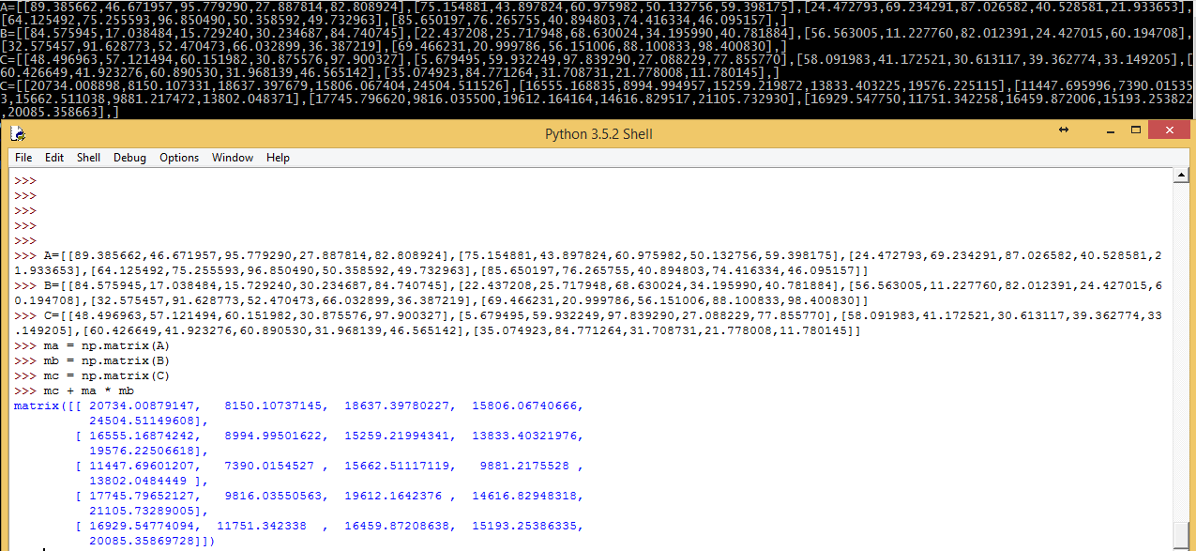
Initialization & Computation
A, B, C matrices are dynamically memory allocated and randomly initialized for various values of N
They are initialized as 1D or linearly to get better performance
To test the correctness of the code, python’s numpy package is used and compared side by side for each combination for small N

Slide 4
Execution Time
For each combination, the function is called several times to get the average execution time for that combination of any specific N
To get better precision, PAPI library’s time function is utilized

Slide 5
Gflop/s
From the execution time, flop/s is calculated:
flop/s = 2N³/execution time
Dividing it by 10⁹ gives us Gflop/s
JIK combination for N=100 has the maximum 2.945508 Gflop/s.
BigRed2’s peak performance: 4*CPU Clock=4*2.5=10

Slide 6
PAPI Events
PAPI high level events are used to analyze the reason:
{PAPI_L1_TCM, PAPI_L2_TCM, PAPI_L1_TCH, PAPI_L1_TCA}
L1 cache miss rate = L1 Total Cache Miss/L1 Total Cache Access = PAPI_L1_TCM/PAPI_L1_TCA
Miss rate of (IJK, JIK, KIJ) & (IKJ, JKI, KJI) are plotted separately as they have similar outputs

Slide 8
Conclusion
Before N=200, (IJK, JIK, KIJ) combination performed higher floating point operation/s
After N=200, they have significant cache miss rate, so Gflop/s dropped & execution rate increased
(IKJ, JKI, KJI) combination have consistent cache miss rate from N=20, so they have consistent Gflop/s

