Slide 1
Blocked Matrix Multiplication
Sharif Ahmed

Slide 2
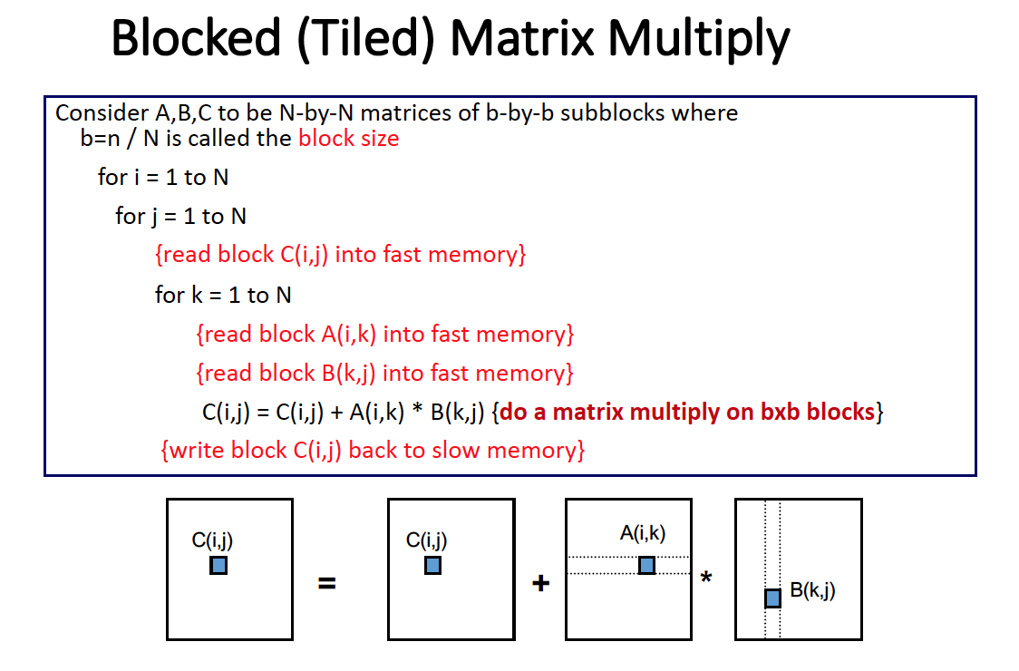
Introduction
C = C + A * B, n×n matrix
n = {64, 128, 256, 512, 1024, 2048}
Tune various block size and unrolling
Compare our result with Atlas
Try to get the peak performance of the system

Slide 3
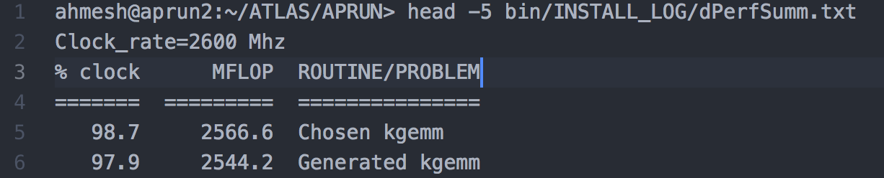
Result: Gflop
Without any optimization:
Atlas:
Block Size\n | 64 | 128 | 256 | 512 | 1024 | 2048
2 | 0.300454 | 0.29596 | 0.298676 | 0.267782 | 0.230758 | 0.209993
4 | 0.689781 | 0.675091 | 0.675181 | 0.649737 | 0.607908 | 0.542324
8 | 1.372674 | 1.340051 | 1.360913 | 1.391333 | 1.334803 | 1.229328
16 | 1.56961 | 1.894485 | 1.922354 | 1.914949 | 1.904525 | 1.886925
32 | 2.309898 | 2.519288 | 2.549315 | 2.537056 | 2.514906 | 2.500049
64 |  | 2.931054 | 3.032482 | 2.999185 | 2.993597 | 2.995418
128 |  |  | 3.199961 | 3.25736 | 3.298042 | 3.309583
256 |  |  |  | 2.771207 | 2.792233 | 2.821632
512 |  |  |  |  | 1.575882 | 1.594635
1024 |  |  |  |  |  | 1.115389
2048

Slide 4
Loop Unroll
Unroll 2, 4, and 8 for each n using the block size for which the highest Gflop can be achieved
Loop\n | 64 | 128 | 256 | 512 | 1024 | 2048
2 | 2.484772 | 3.16748 | 3.32815 | 3.50164 | 3.707563 | 3.724146
4 | 2.51947 | 3.498148 | 3.538074 | 3.833477 | 3.941247 | 3.867375
8 | 2.664133 | 3.688863 | 3.912091 | 4.173092 | 4.268849 | 4.241475

Slide 5
Optimization
With register blocking, loop unrolling, compiler (-O3)
Utilizing array (with aligned attribute) of block size 64, 128, 256
Using memcpy to copy faster memory
Block\n | 64 | 128 | 256 | 512 | 1024 | 2048
2 | 0.234813 | 0.25992 | 0.239796 | 0.223313 | 0.157726 | 0.11318
4 | 0.563708 | 0.56612 | 0.620919 | 0.566658 | 0.448263 | 0.362771
8 | 1.202967 | 1.15102 | 1.314566 | 1.221717 | 1.023949 | 0.973981
16 | 1.934057 | 2.221516 | 2.466353 | 2.449403 | 2.218825 | 2.153776
32 | 2.03991 | 3.063773 | 3.396175 | 3.494391 | 3.482738 | 3.495053
64 | 2.701503 | 3.927704 | 3.484377 | 3.580526 | 3.627009 | 3.657738
128 |  | 3.521959 | 4.218623 | 4.280858 | 4.271507 | 4.253142
256 |  |  | 3.916228 | 4.335754 | 4.356922 | 4.376038
512 |  |  |  | 3.634878 | 3.706425 | 3.767107
1024 |  |  |  |  | 1.697695 | 1.723933
2048 |  |  |  |  |  | 1.342293

Slide 6
Chart

Slide 7
Conclusion
Block size, 256 is optimal for higher input size, n
43.7% of peak performance achieved on BigRed2(10.0Gflop) without SSE code

