Slide 1
Chapter 9 (Continue)
Cover Messages

Slide 2
WRITING THE COVER MESSAGE
Writing the cover message involves matching your qualifications with the job.

Slide 3
Print Cover Letters
The following procedure is used in most successful print efforts:
  Begin with words selected to gain attention appropriately and to set up the review of information.
  Present your qualifications, keeping like information together and adapting to the company and the job.
  Use good sales strategy, especially you-viewpoint and positive language.
  Drive for the appropriate action ( request for interview, reference check, further correspondence).

Slide 4
Gaining Attention in the Opening
Gain attention and set up the information review in the opening.
Gaining attention in the opening makes the letter stand out.
Use your imagination in writing the opening. Make the opening fit the job.
Example
  In case of work that requires an outgoing personality and vivid imagination such as sales or public relations show these qualities in your opening words.
  In case of Work of a conservative nature such as accounting or banking, the opening should be more restrained.
An invited application might refer to the job and the source of invitation.

Slide 5
Continue...
You can gain attention by showing an understanding of the reader’s operations.
You can stress a need of the reader that you can fill.
Using an employee’s name gains attention.
Example:
  At the suggestion of Ms. Mary of your staff, I am sending the following summary of my qualifications for work as your loan supervisor.

Slide 6
Selecting content
Present your qualifications. Fit them to the job.
You do this by studying the job. Use all available information sources.
Include education, experience, personal qualities, references.
The emphasis each of these areas deserves varies by job. So consider the job in determining emphasis.
Do not rely too heavily on the resume. The cover message should carry all the major selling points.

Slide 7
Organizing for Persuasion
In organizing the background facts, select the best of these orders: logical grouping, time, job requirements.
Use words that present your qualifications most favorably.
  You “supervised a sales force of 14”.
Use you-viewpoint where practical.
Avoid tendency to overuse I’s, but use some.

Slide 8
Cover Letters (Interest and Good Organization in a Response to an Advertisement). Three job requirements listed in an advertisement determined the plan used in this letter.

Slide 9
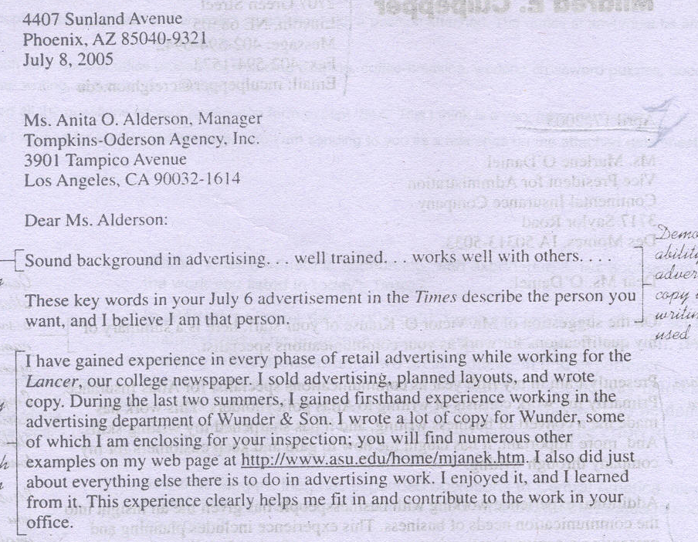

Slide 10
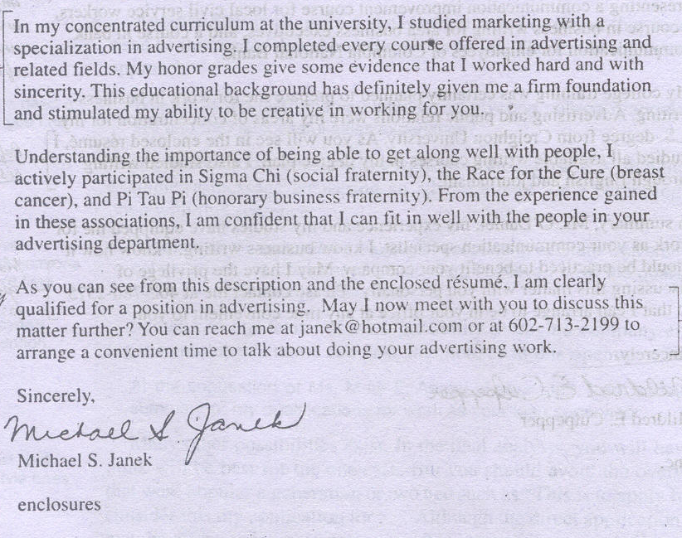

Slide 11
Cover Letters (A Straightforward Prospecting Letter Targeted and Sent as an Attached File to a Particular Receiver)

Slide 12
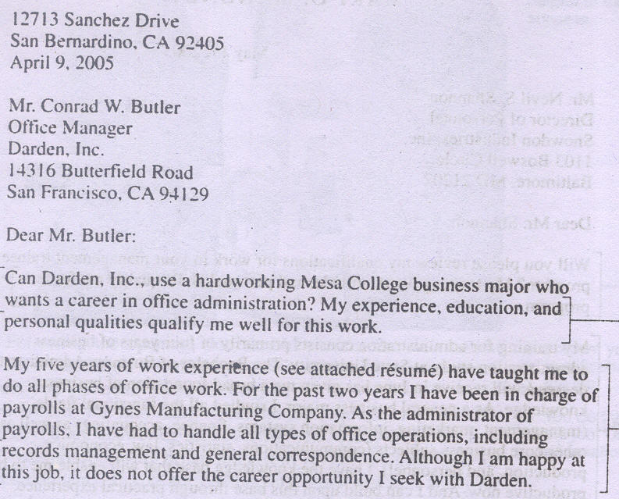

Slide 13
