Slide 1
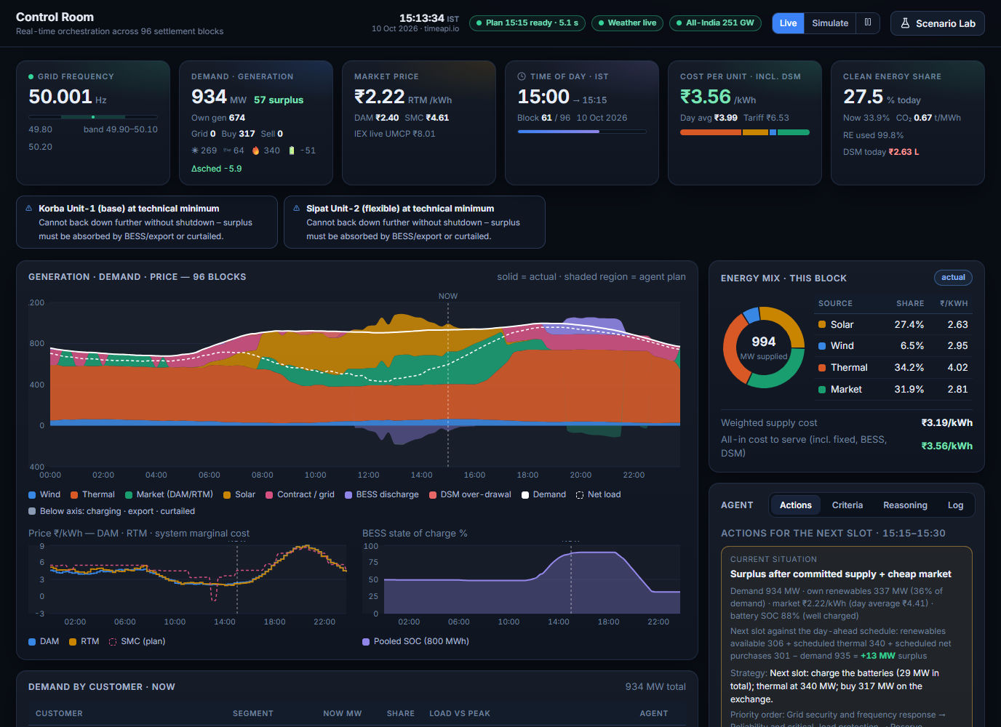
ET AI HACKATHON · PROBLEM 4
GridPilot
An agentic orchestrator for renewable-rich power dispatch in Indian DISCOMs
One optimiser that re-plans every 15-minute block, acts inside hard guardrails, and explains every decision.
96 blocks / day
Live optimiser
Scenario Lab
Team Member: Shivangi Singh
Notes:
GridPilot is an optimisation-based control room for a DISCOM. It plans the next 96 fifteen-minute blocks every block, acts within hard constraints, and explains its decisions. The screenshot is the live Control Room.

Slide 2






Problem statement
Dispatch is planned in steps, mostly by people, while renewables and prices move every 15 minutes
D-1 morning
D-1 by 10:00
Intraday
Real time
Every 15 min
Forecast and plan
Thermal commitment and contract drawal set from forecasts and experience
Day-ahead bids
Exchange volumes bid; position fixed once bids close
Real-time market
Hourly-ahead corrections, adjusted by hand
Balancing
Operators ramp units and call reserves as surprises arrive
Settlement
Deviation charged or credited (DSM); cost known afterwards
Where it hurts
Forecast error becomes cost
Every MW off schedule is settled as a deviation, often at the worst price.
Planning is slower than the grid
Decisions take hours; the system changes every block.
Fragmented tools
Weather, market, SCADA, outages and spreadsheets live apart.
One fixed priority list
The same rule of thumb on a calm day and during a unit trip.
Disturbances met reactively
A trip or cloud burst is handled after it happens; no safe rehearsal.
Decisions are hard to explain
Trade-offs between cost, reliability and renewable use are rarely written down.
Net effect: higher delivered cost per unit, avoidable DSM charges, curtailed renewable energy and operators firefighting.
Notes:
Left to right: the steps of dispatch in a simplified DISCOM. The pain points are qualitative and common to utilities with a growing renewable share; they are the design requirements for GridPilot, not statistics. Real practice varies by state and utility.

Slide 3




GridPilot: observe, decide, act and explain, every block
One closed loop that runs every 15 minutes (and instantly when something changes)
OBSERVE
DETECT
PLAN
VERIFY
ACT
EXPLAIN
Actual block from the digital twin; weather, prices, outages, events; forecasts corrected by what just happened.
Nine situations: frequency, surplus, evening ramp, price spike, battery, line limit, demand spike, forecast error, unit trip.
96-block MILP (HiGHS): unit commitment, dispatch, battery, DAM/RTM, in ranked stages.
Every plan is re-checked independently against hard limits before it is shown.
Real-time balancing, deviation settlement, cost accounting; changes vs the committed schedule.
Reason, shadow price and alternative for each action; audit trail; grounded Q&A.
what actually happened feeds the next plan
Hard constraints always hold
Priorities adapt to the situation
Humans stay in control
security, limits, ramps, minimum up/down
not one fixed ladder
autonomous or supervised, with approvals
Notes:
The same loop serves the Control Room, the planning workbench and the Scenario Lab. The plan is re-run each block, and immediately when a scenario is injected, a maintenance file is uploaded or a schedule is committed.

Slide 4
The Control Room at a glance
1
KPI cards
1
Frequency, demand with its surplus or deficit, market price, time, cost per unit incl. DSM, clean-energy share
2
Live alerts
2
Raised the moment equipment trips or a limit is reached, not at the next plan
3
3
96-block chart
Solid = actual, shaded = agent plan, stacked by source with price and battery charge below
4
Agent panel
4
Actions for the next slot, current situation, priority order, reasoning, log
5
Customers and schedule
Demand by customer with cut / deferred / disrupted pills; the 96-row schedule below
5
Notes:
Walk the screen from the top: KPI cards, alerts, the 96-block chart, then the agent panel. The surplus / deficit next to demand is demand minus own generation, grid and purchases plus sales.

Slide 5
How a decision is made
1
Situation
2
Priority profile
3
Staged optimisation
4
Verify
5
Actions and audit
What is going on? Nine event types detected from data, forecasts, asset status, prices and maintenance, each with severity, confidence and evidence.
Which objectives rank first? Profiles reorder the ladder; several events are combined by weighted rank aggregation.
Minimise objective 1, freeze it with a tolerance, then objective 2, and so on. A higher rank is never traded for a lower one.
Power balance, limits, ramps, battery dynamics, committed volumes re-derived from the result. Nothing is violated silently.
Only the changes against the committed schedule, each with reason and alternative. Full run recorded.
Nine situations the agent recognises
Frequency deterioration
Renewable surplus
Evening ramp
Price spike
Battery outage / low charge
Transmission constraint
Demand spike
Forecast error
Thermal unit failure
Notes:
The thresholds, enter and exit levels and persistence are in a policy file, so noise does not flip the profile. Hysteresis keeps an event active until it genuinely clears.

Slide 6
Priority order 1: the default ladder
1
Grid security and frequency response
Hard limits: interconnection, corridors, import / export. Always enforced first.
How the ranking is applied
Reliability and critical-load protection
Serve demand; never cut critical customers by demand response.
Lexicographic, not weighted. Objective 1 is minimised first; its result is frozen (with a small tolerance) before objective 2 is optimised.
Physical metrics at each stage: MWh unserved, MW·h reserve shortfall, MWh deviation, ₹ cost, MWh curtailed.
Security is a hard constraint, so it is never traded away.
Stages already at their lower bound are skipped, so a calm day solves fast.
2
3
Reserve adequacy
Keep upward and downward reserve sized from solar, wind and load forecast error.
4
DSM / imbalance exposure
Limit deviation from the schedule and the settlement charge it brings.
5
Delivered electricity cost
Minimum all-in cost: fuel, tariffs, market, contract, start-ups.
6
Renewable utilisation
Avoid curtailing solar and wind when it can be absorbed or stored.
7
BESS flexibility and lifetime
Use batteries where they pay; limit cycling and wear.
Notes:
This is the ladder shown in the Criteria tab. Cost sits fifth on purpose: security, reliability, reserve and settlement exposure outrank it. The weights between objectives are not tuned numbers, so a higher rank is never traded for a lower one.

Slide 7
Priority order 2: the ladder reorders with the situation
Situation | Rank 1 | Rank 2 | Rank 3 | Rank 4 | Rank 5 | Rank 6 | Rank 7
Normal operations | Security | Reliability | Reserve | DSM | Cost | RE use | Battery
Frequency deterioration | Security | Reliability | Reserve | DSM | Cost | RE use | Battery
Renewable surplus | Security | Reliability | RE use | Cost | Battery | Reserve | DSM
Evening ramp | Security | Reliability | Reserve | Cost | DSM | Battery | RE use
Price spike | Security | Reliability | Reserve | DSM | Cost | Battery | RE use
Battery outage / low charge | Security | Reliability | Reserve | DSM | Cost | Battery | RE use
Transmission constraint | Security | Reliability | Reserve | Cost | DSM | RE use | Battery
Demand spike | Security | Reliability | Reserve | DSM | Cost | RE use | Battery
Forecast error | Security | Reliability | Reserve | DSM | Cost | RE use | Battery
Thermal unit failure | Security | Reliability | Reserve | DSM | Cost | RE use | Battery
Reading the table
Security is a hard constraint and always first. Highlighted cells moved versus the normal ladder.
Surplus puts renewable use above cost.
Evening ramp and line limits rank cost above DSM exposure.
Frequency, demand spike and unit failure keep the default order but unlock demand response and restrict merchant sales.
Several events at once: profiles are merged by severity- and confidence-weighted rank aggregation, with extra weight for known interactions (for example evening ramp with a battery outage). The reasoning for each ranking is recorded.
Notes:
Profiles live in a policy file that can be edited and is validated on load; a broken file is rejected and the previous policy stays in force. Objectives a profile does not list rank after the listed ones in the normal order, which is why the table shows the full seven-step order for every situation.

Slide 8
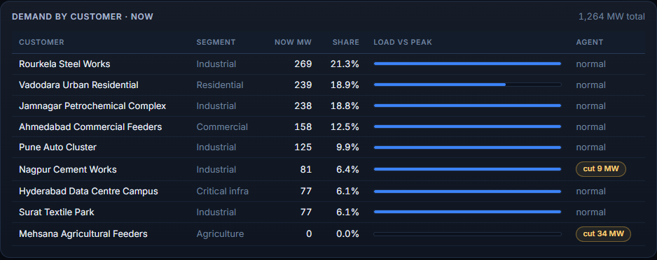
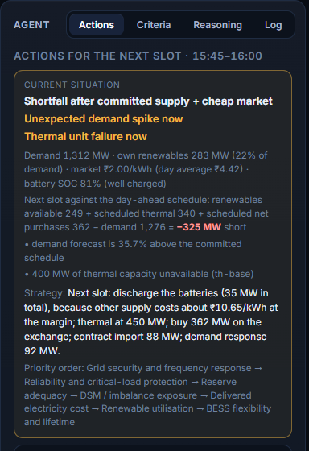
Priority order 3: what happens in a shortage
1
Ramp up thermal
Cheapest unit first, within ramp and capacity
2
Contract import and market purchases
Whichever is cheaper
3
Demand response
Cut or defer flexible and non-critical load; critical loads are never cut
4
Reserves and battery
Korba tripped and demand surged 40%
The Situation card names both events and states the strategy: discharge the battery, buy on the exchange, draw contract power, cut flexible load.
The pills "cut 9 MW" and "cut 34 MW" are the flexible customers the ladder reached.
Use the battery below its normal reserve floor
5
Curb committed exchange sales
Stop delivering sold energy; settled as a deviation
6
Last resort: disruption
Shared across all customers, flagged red
The plan releases one lever at a time, and the next only when the shortage requires it; each plan records which levels it used.
Notes:
In the screenshot Korba Unit-1 is out and demand has jumped. The agent ramps the remaining thermal, imports contract power, buys on the exchange and cuts flexible load at Nagpur and Mehsana (pills "cut 9 MW" and "cut 34 MW"). Critical customers are not cut by demand response.

Slide 9
Realistic timing: what happens now vs next interval
Block starts
Event occurs in the block
Block ends
Next block: new plan acts
Inside the current block
From the next block
Physical facts and protection only
Economic re-dispatch by the agent
Generation and demand are what they actually are
A tripped unit is lost at once; cards, customers and alerts change immediately
Plant follows its schedule; exchange and contract volumes stay fixed
Planned battery charging stops if the block is short
Over-drawal is supplied by the grid and settled as a deviation (DSM)
Emergency load cut only if limits force it
Start, stop or ramp units (after any restart time)
Buy or sell on the exchange; draw contract power
Reshape the battery plan; curtail renewables if needed
Cut or defer flexible load (shortage ladder)
Actions list shows only differences from the committed schedule
Clearing an event follows the same rule: the current block updates at once, the agent re-plans from the next block.
Notes:
This mirrors a control room: the grid reacts before the operator does. A unit trip shows on screen at once; the agent's response comes with the next re-plan. A trip is not undone the moment the fault clears: the unit also needs its restart time, shown as "available - restart pending".

Slide 10
Market timing and deviation settlement (DSM)
Two market windows
Settlement cost of one block against deviation
Day-ahead (DAM)
Scheduled 200 MW, ACP ₹6/kWh, 50 Hz. ₹ thousand per block; credit shown below zero
Bids for a delivery day close at 10:00 on the day before. After that the position is fixed and committing is refused.
Real-time (RTM)
Bids close 4 blocks (1 hour) before delivery; every re-plan can adjust blocks beyond that gate.
How DSM works in GridPilot
Allowed band: 10% of the scheduled net drawal (at least 20 MW at the 200 MW base).
Over-drawal is charged at the reference price; beyond the band the rate rises (x1.2, then x1.5) up to a ₹12/kWh cap.
Under-drawal earns a credit (about 90% of the price) inside the band only. A negative figure is a credit.
Parameters are editable; CERC DSM 2024-inspired, not settlement-grade.
Notes:
The curve is computed from the same DSM function the engine uses. Over-drawal is expensive and the cost steepens once the deviation leaves the band; under-drawal inside the band is credited, so a negative DSM total means the deviations so far earned money.

Slide 11
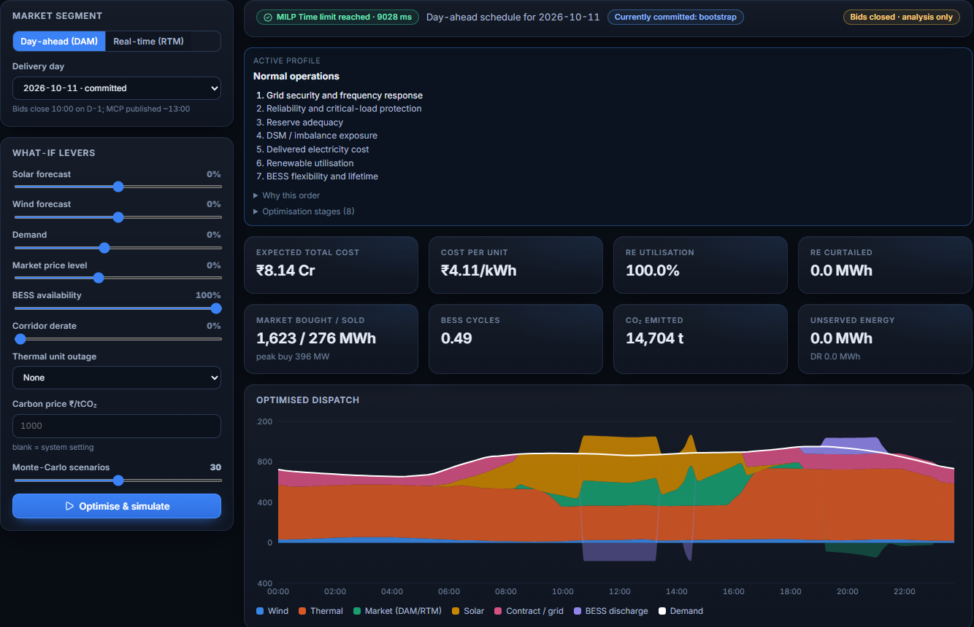
DAM / RTM planning workbench
Optimise a day-ahead or intraday schedule
Same engine as the live loop, for any delivery day.
What-if levers
Solar, wind, demand and price shifts, battery availability, a unit outage, carbon price.
Monte-Carlo risk
30 forecast-error scenarios replayed through the real-time physics: cost P10 to P90, expected DSM, minimum battery charge.
Commit bids
Day-ahead bids until 10:00 on D-1; real-time bids beyond the gate. After the deadline it is analysis only.
Notes:
The workbench shows the active priority profile and its order, the KPIs, the optimised dispatch, the bid table, the risk analysis and a block-wise schedule. Results are compared with a baseline when a lever is applied.

Slide 12
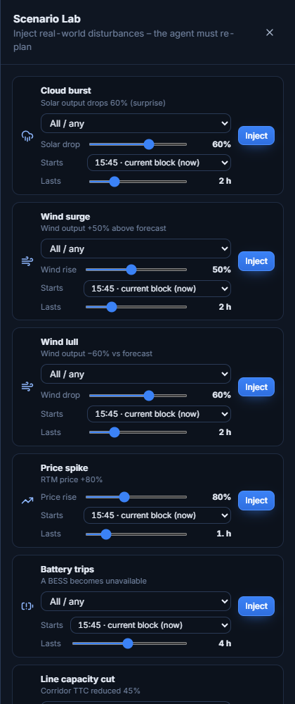
Scenario Lab: rehearse the bad day
Nine disturbances, each with magnitude, start and duration
Cloud burst
Wind surge / lull
Price spike
solar drops by a chosen %
wind rises or falls
real-time price up
Battery trips
Line capacity cut
Demand surge
one or all units
corridor limit reduced
one customer or all
Thermal unit trip
Storm alert
Forecast update
one unit or all
announced ahead
refreshed forecasts
Immediate
Honest response
Realistic recovery
An event in the current block shows on the cards, customers and alerts at once.
The agent reacts from the next block, as a control room would.
A tripped unit needs its restart time (Korba 2 h, Sipat 1.5 h, Dahej 30 min by default) before it can return.
Notes:
Scenario Lab is how operators and judges can see the agent respond: inject a Korba trip with a demand surge, watch the shortage ladder, clear it, and watch the restart-pending alert.

Slide 13
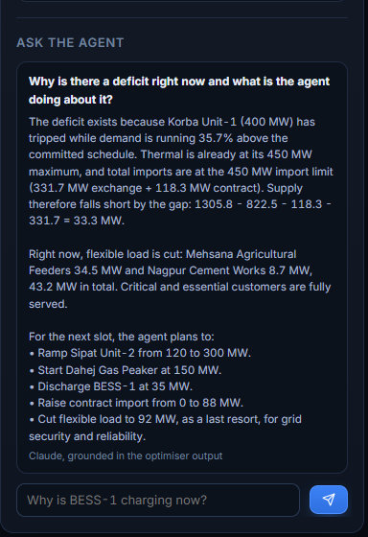
Every decision comes with a reason
Actions that matter
The list shows only what differs from the committed schedule (1 MW or more), each with its reason, criterion and the alternative that lost.
Why this order
The Criteria and Reasoning tabs show the active profile, which objective is binding, and shadow prices such as "stored energy is worth ₹9.26/kWh".
Ask the Agent
Questions are answered from the live data and the app's rules only. A figure that is not in the data is flagged. Falls back to rule-based answers.
Audit and verification
Every run records the situation, profile, binding constraints, selected actions and alternatives; every plan is independently re-checked.
Actions tab
Reasoning tab: a live answer
Notes:
Left: the Actions tab during a shortage. Next: the Reasoning tab with a live answer to "Why is there a deficit and what is the agent doing about it?" The answer is generated from the app's own data and shows its arithmetic.

Slide 14
Running today, and what comes next
Architecture and where the AI sits
Rolling planner, scenario lab, DAM/RTM workbench
Explainable agent and audit trail
Live on Railway
EXPERIENCE
Now
React 19 · Vite · Recharts
REST + live stream (SSE)
Ask the Agent
AGENT LOOP (Node 24 · Express · TypeScript, every block)
Digital twin
truth vs forecast
Situation
9 events, hysteresis
Priority profile
rank aggregation
Actions
delta vs committed
Audit
reason + alternative
Validate settings and uploads; add login
Start-up ramps for thermal units
Real feeds via an India-region data gateway
DECISION CORE
Next
Lexicographic MILP · HiGHS (WebAssembly)
Security, reliability, reserve, DSM, cost, renewables, battery: each stage frozen with a tolerance
Two worker lanes, 45 s watchdog, time limit gives an "approximate" plan
Shortage ladder: soft reserve floor, then soft sales
Independent verifier
Re-derives balance, ramps, min up/down, battery, corridors
Shadow prices (LP duals) feed the explanations
WHERE THE AI / ML IS USED
SCADA / AMI integration; real DSM bands
Multi-DISCOM, multi-region portfolios
Learning layer for demand and price forecasts
LLM
Claude: Ask the Agent only, grounded
Optimisation
MILP decides every dispatch
Expert system
rules, hysteresis, ladder
Probabilistic
Monte-Carlo, 30 AR(1) paths
Forecasting
NWP + physics + persistence
Later
Data: Open-Meteo · MeritIndia · Vidyut Pravah · IEX and maintenance CSV · state.json and audit.jsonl on disk
Notes:
Layered view. The experience layer is a React app fed by REST and a live SSE stream. The agent loop runs in Node every block: digital twin (truth versus forecast), situation assessment with hysteresis, priority profile selection, action selection against the committed schedule, and an audit record. The decision core is a staged lexicographic MILP solved by HiGHS in worker threads, followed by an independent verifier; shadow prices feed the explanations. AI and machine learning in the product: Claude is used only for grounded question answering; optimisation makes the decisions; rules form an expert system; Monte-Carlo gives risk bands; forecasts come from weather-model data, physical conversion and persistence correction, with learning-based forecasting on the roadmap. The app is deployed on Railway and runs locally.

Slide 15
AI models and technologies used
Capability | Technique | What it does here | Technology
Dispatch optimisation | Lexicographic MILP, seven ranked stages | Unit commitment, dispatch, battery and DAM / RTM over 96 blocks; a higher rank is never traded for a lower one | HiGHS (WebAssembly) in worker threads
Forecasting | Weather-model data, physics, persistence | Solar and wind MW from irradiance and wind speed; later blocks scaled by recent error | Open-Meteo NWP, PV and power-curve models
Situation detection | Rule-based expert system with hysteresis | Nine event types, each with severity, confidence and evidence | TypeScript policy engine, JSON policy file
Priority selection | Weighted rank aggregation | Blends the profiles of all active events into one ranking, with interaction boosts | Policy engine
Risk | Monte-Carlo, 30 correlated AR(1) error paths | P10 to P90 cost, expected DSM, minimum battery charge for a plan | Real-time physics replay
Verification | Independent constraint re-check | Balance, ramps, minimum up / down, battery, corridors re-derived from every result | Separate verifier module
Explanation | LP shadow prices and audit trail | "Stored energy is worth ₹x" and the alternative that lost, for every action | HiGHS duals, audit log
Conversation | LLM grounded on live data | Ask the Agent answers only from the app's data; unverified figures are flagged; rule-based fallback | Claude Sonnet 5.5 (Anthropic API)
The optimiser decides; the LLM only explains. Every dispatch comes from the verified MILP, never from a language model. Stack: Node 24, TypeScript, Express 5, React 19, Vite, Recharts, Leaflet, server-sent events.
Notes:
Where AI is used, honestly: optimisation makes the decisions; an expert system detects situations; Monte-Carlo gives risk bands; forecasts come from weather-model (NWP) data converted by physics and corrected by persistence; Claude is used only for grounded question answering. Learning-based forecasting is on the roadmap. HiGHS is an open-source LP / MILP solver.

Slide 16
Business impact
Measured on the app's simulated day (portfolio of 1,240 MW peak demand)
97%
100%
₹4.10
0.68
renewable energy used
reserve adequacy
delivered cost per kWh
t CO₂ per MWh
only 117 MWh curtailed so far
every block held its sized reserve
incl. DSM, against a ₹6.53 average tariff
with 28% clean-energy share
What it could be worth: illustrative annual sizing
Beyond the rupees
Lever | Simulated base | If improved by | Annual value
Delivered cost per unit | ₹2,900 crore a year | 1% lower | ₹29 crore
DSM charges | ₹101 crore a year | 10% lower | ₹10 crore
Curtailed renewable energy | 60 GWh a year | half recovered | ₹12 crore
Faster response: a re-plan every block instead of a few times a day
Fewer surprises: forecast error carried as risk bands and reserve, not discovered at settlement
Auditable decisions: reason, alternative and binding limit for every action
Safer renewable growth: a place to rehearse trips and storms before they happen
Scaled from this simulated day to a full year. These are sizing examples, not measured savings: a real figure needs the DISCOM's own baseline.
Notes:
Measured figures come from the running app's simulated day: renewable utilisation 97%, reserve adequacy 100%, delivered cost 4.10 rupees per kWh against an average tariff of 6.53, carbon intensity 0.68 t per MWh. The sizing table scales the simulated day (about 19,400 MWh a day, 7.1 TWh a year at 4.10 rupees per kWh) and applies assumed improvements; it is arithmetic, not a measured saving. 1% of 2,900 crore is 29 crore; 10% of 101 crore DSM is 10 crore; half of 60 GWh curtailed at 4.10 rupees is about 12 crore.

Slide 17



Scalability
Bigger portfolios
scale up
More DISCOMs
scale out
More data and markets
scale across
Median re-plan 1.7 s, p95 4.1 s for 11 generators, 2 batteries, 9 customers and 4 corridors
Calm days skip ranked stages already at their bound, so most solves are fast
Two solver lanes, a 45 s watchdog and an "approximate" plan if the budget runs out
Next: split the model by corridor, and swap in a commercial solver for very large fleets
One instance per utility, each with its own portfolio, policy file and data
Priority profiles, thresholds and DSM parameters are configuration, not code
Next: multi-tenant service with a shared database and a login in front
Data connectors are adapters that fail soft and label their status
Next: SCADA and AMI feeds, exchange APIs, several weather models and ensembles
Next: state markets, ancillary services and carbon pricing as extra objectives
Built today
Rolling 96-block planner, worker-thread solver, verified plans, audit log, policy file, soft-failing data feeds, live deployment on Railway
To add for production
Login and roles, input validation, database instead of a state file, more than one replica, SCADA and AMI links, real DSM bands
Notes:
Scaling is honest: today one process serves one DISCOM, which is right for a pilot. Solve time is the main limit as portfolios grow, which is why stage skipping, two solver lanes and a watchdog already exist. The route to many utilities is configuration per DISCOM (portfolio, policy, data), a shared database, authentication and several instances.

Slide 18
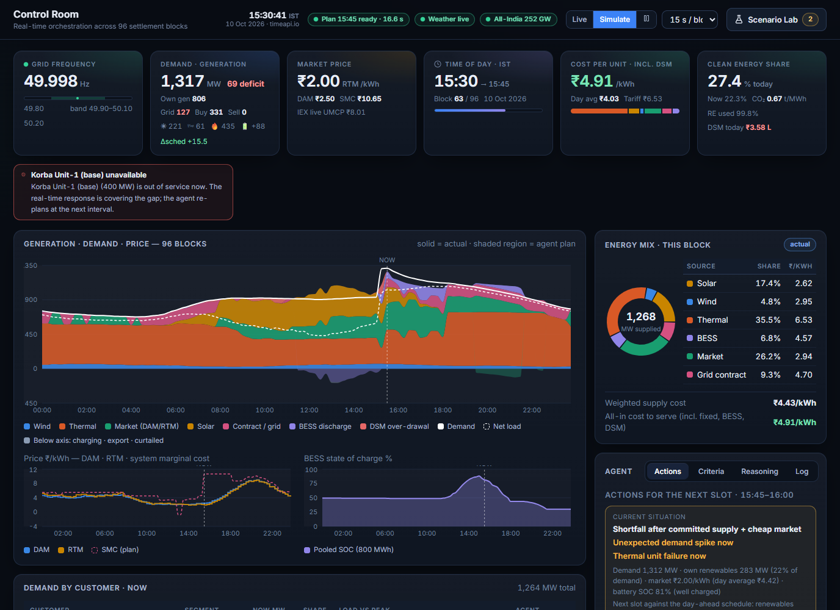
Thank You!
GridPilot turns a renewable-rich, uncertain grid into a plan that is cost-aware, reliable, auditable and fast.
LIVE APP
https://gridpilot-production-2fe6.up.railway.app
SOURCE
github.com/sharifa2708/GridPilot
Notes:
Close with the live Control Room during a shortage: Korba tripped, demand surging, the agent buying, importing and cutting flexible load, and every action explained.

Slide 19
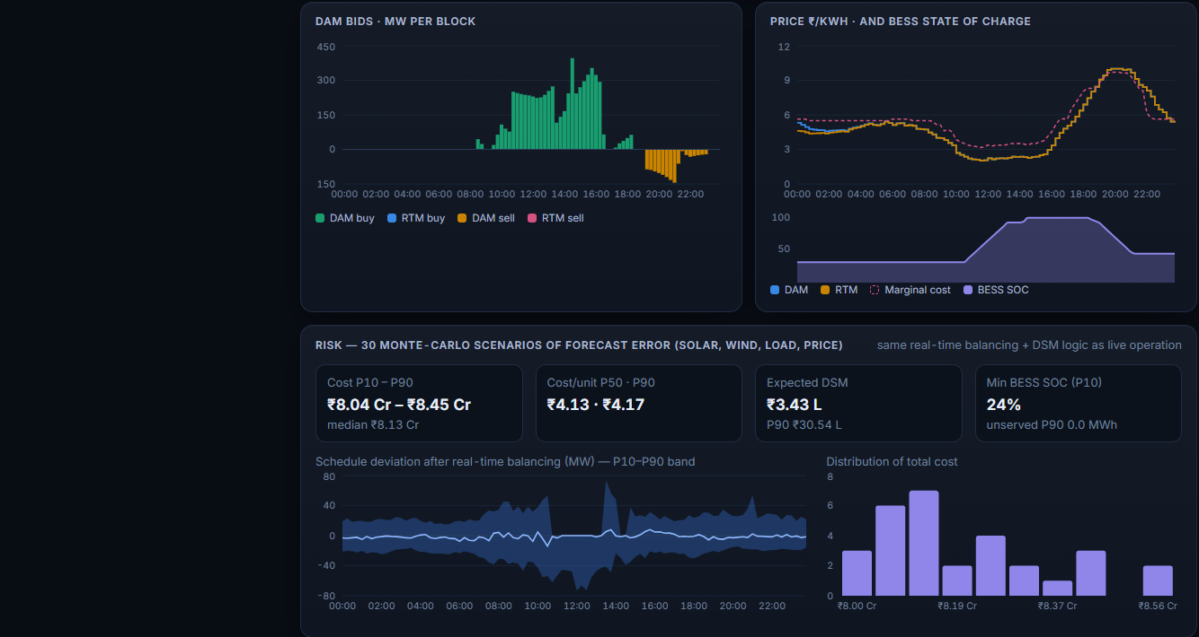
Where GridPilot sits: D3 and F3
D3
Decision autonomy, level 3
F3
Foresight, level 3
The agent decides and acts inside guardrails; people handle exceptions.
Probabilistic, rolling look-ahead rather than a single point forecast.
Hard constraints re-checked on every plan before it is shown
Autonomous or supervised mode; demand response and maintenance changes can require approval
Each action carries its reason, criterion and the rejected alternative
Full audit trail of situation, profile, binding constraints and selection
96-block horizon re-planned every block with persistence-corrected forecasts
Reserve sized from solar, wind and load forecast error
Monte-Carlo risk (P10 to P90) for DAM and RTM plans
Storm alerts and scenario events anticipated in the plan
Seen in the product: the agent acts, and the pills show exactly whom it reached
Seen in the product: Monte-Carlo risk bands (P10 to P90) around every plan
Labels D3 and F3 are our reading of the framework: relabel them to match your rubric. The evidence on this slide stays the same.
Notes:
ASSUMPTION: the meaning of D3 and F3 was not provided, so this slide interprets them as Decision autonomy level 3 and Foresight level 3. Edit the headings and subtitles to the rubric's wording; the evidence bullets are the real capabilities of the app.

Slide 20
Data inputs
Input | Source | Used for | Status
Weather: irradiance, wind, temperature, storms | Open-Meteo (free, per asset location) | Solar and wind MW, cooling-driven demand, storm risk | LIVE
All-India demand and generation mix | MeritIndia public dashboard | National stress index scaling the price level | LIVE*
Frequency and IEX clearing price | Vidyut Pravah public dashboard | Reference price shown beside the model | LIVE*
Day-ahead / real-time prices | Calibrated IEX shape + forecast error; IEX MCP file upload | Market purchases, sales, battery value, DSM reference | MODEL / UPLOAD
Maintenance and outage plan | CSV / XLSX upload (template provided) | Derates and outages in the plan; agent proposes cheaper windows | UPLOAD
Portfolio: assets, customers, corridors, limits | Portfolio page (editable) | Capacities, ramps, minimum run, tariffs, criticality, flexibility | CONFIG
Rules: DSM, market, reserve, policy | Settings page and policy file | Bands, rates, objective profiles, thresholds | CONFIG
Clock | Internet time source, system clock fallback | Live blocks in IST | LIVE
* Public dashboards: reachable from Indian networks; from other regions the app falls back to its modelled values and keeps running.
Notes:
Real where possible, honest where not. Grid-India reports and IEX have no open API, so they are loaded through uploaders. If a live source is unreachable the app keeps running on modelled values and says so on the Data Sources page.

Slide 21
Assumptions
Market and settlement
Priority order
15-minute blocks, 96 per day, all times IST
DAM bids close 10:00 on D-1; RTM gate is 4 blocks
DSM is CERC-2024-inspired and parameterised, not settlement-grade
Price cap ₹10/kWh; exchange fee, buy adder and sell deduction as configured
Security is a hard constraint, always first
Default ladder: security, reliability, reserve, DSM, cost, renewable use, battery
Profiles in a policy file reorder it; edits are validated, not live-edited in the UI
Critical customers are never cut by demand response
Plant and grid
Data
Frequency modelled at 50 Hz, moved only by the DISCOM's own over/under-drawal (10,000 MW per Hz)
Plant follows its schedule inside a block; re-dispatch waits for the next block
A tripped unit needs a restart time before returning
Portfolio, demand profiles and tariffs are representative, not a specific DISCOM's data
Weather is real; demand and prices are modelled from calibrated shapes with forecast error
IEX and Grid-India files are loaded by upload (no open API)
Forecast error is correlated noise plus a day-level bias
Customer criticality and flexibility are configuration inputs
Notes:
These are the assumptions a reviewer should know. The most important are: DSM parameters are indicative, frequency is simplified to 50 Hz, and the portfolio is representative.

