Slide 1

Sourabh Bhagat Graduate Student, CS
sourabhb@buffalo.edu
Sharif Niyaz, Mohammad
Graduate Student, MIS
sharifni@buffalo.edu

Slide 2

Problem
Students spends their precious time trying to find answers on website(s)
Frustrate and overwhelm
Service Employees answering routine queries.
Decrease employee satisfaction and overall staff retention

Slide 3

Solution
Chatbots Act as a guide for finding information
Can helps ameliorate student concerns, and decrease general anxiety
Helps service employees - offload mundane tasks

Slide 4
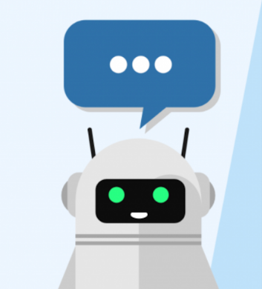
Edubot is a customer service chatbot focused on serving needs of higher Ed administrators.
Edubot makes lives of University organization and their students easier.

Slide 5
Features
Auto response to queries based on Machine Learning and AI
Admissions
Career Services
Financial Aid
Around the clock customer service
Continuous Learning
Reduced Staff burden
Analytics
Notes:
rename this to features

Slide 6
Target Customer
Target
Stats
4500 Colleges and Universities
9 % of US GDP is spent on education
Colleges
Market Size
Market
The US admissions market is approximately $2 billion
Second largest market behind healthcare in the US
Universities
High Schools
Reference: https://www.whitehouse.gov/sites/default/files/unleashing_the_potential_of_educational_technology.pdf

Slide 7
Target Market
37000 high schools
4500 Universities across USA
Assuming $1200 per institute,
TAM = $ 740 million
Assuming 30% of schools and 30% of universities SAM = $200 million
25% of this available market is our
Target market = $ 50 million
Total Available market $ 740 million
Serviceable Available $ 200million
Available
$50 million

Slide 8
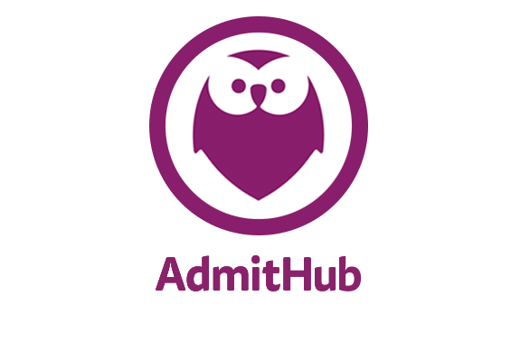

Competitor Analysis
Metric | Edubot | Admithub | Ivy.ai
Analytics | No | Yes | Yes
Application Review | No | Yes | No
Price/university | Low (75,000$/yr) | High (450,000$/yr) | Low (70,000$/yr)
User Registration | With/without | Mandatory | Mandatory
Personalized Answer | No | Yes | No
Customers | None | 10 | 8
Notes:
Employees : Admithub: 29, ivy.ai : (11-50)
Market Share : Admithub : 10%, 4%
Price : Admithub : (15-25$ per student)500,000$/yr, Ivy.ai: (1$ student)(43,000$/yr)

Slide 9
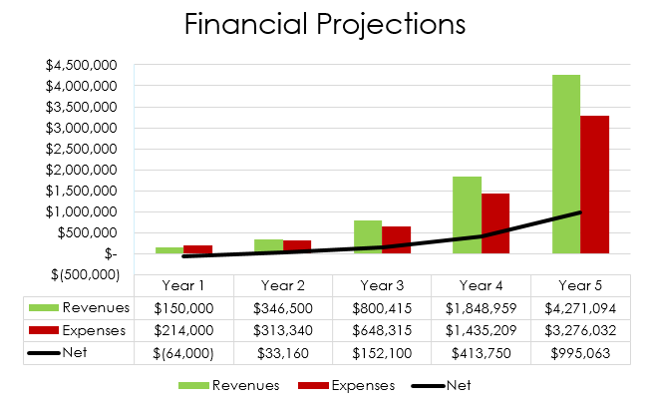

Slide 10
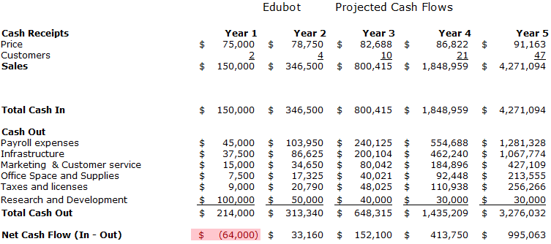

Slide 11
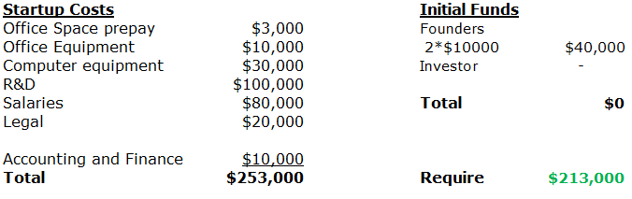
Funds Needed

Slide 12
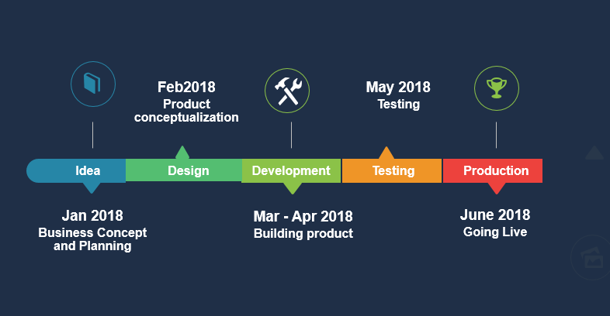
Milestones

Slide 13
thank you

