Slide 1
Cyber Attacks, Threats and Vulnerabilities
Dr. Risala T Khan

Slide 2

Different Types of Attacks

Slide 3
Understanding Social Engineering
The first type of attack is known as a social engineering attack.
Social engineering involves the hacker trying to trick an employee into compromising security through social contact such as a phone call or e-mail message.
Most times the hacker will act as if they need help, exploiting the fact that most people will offer help.
A lot of times the hacker is just trying to collect information to help them perform an attack later on, but the hacker may try to trick an employee into divulging usernames and passwords used on the network.

Slide 4
Popular Social Engineering Attacks
IMPERSONATION:
The most popular scenario for social engineering attacks is when the hacker impersonates another employee in the organization.
In the following scenarios, the hacker impersonates an employee in the company who needs some help:
Hacker impersonates Administrator:
A very popular example of a social engineering attack is when the hacker calls a user and impersonates the network administrator.
In this scenario the hacker, posing as the administrator, tries to trick the user into compromising security by asking the user to do things such as changing their password or giving away account information.
The hacker also may ask the user questions about the general setup of the systems.
Hacker impersonates user:
The hacker calls the network administrator pretending to be a frustrated user. In this scenario the hacker will pretend they do not remember their password or how to get onto the system.
An unaware administrator may help the hacker, who is acting as a frustrated user, gain access to the system by resetting a password and guiding them through the process of gaining access.

Slide 5
Popular Social Engineering Attacks(Cont..)
Hacker impersonates management
If the hacker knows the name of personnel on the management team, the hacker may call employees within the company and impersonate management.
The hacker will ask the unsuspecting employee to perform actions that will essentially compromise the security of the systems or the environment so that the hacker can gain access later.

Slide 6
Popular Social Engineering Attacks(Cont..)
PHISHING:
Another popular scenario for a social engineering attack is known as a phishing attack.
With a phishing attack, the hacker typically e-mails a user and pretends to be a representative from a bank or a company such as eBay. The e-mail typically tells the user that a security incident has occurred and that the user should click the link provided in the e-mail to navigate to the site and check their account status. For example, the e-mail typically looks like it is coming from the security officer for a bank, asking the user to follow the link provided and to log in to the bank site to check their account. The e-mail continues by asking them to report any suspicious transactions to the security officer, with the contact details provided to make the e-mail look authentic.
In this example, the hyperlink that the user is tricked into clicking navigates to a site that the hacker has set up to look like the bank site.
The hacker is waiting for the user to try to log on with their account number and password so they can capture it and then store it in a database.

Slide 7
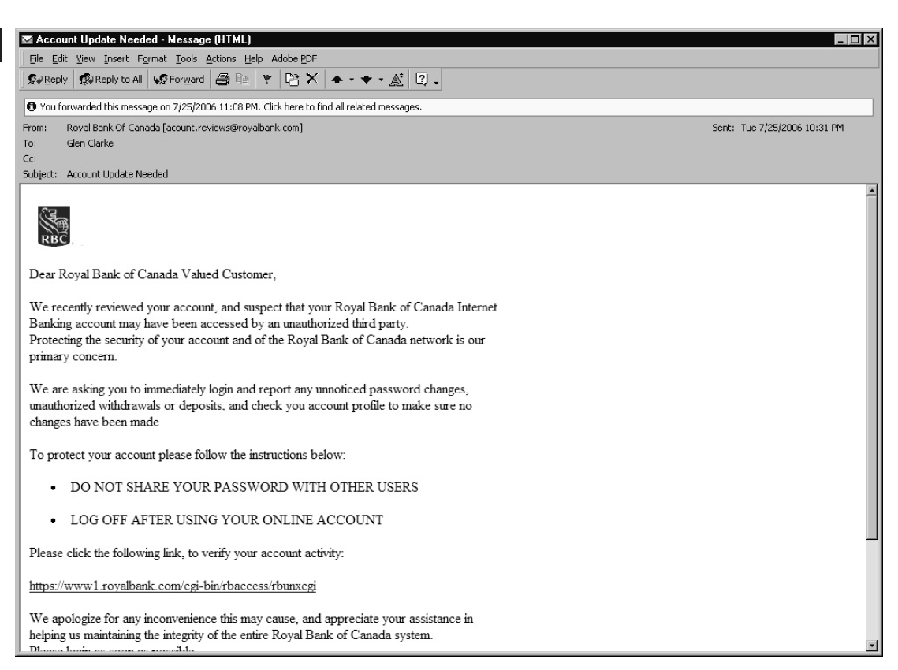
Popular Social Engineering Attacks(Cont..)
Figure displays a sample e-mail trying to trick into clicking a link that appeared to come from the bank.
One of the things you can do to help prevent users from going to a phishing site is to instruct them to always verify the URL the link is pointing to before clicking the link.
For example, in most e-mail programs, if you hover over a link, you will see the actual URL pop up as a tooltip, displaying to you the target of the link.
Users should also compare the display name of the sender to the actual e-mail address for that display name to see if they match.
Also watch for spelling mistakes and bad grammar as another indication that the message could be a social engineering attack.

Slide 8
Popular Social Engineering Attacks(Cont..)
WHALING AND VISHING
A form of phishing attack that has become popular over the last few years is the whaling attack.
Whaling attacks are similar to phishing attacks in that the goal is to send an e-mail to trick someone into giving out their account name and password to sites masquerading as a bank or eBay.
But whaling differs in that instead of sending an e-mail to everyone, the hacker sends the e-mail to a specific person (“the big fish”) who may have a lot to lose from the attack.
The whaling victim is usually an executive for a company, and the hacker typically obtains their name from the company web site and personalizes the e-mail using the name of the executive.
Another popular form of phishing attack is the vishing attack. Like phishing, vishing tries to trick people and steal money from them.
The difference is that with vishing, the contact is made with a phone call instead of an e-mail message.
The term vishing comes from the fact the hacker is using “voice” and “phishing” techniques.
A popular example of vishing is when you receive a phone call from a company claiming to be able to extend your car warranty if you pay a certain amount of money. In this example, you give the money, but you don’t get an extended car warranty

Slide 9
Other Social Engineering Attacks
Smishing
Smishing is a form of phishing attack that involves the hacker sending text messages to a potential victim. The hacker typically impersonates a company that the intended victim would trust in order to trick them into compromising security by exposing sensitive information such as passwords or credit card numbers.
Spim
Spim gets its name from “spam over instant messaging” and is often written as spIM. Typically, instant messenger IDs are learned by the hacker using a bot (a piece of software crawling across the Internet looking for IM login names). The bot then sends the user an instant message asking them to click the hyperlink sent.
Spear phishing
A type of phishing (form of social engineering) attack where the e-mail message sent is spoofed and looks like it comes from a trusted source such as a fellow employee. The e-mail message tries to get the recipient to divulge sensitive information.

Slide 10
Spam
Spam involves sending the same unsolicited e-mail message to a number of people. Spam messages are typically sent in hopes that the receiver of the spam message will buy a product or service from the sender of the message. Most e-mail servers now have spam filters in place that help protect the system from receiving a large number of unsolicited e-mail messages.
Eliciting information
Eliciting information occurs when the attacker uses social engineering techniques to obtain information from a user that could be used in a future attack.
Prepending
Prepending is when information is added to the beginning of malicious data. For example, the attacker may get you to click a link that is www.banksite.com@192.168.2.1, where the browser would ignore everything to the left of the @ sign.

Slide 11
Identity fraud
Identity fraud is when the attacker is able to steal identity information, such as a Social Security number or credit card number, and then use that information. For example, after stealing a victim’s credit card number, the attacker then uses it to make a purchase.
Invoice scams
An invoice scam is when the attacker sends out an e-mail message notifying you that your invoice payment is overdue and immediate payment is required. When you click the link to pay for the invoice, you are either sent to a malicious site or a invoice document opens that runs malicious code.
Credential harvesting
Credential harvesting is when the attacker collects logon information and then uses that information later to access your account.

Slide 12
Reconnaissance
Reconnaissance is when an attacker spends time researching and collecting information about the intended target before deciding how they are going to attack. Reconnaissance involves searching public information available on the Internet about a company and also performing ping sweeps and port scans to discover the systems that are up and running and the services running on each system.
Influence campaigns/hybrid warfare
Influence campaigns are designed to use tools such as social media to create fake accounts as well as fake posts that are designed to sway the views of the public. Hybrid warfare involves using traditional military tactics and nontraditional military tactics, such as organized crime, terrorism, and using civilians for tasks such as propaganda, during a time of conflict.
For the exam, be sure to know the difference between phishing, smishing, vishing, spim, spear phishing, credential harvesting, and spam. You are sure to be tested on these attack types!

Slide 13
Shoulder Surfing and Dumpster Diving
Shoulder surfing is when the hacker tries to view confidential information or information that may help the attacker compromise security by looking over employees’ shoulders to see information either on their desk or on the computer screen.
Dumpster diving is a popular attack where the hacker goes through the victim’s garbage looking for documents or information that could facilitate an attack. The hacker might find information that can help them perform a social engineering attack through a phone call or an in-person discussion, or the hacker could simply locate a password someone wrote down and threw in the garbage.

Slide 14
Tailgating
Tailgating is another important social engineering attack, but it is more of an attack against physical security.
Tailgating is when the hacker walks through a secure area by closely following an authorized person who has unlocked the door using their swipe card or passcode. The hacker may strike up a conversation with the person they are tailgating in order to distract the employee from the fact that the hacker (actually, we call someone who compromises physical security an intruder) has entered the facility without swiping their card or entering their own personal identification number (PIN).
It is important to educate employees on tailgating and to make sure they know it is their responsibility not to open the door if someone is hanging around nearby. Also let employees know that if they swipe their card or input their passcode to unlock the door, it is their responsibility to inform anyone else wanting to enter that they have to swipe their own card or enter their own passcode after the door locks again.
Most people do not feel comfortable saying, “Sorry, you have to wait for the door to close and then swipe your own card,” so as a security professional you may be required to implement security controls to help protect against tailgating.
The most effective way to control tailgating is to create a mantrap, which is an area between two locked doors. The idea of a mantrap is that the second door will not open until the first door is closed, which enables any authorized person who enters the mantrap to notice if anyone is entering the facility with them.

Slide 15
Hoaxes
E-mail hoaxes are e-mail messages that users receive giving a false story and asking the user to take some type of action.
For example, the hoax could say a certain file is causing a serious flaw in the operating system. The e-mail could tell the reader they should delete the file, but in reality there is nothing wrong with the file, and it may be needed for information on important features of the operating system.
If you receive an e-mail that makes certain claims you are unsure of, be sure to do some research on the Internet to validate or discredit the information presented in the e-mail.

Slide 16
Physical Attacks
Physical attacks involve getting physical access to a system or device and gaining access to the device or performing malicious actions against it. The following are some common forms of physical attacks:
Malicious Universal Serial Bus (USB) cable
A malicious USB cable is a type of cable the hacker connects to the system that can then receive commands from the hacker wirelessly as a mechanism to exploit the system.
Malicious flash drive
A malicious flash drive is a USB drive that contains malware that executes on the victim system once the flash drive is connected to the USB port of the system.
Card cloning
Card cloning is when the attacker copies the card information off the magnetic strip of a card and places it on a blank card so that they can use the new card to make purchases or whatever the data is on the card.
Skimming
Skimming is when you swipe your card into a device, the attacker extracts information from the magnetic strip and potentially captures you inputting the PIN for the card. At a later time the hacker will then sell the captured information or use it to make their own card.

Slide 17
Adversarial Artificial Intelligence
Artificial intelligence (AI) is a growing field today, where the AI system is constantly learning and making decisions based on its goals and information learned.
From a security point of view, AI is used with intrusion detection to watch activity and identify anything that is out of the norm.
Machine learning (ML) technologies may be vulnerable to adversarial artificial intelligence attacks, where the attacker sends malicious input to the machine learning system in order to compromise it.
The principle here is that the machine learning system uses models of data to train the system, and if the attacker can give malicious input to the learning system, it may be learning based on tainted training data for machine learning.
This can also be used by security testers to test the security of the machine learning algorithm
Notes:
Tainted training data is a type of attack in which the attacker intentionally provides incorrect or biased data to the machine learning model during the training phase. This can lead to the machine learning model making incorrect predictions or decisions, leading to security or privacy vulnerabilities.

Slide 18
Supply-Chain Attack
The supply chain of a business involves any vendors or activities that are needed to get the goods into the hands of the customers.
For example, a home builder may get its wood deliveries from the lumber yard, so the lumber yard is part of the supply chain for the home builder.
A supply chain attack is when the attacker targets elements of a company’s supply chain, preventing the company from supplying services.
Another scenario for supply-chain attacks is if a company does a great job at securing its assets and the attacker cannot compromise those assets, the attacker may choose to attack resources in the supply chain, knowing that the compromised item will be delivered to the company through the supply chain.

Slide 19
Cloud-based vs On-premises Attack
A cloud-based attack is an attack focused on the cloud services provided to a company.
For example, an attacker may use malicious software that deletes data from cloud storage of a user.
On the other hand, an on-premises attack is focused on attacking the resources of a company that are located in its offices or on its local area network (LAN).

Slide 20
Reasons for Effectiveness of Social Engineering Attacks
There are a number of reasons why people are susceptible to social engineering attacks and why such attacks are so effective on most people. Because people may have not heard of some of the different social engineering techniques, they may not be prepared for these situations.
The following list highlights the principles of social engineering and identifies key reasons for a hacker’s success with social engineering:
Authority :Most of the time the hacker impersonates a person of authority, which makes the victim believe they should do what the hacker says.
Intimidation: The victim may be intimidated by the message the hacker is relaying, so the victim does exactly what the message says.
Consensus/social proof: The hacker usually presents some facts known to the victim (and hacker) to act as proof that what the hacker is saying is true and can be trusted.
Scarcity: Scarcity is when the attack comes in the form of an e-mail, web site, or even a call, where the hacker makes the victim feel they need to click the order link now, as they have a limited amount of time to take advantage of a great deal!
Urgency: The hacker usually has a sense of urgency in their e-mail or voice that makes the victim feel they should fix the problem right away, so the victim doesn’t really think of the security impact.
Familiarity/liking The hacker may use a friendly tone and be very sociable, which makes the victim tend to like them and want to help.
Trust: It is in our nature to trust people who appear to be in need of help.

Slide 21
Preventing Social Engineering Attacks
It is important to understand not only a specific attack but also how you can protect yourself and your organization from such an attack.
When it comes to social engineering attacks, the only way to protect yourself and the organization’s employees is through training and awareness.
Make sure that as part of your training and awareness program you educate employees on the popular scenarios for social engineering attacks. Make sure that all employees, including users, management, and network administrators, know they are susceptible to social engineering attacks.
Ensure that you have a method—known to all employees—to validate anyone who calls stating they are the network administrator and asking employees to change their password.
Most companies will have a secret question that the user can ask the person on the other end of the phone, and if the individual knows the answer, then the user will know that the other person is someone who should be calling and requesting the change.
Ensure that employees understand what a phishing attack is and that they should delete any e-mails they receive asking them to click a link and log on to a site. This includes e-mails that appear to come from their bank, e-mail provider, PayPal, eBay, and so forth

Slide 22

NETWORK ATTACKS

Slide 23
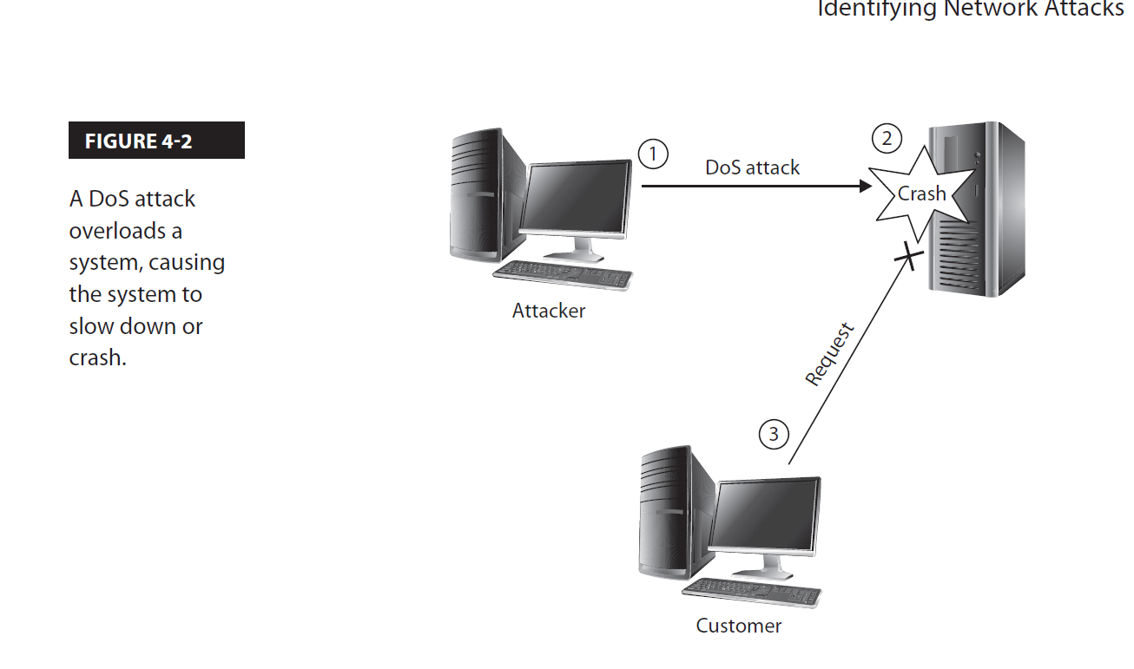
POPULAR NETWORK ATTACKS
Denial of Service
A DoS attack involves the hacker overloading a system with requests so that the system is so busy servicing the hacker’s requests that it cannot service valid requests from other clients
(see Figure 4-2). For example, a hacker could overload a web server with numerous network requests, making the web server unable to send the web pages to customers in a timely manner.
This typically results in the customer going to a different site to get adequate service.
With a DoS attack, the attacker could be causing the target network to perform slowly, or the hacker could crash the victim’s system, causing it to be unavailable

Slide 24
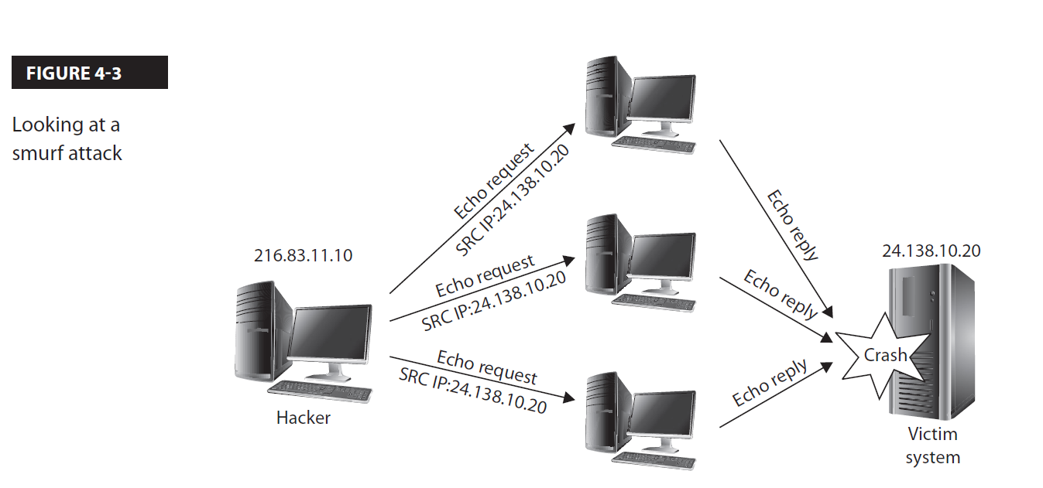
Distributed Denial of Service
A distributed denial of service (DDoS) attack is when the hacker uses a number of systems to perform the attack, which helps the hacker create a large number of requests.
With a DDoS attack, the hacker first compromises and takes control of a number of systems and then uses those systems to help with the attack.
The compromised systems are known as zombie systems because they have no mind of their own and will do whatever the hacker tells them to do.
A very popular example of a DDoS attack years ago was the smurf attack, which involved the hacker sending ping (ICMP) messages to a number of systems, but also spoofing the source IP address of the packets so that they appeared to come from the intended victim
(see Figure 4-3). All of the systems would then send their ICMP replies to the victim system, overburdening it with traffic and causing it to crash.

Slide 25
DDoS Attack (cont..)
There are different types of DDoS attacks:
Network: A network-based DDoS attack involves using up network bandwidth or consuming the processing power of network devices so that the network becomes unresponsive or performs poorly.
Application: An application DDoS attack involves flooding a specific software application or service with requests to cause it to crash or become unresponsive.
Operational technology: An operational technology attack is a DDoS attack against hardware or software that is required to run industrial equipment.

Slide 26
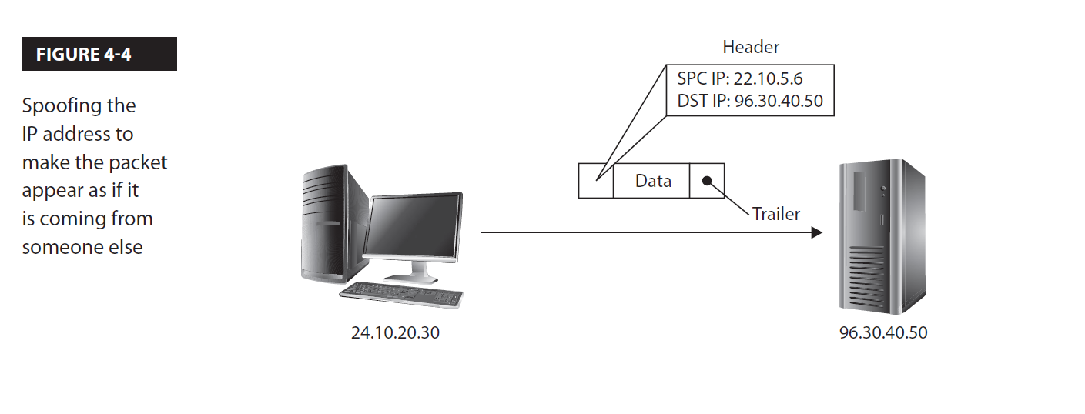
Spoofing
Spoofing is a type of attack where the hacker alters the source address of information to make the information look like it is coming from a different person.
Spoofing is sometimes referred to as refactoring.
A few types of spoofing follow:
IP spoofing: When the source IP address of a packet is altered so that it appears as if the packet comes from a different source (see Figure 4-4).
MAC spoofing: When the source MAC address of a frame is altered so that it appears to have come from a different system or device.
E-mail spoofing: When the “from” address of an e-mail message has been altered so that the e-mail looks like it comes from someone else. This is normally used in a social engineering attack.

Slide 27
It is important to note that the hacker may spoof a frame or a packet in order to bypass an access control list.
For example, most wireless networks implement MAC filtering, where only certain MAC addresses are allowed to access the wireless network. Once the hacker finds out what MAC addresses are allowed on the network, they then spoof their MAC address to look like one of those addresses.
A hacker may also spoof the IP address to bypass a filter on a router that only allows traffic from specific IP addresses to pass through the router.
The following are examples of programs that can spoof packets:
Nemesis A Linux packet-crafting program that creates different types of packets such as ARP and TCP packets.
Hping2 A Linux packet-crafting program that is used to create ping packets that use TCP instead of ICMP packets. Here’s an example of using hping2 to bypass a firewall that is blocking ICMP traffic:
hping2 –c 3 –s 53 –p 80 –S 192.168.2.200
Macchanger A popular Linux program used to modify your MAC address on the system. Macchanger is a common program used by hackers to spoof their MAC address in order to gain access to the wireless network. Here’s an example:
macchanger --mac 11:22:33:44:55:66 wlan0

Slide 28
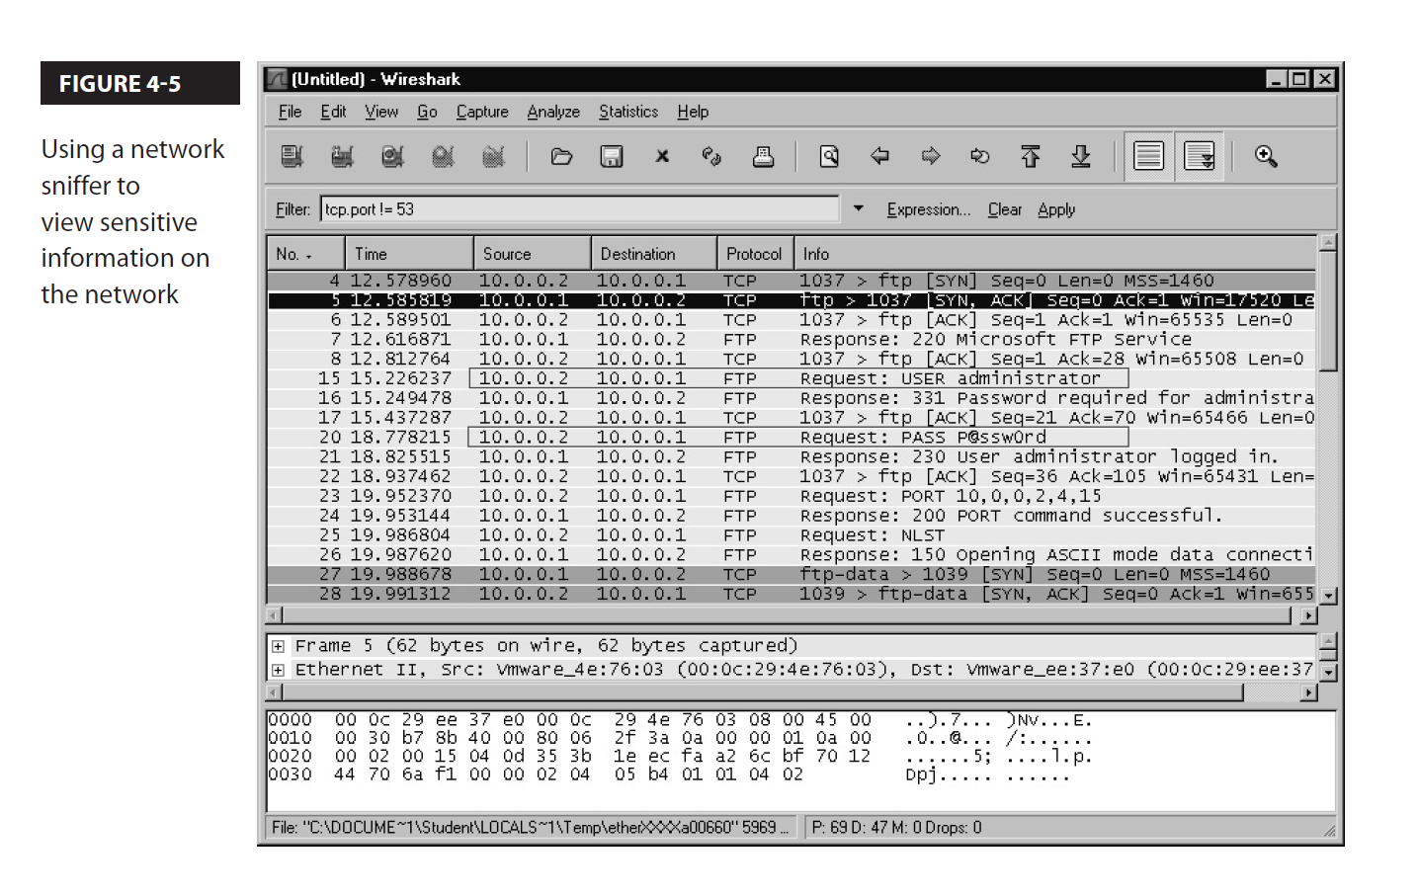
Eavesdropping/Sniffing
A very popular type of attack is an eavesdropping attack, also known as sniffing.
With an eavesdropping attack, the hacker captures network traffic and is able to view the contents of the packets traveling along the network.
The packets may contain sensitive information such as credit card numbers or usernames and passwords (see Figure 4-5).
A network switch filters traffic and sends only the data to the port on the switch where the destination system resides.
This type of filtering helps protect against eavesdropping because it essentially takes the opportunity away from the hacker to capture network traffic.
However, the hacker can poison the MAC address table on the switch with bogus entries so that the switch stops trusting the MAC address table and then starts flooding all frames to all ports—resulting in the hacker now receiving a copy of all traffic!

Slide 29
Different Packet Sniffing Software
Wireshark A program you can download for free from www.wireshark.org. Wireshark is the leading network analyzer that runs on many different platforms, including Windows and Linux.
tcpdump A Linux command used to capture network traffic to a file that can then be reviewed or replayed on the network. The following command captures all traffic on Ethernet interface eth0 and writes the data to a file named output.txt:
tcpdump –v –i eth0 –w output.txt
airodump-ng A Linux program used to capture wireless traffic that can be replayed later. The following command captures traffic on a wireless network using the network card wlan0 and writes the information to a file named wepfile:
airodump-ng -c 11 -w wepfile -bssid 00:11:22:33:44:55 wlan0

Slide 30
Replay
A replay attack starts as a sniffing attack because the hacker first must capture the traffic that they wish to replay.
The hacker then resubmits the traffic onto the network (replays it) later.
The hacker may alter the traffic first and then replay it, or the hacker may simply be replaying traffic to generate more traffic.
A good example of a hacker replaying traffic is with wireless hacking.
To be able to crack the encryption of a wireless network, the hacker has to capture a large amount of traffic.
If the network is a small network with not enough traffic, the hacker can capture some of the existing traffic and replay it over and over again to generate more traffic.
The following are popular commands to replay traffic:
tcpreplay A Linux command used to replay traffic stored in the capture file created by tcpdump. Here’s an example:
tcpreplay output.txt –i eth0
aireplay-ng A Linux command used to replay wireless traffic on the network captured with the airodump-ng command.

Slide 31
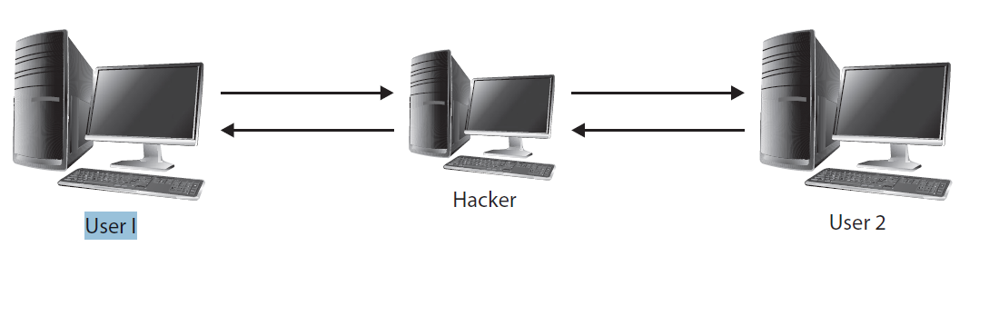
On Path(Man-in-the-Middle) Attack
A very important type of network attack to understand is an on-path attack, also known as a man-in-the-middle (MITM) attack.
In an on-path attack, the hacker inserts himself in the middle of two systems that are communicating.
As shown in Figure, after the hacker inserts himself between the two parties that are communicating, he then passes information back and forth between the two.
For example, when User 1 sends data to User 2, the information is actually sent to the hacker first, who then forwards the information to User 2.
A variation of an on-path attack is the man-in-the-browser (MITB) attack, where the browser contains a Trojan that was inserted via an add-in being loaded or a script executing within the browser.
The Trojan at this point can intercept any data the user inputs into the browser and alter it before sending it to the destination server.
Examples of MITB Trojans are Zeus and SpyEye.
FIGURE 4-6

Slide 32
LAYER 2 ATTACK

Slide 33
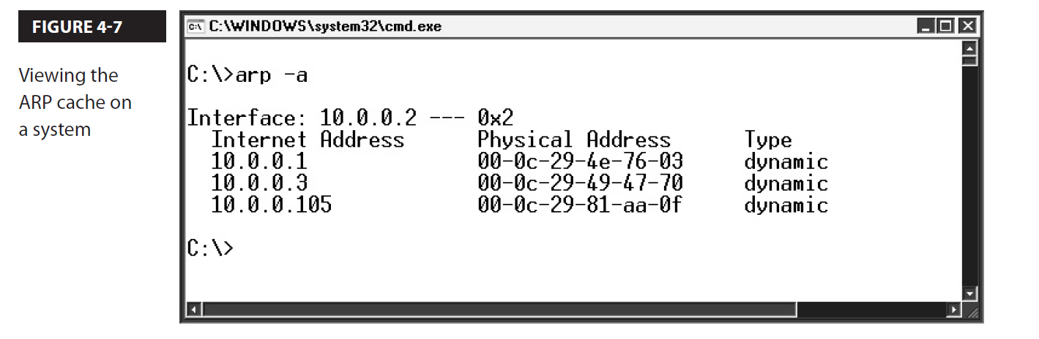
ARP Poisoning
ARP is a protocol that converts the IP address to the MAC address and then stores the IP and corresponding MAC address in memory on the system.
This area of memory is known as the ARP cache (see Figure 4-7).
ARP poisoning involves the hacker altering the ARP cache on a system, or group of systems, so that all systems have the wrong MAC address stored in the ARP cache for a specific IP address—maybe the address of the default gateway.
Typically, the hacker will poison the ARP cache so that the default gateway IP address (your router’s IP address) points to the hacker’s MAC address.
This will ensure that every time a system tries to send data to the router, it will retrieve the hacker’s MAC address from the local ARP cache and then send the data to the hacker’s system instead of to the router.
This is how the hacker typically performs an MITM attack on a wired network or wireless network.
This also allows a hacker to capture all network traffic, even in a switched environment.
The hacker just needs to enable the routing feature on their system so that all data is then passed on to the router and out to the Internet, while in the meantime the hacker has captured every piece of data headed out to the Internet.

Slide 34
MAC Flooding and MAC Cloning
MAC flooding is when the attacker sends a large number of frames to the switch, causing it to fill the MAC address table and, as a result, remove old, valid MAC addresses but add the new fake MAC addresses.
This will cause the switch to flood all frames from valid systems on the network.
Flooded frames go to every port on the switch, thus allowing the attacker to capture and review them.
MAC cloning is when the attacker copies the MAC address of another system and uses it for network communication.
This could be used to bypass access control lists, where only traffic from specific MAC addresses is allowed on the network.

Slide 35
DNS ATTACKS

Slide 36
DNS Poisoning
Poisoning with computers is the concept that someone goes into an environment and purposely places incorrect settings into it in order to disrupt the environment.
DNS poisoning is when the hacker compromises a DNS server and poisons the DNS entries by having the DNS names point to incorrect IP addresses.
Often, the hacker will modify the DNS records to point to the hacker’s system; this will force all traffic for that DNS name to the hacker’s system.
DNS poisoning is also the altering of the DNS cache that is located on your company’s local DNS servers. The DNS cache stores the names of web sites already visited by employees and the IP addresses of those sites.
The cache is on your DNS server so that when another employee surfs the same site, the DNS server already has the IP address of that site and does not need to forward a query out to the Internet.
The DNS server in your local office simply sends the IP address that is stored in the DNS cache to the client.
It is possible for the hacker to poison the DNS cache so that your users are sent to the wrong web sites.
Another popular technique for hackers to lead you to the wrong web site is to modify the hosts file that resides on every system. The hosts file is used to resolve domain names to IP addresses, and if an entry is found in the local hosts file, then the system will not query DNS.
Pharming is the term used for leading someone to the wrong site by modifying DNS or the hosts file.
FIGURE 4-8

Slide 37
Domain Hijacking
Domain hijacking is a type of attack that involves the hacker taking over a domain name from the original registrant.
The hacker may hijack the domain by using social engineering techniques to gain access to the domain name and then switch ownership, or the hacker could exploit a vulnerability on the systems that host the domain name to gain unauthorized access to the domain registration.

Slide 38
Domain Reputation
Domain reputation is a rating on your domain name of whether or not the domain is known to send spam messages.
If an employee in your company sends a lot of spam messages, your domain may be flagged as having a poor reputation due to the sending of those spam messages. Spam-filtering systems will block e-mail messages from systems with a poor domain reputation.

Slide 39
Pass the Hash
Pass the hash is a hacking technique used to access networks that use Microsoft NT LAN Manager (NTLM) as their authentication protocol.
With pass the hash, the hacker first compromises a Windows system and then performs a hashdump of the SAM database.
The hashdump contains all of the password hashes for each of the user accounts on that system.
The hacker can then use those hashes in a pass-the-hash attack to move laterally throughout the network and authenticate to the next system.
The benefit of this type of attack from a hacker’s perspective is that the hacker does not need to crack the user passwords;
they can simply pass the hash value of the password to another system on the network when authenticating.
As a mitigation technique for pass the hash, you can enforce Kerberos authentication in order to remove the risk of this attack.

Slide 40
Spam
Spam is sending the same unsolicited e-mail message to a number of people.
Spam messages are typically sent in hopes that the receiver of the spam message will buy a product or service from the sender of the message.
Most e-mail servers now have spam filters in place that help protect the system from receiving a large number of unsolicited e-mail messages.

Slide 41
Privilege Escalation
Privilege escalation is a popular attack that involves someone who has user-level access to a system being able to elevate their privileges to gain administrative access to the system.
Privilege escalation normally occurs due to a vulnerability within software running on the system or within the operating system itself.
It is important to keep the system and application patched in order to remove any known vulnerabilities, which will help prevent privilege escalation.

Slide 42
Port Scanning Attack
Another popular network attack is known as port scanning or a port scanning attack.
With a port scanning attack, the hacker runs software on the network that does a port scan against the system, which indicates to the hacker what ports are open.
Once the hacker finds out what ports are open, they can then try to exploit the ports to gain access to the system.
A number of different types of port scans can be used; the following list details three of the most popular:
TCP connect scan With a TCP connect scan, the hacker performs a TCP three-way handshake with each port on the system. The concept is that if the hacker can do a three-way handshake with a port, then the port must be open.
SYN scan (half-open scan) The TCP connect scan is easily detected on a network because of the three packets sent between the hacker and the system being scanned; therefore, the SYN scan was created. With the SYN scan, the hacker sends a SYN message but doesn’t send the ACK as the third phase of the three-way handshake after receiving an ACK/SYN from the victim’s system. The goal here is to avoid detection by creating less traffic. This scan is also known as a half-open scan or a stealth scan.
XMAS scan In an XMAS scan, a packet is sent to each port with the PSH, URG, and FIN flags set in the packet. The term XMAS scan comes from the fact that you have three of six flags enabled, which is like turning on a bunch of lights on a Christmas tree. Note that this is also called an XMAS attack.

Slide 43
Other Network Attacks
Pharming As mentioned earlier, pharming is a term some people use for an attack on DNS or the hosts file that leads an individual to the wrong web site.
Antiquated protocols Antiquated protocols are protocols that were developed without security in mind and that typically now have a secure version to replace it. Examples of antiquated protocols are most of the protocols in the TCP/IP protocol suite, such as HTTP, FTP, SMTP, and POP3.
Session hijacking Session hijacking is when the hacker kicks one of the parties out of the communication and impersonates that person in the conversation. The hacker typically disconnects one of the parties via a denial of service attack.
Null sessions A null session is when someone connects to a Windows system without providing any credentials. Once the person connects to the system, they can enumerate the system if it has not been secured. Through enumeration, the hacker may be able to collect the users, groups, and shared folder list. The following command is used to create a null session with a Windows system:
net use \\10.0.0.1\ipc$ "" /u:""

Slide 44
Domain name kiting In domain name kiting, the hacker obtains a domain name for free by using the five-day grace period that is allowed. At the end of the five-day grace period, they cancel the name and then get it free again for another five days. They continue doing this to get the name for free.
Malicious insider threat A malicious insider threat is when someone inside the company purposely destroys or discloses company data. The malicious insider threat could also be someone who performs fraudulent activities (deterrents against which include leveraging the concepts of rotation of duties and least privilege).
Transitive access (attack) A transitive attack occurs when a user receives a hyperlink to another Windows shared folder and clicks the hyperlink. This forces the user’s system to pass the Windows user account credentials to the remote system to try to authenticate. The problem is that if the hacker is using a sniffer and password cracker, they can then try to crack the account password.
Client-side attacks Client-side attacks are attacks on a system through vulnerabilities within the software on a client system. Many client-side attacks come from Internet applications such as web browsers and messenger applications
Watering hole attack A watering hole attack is when the hacker determines sites you may want to visit and then compromises those sites by planting viruses or malicious code on them. When you visit the site (which you trust), you are then infected with the virus.
Typo squatting/URL hijacking Typo squatting is also known as URL hijacking and takes advantage of the fact that some users will make typos when typing a URL into the browser. The hacker sets up a web site with a URL that is very similar to the URL of a popular web site but includes an anticipated typo, leading unwary misspellers to the hacker’s web site.

Slide 45
Preventing Network Attack
With so many different types of network attacks, you can do a number of things to help protect against them.
First, make sure you have physical security controls in place to ensure that unauthorized individuals cannot get access to the facility in order to connect to the network.
Also, implement security features on your switches, such as disabling unused ports on the switches. If a port is disabled, it cannot be used when the hacker tries to connect to the unused port. You should also implement the port security feature on the switches; that is, when a port is enabled, you associate a specific MAC address with the port. This will ensure that someone cannot disconnect one workstation from the switch and replace it with an unauthorized system.
Keep your systems up to date with patches so that you are not vulnerable to known exploits.
Also, make sure to update the firmware on your network hardware, such as switches and routers, so that any known vulnerabilities in the firmware are removed.
The last thing you can do is to make all employees aware of different types of attacks, such as vishing, pharming, spam, and spim, to name just a few

Slide 46

PASSWORD ATTACK

Slide 47
Dictionary Attack
A dictionary attack involves the hacker using a program that has a list of popular usernames in one text file and a list of words in a language dictionary that are to be tried as passwords in another file.
The dictionary file normally contains all of the words in a language and can be downloaded from the Internet.
Figure 4-10 displays a dictionary attack tool called NetBIOS Authentication Tool (NAT) and its sample user list file and password list file.
The benefit of a dictionary attack from a hacker’s point of view is it is a very fast and efficient type of attack because all it does is read the contents of a file—there is no mathematical calculation needed on the part of the password-cracking software.
The disadvantage of the dictionary attack is that most passwords today are complex passwords in the sense that they require letters, numbers, and symbols.
This makes the dictionary attack ineffective because those passwords are not dictionary words

Slide 48
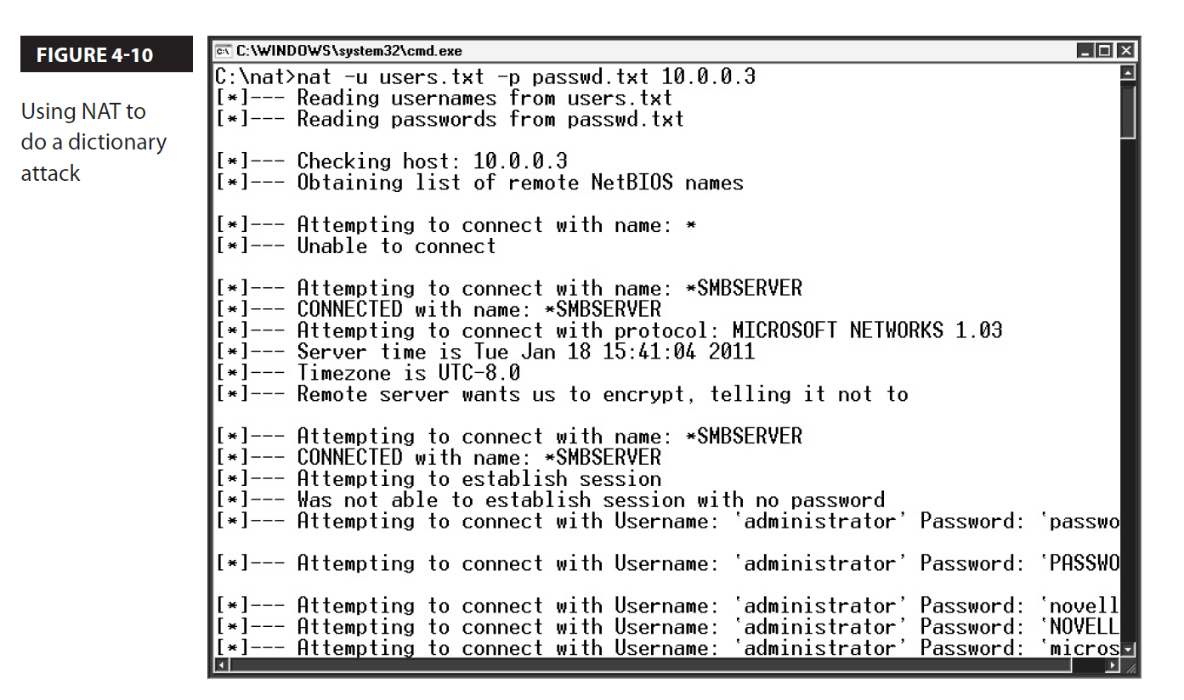

Slide 49
Brute-Force Attack
A brute-force attack is a password attack that involves using the password-cracking software to mathematically calculate every possible password.
Normally, the hacker would configure the password-cracking software with requirements such as the number of characters and whether to use letters, numbers, and symbols.
The benefit of a brute-force attack from the hacker’s point of view is that it is very effective—it will crack the passwords on a system if it has enough time to do so.
The disadvantage of a brute-force attack is the time it takes to complete it.
Due to the large number of possible passwords, it could take years for the password crack to complete!

Slide 50
Hybrid Attack
Another type of password attack is known as a hybrid attack.
A hybrid attack involves the password-cracking software using a dictionary file, but after the software tries a word from the dictionary file, it then tries to modify the word.
Examples of modifications that the cracking software will use are to place numbers after the word and possibly to replace characters.
For example, after the word “house” is attempted, the software will then try “house1,” “house2,” and so on.
Examples of popular character replacement scenarios include replacing an “a” in the word with an “@” symbol, replacing an “L” with the number “1,” and replacing the “o” with a “0.”

Slide 51
Password Spraying
Password spraying is a type of attack on user accounts that involves the attacker sending a commonly used password to many different accounts to see if any of the accounts are using the common password.

Slide 52
Rainbow Tables
Rainbow tables are used to speed up the process of performing a brute-force attack.
Recall that brute-force attacks can take a very long time.
To speed the process up, the hacker can generate a rainbow table, which is a file generated that contains all mathematically possible passwords based on criteria given by the rainbow table generator.
Rainbow tables are in the table (file); the hacker is simply reading a file.
So the hacker gets the complexity of a brute-force attack but the speed of a dictionary attack

Slide 53
Known-plaintext Attack
Another common type of password attack is called the known-plaintext attack (KPA), or unencrypted attack.
With a known-plaintext attack, the hacker knows the plaintext value of a password (known as the crib) and the corresponding encrypted version (known as ciphertext).
With this information, the hacker can then work on figuring out the encryption keys and other passwords.

Slide 54
Online vs Offline Attack
As mentioned earlier, password attacks can be either online or offline.
With an online attack, the hacker is trying to crack the password against the live system.
The problem with this is that the hacker risks getting detected and locking out the accounts.
If the hacker can get a copy of the user account database on a flash drive, the hacker can then take that away with them and try to crack the passwords offline.

Slide 55
Other Password Attack
Replay Attack:
A password replay attack is when the hacker eavesdrops on a conversation and captures the password hash being sent from a client system to the server.
Once the hacker has the hash value, they then use that to impersonate the original client and access the server.
Weak Implementation:
Passwords can be encrypted to protect the plaintext value, but sometimes the encryption is not performed in the best way possible.
For example, the Windows passwords are hashed in the SAM database, but they are broken into two seven-character hashes.
This allows the hacker to determine very easily if someone has a password of fewer than eight characters because the last part of the password hash would be the same for all of those passwords.

Slide 56
Cryptographic Attack and Concept
Birthday:
A birthday attack is a type of attack performed on hashing functions.
It has been found that if you try enough data input, you will find that two different data inputs generate the same hash value.
This is known as a birthday attack because the theory is based on the fact that when you select a large, random group of people, you will have people with duplicate birth dates.
Collision and Downgrade Attacks
Hashing protocols are known to create collisions, which is when two different pieces of data create the same hash value.
The higher number of bits the hash value is, the less of a chance there is that two different pieces of data create the same hash value.
A downgrade attack is a cryptography attack where the attacker forces a network connection between two systems to drop the high-quality encryption protocol and go with a less secure encryption protocol.
The attacker does this so that they have better chances of cracking the weaker encrypted communication.

Slide 57
Preventing Password Attack
Understanding how to prevent password attacks in your environment is an important skill for any security professional.
To prevent dictionary attacks against your systems, you must implement a strong password policy and require users to use complex passwords. A complex password is a password that has a mix of uppercase and lowercase characters, and it uses numbers and symbols.
You should also ensure that users are creating passwords that are at least eight characters in length.
Implementing password complexity will not protect your systems from brute-force attacks, so you must implement an account lockout policy to protect your systems from them.
If you use an account lockout policy, after a certain number of bad logons, the account is locked out and cannot be used until the administrator unlocks it. Most companies implement an account lockout policy that locks an account after the third bad logon attempt. The account lockout policy takes the time away that is required to perform a bruteforce attack; after the third bad logon attempt, the account is locked.

