Slide 1
Operations Modelling Challenge
Sri RamaJayam
Organized by OpperHeimer – Optima – IITKGP – ORMAE
Presented By:
Hariharan Subramanian – SASTRA University
SSVKSS JyothirAditya -IIT Kharagpur
Please visit GitHub link for revised presentation and code
GitHub Link : https://github.com/shariharan2002/Heterogenous-Fleet-and-Commodity-VRP/

Slide 2
Preliminary Answers to Questions
Q1
In our trial runs, we found that Vessel V4 was heavily used
Q2
Depots are visited once per commodity type
Q3
Answered via the formulation/optimization model. We load only one product per vessel.

Slide 3
Intro to the problem statement
We are given a set of refineries(oil production centres), oil depots(oil demand centres) with variable demands.
We are given different types of products, which are being produced in variable quantities
We are also given various types of vessels, each with different capacities and costs of travel.
We are given variable demands over a period of 15 days(predicted by some methods for Jun 2023), and we need to maximize the demand satisfied, but at the same time minimizing route cost over all days

Slide 4
Our Approach
We saw existing papers in the literature and found one paper that closely resembled the problem statement given.
The paper had implemented A branch and Price algorithm for Heterogenous Fleet MultiDepot-MultiTrip Vehicle Routing Problem With Time Windows
We removed the time windows capability and extended the formulation to add Heterogenous commodities
We develop a Multi-Day Multiple Depots Multiple Commodity Heterogeneous Fleet formulation
However, we were unable to extend the formulation to account for >1 product within a single vessel
We also did not delve into advanced Integer programing techniques(like branch and price, or column generation).
Instead for classic MIP problems, we chose to stick with the CPLEX branch and bound solver due to shortage of time.

Slide 5
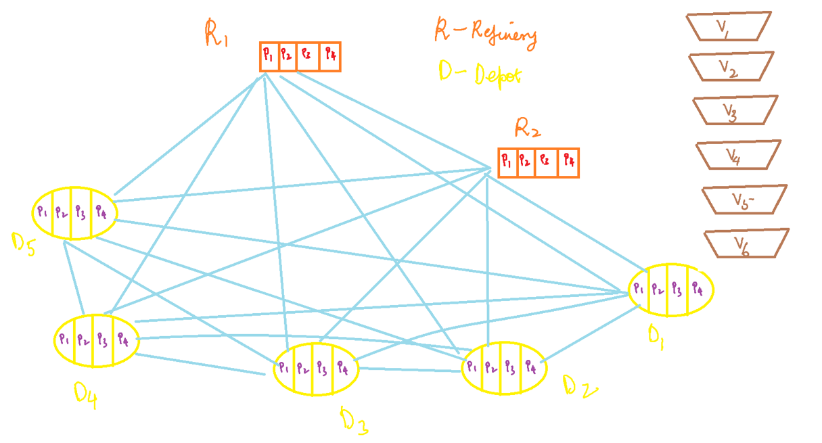

Slide 6
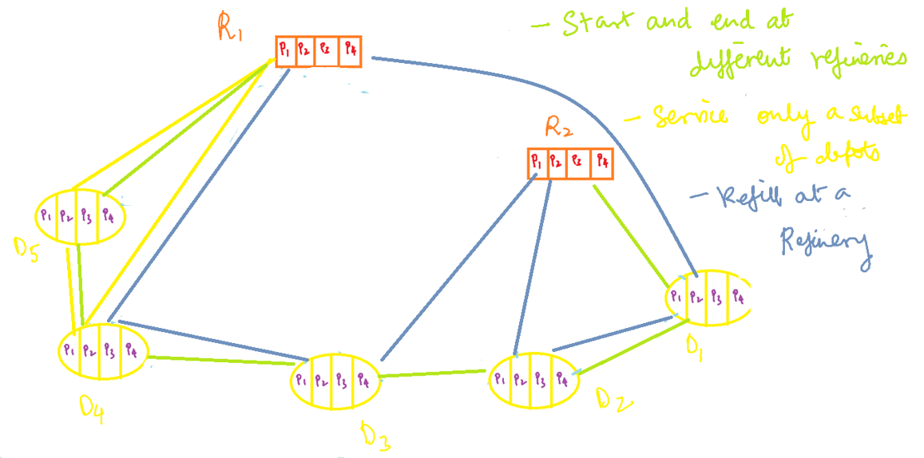

Slide 7
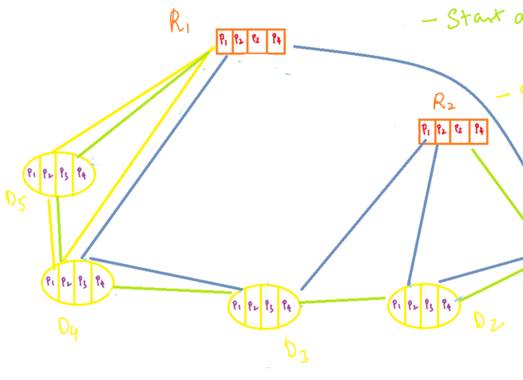
Day 15
Day 4
Day 3
Day 2
Per day routing solution over 15 days
Day 1

Slide 8
Aim and Assumptions
Aim: To find sets of trips that both start and end at refineries with minimum cost.
Assumptions:
Set of trips should satisfy that each depot is visited only once for each commodity type, Or not visited at all.
Total demand of depots in a trip should not exceed the vessel capacity.
Capacity consumption of a vessels assigned to refinery should not exceed the refinery capacity.
Each vessel is allowed to perform several trips, and can start and end each of its trips at same refinery.
The no. of vessels for each vessel type at each refinery is assumed to be unlimited. No. of vessels can be limited using a procurement cost per vessel.
No. of vessels at each depot at start and end of workday should remain the same

Slide 9
Overall Flow
Find all paths and store it in global paths set, either all paths or using a heuristic like TSP
Define the IP formulation
Feed the paths, and solve using CPLEX
Find feasible paths between all depot start and end combinations w.r.t vessel capacity, refinery capacity and demand satisfaction

Slide 10
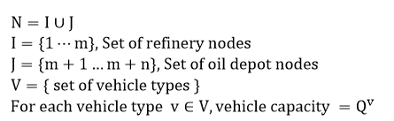
Notation and Terminology

Slide 11
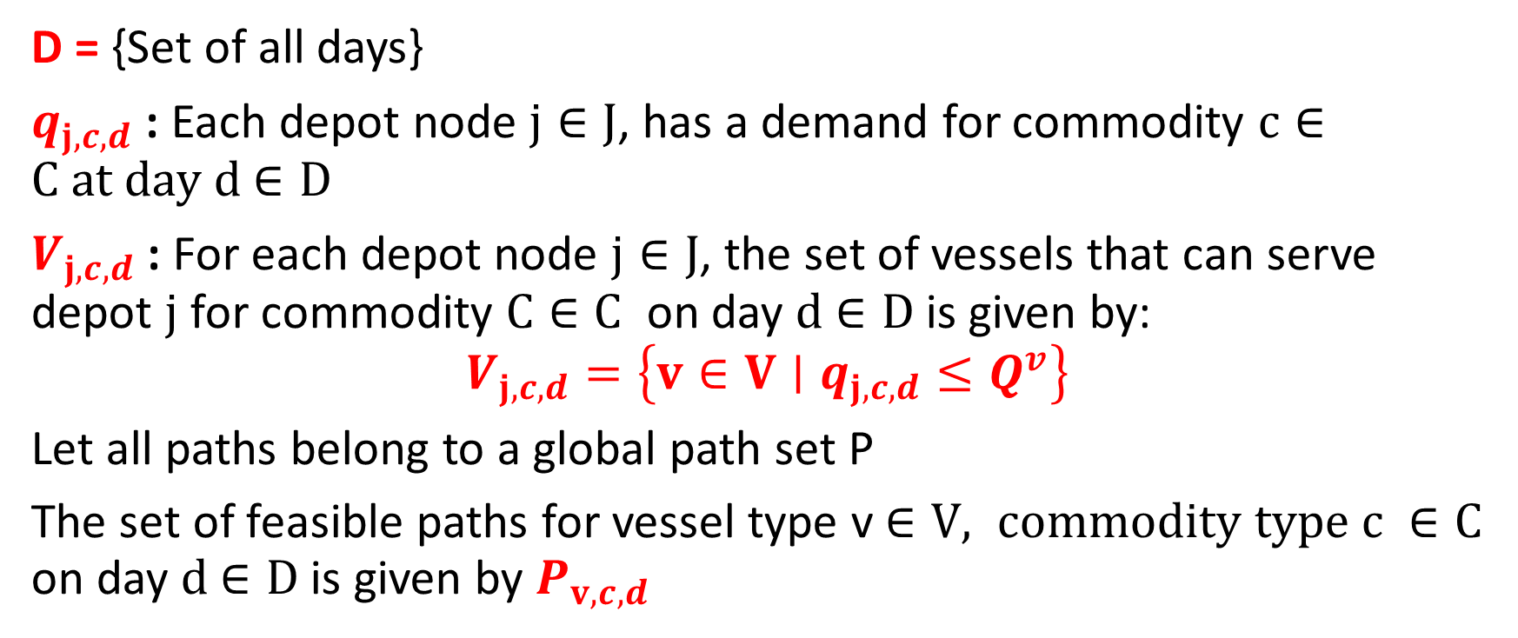
Notation and Terminology
D = {Set of all days}
$q_{j,c,d}$ : Each depot node $j∈J$, has a demand for commodity $c∈C at day d$ $∈D$
$V_{j,c,d}$ : For each depot node $j∈J$, the set of vessels that can serve depot $j$ for commodity $C∈C$ on day $d$ $∈D$is given by:
$$V_{j,c,d}=\left\{v∈V∣q_{j,c,d}≤Q^{v}\right\}$$
Let all paths belong to a global path set P
The set of feasible paths for vessel type v $∈V, commodity type c ∈C$ on day $d$ $∈D$is given by $P_{v,c,d}$

Slide 12
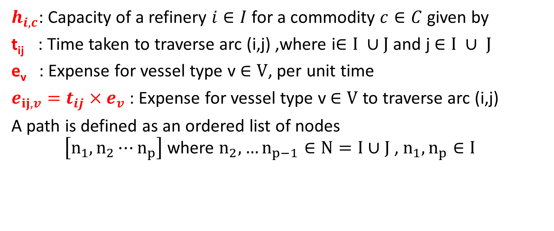
Notation and Terminology
$h_{i,c}$: Capacity of a refinery $i∈I$ for a commodity $c∈C$ given by
t_{ij} : Time taken to traverse arc (i,j) ,where i$∈I ∪J$ and j $∈I ∪ J$
e_{v} : Expense for vessel type v $∈V$, per unit time
$e_{ij,v}=t_{ij}×e_{v}$ : Expense for vessel type v $∈V$ to traverse arc (i,j)
A path is defined as an ordered list of nodes $\left[n_{1},n_{2}⋯n_{p}\right]$ where $n_{2},…n_{p−1}∈N=I∪J$ , $n_{1},n_{p}∈I$

Slide 13
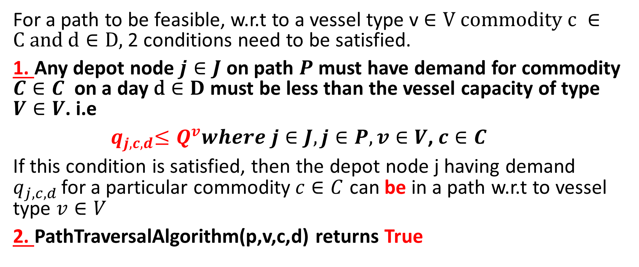
Defining the feasibility of a path
For a path to be feasible, w.r.t to a vessel type v $∈V$ $commodity c ∈C and \text{d}∈D,$2 conditions need to be satisfied.
1. Any depot node $j∈J$ on path $P$ must have demand for commodity $C∈C$ on a day $\text{d}∈D$ must be less than the vessel capacity of type $V∈V$. i.e
${ q}_{j,c,d}≤Q^{v}where j∈J,j∈P, v∈V$, $c∈C$
If this condition is satisfied, then the depot node j having demand $q_{j,c,d }$for a particular commodity$c∈C$ can be in a path w.r.t to vessel type $v∈V$
2. PathTraversalAlgorithm(p,v,c,d) returns True

Slide 14
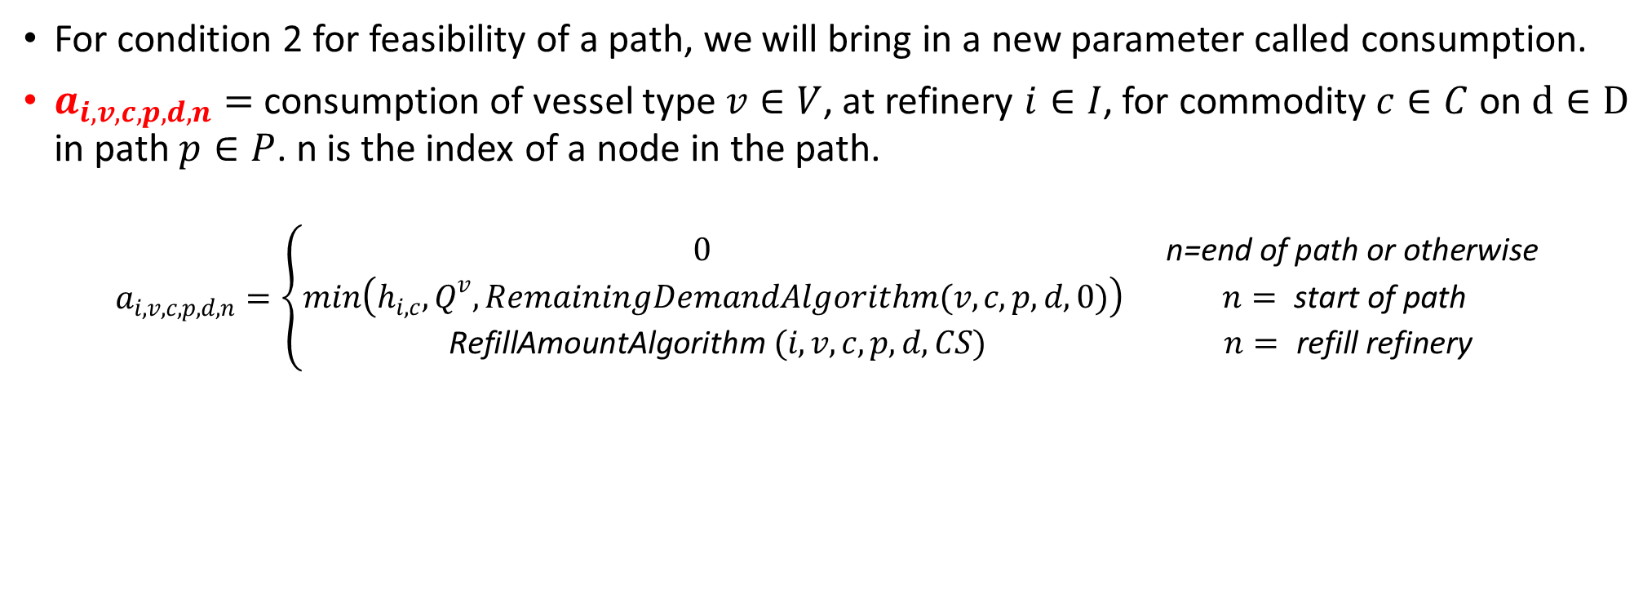
Consumption Parameter
For condition 2 for feasibility of a path, we will bring in a new parameter called consumption.
$a_{i,v,c,p,d,n}=$ consumption of vessel type $v∈V$, at refinery $i∈I$, for commodity $c∈C$on $\text{d}∈D$ in path $p∈P$. n is the index of a node in the path.
$$a_{i,v,c,p,d,n}=\left\{\begin{matrix}0 & \text{n}\text{=}\text{end} \text{of} \text{path} \text{or} \text{otherwise} \\ min\left(h_{i,c},Q^{v},RemainingDemandAlgorithm(v,c,p,d,0)\right) & n= \text{start} \text{of} \text{path} \\ \text{RefillAmountAlgorithm} (i,v,c,p,d, CS) & n= \text{refill} \text{refinery}\end{matrix}\right.$$

Slide 15
How does the consumption parameter work?
Start of a path: We calculate the remaining demand for all the customer nodes present on a path. We take the minimum of the vessel capacity, the start depot capacity and the remaining demand and fill it into the vessel
End of a path: This means our trip has ended and we shall not refill.
Middle of a path: We have encountered a refinery node, then there is a scope for refill. The amount to be refilled is given by RefillAmountAlgorithm.

Slide 16
What might be the disadvantages of using a predetermined consumption parameter?
We tune the consumption of a vessel at a refinery for a commodity manually using logical ideas. This may not entirely be optimal. The most optimal way would be to make the consumption parameter itself a decision variable and let the solver decide. However, with the given constraints, it might be possible that the formulation becomes non-linear(product of decision variables). Hence we chose to avoid this.
When we choose to change the consumption parameter from one feasible path to another feasible path based on various factors(in our case, CS, remaining demand and so on), the formulation cannot be easily extended to solve large scale problems. I.e when the consumption parameter is a constant, the pricing subproblem is SPPRC(Shortest path problem with Resource Constraints). But when it’s not a constant, all feasible paths need to be enumerated, and fast IP solving techniques like Column Generation and/or Branch and Price cannot be employed.
This is one of the main reasons that the author of the research paper chose to keep the consumption parameter constant so as to allow tractability.

Slide 17
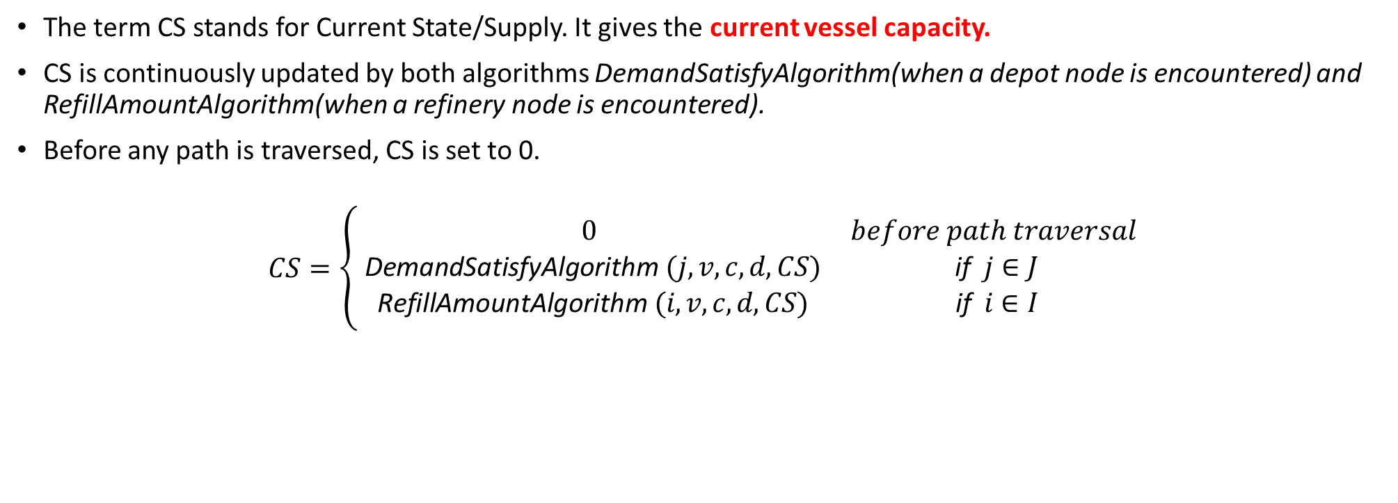
Current State/Supply
The term CS stands for Current State/Supply. It gives the current vessel capacity.
CS is continuously updated by both algorithms DemandSatisfyAlgorithm(when a depot node is encountered) and RefillAmountAlgorithm(when a refinery node is encountered).
Before any path is traversed, CS is set to 0.
$$CS=\left\{\begin{matrix}0 & before path traversal \\ \text{DemandSatisfyAlgorithm} (j,v,c,d, CS) & \text{if} j∈J \\ \text{RefillAmountAlgorithm} (i,v,c,d, CS) & \text{if} i∈I\end{matrix}\right.$$

Slide 18
The 4 Algorithms
The RefillAmountAlgorithm is encountered when a node is refinery node
The DemandSatisfyAlgorithm is encountered when a node is depot node
The PathTraversalAlgorithm traverses each node of the path and calls the appropriate algorithm based on type of node(refinery or depot)
The RemainingDemandAlgorithm calculates the remaining demand of all depots from a particular node index on a given path for a particular commodity
CS is in fact updated by both DemandSatisfyAlgorithm and RefillAmountAlgorithm

Slide 19
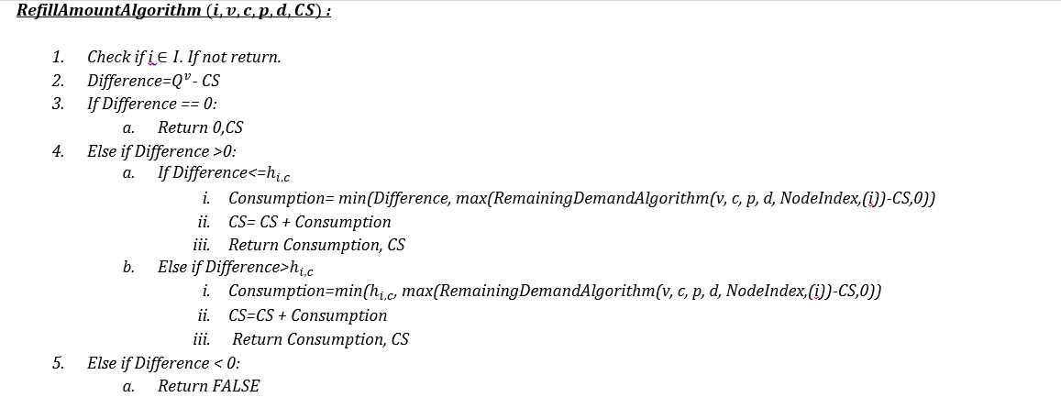

Slide 20
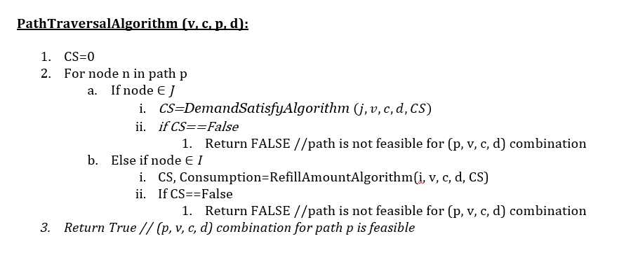
PathTraversalAlgorithm

Slide 21
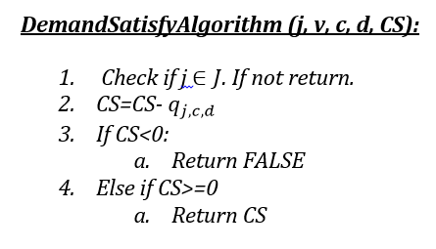
DemandSatisfyAlgorithm

Slide 22
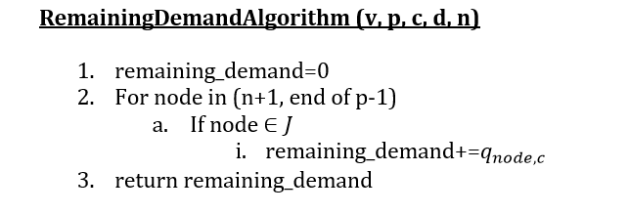
RemainingDemandAlgorithm

Slide 23
Overall Flow
Start with CS=0
Traverse the path
Traversal controlled by PathTraversalAlgorithm
Refinery Node
Depot Node
Calculate Remaining Demand
Reduce the demand of depot from CS
Start Refinery
Intermediate Refinery
Refill min(remaining demand, capacity of vessel, capacity of refinery)
Fill according to RefillAmountAlgorithm()
If negative return False, else keep traversing

Slide 24
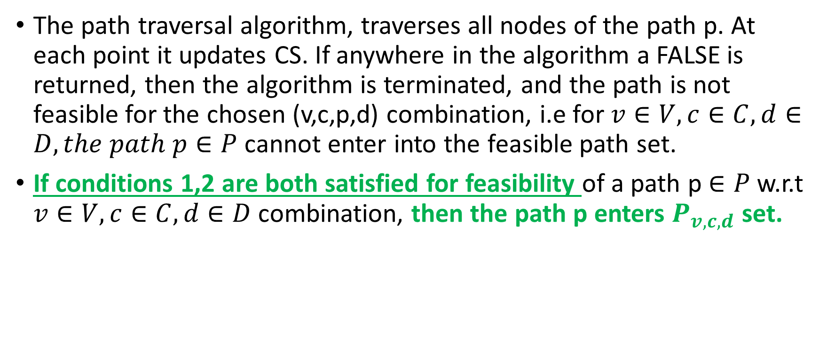
Back to path feasibility
The path traversal algorithm, traverses all nodes of the path p. At each point it updates CS. If anywhere in the algorithm a FALSE is returned, then the algorithm is terminated, and the path is not feasible for the chosen (v,c,p,d) combination, i.e for $v∈V, c∈C,d∈D, the path p∈P$ cannot enter into the feasible path set.
If conditions 1,2 are both satisfied for feasibility of a path p $∈P$ w.r.t $v∈V, c∈C,d∈D$combination, then the path p enters $P_{v,c,d}$ set.

Slide 25
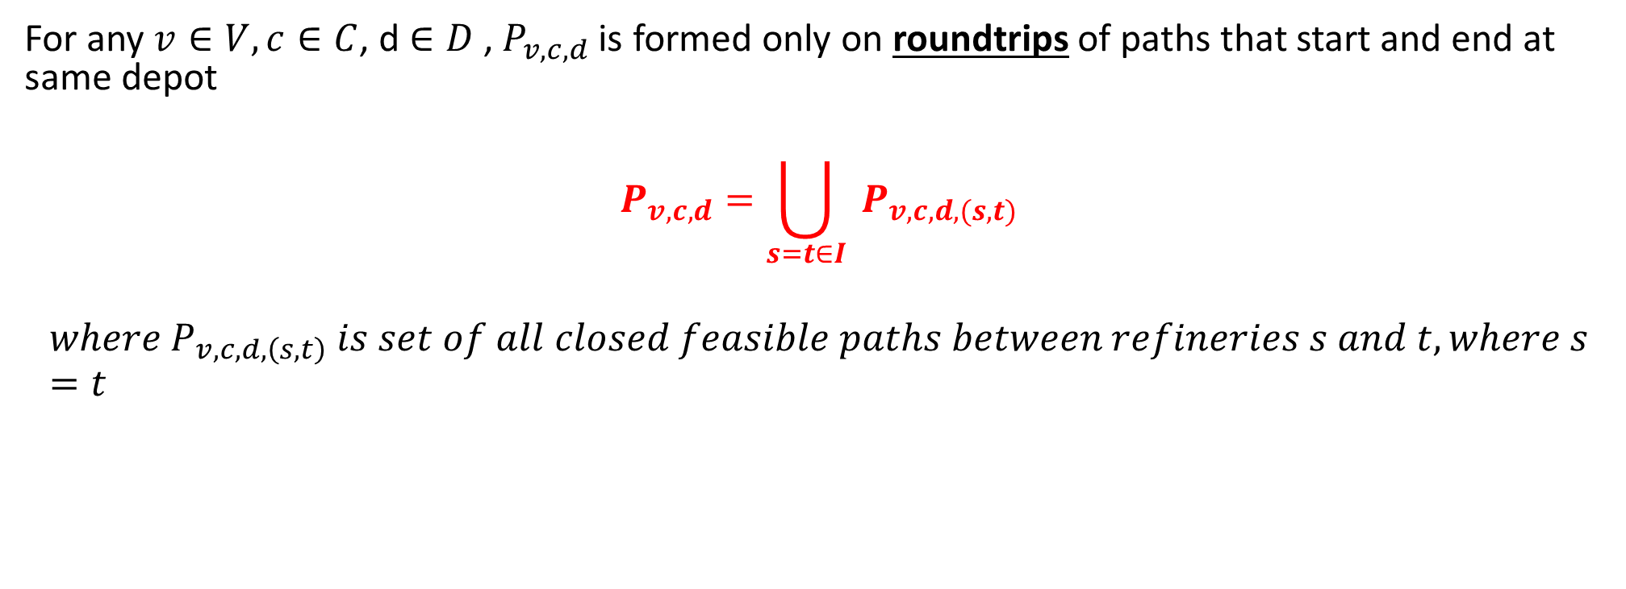
Path Feasibility between 2 same refineries
For any $v∈V, c∈C$, d $∈D$ , $P_{v,c,d}$is formed only on roundtrips of paths that start and end at same depot
$$P_{v,c,d}=\bigcup_{s=t∈I}{ }P_{v,c,d,(s,t)}$$
$${where P}_{v,c,d,\left(s,t\right)} is set of all closed feasible paths between refineries s and t, where s=t$$

Slide 26

Expense of a path
Expense of a path $Δ_{v,c,p,d}$ is defined as:
$$Δ_{v,c,p,d}=\sum{ }e_{ij,v}$$
Where ij is arc present in path p$∈P_{v,c,d}$ $,v∈V, c∈C,\text{d} ∈D$

Slide 27
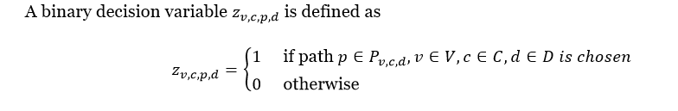
Decision Variable

Slide 28
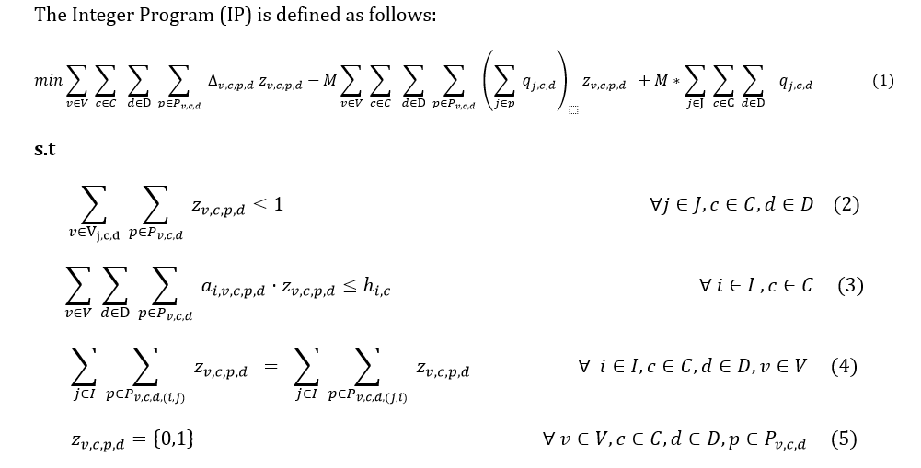
Integer Program Formulation

Slide 29

This term represents the routing cost
This term represents the demand satisfied by chosen paths
This term represents the total demand that needs to be fulfilled and is a constant.
The difference between total and satisfied demand represents unsatisfied demand
M is a big constant that is used in order to balance the routing and demand components. If the routing cost is too high than the unsatisfied demand, then the solver shall choose not to select any path and hence the overall cost might be the last term.

Slide 30

Depot can be visited at most once
The above imposes that a depot for a particular commodity c, on a particular day d can at most be visited once. It need not be visited at all, but if visited, it can only be visited once

Slide 31
Refinery Capacity Constraint
The overall consumption by all vessels across all days must be less than the refinery capacity for that particular commodity

Slide 32

Refinery Vessel Type Balance Constraints
The no. of vessels of a particular vessel type leaving at the start of a workday and returning back at the end of a workday must be the same for each day

Slide 33
Some ways to reduce decision variables
The primary reason for high no. of decision variables is due to the exponential increase in no. of paths as the no. of nodes increases.
Instead of generating all paths, one can do the following:
Generate first all possible subsets of nodes to be visited. The subset will have at least one refinery node and one customer node.
Then for each subset of nodes to be visited, solve a TSP problem
This will drastically reduce the no. of decision variables.

Slide 34
Some slight changes while solving via TSP
Note that since the travel time matrix does not obey triangle inequality, it may lead to many unwanted nodes.
On encountering an “unknown depot or refinery node” we again simply pass(Unknown refers to node that is not in “to be visited” set)
The decision to simply pass or refill or supply demand is done with the help of to be visited nodes subset.

Slide 35
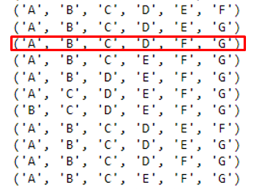
A possible subset of nodes to be visited
Actual TSP Path
To be Visited Nodes set
Note that ‘E’ is not in to be visited nodes set, hence we simply pass

Slide 36
Benefits to involving all paths
For each node set to be visited, the no. of path combinations are in terms of the permutations of the arrangement of nodes. This potentially leads to many refilling arrangements.
Also, This higher no. of refilling arrangements may open up other depots to be serviced. Thus leading to higher satisfaction of demand.
A higher satisfaction in demand might lead to more operation of routes and hence can increase the routing costs

Slide 37
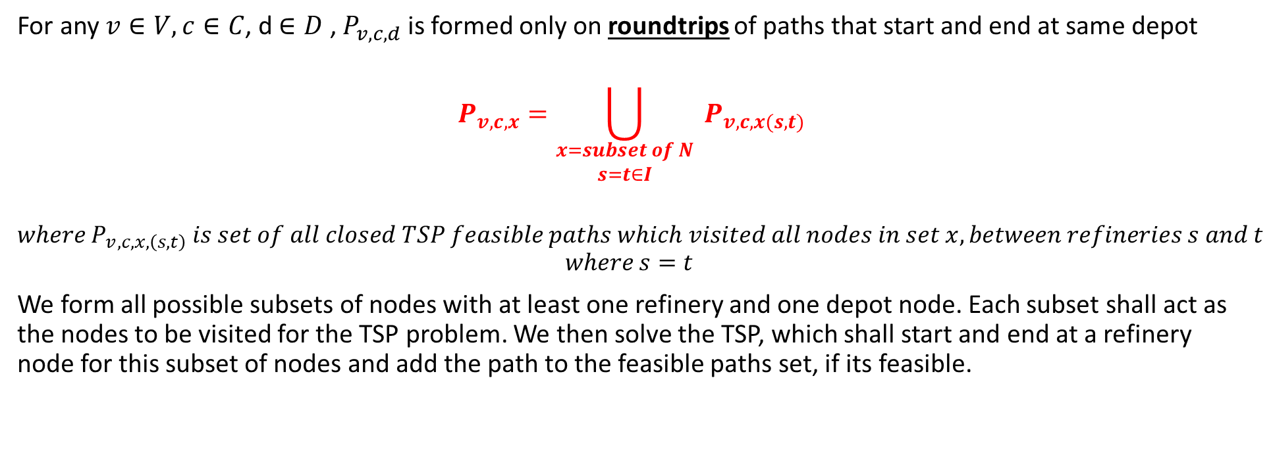
TSP Paths Set
For any $v∈V, c∈C$, d $∈D$ , $P_{v,c,d}$is formed only on roundtrips of paths that start and end at same depot
$$P_{v,c,x}=\bigcup_{\begin{aligned}x=subset of N \\ s=t∈I\end{aligned}}{ }P_{v,c, x(s,t)}$$
$${where P}_{v,c,x,\left(s,t\right)} is set of all closed TSP feasible paths which visited all nodes in set x, between refineries s and t$$
$${where s=t}_{ }$$
We form all possible subsets of nodes with at least one refinery and one depot node. Each subset shall act as the nodes to be visited for the TSP problem. We then solve the TSP, which shall start and end at a refinery node for this subset of nodes and add the path to the feasible paths set, if its feasible.

Slide 38
Results
Properties/Model | All Paths Model | TSP Heuristic Model
No of Depots | 5 | 5
No of Refineries | 2 | 2
No. of Paths Generated | 3912 | 126
No. of Decision Variables | 1261620 | 39960
No. of Routes selected after optimization(No of D.V =1) | 34 | 34
Routing Cost | 1217250 | 1198350
Demand Satisfied | 1808159 | 1745553
Total Demand to be Satisfied | 3724991 | 3724991
Solve Time | 240 seconds | 30 seconds
Vehicle Set Used | V4 | V4
Refills | 0 | 0

Slide 39
Comparison
The all paths model performs the best in terms of demand satisfaction. Since we try to satisfy as much as demand as possible(unsatisfied demand has high penalty), the all paths model satisfies it by opening some extra routes thus leading to higher routing costs
However, note that the demand satisfied by both models are quite close
This means that, the TSP heuristic model could be used for solving large scale problems in short times

Slide 40
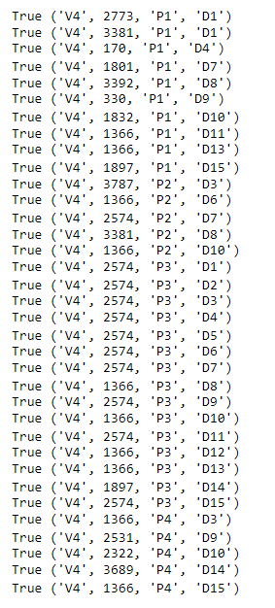

Multi Day Sample Output
Notice that for some days, the demand for a particular commodity could not be fulfilled.
Eg: For product P1, days D2, D3 could not be filled

Slide 41
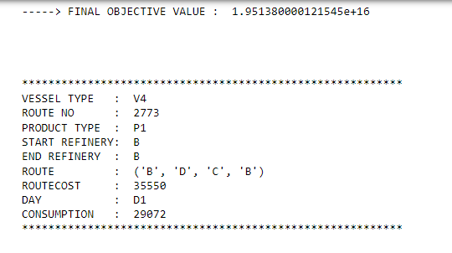

The high objective value is due to the penalty in not satisfying demands
M was set to 10^10
The difference in total demand to be satisfied and the demand satisfied by the model

Slide 42
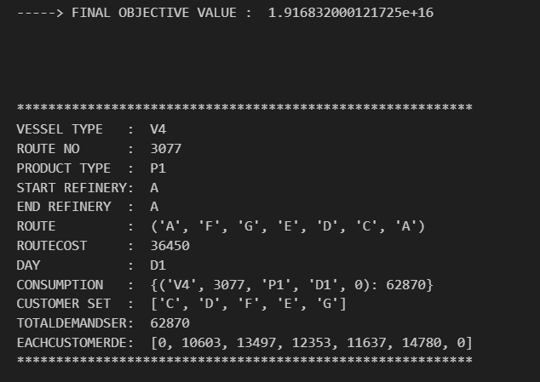
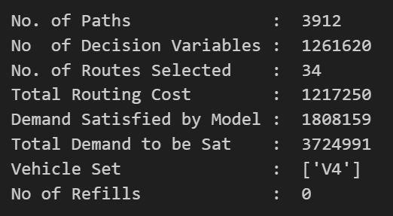
All Paths Model

Slide 43
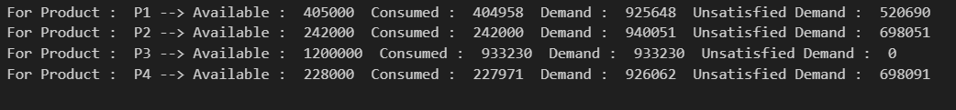
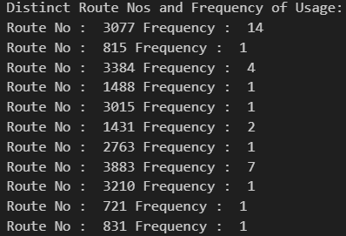
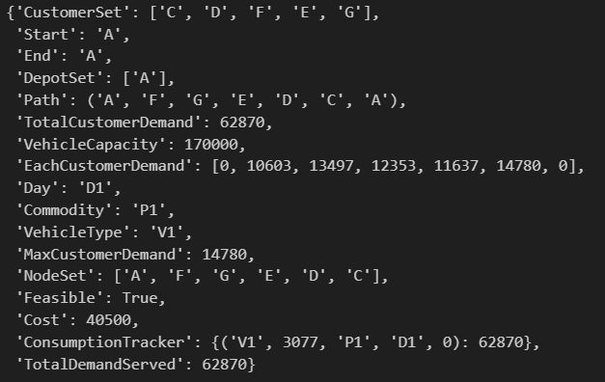
All Paths Model

Slide 44
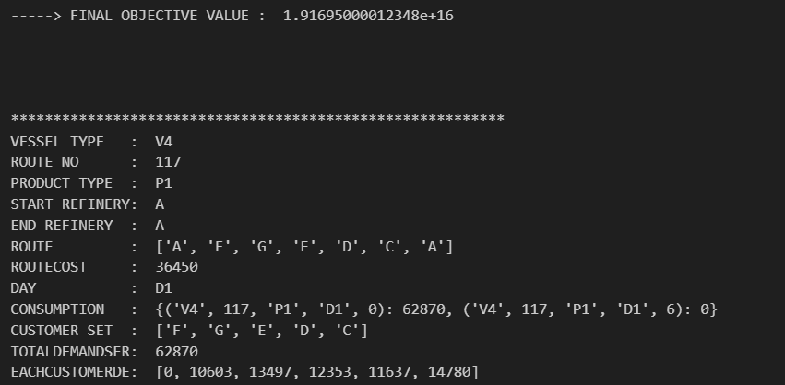
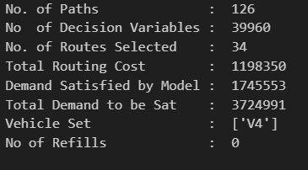
TSP Model

Slide 45
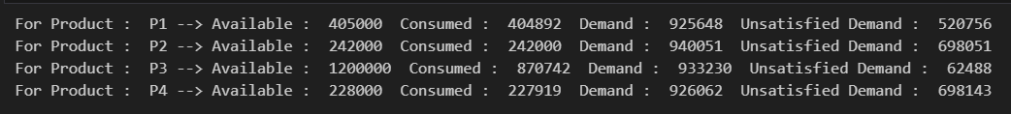
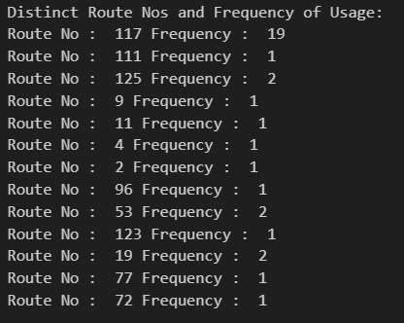
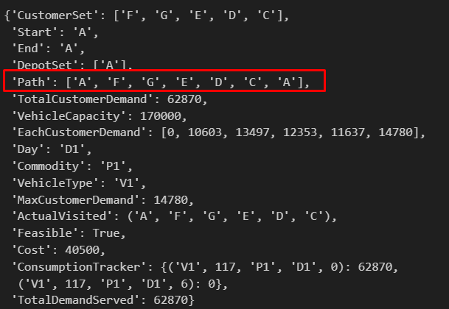
TSP Model

