Slide 1
Assessing Damage with Mixed Effects Modeling
Bayesian Blue Devils

Slide 2
Motivations
Determining how a minor league player could perform in the major leagues
Insight into the characteristics of pitches that result in various outcomes in a game
Assess variation in pitcher style and results

Slide 3

Defining Damage
Way of measuring the success of a batter
Focused on balls that were only put into play
Assigned discrete values to singles, doubles, triples, home runs and outs from fangraphs.com linear weights
Notes:
Values assign relative weights to the outcome, chose these values because they are based on the average run expectancy created by these events
Context neutral

Slide 4

The Model
Bayesian Linear Mixed Effects model
Random effect on each pitcher
Handedness and batter handedness
bat_side, throws, plate_speed break_x, break_y, break_z, plate distance, initial distance, initial velocity (x, y, z), initial acceleration (x,y,z)
Notes:
Blme package in R

Slide 5
Room for Improvement
Create continuous statistic to assess damage across all pitches
Different ways of defining success for a batter
Incorporate pitches that are not put into play
Using the model to predict future data
Improve the measure of location
Currently distance from the center of the plate

Slide 6
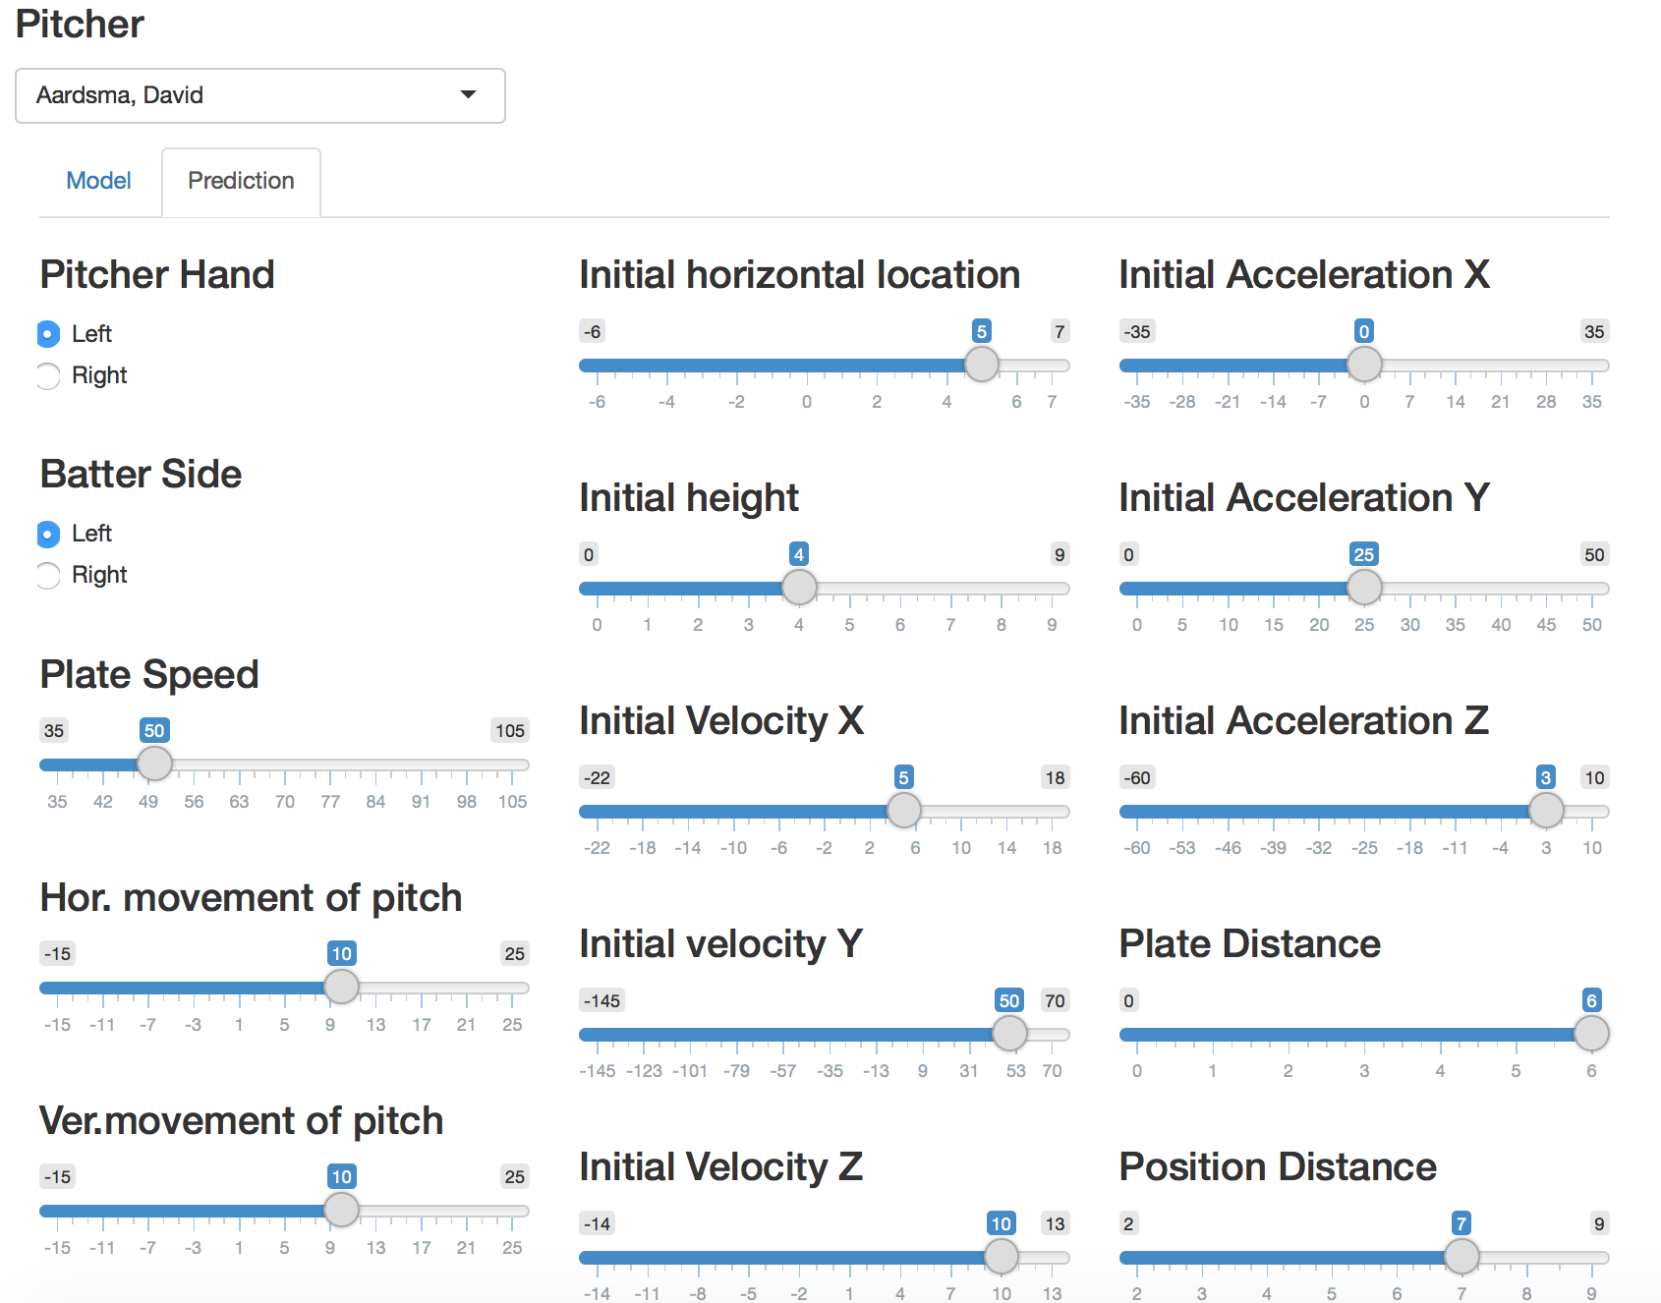

Slide 7
Thank You

