Slide 1
Modern Neural Architecture & Scalable Systems
A Comprehensive Overview by Dr. Jane Doe & Team

Slide 2
Key Findings & Special Metrics (%)
First core result with bold parameter: learning_rate = 0.001
  Sub-level observation with special characters: 100% accuracy & $500 cost on dataset_v2
  Third bullet: Testing symbols #1, #2, and variable {alpha_beta}
High-throughput pipeline verification across distributed nodes.
Notes:
Highlight the 100% accuracy metric and explain cost reduction.

Slide 3
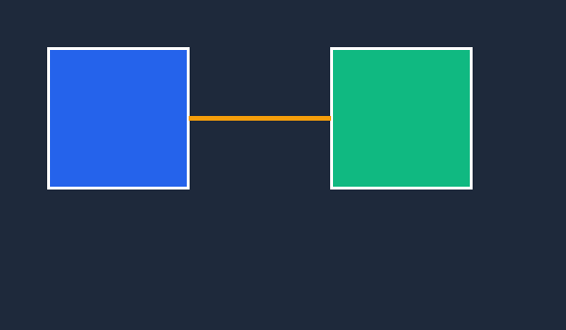
Architecture Visual Flow

Slide 4
Benchmark Performance Comparison
Model | Accuracy (%) | Latency (ms)
Baseline ResNet | 84.2% | 45ms
Vision Transformer | 91.8% | 72ms
Proposed Hybrid | 95.6% | 38ms

