Slide 1

AWS AppSync for Building a GraphQL API
S.Sneha (2210030133)
Under the esteemed guidance of
Ms. P. Sree Lakshmi
Assistant Professor,
Department of Computer Science and Engineering

Slide 2
Project Overview
Problem Statement: Traditional REST APIs lack flexibility and efficiency for real-time task management.
Objective: To build a serverless, scalable To-Do task app using AWS AppSync with real-time updates and analytics.
Impact: Simplifies client-server communication, supports real-time data access, and leverages AWS serverless architecture for scalability and cost efficiency.

Slide 3
Services Used
AWS AppSync: GraphQL API layer.
Amazon DynamoDB: Task storage.
AWS Lambda: Custom logic (metrics push, reminders).
Amazon CloudWatch: Metrics and alarms.
Amazon SNS: Notifications (email/SMS)
AWS IAM: Permission management.

Slide 4
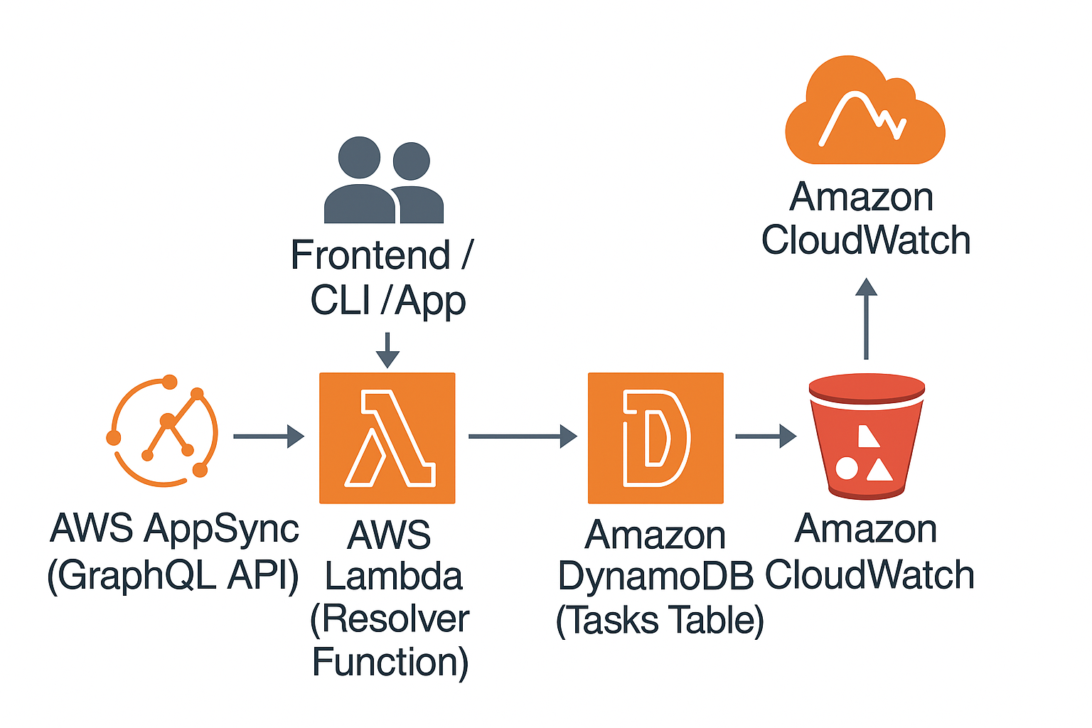
Flow Diagram
Architecture:
Tools: AWS Console

Slide 5
Implementation Process
Created a DynamoDB table with todoID as the partition key.
Built an AppSync API with GraphQL types, queries, and mutations.
Developed two Lambda functions for logging and updating metrics.
Connected resolvers to DynamoDB and Lambda using templates.
Deployed the Lambda code and AppSync API.
Tested with sample data and fixed errors using CloudWatch logs.

Slide 6
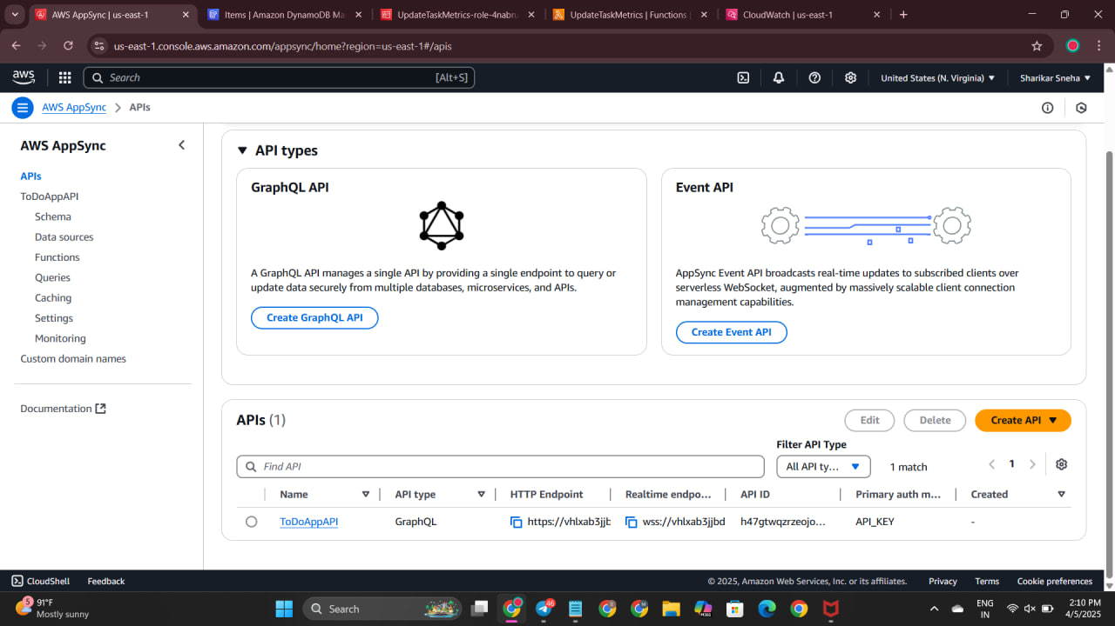
AppSync console showing API setup

Slide 7
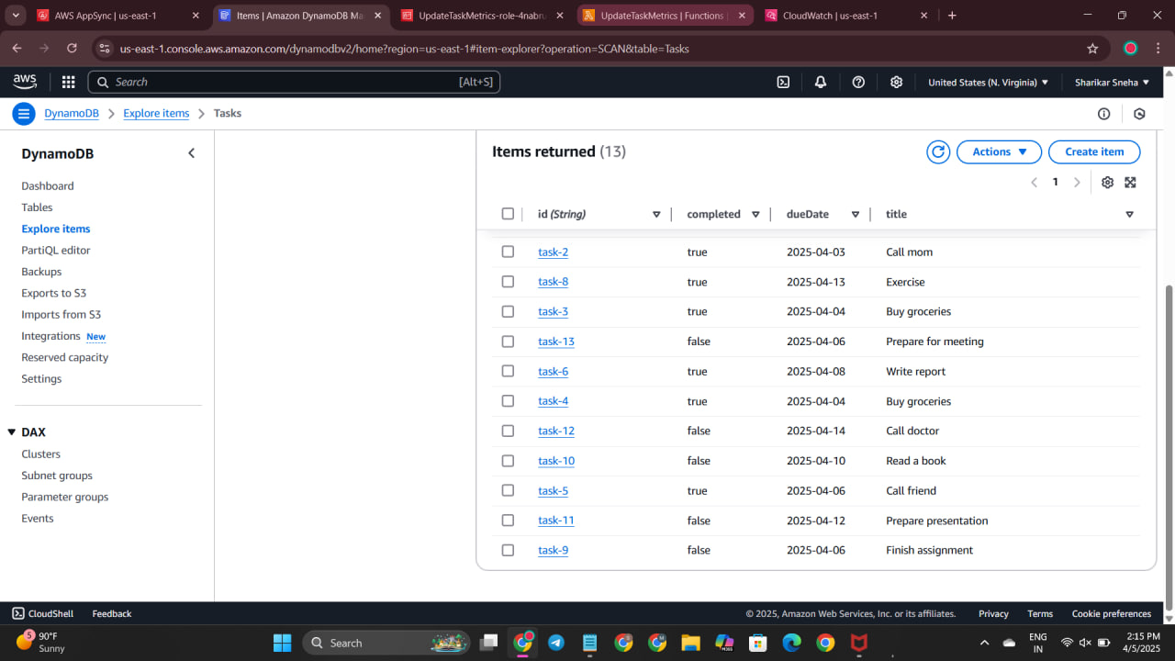
DynamoDB table with items

Slide 8
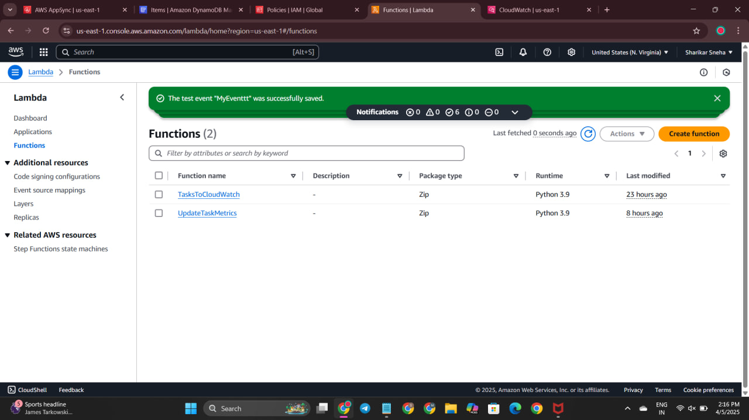
Lambda functions

Slide 9
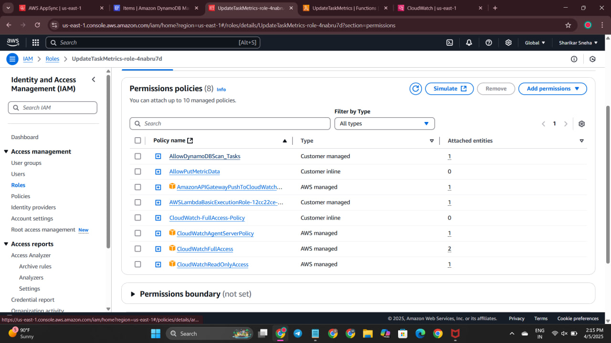
IAM role permissions

Slide 10
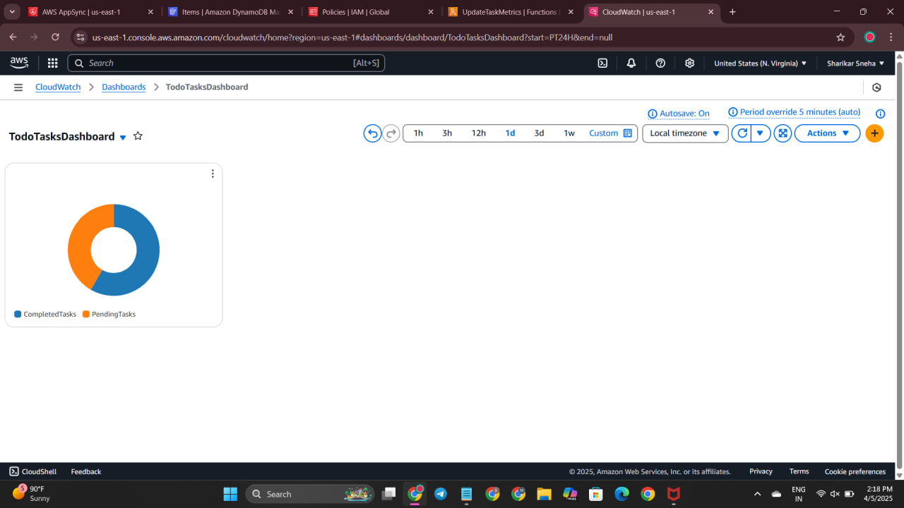
IAM CloudWatch metrics

Slide 11
Key Features and Functionality
Serverless GraphQL API for managing todo items.
Flexible queries and mutations (e.g., getTodo, addTodo, updateTodo).
Real-time logging and metrics via TasksToCloudWatch and UpdateTaskMetrics.
Secure access with IAM roles and API key authentication.
Scalable storage with DynamoDB and monitoring via CloudWatch.

Slide 12
Results and Outputs
Output: Functional GraphQL API (TodoAppAPI) with HTTP endpoint, supporting CRUD operations for todo items.
DynamoDB: Stores 13 todo items with fields like id, title, completed, and dueDate (e.g., “Call mom”).
CloudWatch: Visualizes metrics (CompletedTasks, PendingTasks) in a pie chart.

Slide 13
Challenges and Solutions
Challenges:
Incorrect GraphQL schema syntax and resolver mapping errors.
Configuring secure IAM permissions for AppSync and Lambda.
Solutions:
Debugged schema and resolvers using CloudWatch logs and corrected JSON code.
Configured IAM roles (AppSyncTodoRole, UpdateTaskMetrics-role-4nabru7d) with policies like AllowDynamoDBTasks and CloudWatchFullAccessPolicy.

Slide 14
Learnings & Takeaways
Learned AWS services like AppSync, Lambda, DynamoDB, IAM, and CloudWatch.
Understood GraphQL schema, queries, and real-time features.
Used CloudWatch to fix errors in schema and resolvers.
Gained knowledge of serverless benefits.
Followed best practices in API security and design.

Slide 15
Future Scope
Implement real-time subscriptions for todo updates using WebSocket-based @aws_subscribe.
Add fine-grained access control with AWS Cognito or IAM.
Deploy a frontend interface on Amazon S3 and CloudFront for user interaction.
Optimize resolver performance and add advanced metrics (e.g., task completion trends).
Integrate AI for task prioritization or categorization.

Slide 16
References
AWS AppSync Developer Guide: https://docs.aws.amazon.com/appsync/latest/devguide/welcome.html
AWS Lambda Developer Guide: https://docs.aws.amazon.com/lambda/latest/dg/welcome.htmlAmazon
DynamoDB Developer Guide: https://docs.aws.amazon.com/dynamodb/latest/developerguide/Introduction.html
AWS IAM Documentation: https://docs.aws.amazon.com/IAM/latest/UserGuide/introduction.html
Amazon CloudWatch Documentation: https://docs.aws.amazon.com/AmazonCloudWatch/latest/monitoring/WhatIsCloudWatch.html

Slide 17
THANK YOU

