Slide 1

Parallel implementation of particle swarm optimization algorithm for the ackley function
Shreya Sevelar and Sharini V
AI-DS B

Slide 2
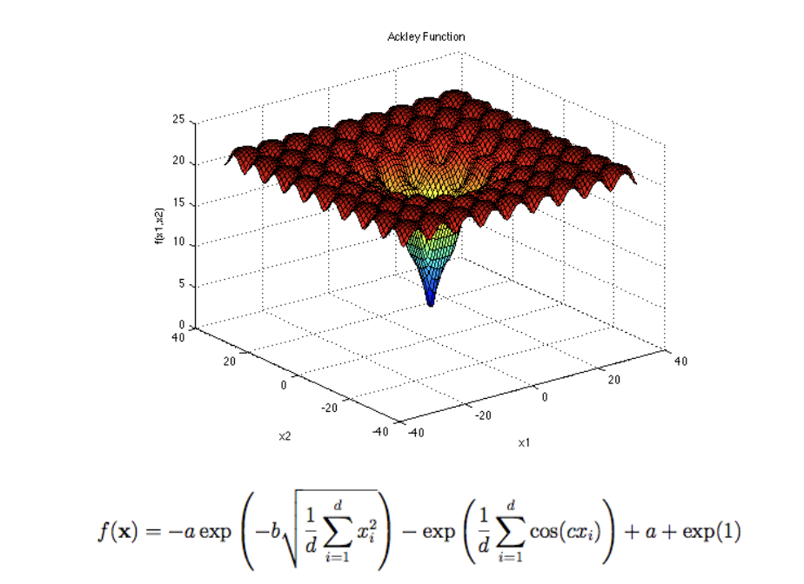
AIM:
To find an optimal solution of the Ackley function using a parallel implementation of Particle Swarm Optimization Algorithm using MPI.

Slide 3
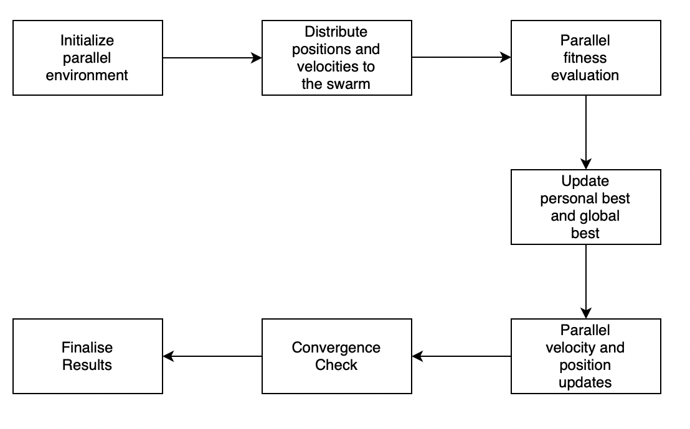
Overview and workflow
Set up the environment, including processes or threads for parallel execution.
In the fitness evaluation stage, fitness of the particles in the swarm is calculated using the Ackley function.
Personal best and Global best values are updated.
Final best position is then considered the optimal solution to the Ackley function.

Slide 4
task
MPI is used for distributed-memory parallelism
Performance metrics to be compared:
Speedup: of each approach concerning serial implementation.
Scalability: by measuring the performance as the number of processing units (threads or processes) increases.
Communication overhead: time spent on communication in the MPI implementation
Efficiency: considering the ratio of achieved speedup to the number of processing units used.

Slide 5
Timeline/ steps to follow
Implementation: develop an implementations of PSO for the Ackley function using MPI.
Benchmarking: Benchmark the performance using various problem sizes and number of processing units used.
Statistics: on execution time, speedup, communication overhead and efficiency is collected.
Analysis: strengths and weaknesses of the parallelization approach.

Slide 6
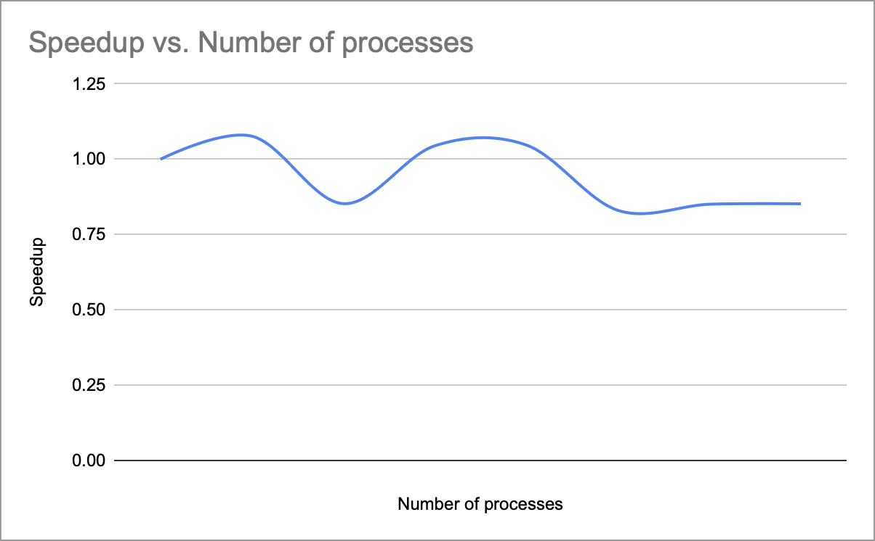
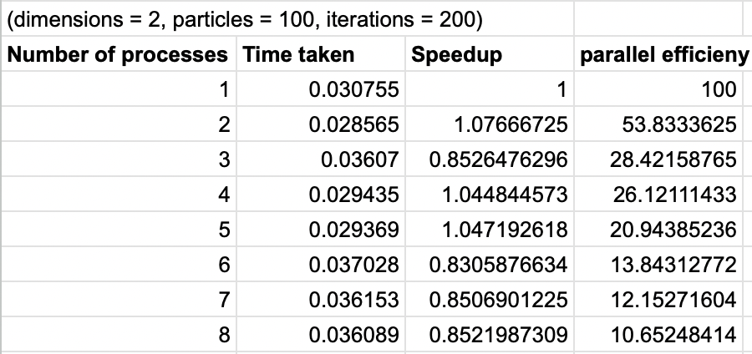
Graph 1: for different values of N, plot of speedup with respect to number of processing elements

Slide 7
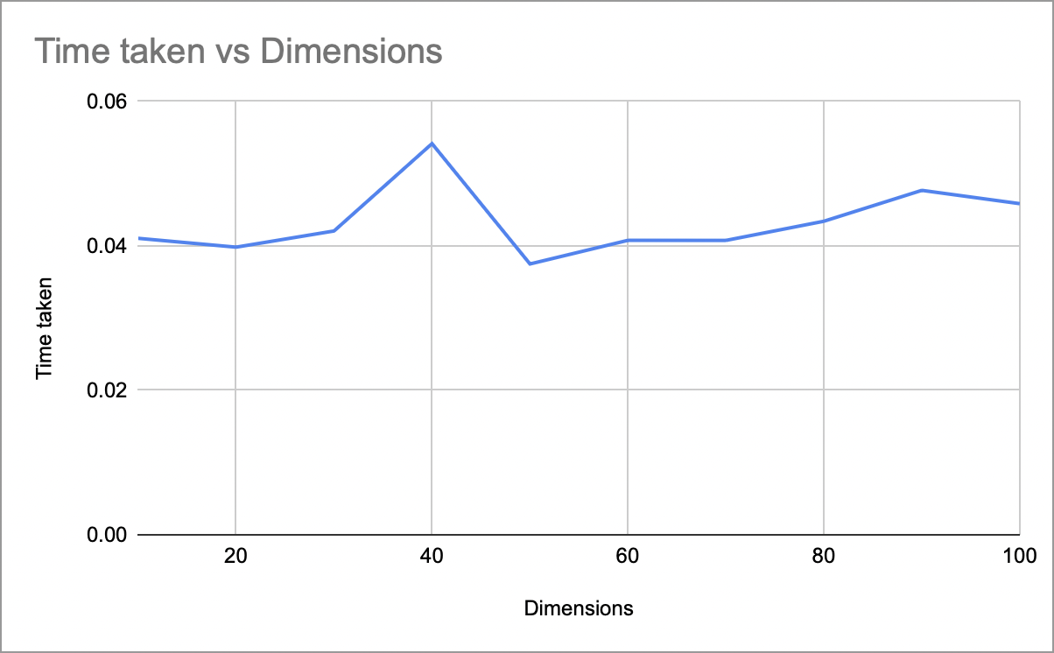
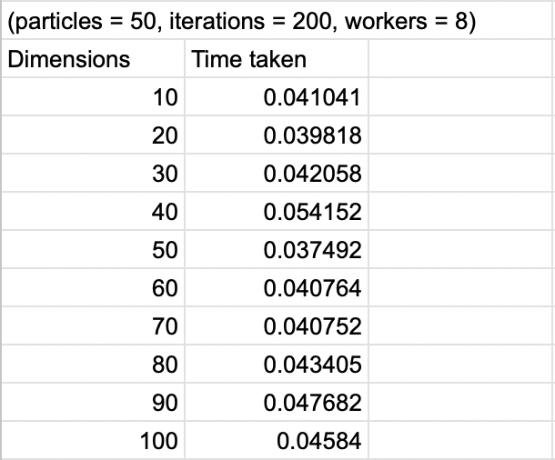
Graph 2: for a particular set of parameters, plot of time taken vs dimensions

Slide 8
Benefits of parallelizing PSO
Provides improved convergence speed and diversity.
Better exploration of the search space.

Slide 9
References and challenges
The main drawback of bio-inspired algorithms is their hunger for intensive computational power and are significantly time consuming.
https://link.springer.com/article/10.1007/s10766-022-00736-3 Parallelization of Swarm Intelligence Algorithms: Literature Review.

