Slide 1
Smart Home Intercom System
Prepared for:
D. Kevin McGrath
Prepared by:
Glen Anderson
Jordan Davis
Lazar Sharipoff

Slide 2
Purpose:
Replace old fashioned paging systems
Remove the need to shout throughout the house
Ability to page a specific node
Ability to identify rooms with a person in them and page to these rooms
Ability to have a video conversation in separate rooms

Slide 3
Requirements:
Place call from one node to another
Call can stream audio and video
Secure
Audio and video encrypted
No audio or video data is stored, only streamed
No connection to external network
Different user modes with varying levels of access
Ability to detect a person in a room
Reasonably easy setup, minimal configuration
Low per unit cost
~$200.00

Slide 4
Systems:
Hardware
Operating System
Software
Screen
Data Storage
Audio I/O
Networking
IR Camera
Encryption
Raspberry Pi 3
Person Detection

Slide 5
Hardware:
Raspberry Pi 3
Touchscreen
Case
Audio Hat
Microphone
IR Camera

Slide 6
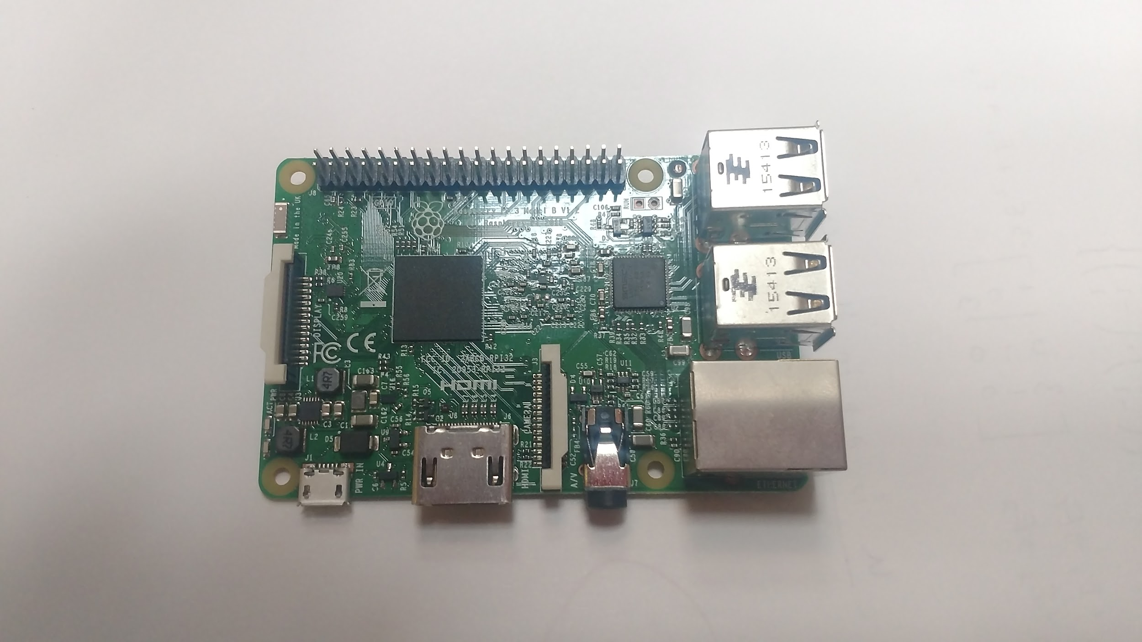
Raspberry Pi 3
Small single board computer
Fits within budget
Can be deployed with software package pre-installed
Can support multiple sensors and pieces of hardware
Has a large amount of community support

Slide 7
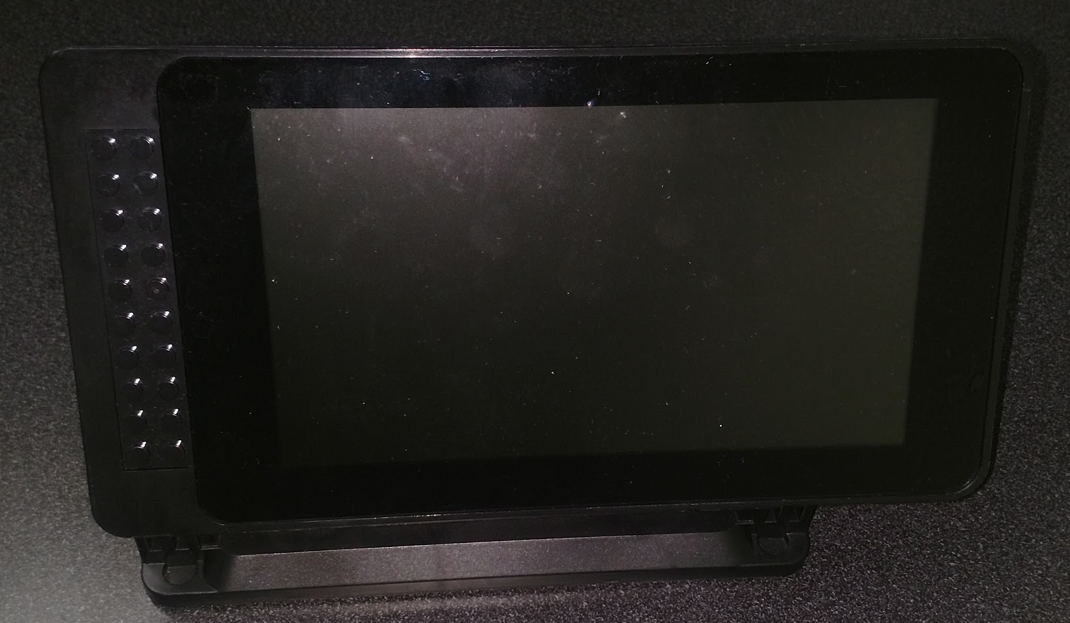
Touchscreen
7” Screen
Size and Resolution
Cost

Slide 8
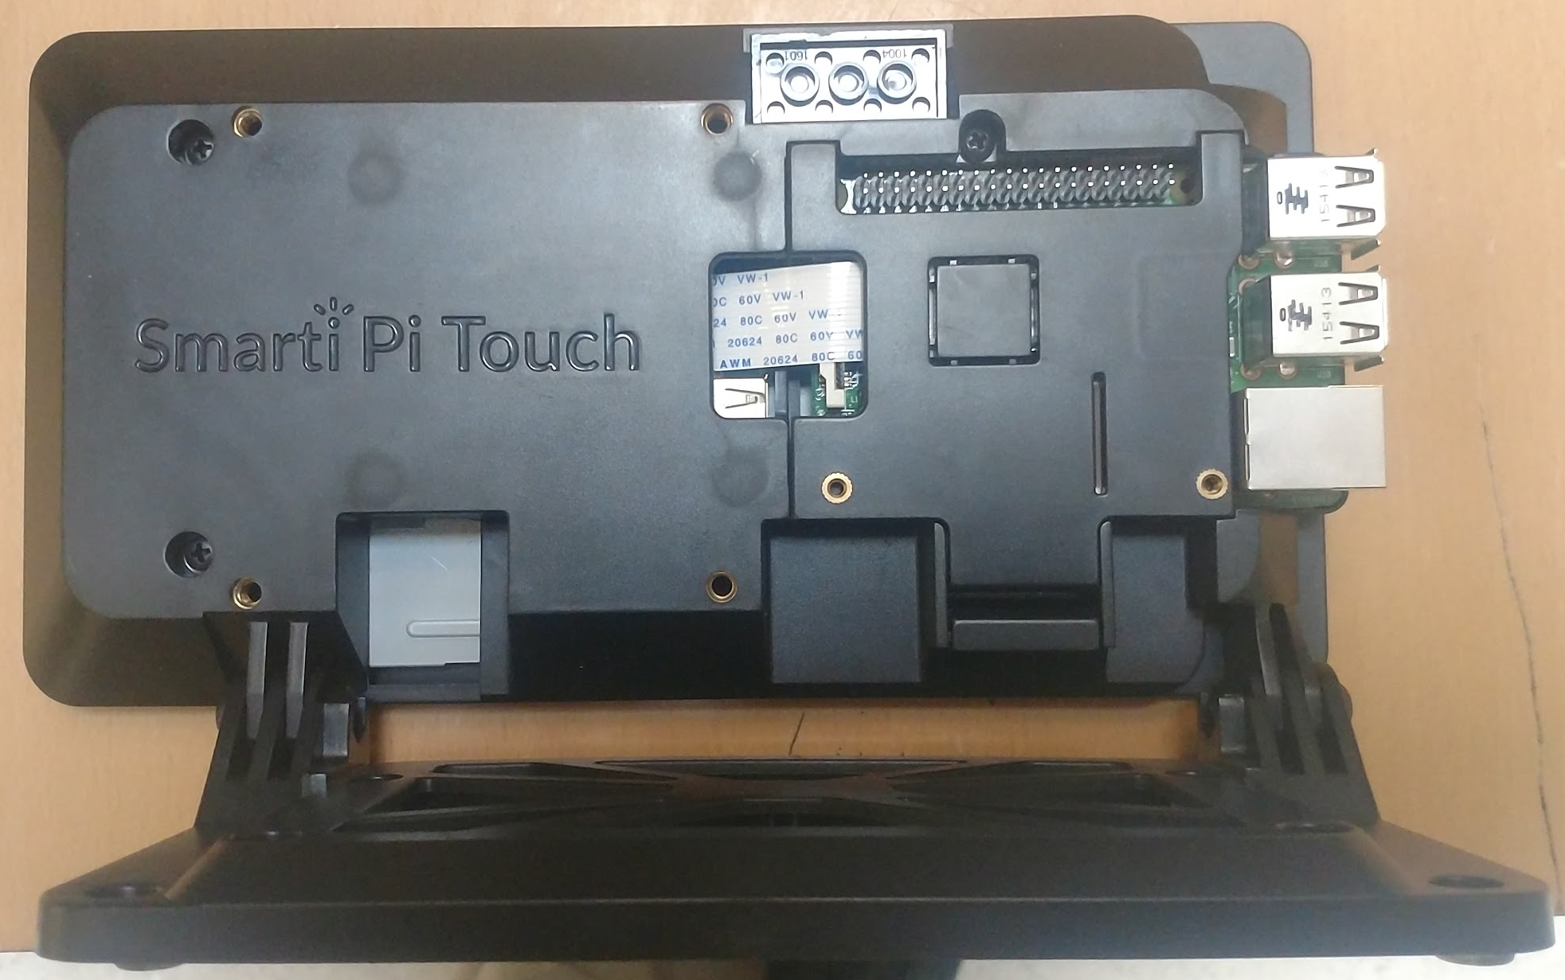
Case
Case
Can house a 7” touch screen
Can be mounted on wall
Keeps USB ports of Pi open
Can have camera mounted to it easily
Supports expansion
GPIO pins for hats
Punch out hole for heatsink

Slide 9
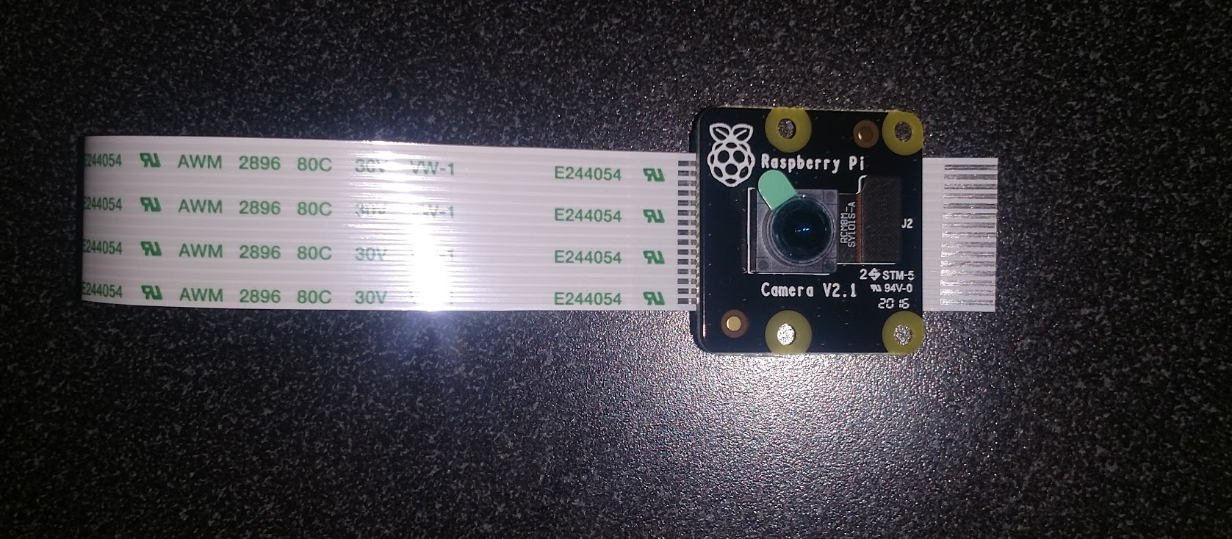
Camera
NoIR Camera
Will be upgraded to IR
Used for video stream input
Used for person detection

Slide 10
Audio I/O
HiFiBerry sound card for audio output
Higher quality than built in sound card
Widely available
Sparkfun microphone or USB microphone for audio input
USB microphone would require no hardware configuration but would allow for less flexibility
Sparkfun microphone would have to be installed, but would allow for flexibility with the design of each node
VideoLAN media player to stream audio between nodes
Compatible with the platform

Slide 11
Operating System
OS will be implemented using Raspbian Stretch
Two options available, Stretch and Stretch Lite
Stretch Lite is implemented without a GUI
Stretch has GUI but is approximately 1.25GB larger
Ultimately as a proof of concept, Stretch will have greater support of systems.

Slide 12
Software:
Network Modules
Network Encryption
Person Detection
Data Management
Video Streaming Software
User Interface

Slide 13
Network Modules
Qt 4.8 Network Module
Examples online to test implementation
Encapsulates application data
Better Approach to Mobile AdHoc Networking (B.A.T.M.A.N.)
Batman-adv is a well documented implementation
Layer 2 implementation
Will be using WPA_NONE for encryption
Will create its own mesh network for talking between nodes

Slide 14
Person Detection
IR-capable camera
Use for initial detection of a person entering a room to bring the system out of sleep mode
Facial recognition
Use OpenCV library for facial recognition
Used to verify that the IR system detected an actual person
Log that a person is in the room so that other devices can use this information when suggesting which room to call

Slide 15
Data Management
Flat file system for storing data
Store which room last had a person in it
Log detailed errors for troubleshooting purposes
Need to reliably check which rooms had a person in them
Files will be read directly from related programs, which will be activated when the system powers on

Slide 16
Video Streaming Software
VLC
Capture Rate
Can be set to the max capture rate of the installed camera
Hardware Compatibility
Bandwidth
Can stream audio
Installation

Slide 17
User Interface:
Implemented using Qt 4.8
Will boot using embedded mode straight into the program
Will first be implemented as a baseline to test network connectivity and video capture
Ultimately should be able to control brightness and contrast along with controlling camera power and swapping user modes

Slide 18
Where we are
Alpha level functionality of individual components
Video streaming working as proof of concept over UDP using gstreamer
Home screen designed with QT 4.8
Facial detection using OpenCV working

Slide 19
Changes from the plan
Qt 5.0 embedded mode requires a subscription
Qt 4.8 has embedded mode and is well supported freeware.
VLC is difficult to set up in embedded mode, so gStreamer will be used to stream video instead

Slide 20
Video streaming
Streaming between two nodes
High latency, receiver overheats
gstreamer instead of VLC
Embedded mode better supported with gstreamer
Possible solutions
Use raw video instead of H264, which will help with FPS and latency issues
Use heatsink and/or fan on back of the Raspberry Pi
Use an UPboard as transmitting node if streaming is still slow

Slide 21
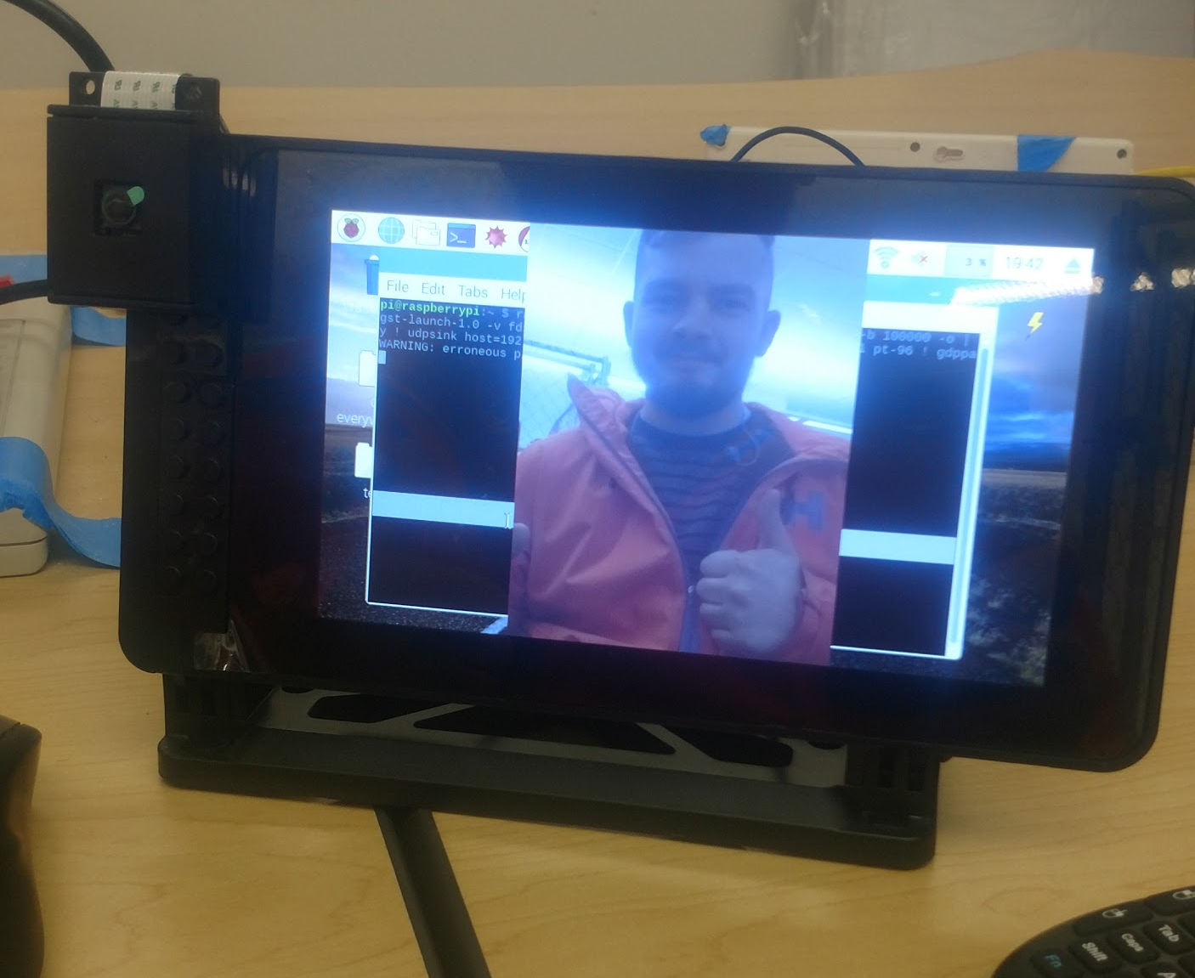

Slide 22
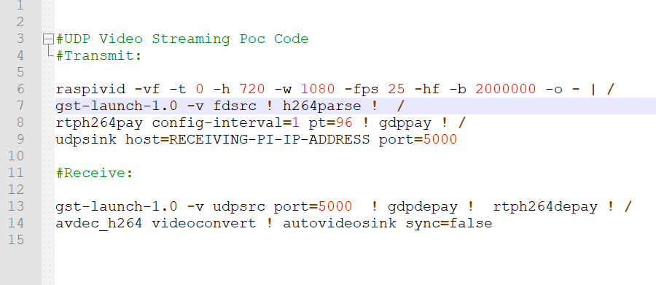

Slide 23
User interface
Home screen
In progress, still needs to be tested on the Raspberry Pi
Options menu
In progress, design done but needs to be implemented
Status bar
In progress, design done but needs to be implemented

Slide 24
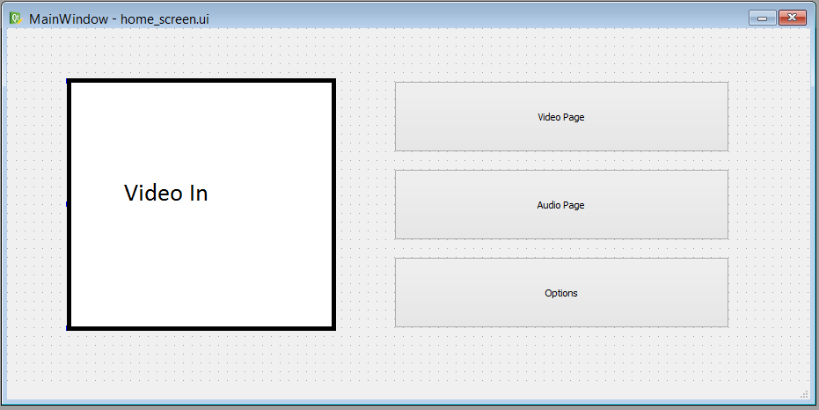

Slide 25
Person detection
OpenCV implemented, need to add infrared sensing
May have to adjust colors when using infrared cameras as they could distort colors when playing video
Need to compile face detection on the Raspberry Pi

Slide 26
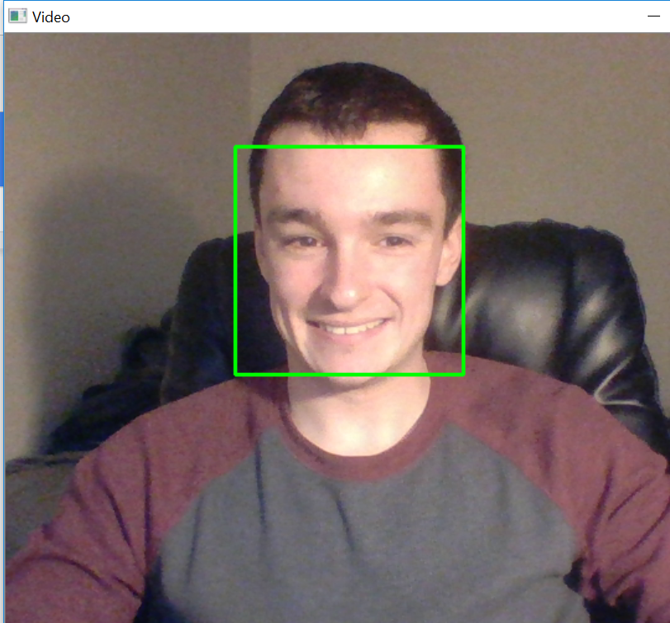

Slide 27
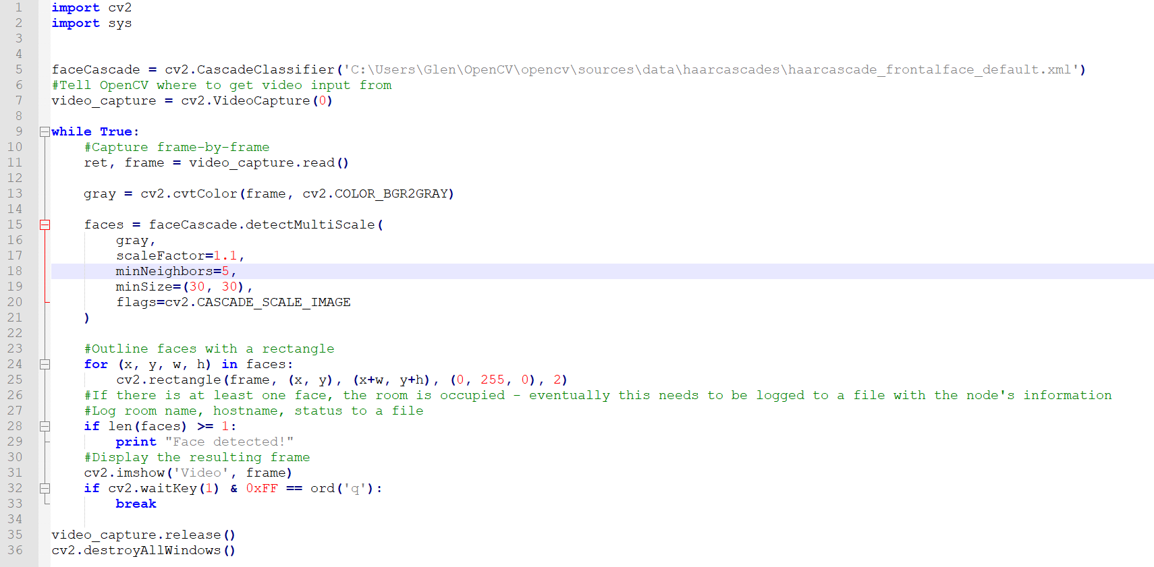
Person detection script (using OpenCV)
Based on this resource: https://realpython.com/blog/python/face-detection-in-python-using-a-webcam/

Slide 28
Problems
Scheduling difficulties continue to be an issue
To overcome scheduling difficulties, establish consistent meeting times and cancel as far ahead in advance as possible (if needed)
Video streaming has low quality and high latency
This is likely due to the overhead of encoding and decoding the video, we will troubleshoot by streaming raw video at a lower resolution
When streaming video, receiving node overheats
We will use a heat sink and possibly a fan to cool off the system, and remove some of the overhead with encoding video
Libraries like OpenCV take up a lot of space and will require a substantial portion of the available computing resources, this may become an issue eventually

Slide 29
What needs to get done
BATMAN needs to be implemented for the mesh network
User interface needs to be finished and back-end needs to be added
Person detection needs to be updated to include infrared sensing to tell a person apart from a pet
Video streaming needs to be enhanced so that it is fast
Audio I/O hardware needs to be added and audio streaming needs to be implemented

Slide 30
Implementation sequence (updated from Fall report)
1
2
3
4
5
B.A.T.M.A.N.
Encryption
User Interface
Operating System
Video Streaming
Audio Streaming
Assembling Hardware
Person Detection
Data Storage

Slide 31
Conclusion
Comfortable with where we are, certain components need to be worked on more in depth than others like batman-adv and audio streaming
Will continue meeting together on weekends to work more as a group
Looking forward to having a working product that can be prepackaged with a user manual

