Slide 1
Neural pathways related to alcoholism
PRESENTED BY SHARIQ H. AND KRITHIKAA M.
Notes:
We worked on the model by meeting in person and working on it together. We split the slide content, and presented the corresponding slides we created.

Slide 2
“Do people with alcoholism exhibit distinctive spatiotemporal patterns that are consistent enough across trials to allow a convolutional neural network to learn a reliable decision boundary between alcoholic and control groups using raw electrode signals alone?”
Our research question
Notes:
Spaciotemporal patterns- “differences in how electrical activity is distributed across the scalp and evolves over time in response to visual stimuli”

Slide 3
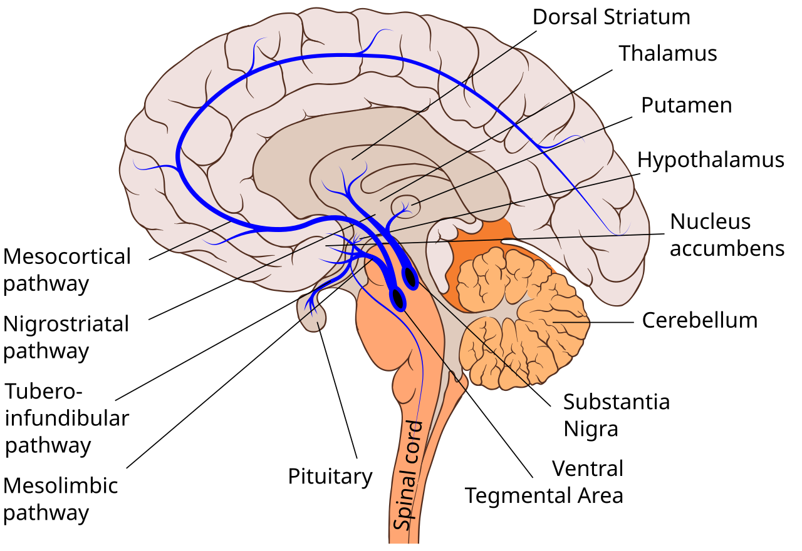
background
WHY THIS MATTERS
Understanding brain function in addiction
Reduce reliance on feature engineering
Possible real-time clinical applications
COGNITIVE/NEUROSCIENCE MOTIVATIONS
Alcoholism alters dopaminergic pathways
chronic alcohol use dysregulates the mesolimbic reward system, reducing baseline dopamine and driving compulsive seeking behavior
EEG captures cortical signatures of addiction
alpha suppression and theta enhancement are well-documented neural biomarkers that distinguish alcoholic brains even at rest
Early detection has clinical value
identifying neurological markers before behavioral symptoms emerge could enable earlier intervention and reduce misdiagnosis reliance on self-reporting

Slide 4

The Data
Data Source
From UC Irvine Machine Learning Repository Donated October 1999
Dataset Info
122 subjects each with 120 trials with different stimuli shown (3 classes: single stimulus, two matching stimulus, two unmatching stimulus)
Measured EEG signals of 64 electrodes sampled at 256 Hz for 1 second
Preprocessing Steps
Parse outdated trial files into one 18-million-line CSV

Slide 5
Model architecture
Input trial
(batch, 1, 64 channels, 256 samples)
Based of off EEGNet from Lawhern et al. (2018), a Convolutional neural network designed for EEG data.
Input: (1, 64 channels, 256 time samples)
Block 1 temporal conv
Leans frequency-selective patterns; picks up EEG rhythms (delta, theta, alpha, beta)
Block 1 spatial conv
Leans which electrode combinations relate to which brain regions; i.e. which electrodes fire together
Block 2 separable conv
Combines the temporal summary and frequency patterns to get combined spatiotemporal pattens
Block 1- temporal & spatial
frequency
patterns
Temporal conv
Conv2d(1->8, 64 channels, 256 samples)
electrode
weighting
Depthwise spatial conv
Conv2d(8->16, 64->1 channels, 256 samples)
ELU, AvgPool(1x4), Dropout
(16, 1 channels, 64 samples)
Block 2- separable conv
Depthwise temporal conv
Conv2d(16, 1 channels, 64 samples)
time
series
Pointwise conv
Conv2d(16, 1 channels, 64 samples)
ELU, AvgPool(1x8), Dropout
Conv2d(16, 1 channels, 64->8 samples)
Flatten
(batch, 128)
Logits (Probabilities)
Notes:
Input shape: (batch, 1, 64, 256)
Block 1 temporal: operates along time only, independent across channel (8, 64, 256)
Block 1 depthwise: each of the 8 feature maps is processed independently to 2 output maps -> 16 feature maps (16, 1, 256)
ELU activation keeps strong signals, suppresses weak signals
, avg pool reduces time 256 -> 64, (16, 1, 64)
dropout does regularization randomly zeros out some activations
Block 2
Depthwise temporal conv (16, 1, 64)
Each feature map is processed independently again, learns longer temporal dependencies
Then pointwise conv combines independently processed features for cross feature interaction
Avg pool 1x8 -> (16, 1, 8) -> flattened to 128

Slide 6
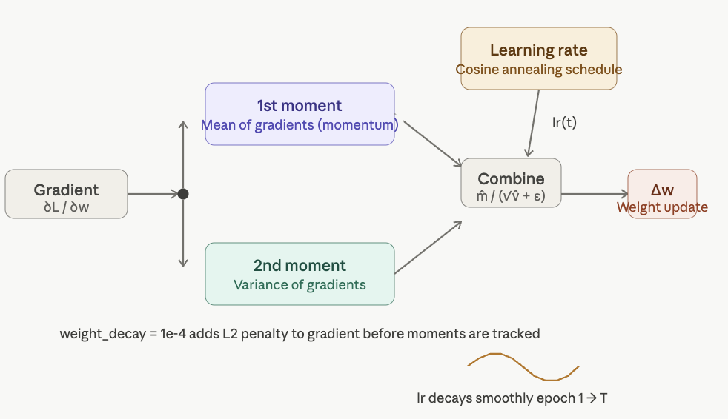

Learning rule
Loss function - CrossEntropyLoss (log loss)
CrossEntropyLoss applies softmax to convert raw outputs into probabilities, then computes the negative log-likelihood of the correct class. The model penalizes confident wrong predictions:
$L=−\log\left(p_{correct}\right)$
Optimization method - ADAM
Adaptive moment estimation updates each parameter using its own adaptive learning rate, tracking both gradient mean(momentum) and gradient variance. More stable than SGD on noisy EEG data. To preventor reduce overfitting, $weight_decay = 1e−4$adds L2 regularization.
Learning Rate - Cosine Annealing Schedule
ADAM starts with Ir – 0.001(default). Rather than keeping it fixed, a cosine annealing schedule gradually decays the learning rate toward zero across epochs:
$lr\left(t\right)=lr_{min}+\frac{1}{2}\left(lr_{max}−lr_{min}\right)\left(1+\cos\left(πt/T\right)\right)$.
Early epochs uses large steps while later epochs uses smaller steps to allow Adam’s momentum to fine-tune weights into a sharp minimum.
Train / Validation / Test Split
Data split: 70% / 15% / 15%,
divided by trial not subject.

Slide 7
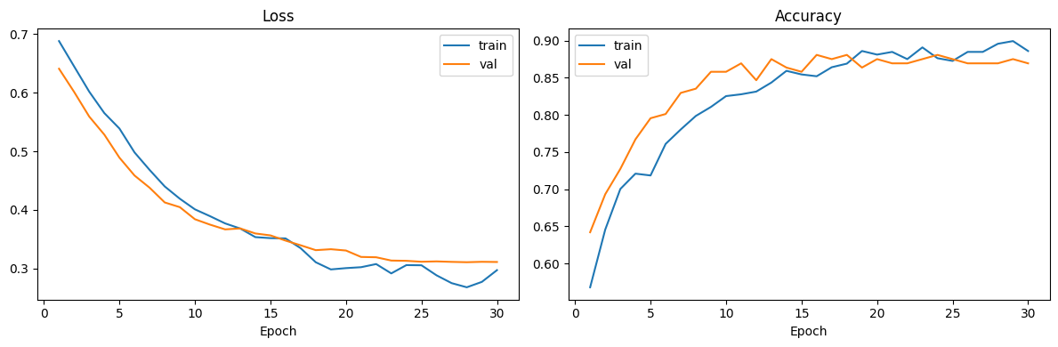
Training results
Loss curve
Training and Validation loss decrease steadily from ~0.69 to ~0.30 over 30 epochs
Both curves stay close together indicating that the model generalizes well with no significant overfitting
Both losses are low and decrease substantially & accuracies are high and close, indicating no underfitting.
Accuracy curve
Training and Validation accuracy rise from ~0.58 to ~0.88 over 30 epochs
Validation tracks closely, occasionally exceeding training accuracy, showing good generalization.

Slide 8
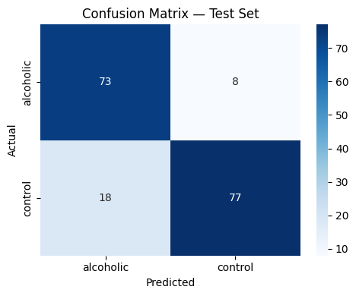
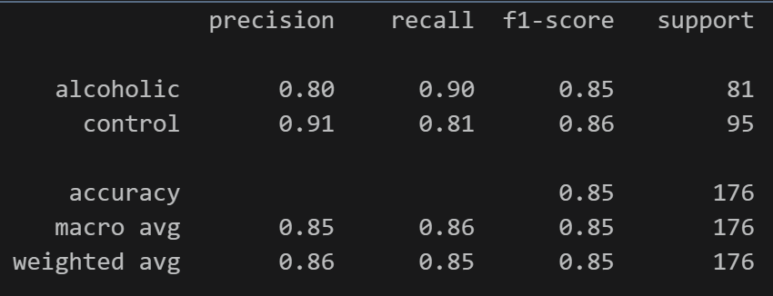
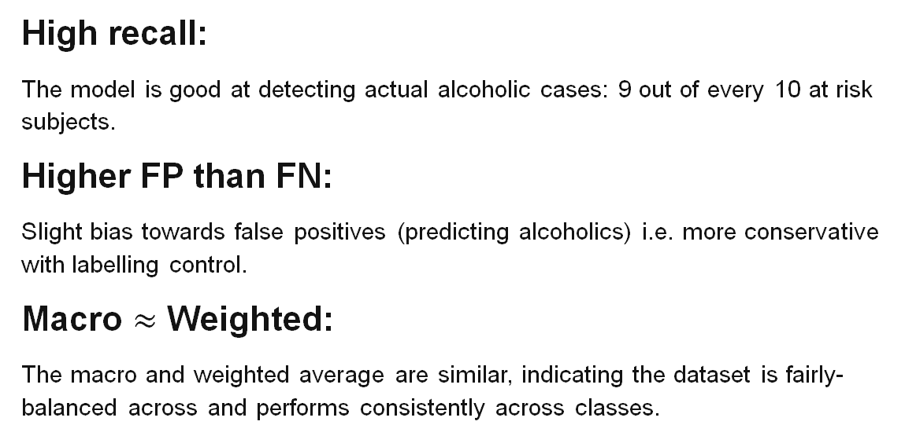
Evaluation
Overall Accuracy
85%
Over 175 samples
Macro F1 Score
0.85
Balanced classes
Alcoholic Recall
0.90
90% of cases
Control precision:
0.91
↓ false negatives
High recall:
The model is good at detecting actual alcoholic cases: 9 out of every 10 at risk subjects.
Higher FP than FN:
Slight bias towards false positives (predicting alcoholics) i.e. more conservative with labelling control.
Macro $≈$ Weighted:
The macro and weighted average are similar, indicating the dataset is fairly-balanced across and performs consistently across classes.
Notes:
Alcholic class has precision 80%, recall 90%
Control “” 91%, 81%

Slide 9
Interpretation
What does the model tell us?
It approximates the brain signal patterns associated with alcoholism, using raw spatiotemporal EEG patterns. Our model does not model cognition, rather it recognizes patterns.
Cognitive Implications
Alpha suppression (relaxation) and theta enhancements (drowsiness) are known biomarkers of alcoholism. Model’s ability to classify above 85% accuracy supports the hypothesis that EEG caries genetic predisposition signatures before the disorder develops.
Deterministic or Probabilistic?
Deterministic – same EEG input produces same classification output. SoftMax outputs class probabilities but does not quantify uncertainty.
Model Assumptions
EEG signals contain discriminative patterns.
Temporal patterns are meaningful
Spatial electrode relationships carry diagnostic information
Data is clean, correctly labeled & accurate
Trials are independent of each other
Assume consistent electrode ordering across trials

Slide 10
Limitations
Biological Realism
The model processes EEG signals but does not reflect how biological neurons compute (all or nothing).
Model learns by sending error signals backwards through the network (Backpropagation) and finds statistical regularities in EEG data
Real neurons fire in an all-or-nothing fashion, ELU activation outputs a continuous value, which doesn't reflect that
Learning happens via backpropagation, which requires sending error signals backward through the network unlike real brains
The model has no concept of timing/spiking; real neurons communicate through spike timing, not weighted sums
The model is a functional classification model, not a biological mechanical one.
Data limitations
Subject leakage: split by trial not subject
Small dataset: EEG inherently noisy and hard to standardize.
Temporal window fixed at t1: Might miss longer cognitive processes
Artifact handling: no removal of eye blinks, muscle noise or electrode artifacts.
Black box model

Slide 11
Future work
Increase Dataset Size
Adding full UCI EEG dataset or combining with other public EEG alcoholism datasets
Increase Temporal Window
Trials currently fixed at 1 second, experimenting with longer time window ma capture slower cognitive processes
Bayesian CNN
Replace standard weights with probability distribution to quantify uncertainty per predication to make the model more confident.

Slide 12
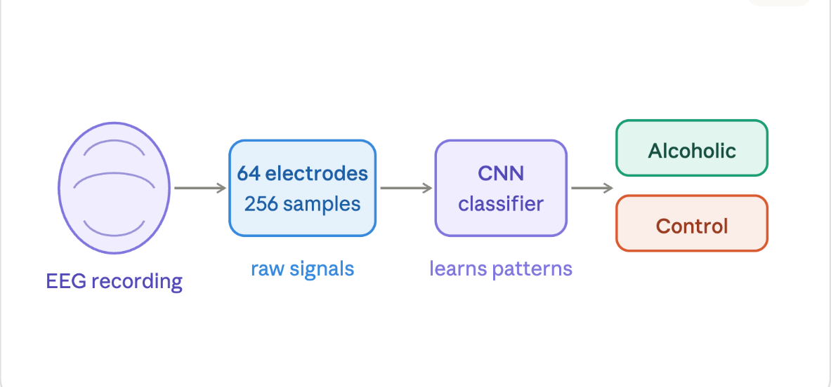
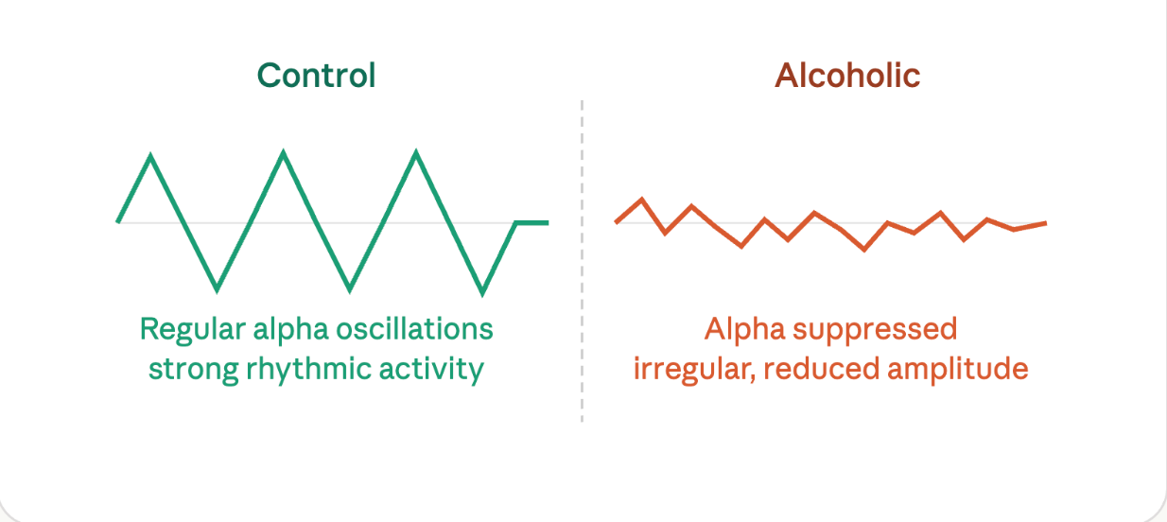
Conclusion
85% accuracy classification of Control vs Alcoholic subjects
Spatiotemporal EEG patterns are detectable enough for model to learn and make decisions
Biomarkers of Alcoholism risk: Alpha suppression and theta enhancement key to model performance
Use of CrossEntropyLossModel + ADAM + Cosine annealing were effective for handling noisy EEG data
Demonstrates High recall: 0.90 for alcoholic

