Slide 1
Models
“All models are wrong, but some are useful”
-George Box, 1979

Slide 2
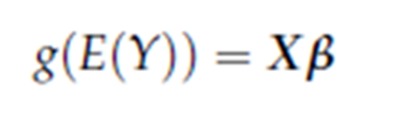

General set-up
Outcome Y, Predictors X
Number of predictors p
Number of observations n
Typical statistical model is of the form:
Where g is the link function (identity, logistic, log, probit) and is the vector of regression
coefficients.

Slide 3
General Caveats
All inferential tools that you learned assumes that the model was specified a’priori. They are invalid if model was chosen based on data.
Generally, data adaptive model selection makes estimated regression coefficients biased away from zero and estimated residual variance towards zero.
Leading to false positives and overfitting.

Slide 4
Highly active area of research
The problem becomes adverse (larger biases) when the potential model space to search is large and the number of observations is not that large. We statisticians call it the large p small n problem.
Easiest solution is not to carry out model selection based on data but often unavoidable.

Slide 5
Constructing a Model
Usually faced with problem of selecting subset of p possible predictors.
Have to balance conflicting objectives
- Predictive Accuracy versus Model Parsimony
Ideal: determine single best subset of predictors
But no single definition of “best”
Different algorithms will produce different "best" subsets
Problems magnified by correlation among predictors

Slide 6
Model selection strategies differ based on your inferential objective
Prediction?
Estimation?
Hypothesis Testing?
Interpretation as risk factors?
Discovery of biomarkers?
Testing treatment effect?
Causal interpretation of a coefficient?
Identification of sets of important predictors/variables.

Slide 7

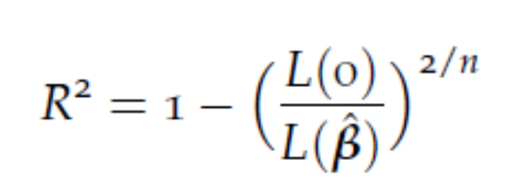

Criteria for Choosing Models
R², Adjusted R², Mallows C_{p}
Pseudo R² type measures for logistic regression, Cox and Snell R², Naglekerke R²
Likelihood of model with only intercept: L(0), Likelihood evaluated at MLE:

Slide 8

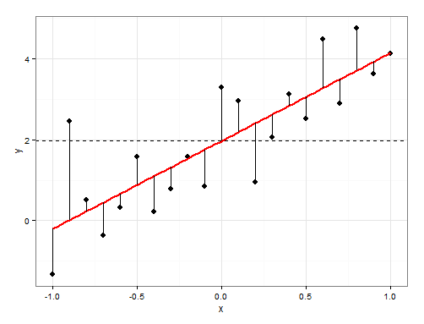
Overfitting

Slide 9
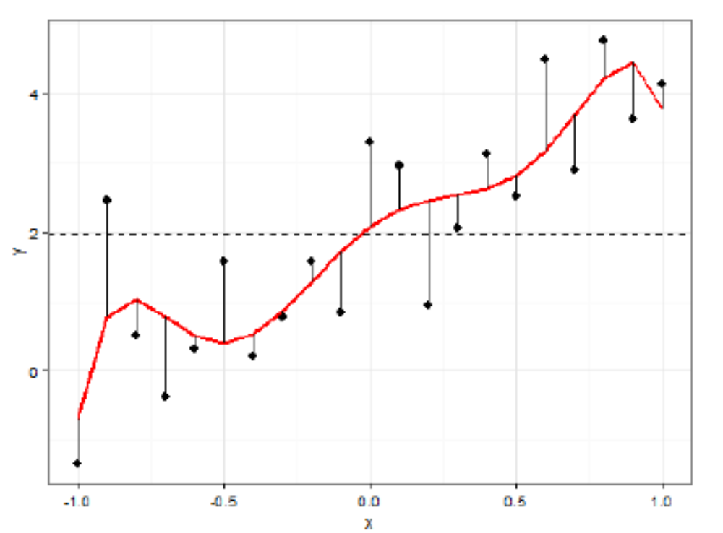
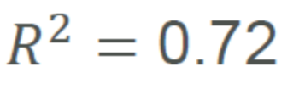
A better model?

Slide 10
Model complexity versus accuracy
Assessment of prediction error on the same dataset used to fit a model may be misleading.
Too much complexity can diminish its accuracy on predicting a future set of observations.

Slide 11
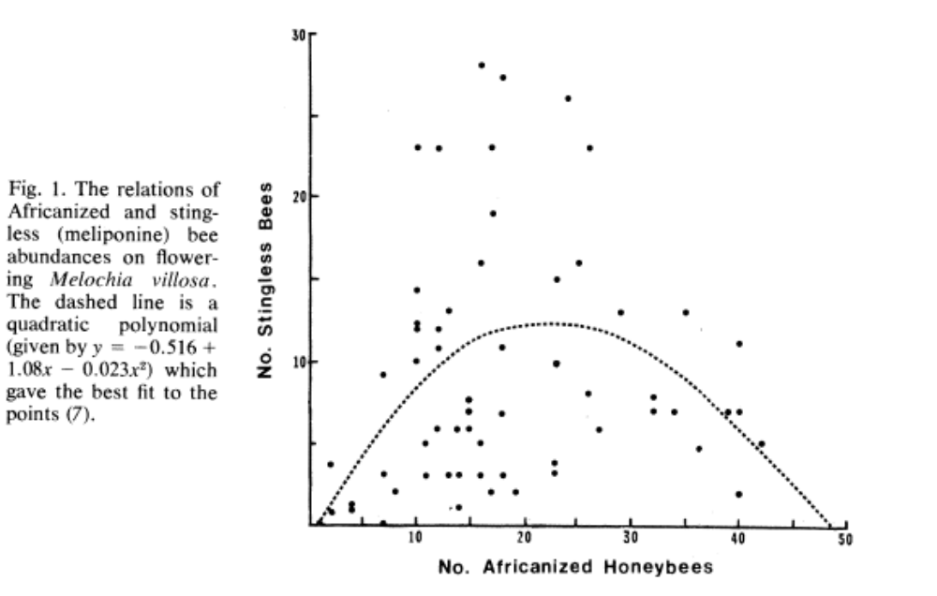
Overstretching your data to create a buzz…

Slide 12
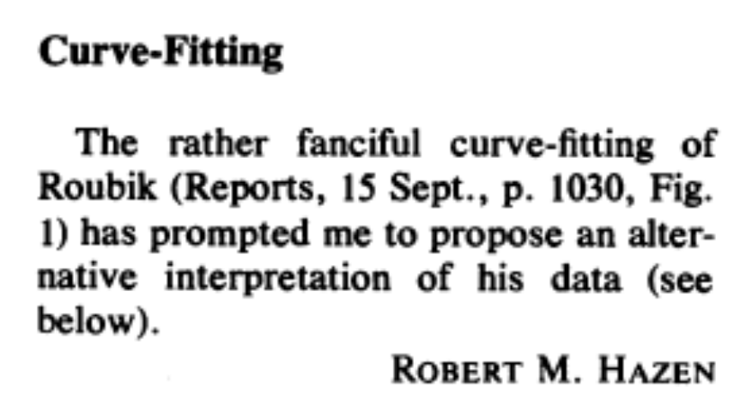
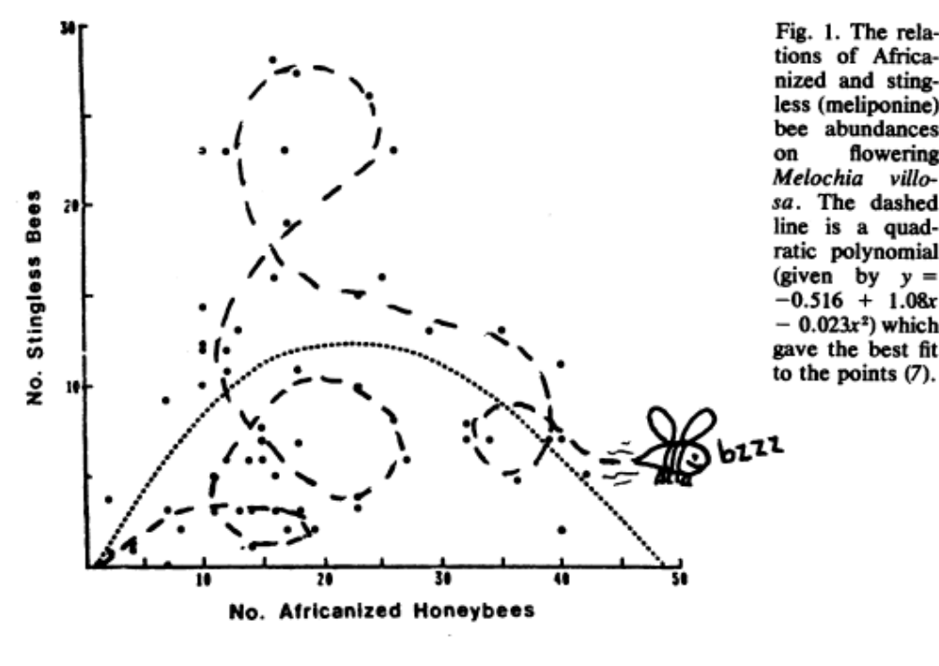
Bee Careful of
Stinging rebuke

Slide 13
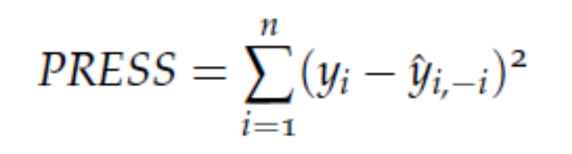

Out of sample prediction
PRESS (predicted residual sum of squares)
Remove the i-th observation, re-fit model, re-estimate parameters, predict the i-th observation with this model: calculate the residual. Do it for each observation (or a random subset). The model structure leading to smallest value of PRESS is preferred.

Slide 14
General strategy of cross-validation
Data divided into two parts: test data and training data.
Model selection, fitting uses training data.
Selected model is used to predict values in the test data.
Use measures of assessment to quantify how well model predicts test data set.
This provides a more realistic unbiased estimate of the predictive power of a model.

Slide 15
K-fold cross validation
Split the data into k subsets of equal size.
Estimate/fit model based on all subsets except one.
Use the left out subset to test your model by calculating a metric of your choice (for example mean squared residual error)
Average the metrics across the subsets to get an estimate of the cross-validation error.

Slide 16
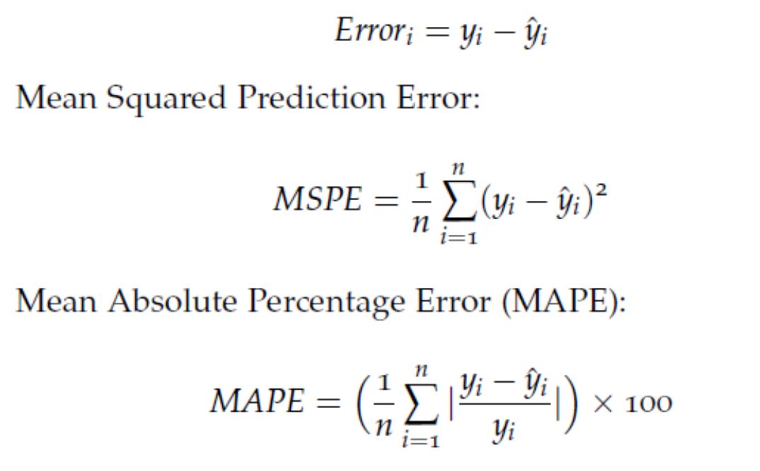

Cross-validation metrics

Slide 17
Goodness of fit criteria:
Akaike Information Criterion, Bayes Information Criteria (smaller is better)
-2*maximized log likelihood + 2p : AIC
-2*maximized log likelihood+ p log(n) : BIC
For small data sets a correction is needed for AIC, namely AIC_{c}
BIC gives more parsimonious models

Slide 18
Typically in R
dat=data.frame(cbind(y,x))
fit=lm(y~x,data=dat)
summary(fit)
AIC(fit)
BIC(fit)
library(leaps)
leaps( x, y, method="Cp")

Slide 19
Univariate Association
y=dat$bloodpb
num.x= ncol(x) #number of predictors
col.x=colnames(x)
univ=matrix(0,num.x,2)
colnames(univ)=c('beta','pvalue')
rownames(univ)=col.x

Slide 20
univ=data.frame(univ)
for(i in 1:num.x)
{fit=lm(y~x[,i]) univ[i,]=
summary(fit)$coefficients[2,c(1,4)]}
univ=univ[order(univ$pvalue),]
# sorted by pvalue in increasing order
univ

Slide 21
First few rows….
beta pvalue
calcium 1.33e+00 0.000366
white -3.11e+00 0.001074
dbp 5.01e-02 0.001566
wcollar -8.84e-01 0.003911
twodrink 1.02e+00 0.006163

Slide 22
Screen based on univariate association
A naïve approach by fixing a significance threshold and use all predictors with univariate p-value less than the cut-off in a multivariate model.
No consideration regarding correlation among predictors.

Slide 23
col.x.ml=rownames(univ)[which(univ$pvalue<0.2)]#the names of predictors that have p-values<0.2 in the univariate association analysis
length(col.x.ml)#tells you how many
dat.ml=data.frame(cbind(y,x[,col.x.ml]))
fit.ml=lm(y~.,data=dat.ml)
summary(fit.ml)

Slide 24
Algorithms to select subsets
All possible subset (feasible for p<10)
Leaps and Bounds (search through smaller model space)
Forward Selection
Backward Elimination
Stepwise Selection

Slide 25
All possible subset
With 10 predictors 2¹⁰ or 1024 models to evaluate.
Within models of dimension k, pick the top models according to a criteria (say Mallow’s Cp or R² ), then compare across k
Computation gets out of hand quite quickly.

Slide 26
Backward Elimination
Start with all p predictors.
Remove the least significant predictor with p> pre-determined threshold=α*
Re-fit model and go to step 2.
Stop when p-values for all predictors retained in model are less than α*
This threshold is typically not set at 5% but at 10-20%.

Slide 27
Forward Selection
Start with intercept only model.
For all potential predictors check p-values if they are added to the model, choose the one with lowest p-value (< α*).
Continue until no new predictor can be added.
Things entered earlier steps may lose significance as new predictors are added.

Slide 28
Stepwise Regression
Each step a variable can be added or removed, bidirectional.
This can be carried out in a number of ways.
At each step of forward selection you check whether one or more predictors can be removed without increasing the residual some of squares “too much”.

Slide 29
Drawbacks
No guarantee of optimal model
So much unaccounted multiple testing, the P-values are dubious at best
No direct connection to the application context (prediction, estimation)
Tends to overstate the effect of predictors retained in the model.

Slide 30
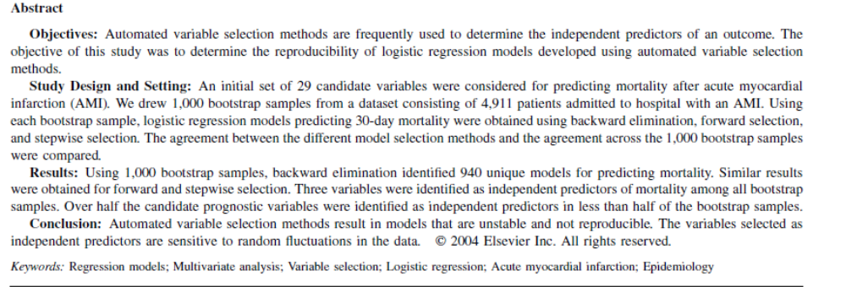
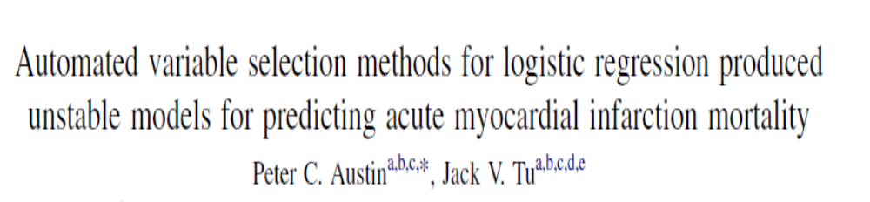
Model Validation

Slide 31
R implementation
dat.nas=data.frame(cbind(y,x))
fit.ml2=lm(y~.,data=dat.nas)
fit.stpwise=step(fit.ml2,direction='both')#do both forward and backward selections
summary(fit.stpwise)
Can choose direction forward or backward as well.

Slide 32
Want to enforce certain X
##always keep age and packyrs in the model
fit.stpwise2=step(fit.ml2,scope=list(lower=~age+packyrs),direction='both')
summary(fit.stpwise2)

Slide 33
General Guidelines
Don't rely too heavily on numerical criteria
All models are wrong, some less wrong.
Be guided by background knowledge of relationships whenever possible
Follow Occam’s Razor principle, beauty in simplicity, parsimony, succinctness
For GLMs there are really two parts to model selection, link function & variable selection

Slide 34
Some things to think about
Many models may be consistent with data
Chance for finding spurious correlation go up with the size of the screening list
Bring in substantive information to initially reduce the initial list.
Adjust for confounding. Covariates strongly associated with outcome are introduced to gain precision not just confounders.

Slide 35
A conceptual framework
Compulsory confounders: Either by convention (Race) or strongly associated with both Y and X (smoking, BMI)
Optional confounders: The case is not very strong, can be omitted if estimated effect for X does not change very much.
Precision variables: Not associated with X but associated with Y, helps reducing error variance.

Slide 36
Summary Thoughts
Variable Selection is means to an end, not an end in itself. Use as a guide.
Several competing models
- Do they make similar predictions?
- What is the cost of measuring the predictors in a new study?
- Which model has best regression diagnostics
-What are the qualitative consequences? The data may be ambiguous about your question of interest, leading to models with opposite conclusions being equally preferred.

Slide 37
References
Harrell, F. E. (2001), Regression modeling strategies: With applications to linear models, logistic regression, and survival analysis, Springer-Verlag, New York.
http://biostat.mc.vanderbilt.edu/wiki/Main/FrankHarrell
Miller, A. J . (2002), Subset selection in regression, Chapman & Hall, London.

