Slide 1
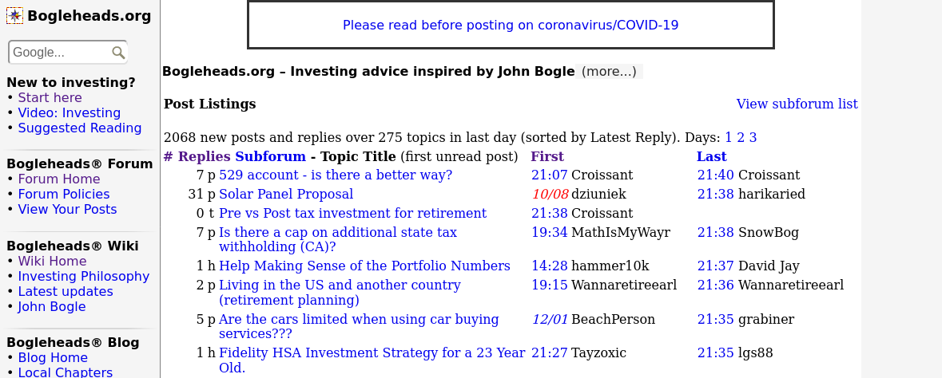
Boglehead Recommendations
Crawled www.bogleheads.org and scraped posts for links

Slide 2
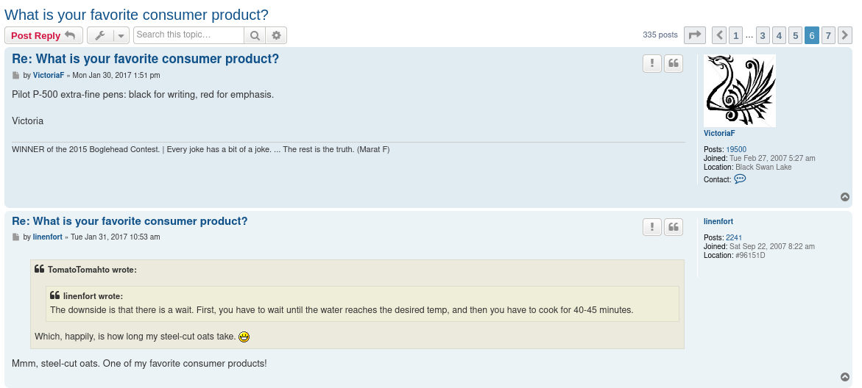
Problem Statement

Slide 3
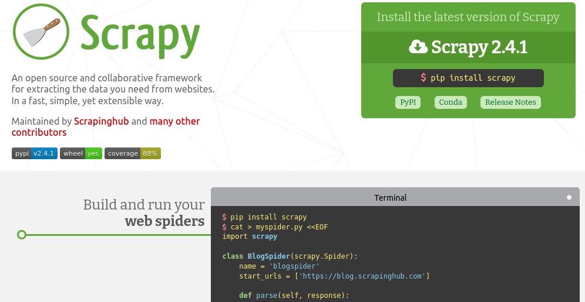
Libraries Used
Scrapy (https://scrapy.org/)

Slide 4
Libraries Used
urllib (Extracting domain name from URL)
psycopg2 (Database operations)
configparser (Extracting database credentials from config file)
matplotlib (Visualizing results)

Slide 5
Lessons Learned
Power of crawling and scraping
Databases

Slide 6
Limitations
Amazon API
Web development
  Trends
  Search/Filter

