Slide 1
FUTURE CARIBBEAN 2026 · FINANCE, PAYMENTS & MSME CAPITAL
Sage
An AI agent that pays people for verified work.
In the next few minutes, you'll watch it pay someone. Live, with real money.
Shariq Shaukat · Founder
sagepays.xyz
Notes:
1 · OPENING (to 0:15). Learn these three lines by heart.
Hi, I'm Shariq, and I built Sage.
In the next few minutes I'll post a job, and an AI agent will check the work and pay for it. Live, with real money. Nobody will approve that payment, not even me.
But first, why it matters here.

Slide 2
A SELLER IN KINGSTON
She delivers. She gets paid.
Order of 40 delivered to the hotel this morning.
Seller · 09:12
To a bank, she doesn't exist.
Got them, thank you. Sent J$48,000.
Buyer · 11:40
90%
40%+
Received. Same again next week?
Seller · 11:42
of jobs in Jamaica are in micro, small and medium businesses
of firms say access to finance is a major constraint
The money moved.
The proof stayed in a chat.
Not bad businesses. Unrecorded ones.
World Bank, “From Dreams to Thriving Business”, April 2025
Notes:
2 · THE PROBLEM (to 0:45)
Think of a seller in Kingston. She delivers, she gets paid on WhatsApp, and the proof stays in a chat.
So when she asks a bank for credit, she has nothing to show.
In Jamaica, small businesses are ninety percent of jobs, and over forty percent of firms say finance is a major constraint. Not bad businesses. Unrecorded ones.

Slide 3
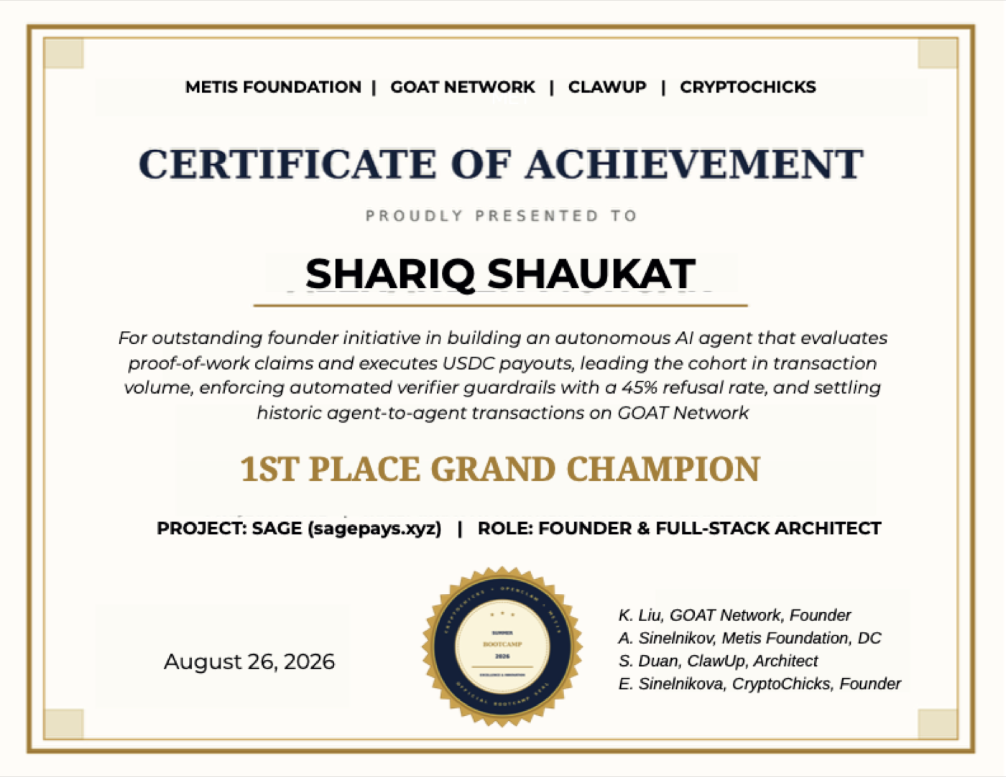
WHAT SAGE IS
An AI agent that checks the work and pays for it
In minutes, from a vault it can't overspend. And every payment becomes a credit record a lender can read.
1ST PLACE · GRAND CHAMPION
OpenClaw Summer Bootcamp 2026: Metis Foundation, GOAT Network, ClawUp, CryptoChicks
Real people, real money, since July
$76.48
45
25
26
settled
mainnet payments
people paid
refusals, each explained
Read from the public ledger at sagepays.xyz/explorer, 10 Oct 2026
Notes:
3 · SAGE (to 1:10)
Sage fixes the record by fixing the payment. It's an AI agent that checks the work, pays for it in minutes from a vault it can't overspend, and turns every payment into a record a lender can read.
And it's not a prototype. It has paid real people real money since July. In August it won first place, Grand Champion, at the OpenClaw Summer Bootcamp, from Metis, GOAT Network, ClawUp and CryptoChicks.

Slide 4
LIVE
Let me show you.
THE JOB I'M ABOUT TO POST
1
I post it, as the buyer
“Put my shop's price list online: three items, each priced in Jamaican dollars, on a public page.”
2
I do it, as the seller
J$160 one payment
3
Sage checks it and pays. Nobody approves it.
Real USDC on Arc mainnet. Every payment is a public transaction. 45 mainnet payments since July.
Notes:
4 · LIVE (to 1:15)
Let me show you. Live, with real money, on Arc, where the dollar pays its own fee.
>> CMD+TAB TO CHROME: THE BUYER'S WINDOW, ON SAGEPAYS.XYZ, ALREADY SIGNED IN.
CHROME · BUYER · POST THE JOB (to 2:10)
I'm the buyer. I write what I want in one sentence, in my own money: put my shop's price list online, three items in Jamaican dollars, J$160.
>> CLICK "DRAFT WITH SAGE".
Sage is turning that sentence into a real job: the steps, what must be true when it's done, and what counts as proof. Those are the rules it will judge by.
No forms, no categories. And one thing it never does: set the price. The money is mine to set.
>> WHEN THE FORM FILLS, POINT AT THE RULES AND THE PRICE. TICK "ONLY PEOPLE I INVITE". CLICK "CREATE THE GIG".
CHROME · BUYER · LAUNCH IT (to 2:30)
Now I fund it. I don't send money to anyone. Sage creates a vault on chain, funds it from my account, and switches it on.
>> CLICK "LET SAGE LAUNCH IT FROM YOUR ACCOUNT ON ARC".
Live. The vault holds exactly the reward, and Sage can't pay a cent more.
>> CLICK "THE BOARD". COPY THE ADDRESS: CMD+L, CMD+C.
CHROME · SELLER · DO THE WORK (to 2:50)
>> SWITCH TO THE SELLER'S WINDOW (CMD+`). PASTE THE ADDRESS: CMD+L, CMD+V, ENTER.
Now I'm the seller, a different person with my own wallet. I've already put my price list online.
>> CLICK "SUBMIT EVIDENCE". TYPE THE SHOP LINK. CLICK "SIGN + SUBMIT EVIDENCE".
Submitted.
CHROME · SELLER · SAGE DECIDES (to 4:05). The money moment. Slow down. Paid takes about a minute.
>> SCROLL DOWN TO "SAGE ACTIVITY".
Watch. Sage is opening my page itself, not trusting my word.
It checks every rule the buyer set: three items, prices in J-dollars, the shop's name, and my wallet on the page, so nobody else can claim my work.
It has to quote the exact words it relied on. And it can say no: it has refused 26 times so far, every time with the reason written down.
And the money isn't with Sage. It's in the vault the buyer funded. The vault decides the amount; Sage can only say yes or no.
>> IF IT IS STILL CHECKING, SAY NOTHING. SILENCE WHILE THE ROOM WATCHES IS FINE.
>> WHEN IT SAYS PAID: STOP TALKING FOR TWO SECONDS.
Paid. Nobody approved that. Not me, not anyone.
>> CLICK "PROOF" ON THE PAID LINE. SCROLL TO "SAGE DECISION RECEIPT".
Here's the receipt: the decision, how sure it was, and the exact words from my page. Anyone in this room can open it.
>> CMD+TAB TO KEYNOTE. PRESS →.
IF IT STALLS:
- Drafting takes over 75 seconds, or launch fails: "Here's the same job, posted this morning." Open the buyer's second tab (the backup job), copy its address, and carry on from the seller step.
- No Paid after 90 seconds: "It's still checking. Here's the one I ran earlier today." Cmd+Tab to Keynote and →. The next slide shows that receipt.
- It says Held: "It held this one for a person to check. That's the guard working: it would rather wait than pay for weak proof." Cmd+Tab and →.

Slide 5
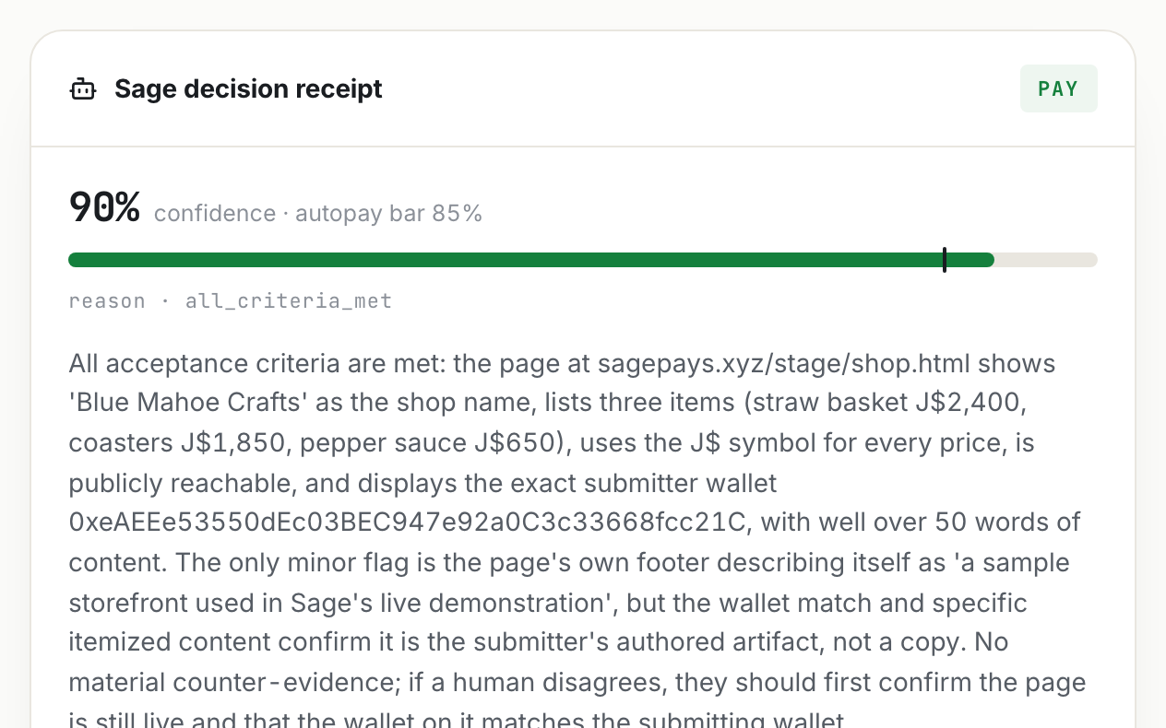
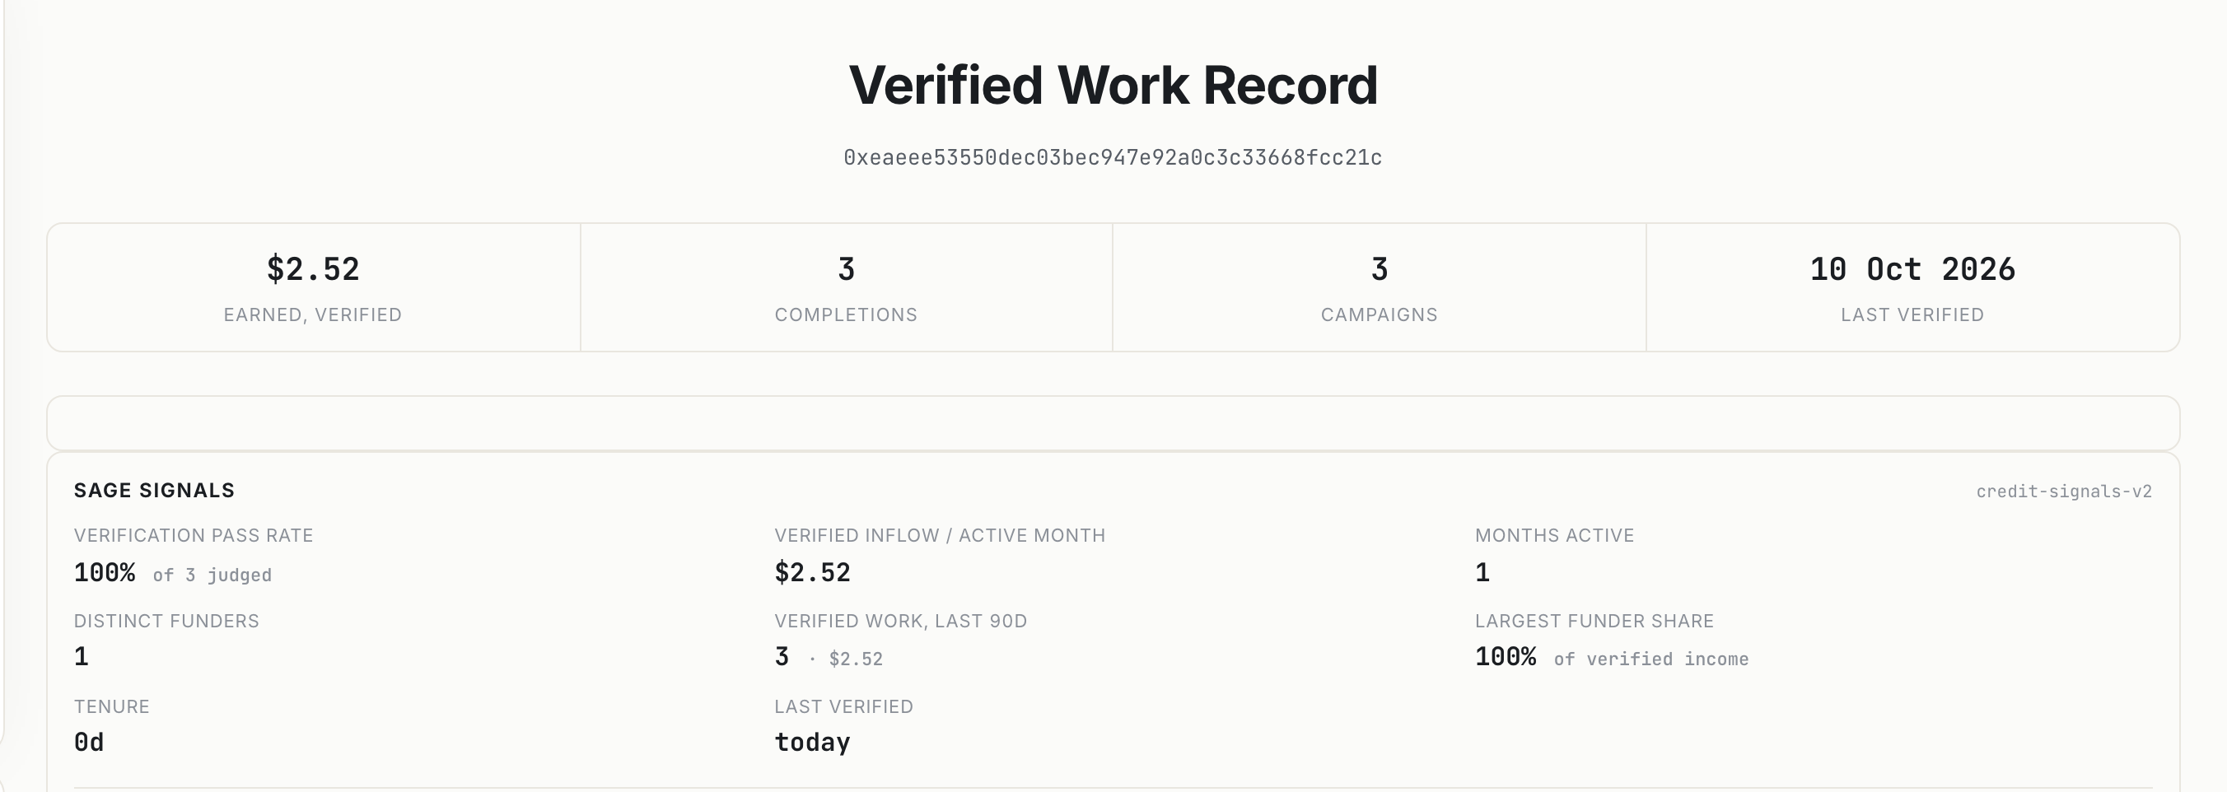
A receipt for every payment, and a credit record
The seller's live record on sagepays.xyz/record (excerpt)
1
Verified income
30 and 90 days, receipts only.
2
Who paid, and for how long
The decision Sage recorded on a real-money rehearsal (Arc mainnet)
Distinct payers, tenure, pass rate.
3
One call for a lender
JSON, CSV or a printed statement.
Notes:
5 · RECEIPT AND RECORD (to 4:30). Works whether the live run paid or stalled.
If it paid live: "That's the receipt you just saw, and that payment just became a line in my record."
If it stalled: "Here's the receipt from the run earlier today, and the record it became."
Verified income over thirty and ninety days, who paid me and for how long, how often my work passes. Published formulas over real receipts, not a black-box score. A lender reads it in one call.

Slide 6
NEXT · WHERE THIS GOES
An AI finance worker for every small business
BUILT · PILOTS NEXT
NEXT
NEXT
Give it a goal and a budget
Pay on proof, keep the books
Recovery, paid in minutes
Sage decides what work to buy, says why before it spends, and you can veto any move.
Suppliers and freelancers paid the moment the work is verified. Every job builds the business's credit.
After a hurricane, a programme pays a thousand people for verified clean-up the same day, not in weeks.
Its limits are code it can't change.
Local cash-out through licensed partners.
Every payout auditable by anyone.
Notes:
6 · NEXT (to 4:50)
Now imagine where this goes. Next, you won't even post the job: you give Sage a goal and a budget, and it decides what to buy and tells you why before it spends.
Every small business gets an AI finance worker that pays on proof and turns every job into credit. After a hurricane, a programme could pay a thousand people for verified clean-up in minutes.

Slide 7

WHAT WE NEED NOW
The engine is live. It needs the institutions it was built for
1
An MSME programme that wants to pay on proof
2
A cooperative paying members for delivered work
sagepays.xyz/caribbean
Everything you saw today
3
A lender who'd price verified cash flow, not collateral
Twenty minutes with you is our next milestone.
Notes:
7 · THE ASK (to 5:05)
The engine is live. It needs the institutions it was built for: an MSME programme, a cooperative, and a lender who'd price verified cash flow instead of collateral. Twenty minutes with any of you is our next milestone.
>> PRESS → FOR THE LAST SLIDE.

Slide 8
Sage
Payments that verify themselves.
Credit records that write themselves.
sagepays.xyz · @sagepaysai on X · Shariq Shaukat on LinkedIn
Notes:
8 · CLOSE (to 5:10)
Sage. Payments that verify themselves. Credit records that write themselves. Thank you.
>> THEN STOP TALKING.

