Slide 1

Movie Revenue Prediction
Shariq Hashmi

Slide 2
Business Problem
Movie Revenue Prediction
Business Need: A movie studio while budgeting a movie production wanted a deeper insight and a more precise budgeting amount for allocating investment funds in producing a movie. The client wanted a data-driven decision based on the historical data, they wanted a prediction model which can predict a movie’s revenue collection once its released. This prediction model will help the movie sponsors to allocate budget amount better confidence.
A historical dataset was provided comprised mainly of categorical variables. Since machine learning models take only numerical inputs, the dataset needed to be modified and reformatted before being fed to the model.

Slide 3
Data Understanding
Revenue is the predicted Target Variable
Revenue is a continuous value, Regression Analysis is performed.
Models generated: Linear Regression & XGBoost

Slide 4
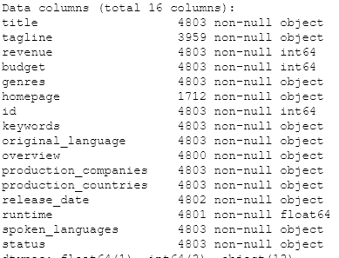
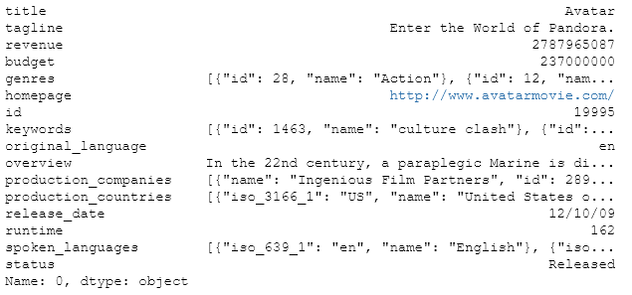
Data Understanding
Data has 4803 Rows and 16 Columns
  4 columns numeric and 12 non numeric

Slide 5
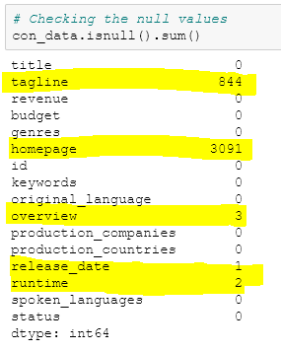
Data Understanding
Missing values:
  Tagline → 844
  Homepage → 3091
  Overview → 3
  Released date → 1
  Runtime → 2

Slide 6
Data Preparation
Selected few variables (genres, revenue, budget, runtime, status)
Removed observations with missing values
Convert String to List
Convert Date (Split into Month/Day/Year)
Fix Date with 2 Digits
Pulled values of the dictionaries (using the “NAME” value)
For genres column, picked the first element of the NAME list

Slide 7
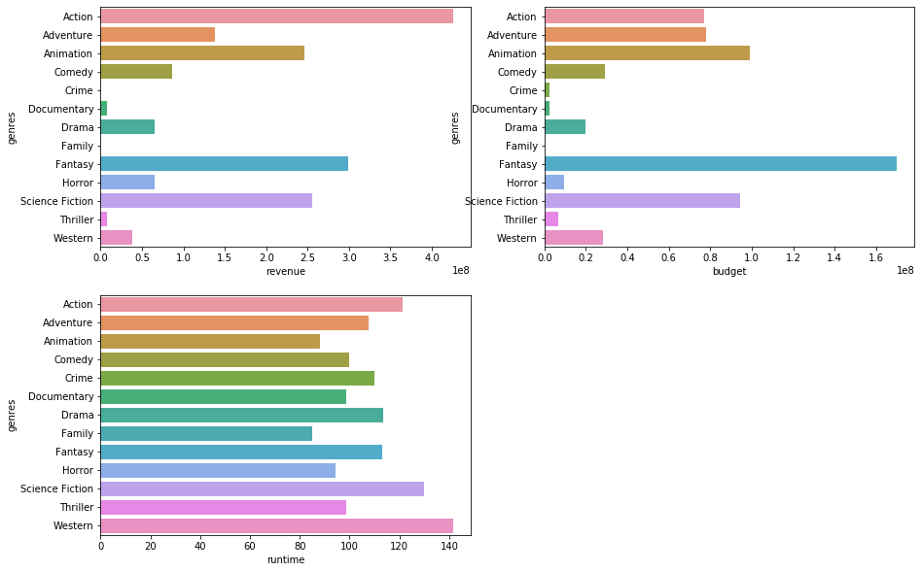
Data Viz
Distribution of revenue per genres
Distribution of Budget per genres
Distribution of runtime per genres

Slide 8
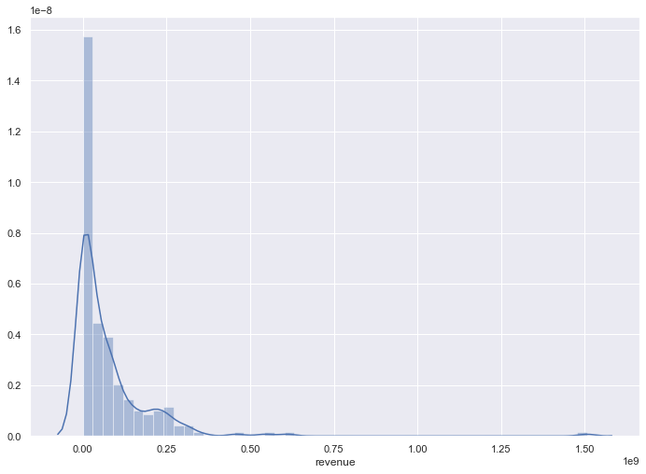
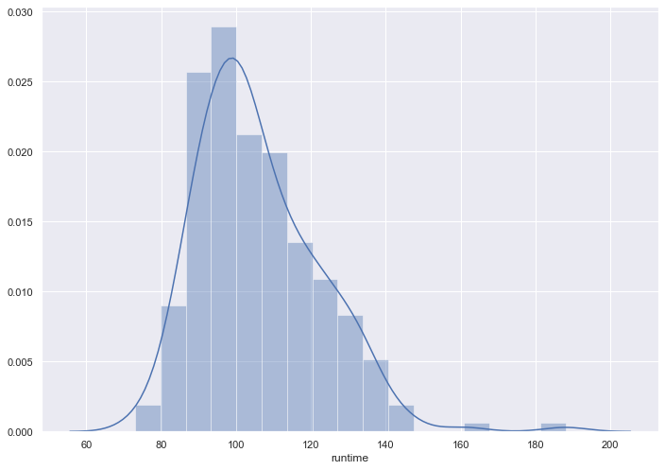
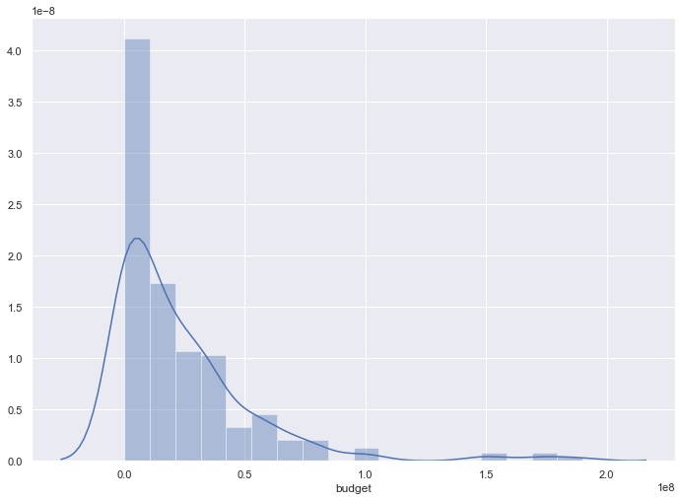
Data Viz
Distribution of revenue
Distribution of Budget
Distribution of runtime

Slide 9
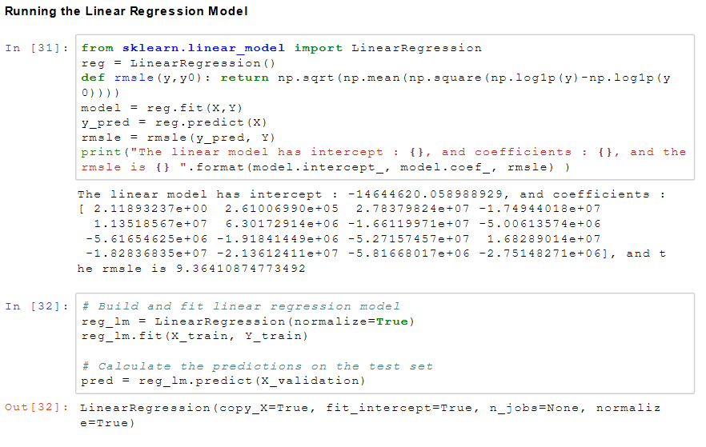
Analytical Approach
    Used Linear Regression
    Used XGboost

Slide 10
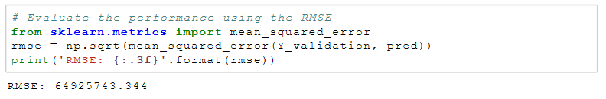
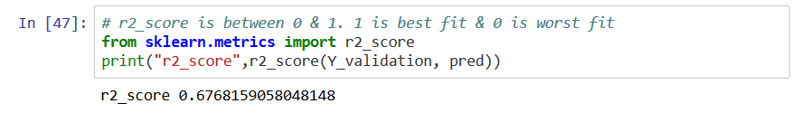
Algorithm - Testing
metric calculates the error.
Mean absolute error regression loss
R^2 (coefficient of determination) regression score function.

Slide 11
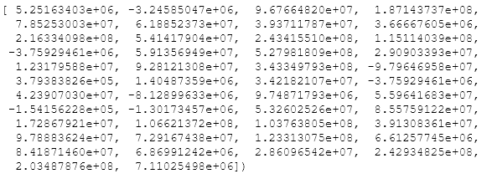
Analytical Approach(LR)
    Linear Regression

Slide 12
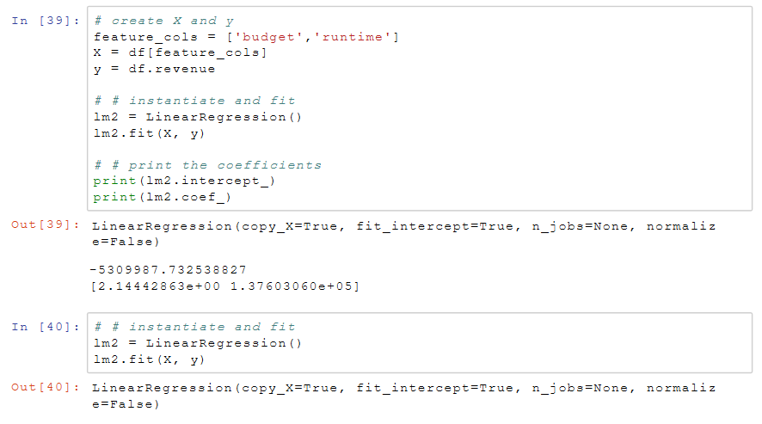
Analytical Approach(LR)
Linear Regression

Slide 13
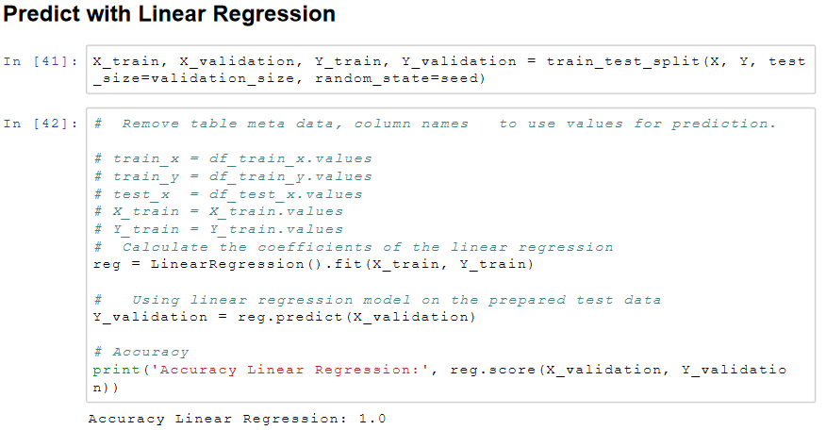
Analytical Approach(LR)

Slide 14
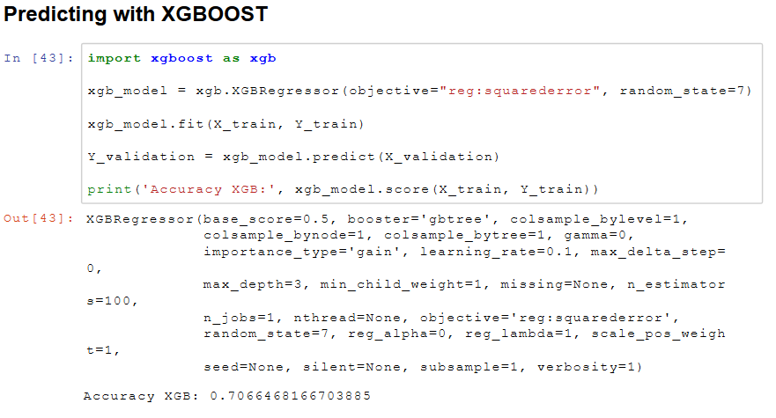
Algorithm – XGBoost Model
Predicting with XGBoost.

Slide 15
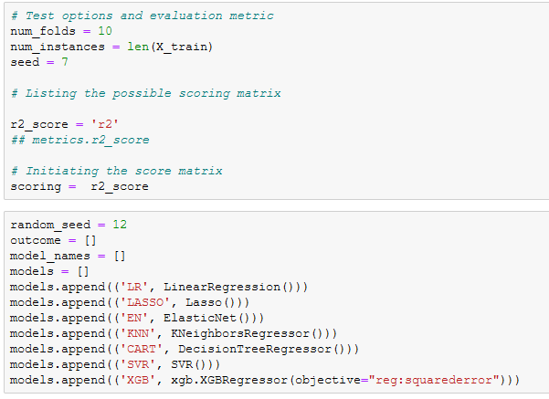
Multiple Algorithms
Trying with other algorithms.

Slide 16
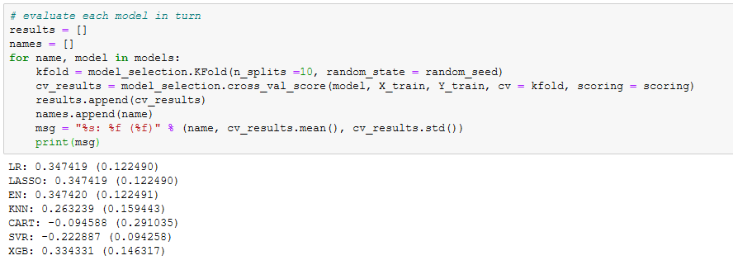
Multiple Algorithms
Trying with other algorithms.

Slide 17
Multiple Algorithms
Trying with other algorithms.

Slide 18
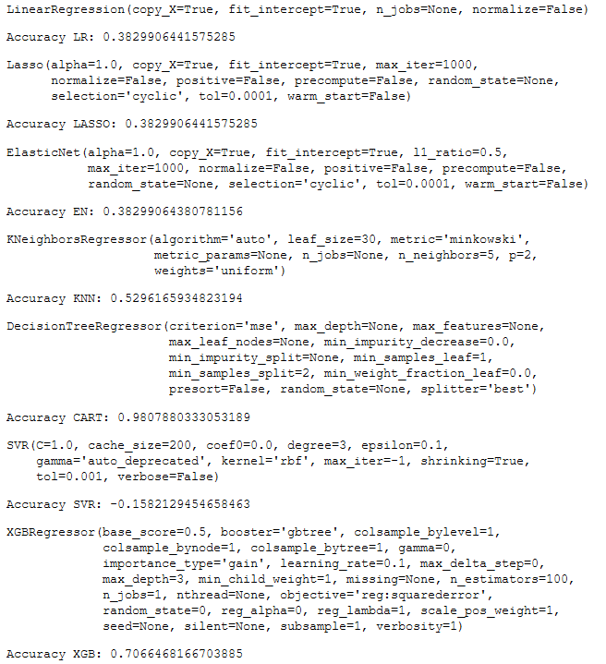

Slide 19
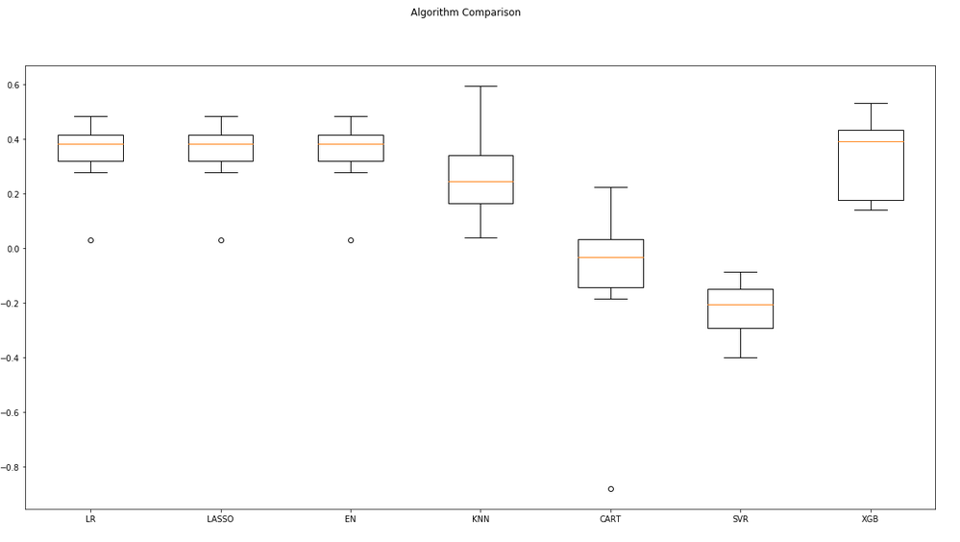

Slide 20
Recommendation
    I used only few variables (genres, revenue, budget, runtime, status) and for the genres, I used the first name. I could have used all names and transform them in Dummy variables….
    Other variables requires in depth machine learning to extract features: example I could have used NLP for the overview/tagline/Keywords columns, to transform meaningful works into matrix(TF-IDF)

