Slide 1
Assignment
YOUTH SMOKING AND DRUG DATA
Sharis Rebeiro

Slide 2
Purpose
This list has been selected for its relevance to public health, richness of information, and potential for policy identification. It allows for research into how demographic and social factors influence youth substance use, and identifies target interventions and educational programs for youth making healthy choices.
This list has been selected for its relevance to public health, richness of information, and potential for policy identification. It allows for research into how demographic and social factors influence youth substance use, and identifies target interventions and educational programs for youth making healthy choices.

Slide 3
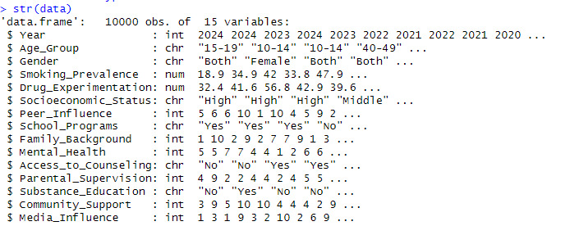
The dataset consists of 10,000 rows and 15 columns, capturing key characteristics of adolescent behavior in terms of smoking and drug use. Key features include:
-Demographic: year, age_group, gender.
-Habit description: smoking_prevalence, drug_use.
-Social factors: socioeconomic_status, peer_influence, family_externality, mental_health, parental_monitoring, community_support, media_influence.
-Support systems: access_in_counseling, school_systems, medication_education.
This data set provides insight into the factors affecting adolescent smoking and drug use, making it valuable for public health and educational research

Slide 4
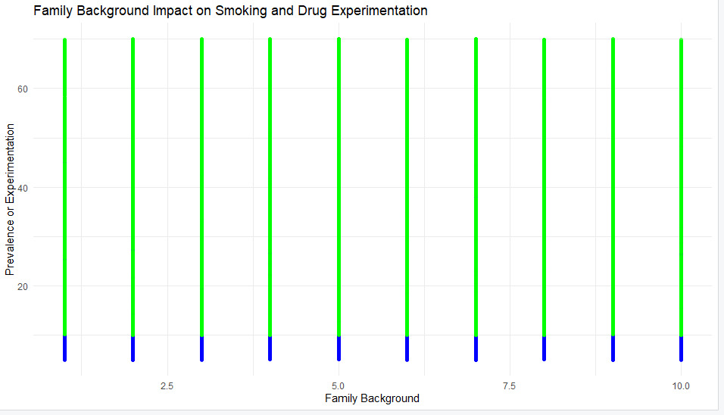
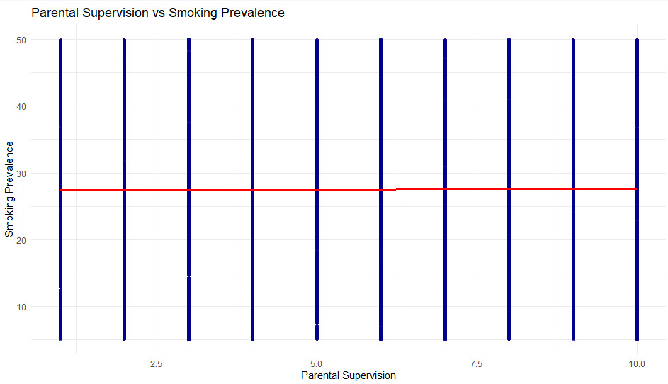
The chart shows the influence of family background on the prevalence of smoking and drug use. The y-axis shows the breadth of use, while the x-axis represents background scores. Each vertical line appears to indicate a frequency distribution, with the blue and green blocks likely representing different groups in the prevalence data but equal heights on the x-axis indicating little difference was in the prevalence range by post familial score.
This scatter plot shows no visible correlation between parental supervision and smoking prevalence, as smoking prevalence remains constant across various levels of supervision.

Slide 5
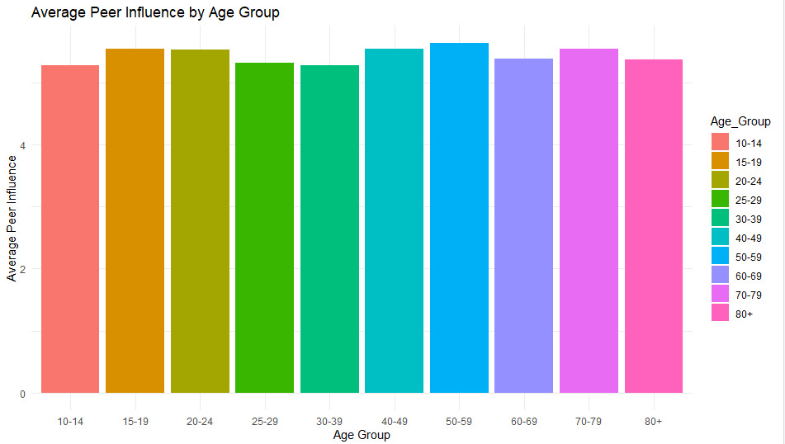
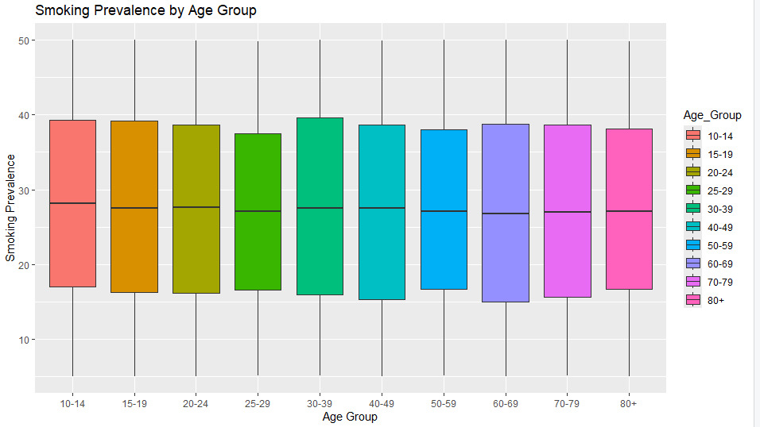
The bar chart highlights that peer influence is relatively consistent across age groups, with slight variations, peaking around the younger age groups.
The box plot illustrates the distribution of smoking prevalence across different age groups, showing that smoking prevalence tends to be similar across groups with some variation within each age category.

Slide 6
Thank you

