Slide 1
HOTEL Management
Syed Ali ahmed 4308
Muhammad sharjeel husnain 4345
Muhammad hammad ullah 4307
Abuzar hassan 4313

Slide 2
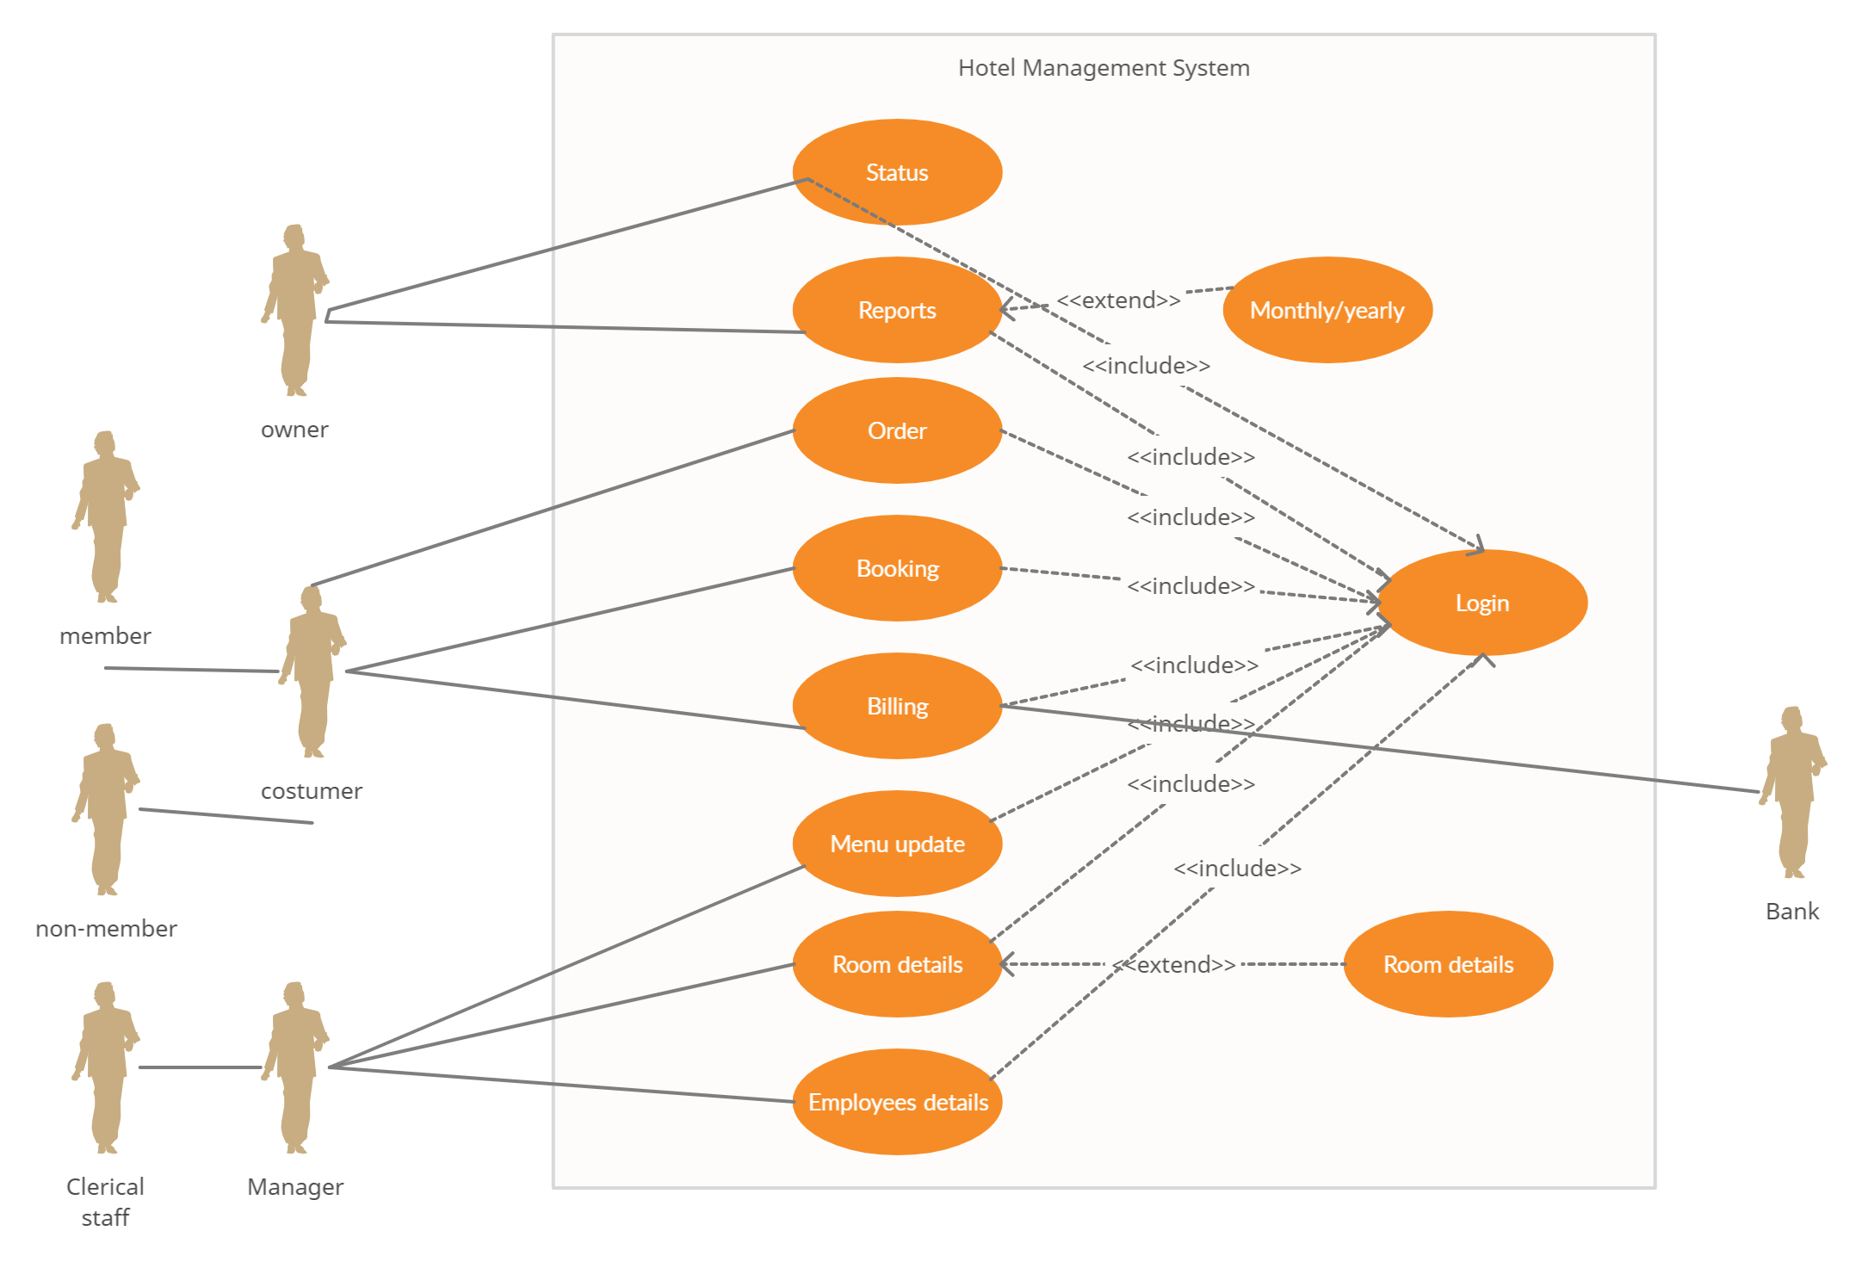
Use case diagram

Slide 3
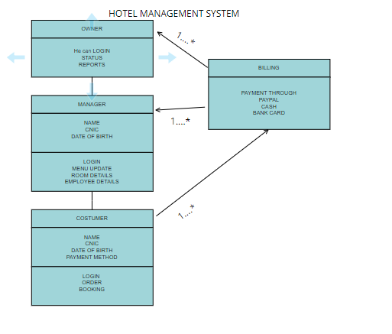
DOMAIN MODEL DIAGRAM

