Slide 1
DSAI1202: Introduction to Artificial Intelligence and Data Analytics
Introducing the Course Project
Dr. Mingsong LYU (呂鳴松)
Department of Computing
The Hong Kong Polytechnic University
Autumn 2026

Slide 2
What I Hope You Take from This Course
Marks matter; but something matters more
Five years from now, few people will care about your exact mark in DSAI1202
What may still matter is whether you learned how to use AI to make yourself more capable — to do things you could not do before, while still thinking, checking, judging, and taking responsibility yourself
If others are learning to use AI and you are not, the gap in what you can do may become visible surprisingly quickly
The mission of this course is to help you embrace the AI era by learning to use AI confidently, effectively, and responsibly

Slide 3
Astonishing Stories of Using AI
AlphaFold has predicted structures for 200+ million proteins, reducing the time spent from years to minutes
JPMorgan reported that AI could extract key information from work that previously required up to 360,000 hours of manual contract review per year in seconds
In Everything Everywhere All at Once, AI helped reduce some visual-effects work from days to just minutes
The German Bundesliga used AI to reduce the cost of translating match content from about $9.50 to $0.05 per language — a 99% reduction
Block cut more than 4,000 jobs — nearly half of its workforce — as its CEO said much smaller teams using AI can now do more and do it better
AI is changing both what people can do and what many jobs require.
The best response is not to avoid AI, but to learn how to work with it well.

Slide 4
Do Something Cool with AI
In this project, your team will use AI to attempt something that you genuinely find interesting, useful, meaningful, or simply cool
“Cool” does not mean flashy, technically difficult, or visually impressive. It means something your team genuinely wants to make happen — especially something you might previously have thought was difficult or impossible
Part 1: what were you able to do with AI that would otherwise have been difficult?

Slide 5
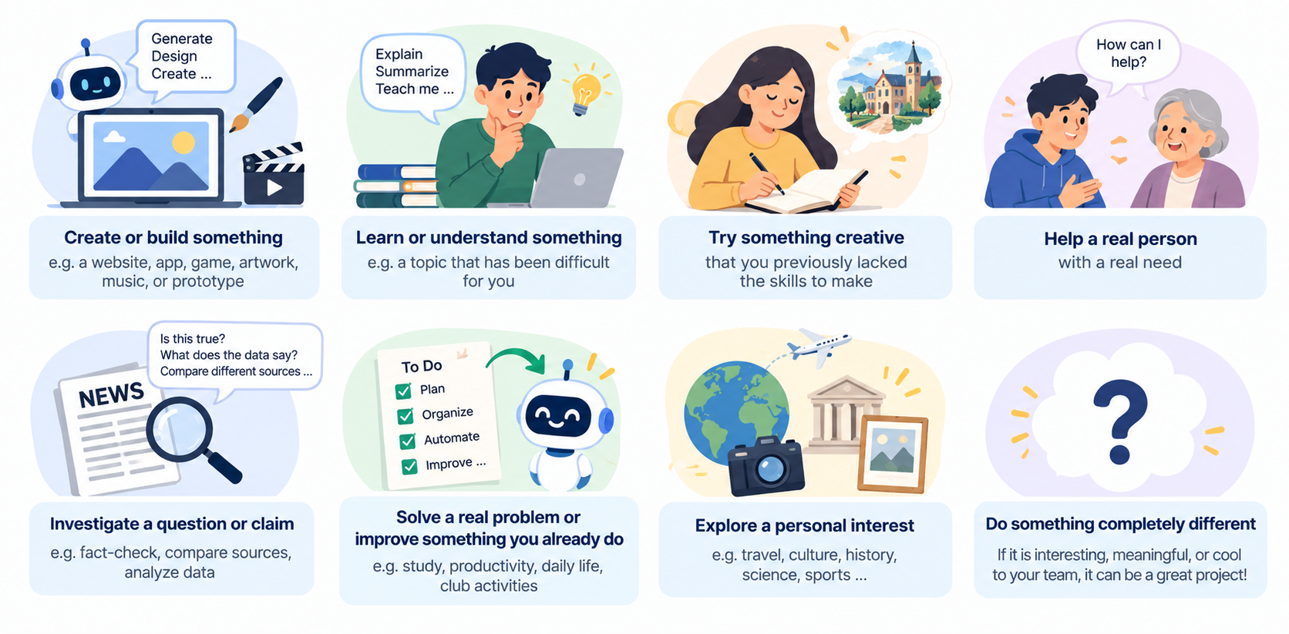
Project Ideas – Many Possible Directions

Slide 6
One Question for You
If AI could help you do, understand, create, investigate, or improve ONE thing… What would you choose?
DO · UNDERSTAND · CREATE · INVESTIGATE · IMPROVE

Slide 7
Lessons Learned from Working with AI
While doing the project, pay attention to what happens when you work with AI
Your lessons may include:
  What worked?
  What failed?
  What did you verify or reject?
  Where did human judgment matter?
  What would you do differently?
Your lessons should come primarily from your actual project experience
They do not need to be universal
Specific lessons from a real attempt are often more useful than generic advice about AI
Part 2: lessons learned from working with AI

Slide 8
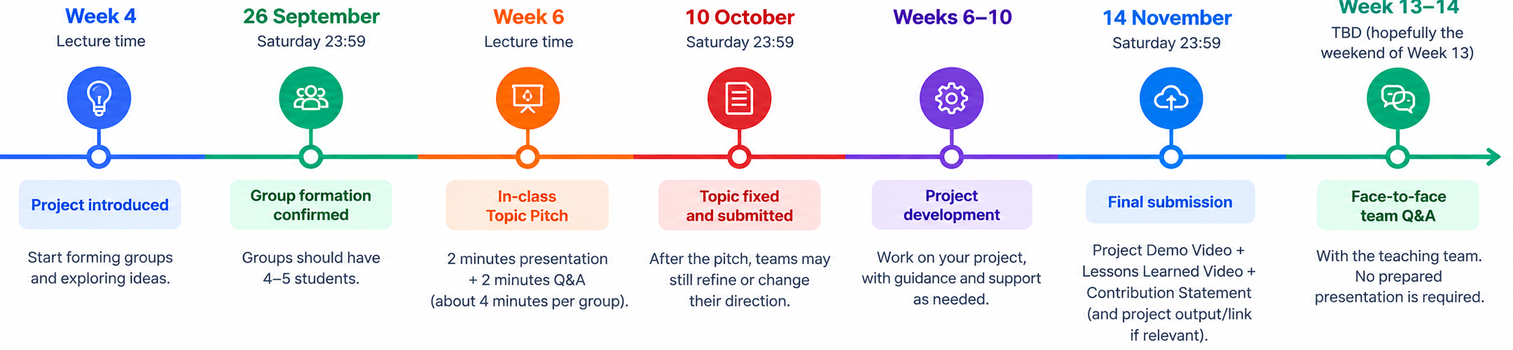
Group Formation (Week 4)
By the end of Week 4, you should form groups
  Each group should have 4–5 students
  Form your own groups
  Get to know your classmates and learn to work with people you may not know yet
  Join the correct Canvas Project Group Set for your lecture class (either LEC007 or LEC008)
  Decide on a team leader of your group

Slide 9
Topic Pitch (Week 6)
Week 6’s lecture will be devoted to topic pitch
  Each group will briefly present its current project idea to the class by the team leader
  2 minutes’ presentation + 2 minutes’ short questions or comments from classmates
  Answer three questions: (1) What do you want to do? (2) Why do you find it interesting? (3) How might AI help?
  The Week 6 pitch is an idea test, not a final commitment. You may refine or completely change your direction after hearing questions and seeing other groups’ ideas
  The final topic will be fixed on 10 October, the end of Week 6
  Complete the pitch → 5 marks. Topic quality is not graded

Slide 10
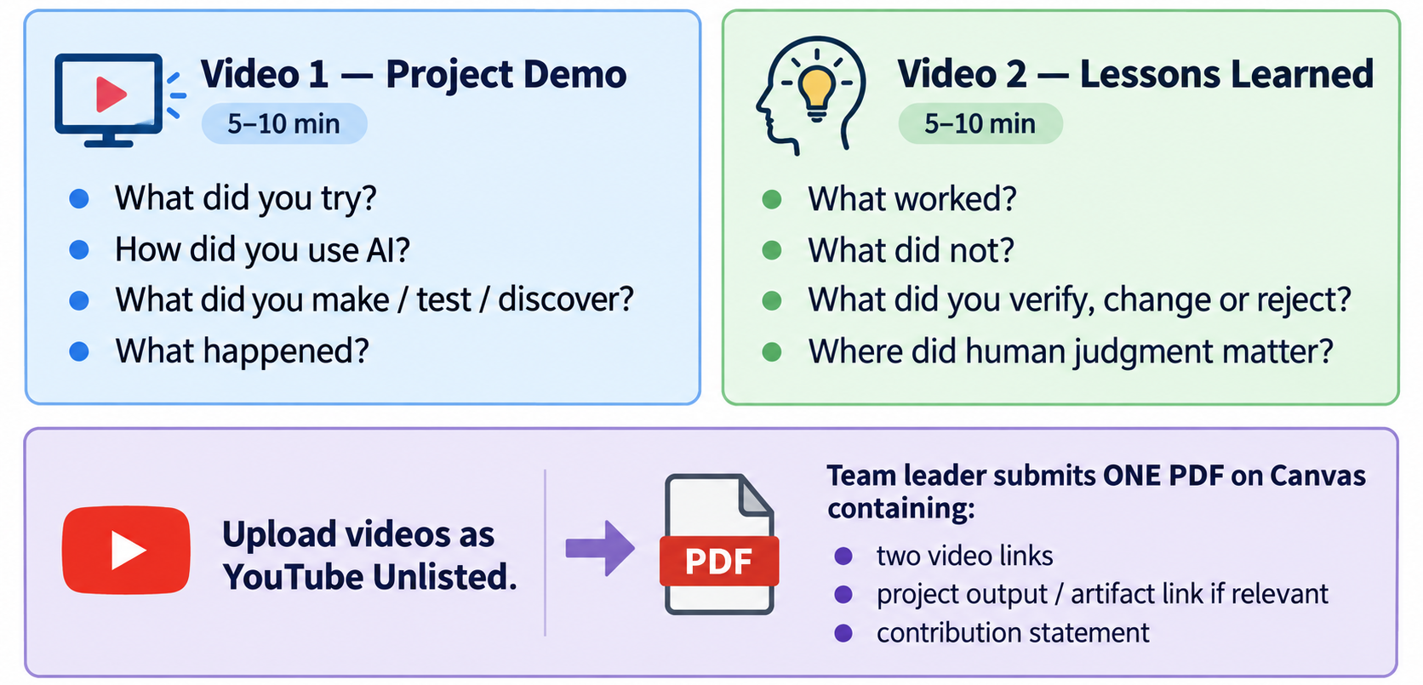
What Do You Submit? (Week 11)
Then, you will conduct the project work mainly in four weeks (W7-10)
By the end of Week 11 (14 November), you will submit

Slide 11
How is it Graded?
Component | Marks
Topic pitch | 5
What you did | 10
Lessons learned from using AI | 10
Total | 25
The Topic Pitch is completion-based. A group that gives a proper pitch receives the full 5 marks. We are not grading whether your topic sounds more impressive than another group’s topic.

Slide 12
How is it Graded?
What you did? -- 10 marks
Criterion | Marks | What we look for
Meaning and ambition of the attempt | 2 | The team attempts something genuinely interesting, useful, meaningful, or challenging to them. “Ambitious” does not mean technically complicated or flashy.
Real engagement with the task | 3 | The team actually explores the problem rather than simply producing a polished final output. There is evidence of trying, testing, revising, comparing, or responding to what happened.
Purposeful use of AI | 2 | AI is used to extend what the team can do. The team makes active choices about how AI is used rather than simply accepting whatever it generates.
Outcome / what was actually achieved | 3 | The team clearly demonstrates what they made, learned, tested, discovered, or accomplished. A meaningful failed attempt can also score well if the exploration is substantial.

Slide 13
How is it Graded?
Lessons learned from using AI -- 10 marks
Criterion | Marks | What we look for
Grounded in the actual project | 4 | Lessons clearly come from things that actually happened during the project and are supported by concrete examples rather than generic statements about AI.
Depth of reflection | 3 | The team goes beyond describing what happened and explains why it happened, what they learned, and how their understanding or approach changed.
Human judgment and responsibility | 3 | The team identifies where human decisions, evaluation, verification, creativity, knowledge, taste, or responsibility mattered, and explains how these affected the project.

Slide 14
One Last Thing: You Should Know Your Own Work
Face-to-face team Q&A in Week 13/14
No prepared presentation
We may ask:
  Why did you make this decision?
  What did AI get wrong?
  What changed during the project?
  How did you verify this?
  What did you personally contribute?
We are not trying to prove whether you used AI. AI use is encouraged. We want to see whether each student remained genuinely involved, understood the work, and can take responsibility for what the team submitted.
The submissions in Week 11 will receive an initial mark on my side. Marks may be adjusted based on the Q&A

Slide 15
Use AI. Try something ambitious.
It may work. It may fail.
But make it yours.
“We made this.”

