Slide 1
CSC 344 – Principles of Operating Systems
Instructor: Ms. Mamoona Tasadduq
Lecture# 01: Introduction

Slide 2
What is an Operating System?
A program that acts as an intermediary between a computer user and the computer hardware
  High level interface between the user and the hardware
“Code’’ that sits between:
  Programs and hardware
  Different programs
  Different users
Operating System Goals:
  Execute user programs and make solving user problems easier
  Make the computer system convenient to use
  Use the computer hardware in an efficient manner

Slide 3
What Operating Systems Do
Depends on the point of view
User View: Ease of use & good performance without care of resource utilization
System View
  Resource Manager: Deciding between competing and conflicting requests for efficient and fair resource use. Multiplex (share) resources in time and space. Illusion of infinite, private resources
    Allocation: Finite resources & competing demands; e.g., CPU, memory, disk, network
    Reclamation: Implied at termination, involuntary at runtime, or cooperative (yield CPU)
    Protection: Implies some degree of safety & security
  Control Program: Controlling execution of programs to prevent errors & improper use of the system and controlling interaction with input and output devices (hardware)

Slide 4
Operating System Definition
No universally accepted definition
“Everything a vendor ships when you order an operating system” is a good approximation but varies wildly
“The one program running at all times on the computer” is the kernel, part of the operating system
Everything else is either
  A system program (ships with the operating system, but not part of the kernel) , or
  An application program, all programs not associated with the operating system
Today’s OSes for general purpose and mobile computing also include middleware – a set of software frameworks that provide additional services to application developers such as databases, multimedia, graphics

Slide 5
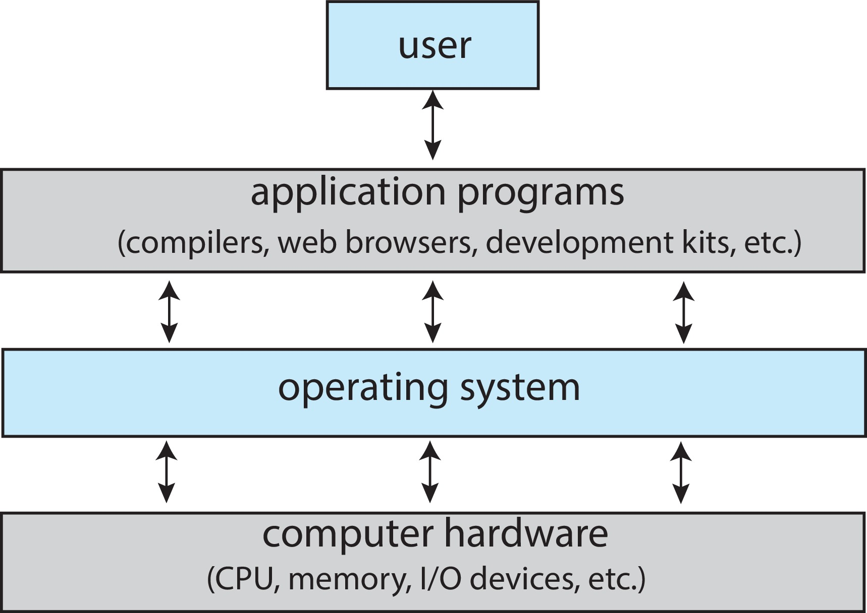
Computer System Structure
Computer system can be divided into four components
People, machines, other computers
Define ways in which system resources are used to solve the computing problems of the users; i.e., Word processors, compilers, web browsers, database systems, video games
Controls and coordinates use of hardware among various applications and users
Computing resources such as CPU, memory, I/O devices

Slide 6
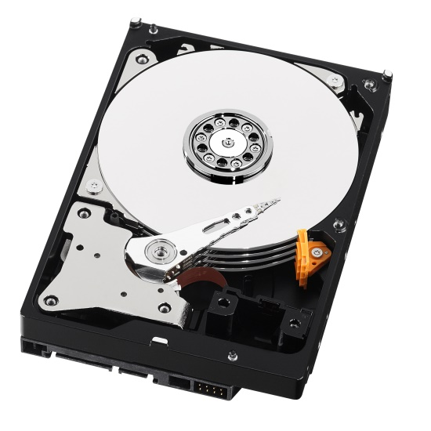
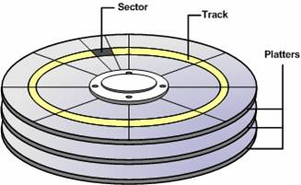
Example: Programming Hard Drive
Physical reality
  Block oriented
  Physical sector numbers
  No protection among user systems
  Data might be corrupted if machine crashes
  Programming:
    Loading values into special device registers
“I will save my lab1 solution on platter 5, track 8739, sector 3-4.”

Slide 7
Example: Programming Hard Drive
Physical reality
  Block oriented
  Physical sector numbers
  No protection among user systems
  Data might be corrupted if machine crashes
  Programming:
    Loading values into special device registers
“I will save my lab1 solution on platter 5, track 8739, sector 3-4.”
File system abstraction
  Byte oriented
  Named files
  User protection from each other
  Robust to machine failure
  Programming:
    open/read/write
“I will save my lab1 solution in ~mhjamal/lab1/process.c.”

Slide 8
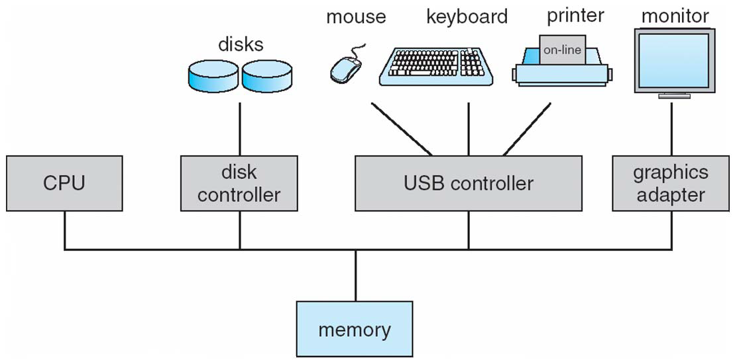
Computer System Organization
One or more CPUs and device controllers connected through common bus providing access to shared memory
Concurrent execution of CPUs and devices competing for memory cycles

Slide 9
Concurrent Computing
Initially, simple batch systems could entertain only one user/program at a time
  Spooling (the overlapping of output of one job with input of other jobs) and buffering (storing data temporarily while it is being transferred) allowed jobs to be read ahead of time
  Poor utilization of hardware and user
Modern systems support concurrent computing allowing multiple processes to be executed in overlapping time periods, enhancing efficiency and performance.
  Multiprogramming
  Multiprocessing
  Multitasking

Slide 10
Concurrent Computing
Multiprogramming:
  Ability to run more than one program simultaneously by keeping several programs in the memory at the same time.
  CPU and I/O devices are kept busy by overlapping I/O with computation resulting in increased utilization (throughput).
  One job is selected and run via job scheduling
  It is the function of operating system to share CPU time among all the users equally.
  1st instance where the operating system must schedule resources
    CPU scheduling
    Memory management
    Protection
Multiprocessing
  Involves the use of two or more CPUs within a single computer system to execute multiple processes simultaneously, truly allowing parallel execution.

Slide 11
Concurrent Computing
Multitasking (Timesharing)
  Logical extension of multiprogramming operating system but more complex
  Ability to execute multiple tasks or processes at the same time on a single CPU by rapidly switching between them, giving the appearance of simultaneous execution.
  Each user feels to have the entire machine (interactive computing)
  Optimize response time (less than a second) by frequent time-slicing multiple jobs
  Each user has at least one process in memory ready for execution
  If several processes are ready for execution at the same time, one process is selected and run via CPU scheduling
  If a process does not fit in memory, virtual memory allows execution of the process by having part of the process to be in memory by swapping parts in and out of memory when needed
  Additionally requires file system, job communication, synchronization and deadlock handling
  Most systems today are timesharing (focus of this course)

Slide 12
Computer-System Operation
I/O devices and the CPU can execute concurrently
A device controller is an interface between the device and the OS which oversees a particular device type. Each device controller has a local buffer.
Each device controller type has an OS device driver to manage it.
CPU moves data from/to main memory to/from local buffers
I/O is from the device to local buffer of controller
Device controller informs CPU that it has finished its operation by causing an interrupt

Slide 13
Interrupt
Interrupt is a mechanism for coordination between concurrently operating units of a computer system (e.g., CPU and I/O devices) for responding to specific conditions within a processor
Results in transfer of flow of control (to interrupt handler in the OS), forced by the hardware
An operating system is interrupt driven
Hardware Interrupts
  Timers
  Keyboards, NICs, etc. (I/O devices)
Software Interrupts (also know as trap or exception)
  An error (floating point exception)
  A system call requesting OS for special services (e.g., I/O)

Slide 14
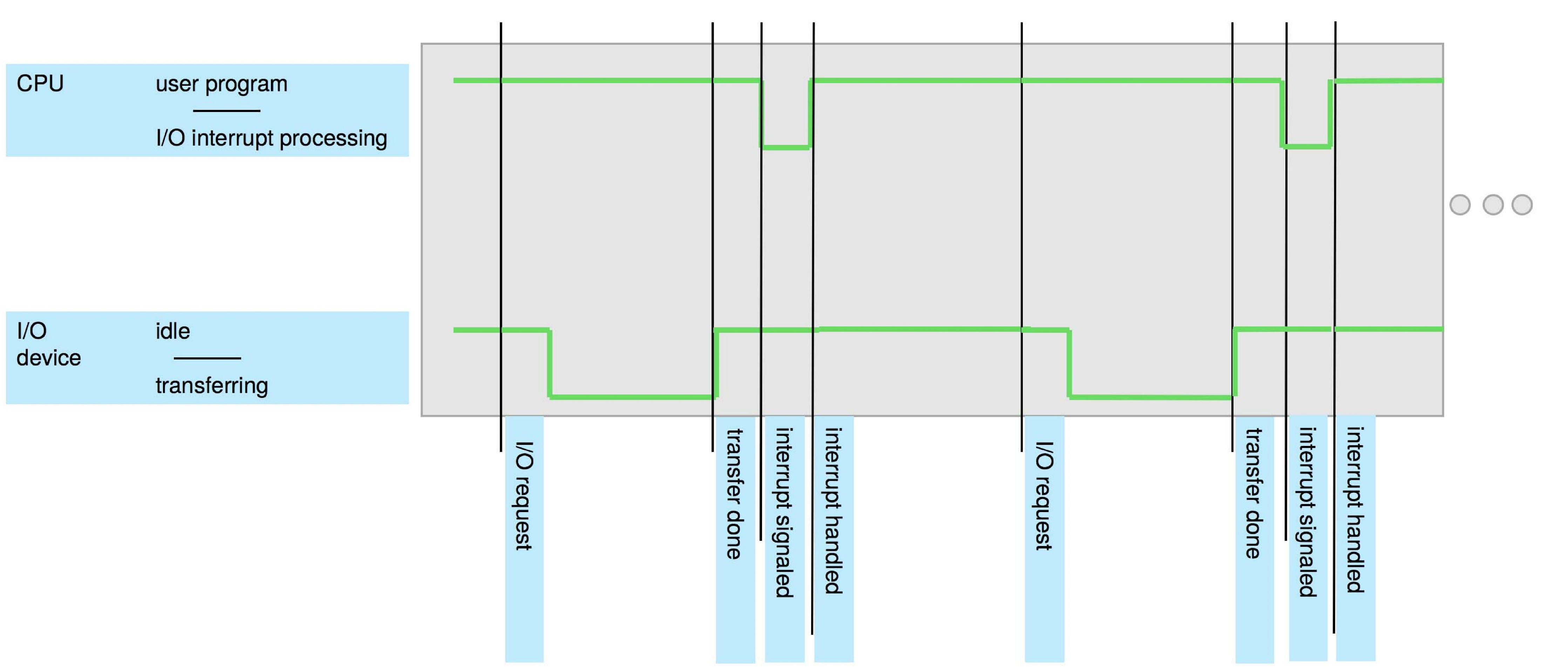
Interrupt

Slide 15
Handling Interrupts
Incoming interrupts are disabled (at this and lower priority levels) while the interrupt is being processed to prevent a loss interrupt
Interrupt architecture must save the address of the interrupted instruction
Instruction transfers control to the interrupt service routine, generally through the interrupt vector, which contains the addresses of all the service routines
Determine which type of interrupt has occurred. A separate segments of code determine what action should be taken for each type of interrupt
If interrupt routing modifies process state (register values)
  Save current state of CPU (registers and the program counter) on the system stack
  Restore before returning
Interrupts are re-enabled after servicing current interrupt
Resume the interrupted instruction

Slide 16
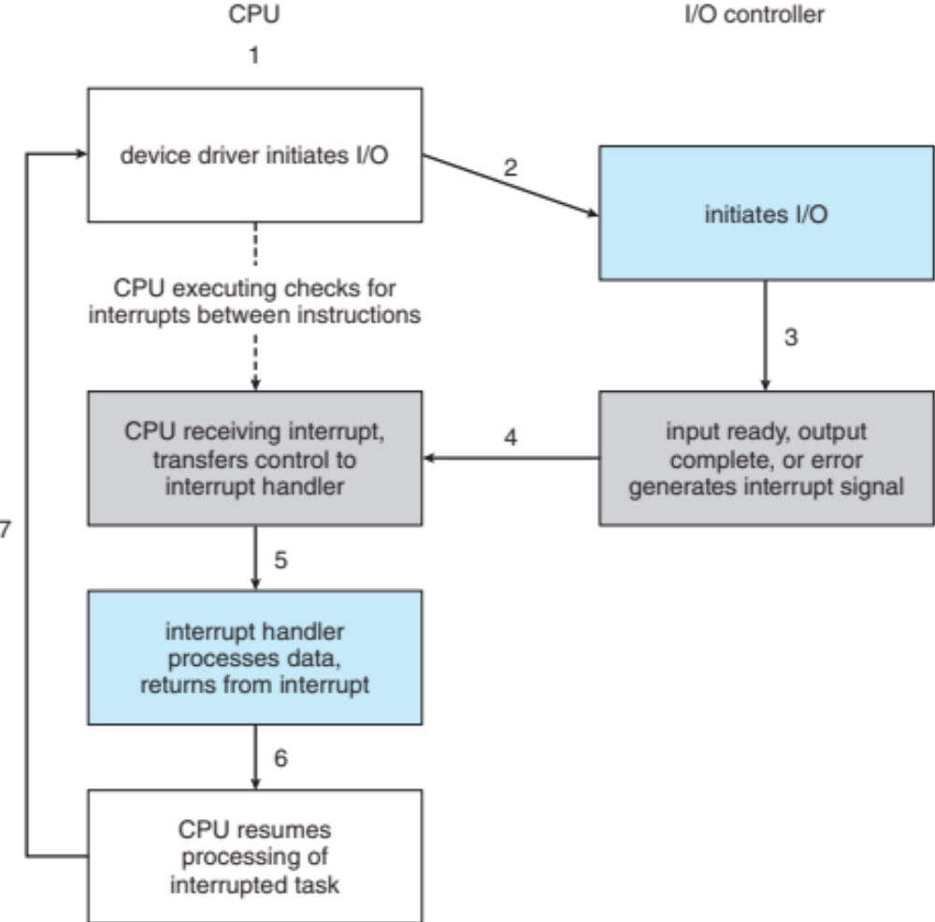
Handling Interrupts
Interrupt-drive I/O Cycle

Slide 17
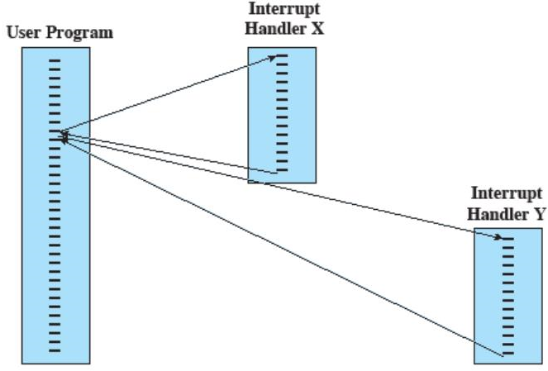
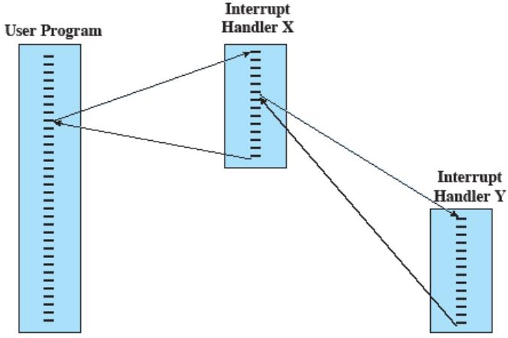
Handling Interrupts
What happens if while handling an interrupt, another interrupt triggers?
It can be handled using two approaches
  Sequential approach
  Nested approach
(a) Sequential Interrupt Processing (b) Nested Interrupt Processing

Slide 18
I/O Structure
Two methods for handling I/O
After I/O starts, control returns to user program only upon I/O completion
  Wait instruction idles the CPU until the next interrupt
  Wait loop (contention for memory access)
  At most one I/O request is outstanding at a time, no simultaneous I/O processing
After I/O starts, control returns to user program without waiting for I/O completion
  System call – request to the OS to allow user to wait for I/O completion
  Device-status table contains entry for each I/O device indicating its type, address, and state
  OS indexes into I/O device table to determine device status and to modify table entry to include interrupt

Slide 19
Computer Startup/ Bootstrap Process
BIOS is a firmware that is pre-installed in a ROM chip on the motherboard and is the first code that runs when a computer is powered on.
  Hardware Initialization: BIOS checks the health of system hardware components such as keyboard, RAM, and storage devices to ensure they are functioning correctly and initializes system components like the CPU, memory, and storage.
  Firmware Interface: BIOS provides an interface between the computer’s hardware and the OS
  Boot Process: After hardware is initialized and tested, BIOS locates and executes the bootloader from a bootable device to hand off control to the OS bootloader.
BIOS has largely been replaced by UEFI (Unified Extensible Firmware Interface) in modern systems, which offers more features and capabilities such as a graphical user interface, faster boot times, and support for larger hard drives.

Slide 20
Computer Startup/ Bootstrap Process
During hardware initialization, BIOS checks for the presence of bootable storage device and searches for the OS bootloader on it.
If bootable storage device is not found, “No boot device available” message is displayed.
If a storage device is found but OS bootloader is not located, “Insert System Disk” message is displayed.
Question: If storage device is not found, where do the messages that appear on the screen come from? There must be some storage that contain these messages?

Slide 21
Computer Startup/ Bootstrap Process
Bootloader is a specific program that loads the OS into memory at starts it and is executed after the BIOS has completed its tasks.
  Locates OS kernel on a storage device, loads it into RAM and passes control to it
  Stored in Master Boot Record (MBR) which is the first 512 bytes of storage device
  Initial part contains enough code to load more complex secondary bootloader stage to complete the boot process.
  Secondary stage is typically stored elsewhere on the storage device within the partition the OS resides.
  Can be configured to handle multiple operating systems and specific boot parameters.

Slide 22
Storage Definition and Notation Review
Bit: Basic unit of computer storage containing values 0 and 1. All storage in a computer is based on collection of bits.
Byte: Group of 8 bits and on most computers, it is the smallest convenient chunk of storage; e.g., computer instruction to move a byte rather than a bit. It represents a character or a number.
Word: Natural unit of data used by a particular processor design
  usually 16, 32, or 64 bits
Computer storage is generally measured and manipulated in bytes and collections of bytes. A kilobyte (KB) is 1024 bytes; a megabyte (MB) is 1,024² bytes etc.

Slide 23
Storage Structure
Main Memory: Only large storage media that the CPU can access directly
  Random-access memory in form of Dynamic Random-access Memory (DRAM)
  Volatile
Secondary Storage: Extension of main memory that provides large nonvolatile storage capacity
  Hard Disk Drive (HDD): Rigid metal or glass platters covered with magnetic recording material.
    Disk surface is logically divided into tracks, which are subdivided into sectors.
    The disk controller determines the logical interaction between the device and the computer.
  Non-volatile memory (NVM): Non-volatile devices faster than HDD. Uses flash memory to store data.
    Various technologies
    Becoming more popular as capacity and performance increases, price drops

Slide 24
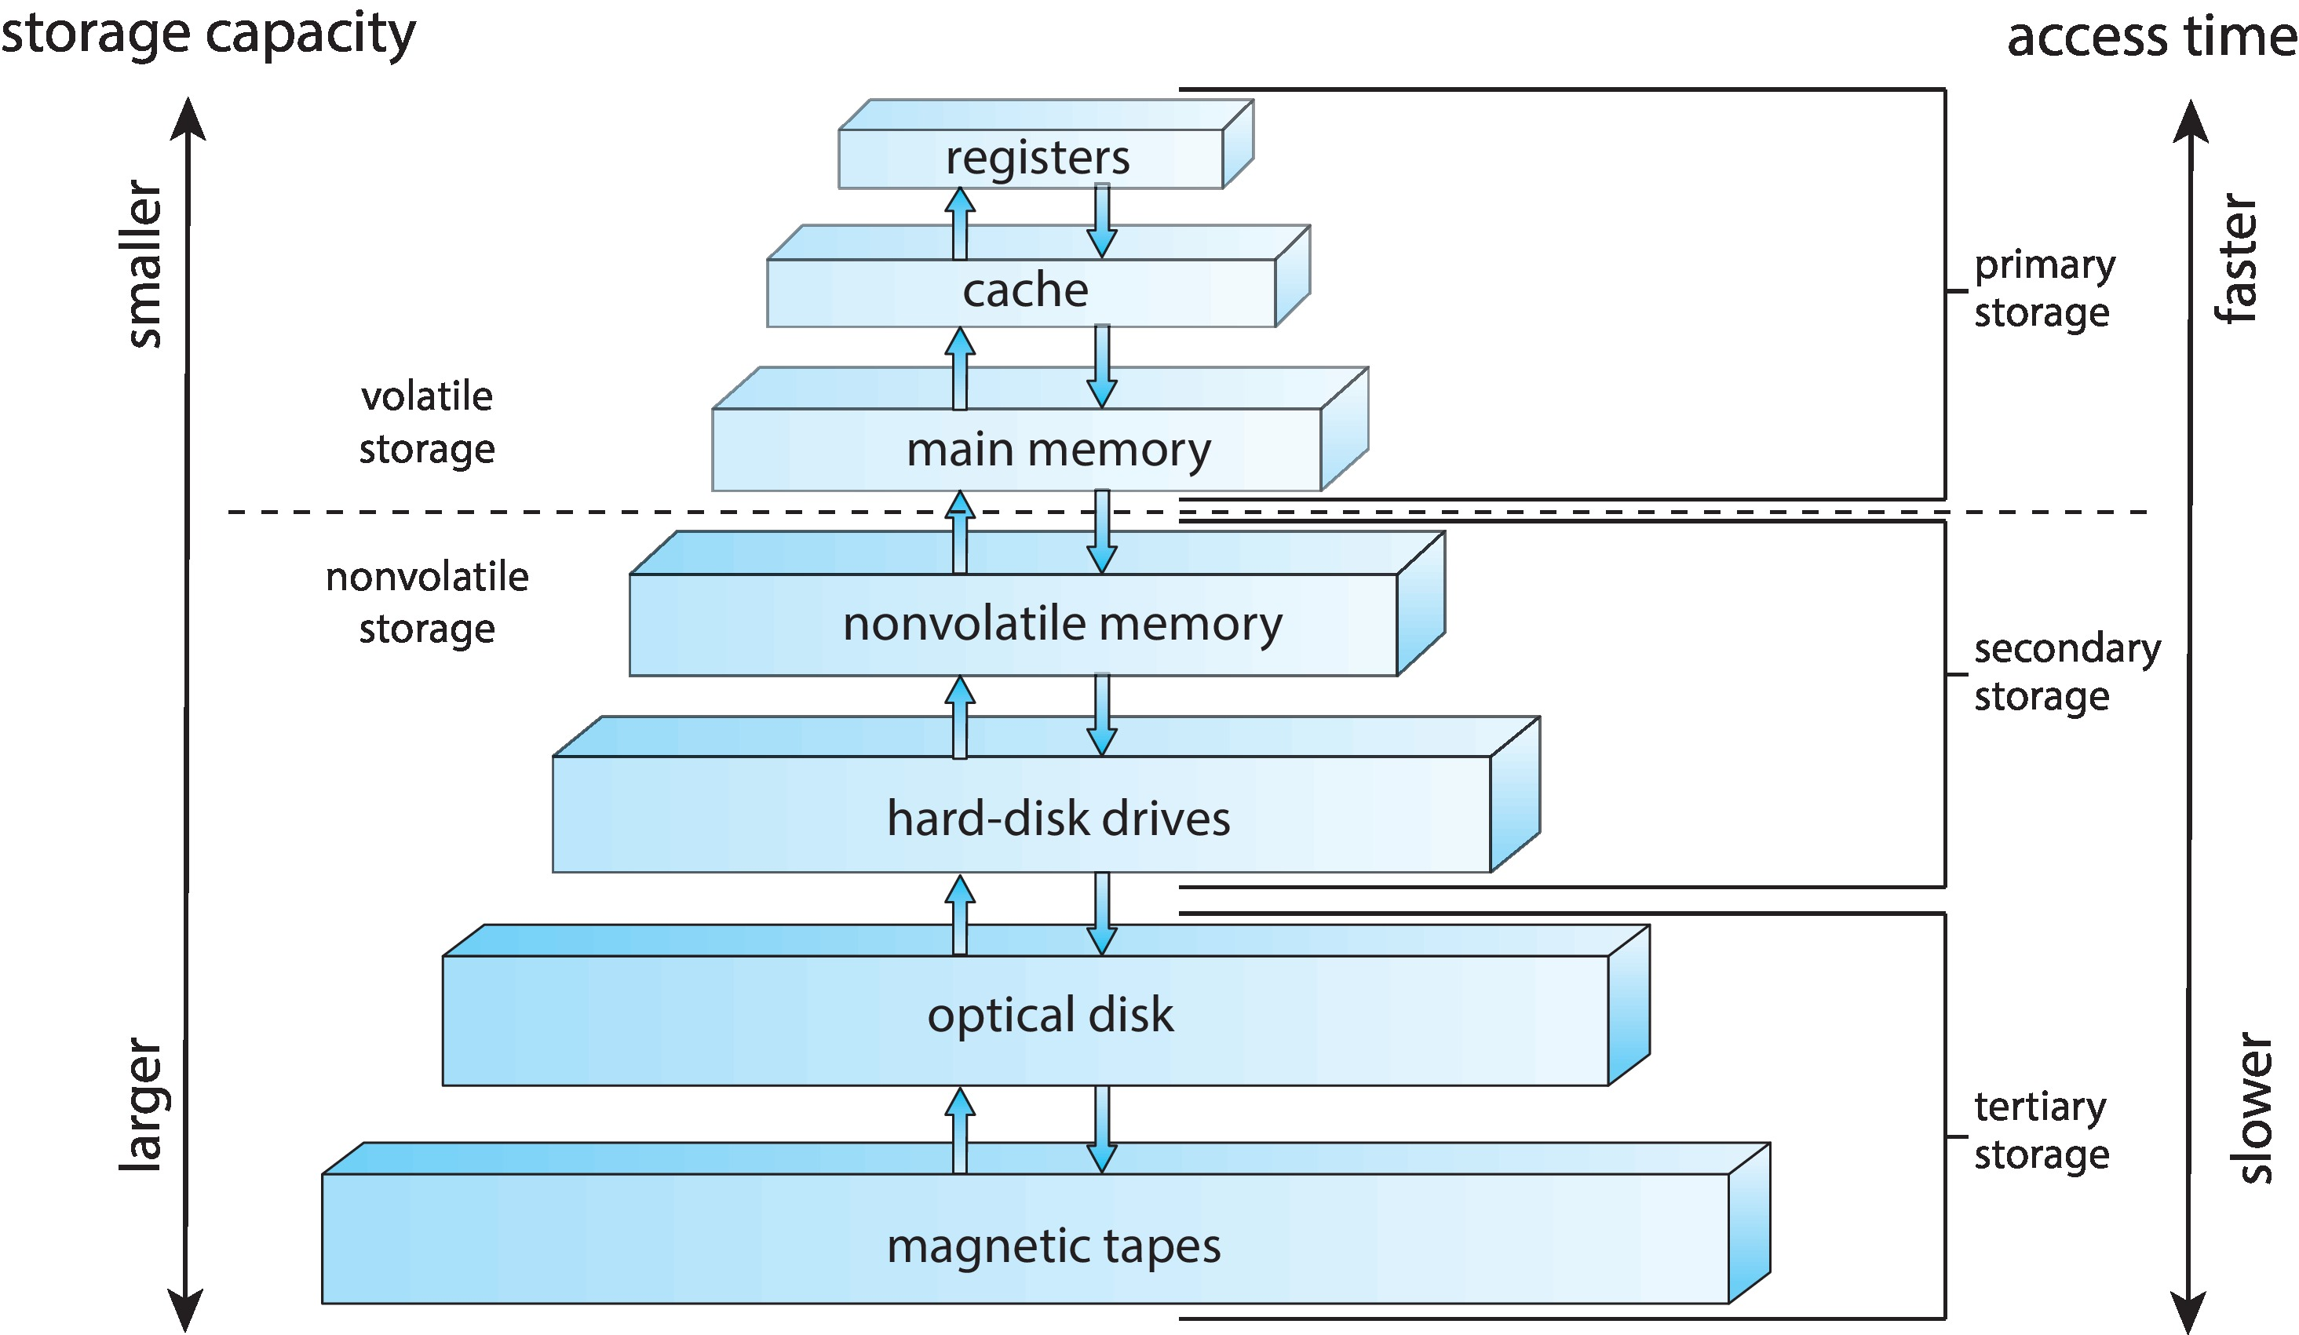
Storage Hierarchy
Storage systems organized in hierarchy
  Speed, cost, volatility
Registers and cache are high-speed memory used to store data temporarily for quick access. Registers are located within the CPU itself. Cache memory may be part of the CPU chip or on a separate chip close to the CPU.
Device Driver for each device controller to manage I/O
  Provides uniform interface between controller and kernel

Slide 25
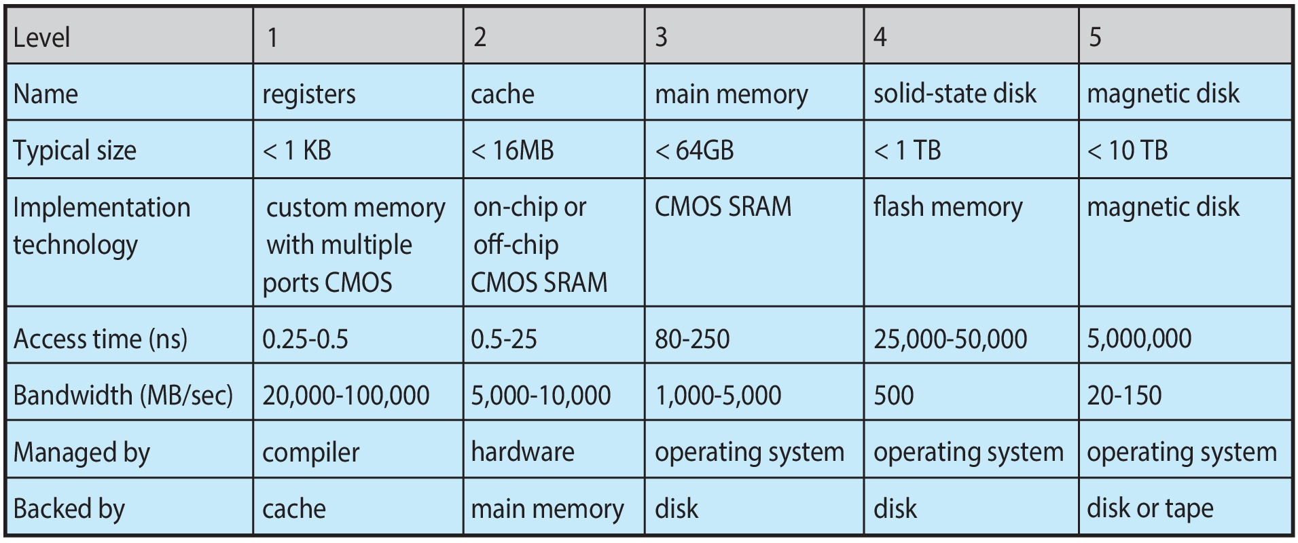
Characteristics of Various Storage Types
Movement between levels of storage hierarchy can be explicit or implicit

Slide 26
Caching
Caching – copying information into faster storage system
Important principle, performed at many levels in a computer (in hardware, operating system, software)
Information in use copied from slower to faster storage temporarily. main memory can be viewed as a cache for secondary storage
Faster storage (cache) checked first to determine if information is there
  If it is, information used directly from the cache (fast)
  If not, data copied to cache and used there
Cache smaller than storage being cached
  Cache management important design problem
  Cache size and replacement policy

Slide 27
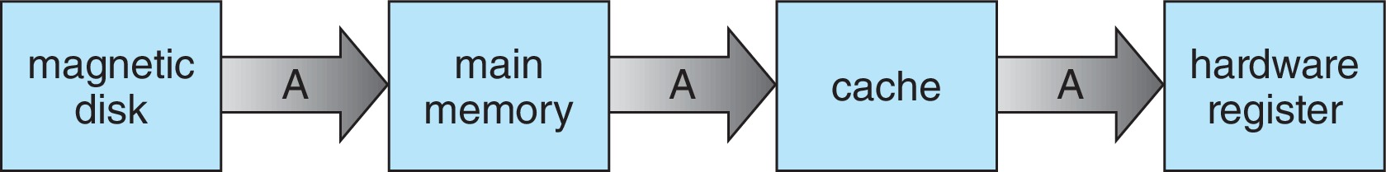
Data Migration from Disk to Register
Multitasking environments must be careful to use most recent value, no matter where it is stored in the storage hierarchy
Multiprocessor environment must provide cache coherency in hardware such that all CPUs have the most recent value in their cache
Distributed environment situation even more complex
  Several copies of a datum can exist
  Various solutions covered in Chapter 19

Slide 28
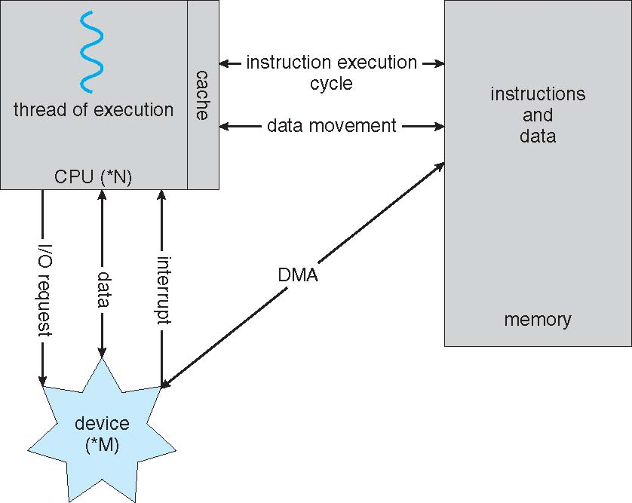
How a Modern Computer Works
Direct Memory Access (DMA) controller used for high-speed I/O devices able to transmit information at close to memory speeds
Device controller transfers blocks of data from buffer storage directly to main memory without CPU intervention.
Only one interrupt is generated per block, rather than the one interrupt per byte
A Von Neumann architecture

Slide 29
Operating System Operations
Bootstrap program – simple code to initialize the system, load the kernel
Kernel loads
Starts system daemons (services provided outside of the kernel)
Kernel interrupt driven (hardware and software)
  Hardware interrupt by one of the devices
  Software interrupt (exception or trap):
    Software error (e.g., division by zero)
    Request for operating system service – system call
    Other process problems include infinite loop, processes modifying each other or the OS
At the lowest level OS is just a bunch of interrupt service routings, each routine simply returning to whatever was executing before it was interrupted, else infinite wait loop.

Slide 30
Timer
Timer to prevent infinite loop (or process hogging resources)
  Timer is set to interrupt the computer after some time period
  Keep a counter that is decremented by the physical clock
  Operating system set the counter (privileged instruction)
  When counter zero generate an interrupt
  Set up before scheduling process to regain control or terminate program that exceeds allotted time

Slide 31
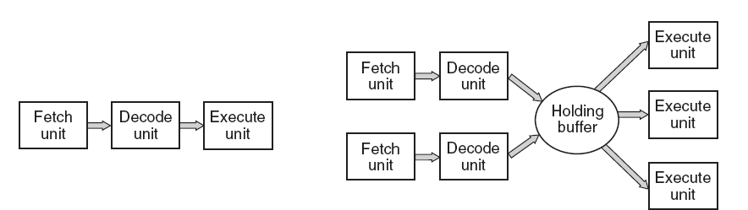
Computer System Architecture
A CPU comprises general registers, arithmetic/logic unit, and control unit.
Instruction Set: A group of commands, in machine language, that tell the CPU to perform tasks (x86, ARM, MIPS, SPARC etc.)
Each instruction of the program loaded in the memory to be executed must be looked at, decoded and acted upon in turn until the program is completed. This process is known as instruction execution cycle
  At the beginning of each instruction cycle, CPU fetches instruction from memory.
  Instruction pointer holds the address of the next instruction to be executed.
  The fetched instruction is loaded into the instruction register.
(a) A three-stage pipeline. (b) A superscalar CPU

Slide 32
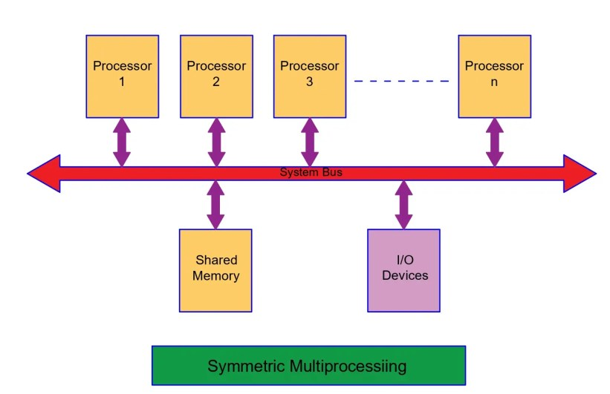
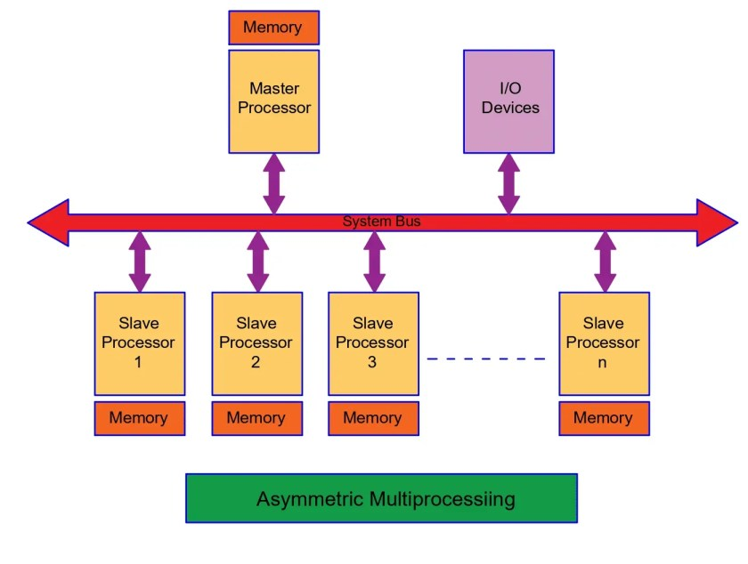
Computer System Architecture
Most systems contain a single general-purpose processor while many systems also contain special-purpose processors as well
Multiprocessor systems are of two types:
  Asymmetric multiprocessing: has a master-slave relationship where each processor, having its own memory address space, is assigned a specific task that are divided based on type of processors
  Symmetric multiprocessing (SMP): All processor are peers and can performs all tasks. The processors share physical memory but contain own set of registers and private or local caches

Slide 33
Computer System Architecture
Multiprocessor systems growing in use and importance
  Also known as parallel systems, tightly-coupled systems
Advantages of multiprocessor systems include:
  Increased throughput: More work done in less time
    Speedup ratio with N processors in not N due to overhead of keeping all component working correctly and contention for shared resources
  Economy of scale: With the increase in number of processors, the system can perform more tasks simultaneously, leading to higher efficiency and better resource utilization, often at a reduced cost per unit of processing power.
  Increased reliability: Graceful degradation or fault tolerance
    The ability of a system to maintain limited functionality even when a large portion of it has been destroyed or rendered inoperative

Slide 34
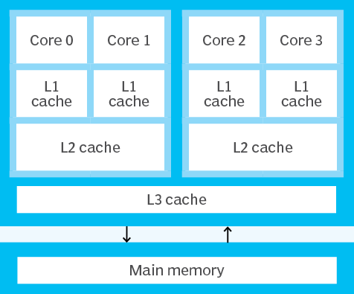
Computer System Architecture
Multicore systems contain multiple cores on a single processor chip. These cores share some resources, such as cache memory and the memory bus, but each core can independently execute instructions, making the system capable of handling multiple tasks concurrently.
  On-chip communication is faster
  Well suited for server (i.e., database, Web servers)
  Multicore CPUs appear to the operating system as N standard processors
Quad-core processor architecture

Slide 35
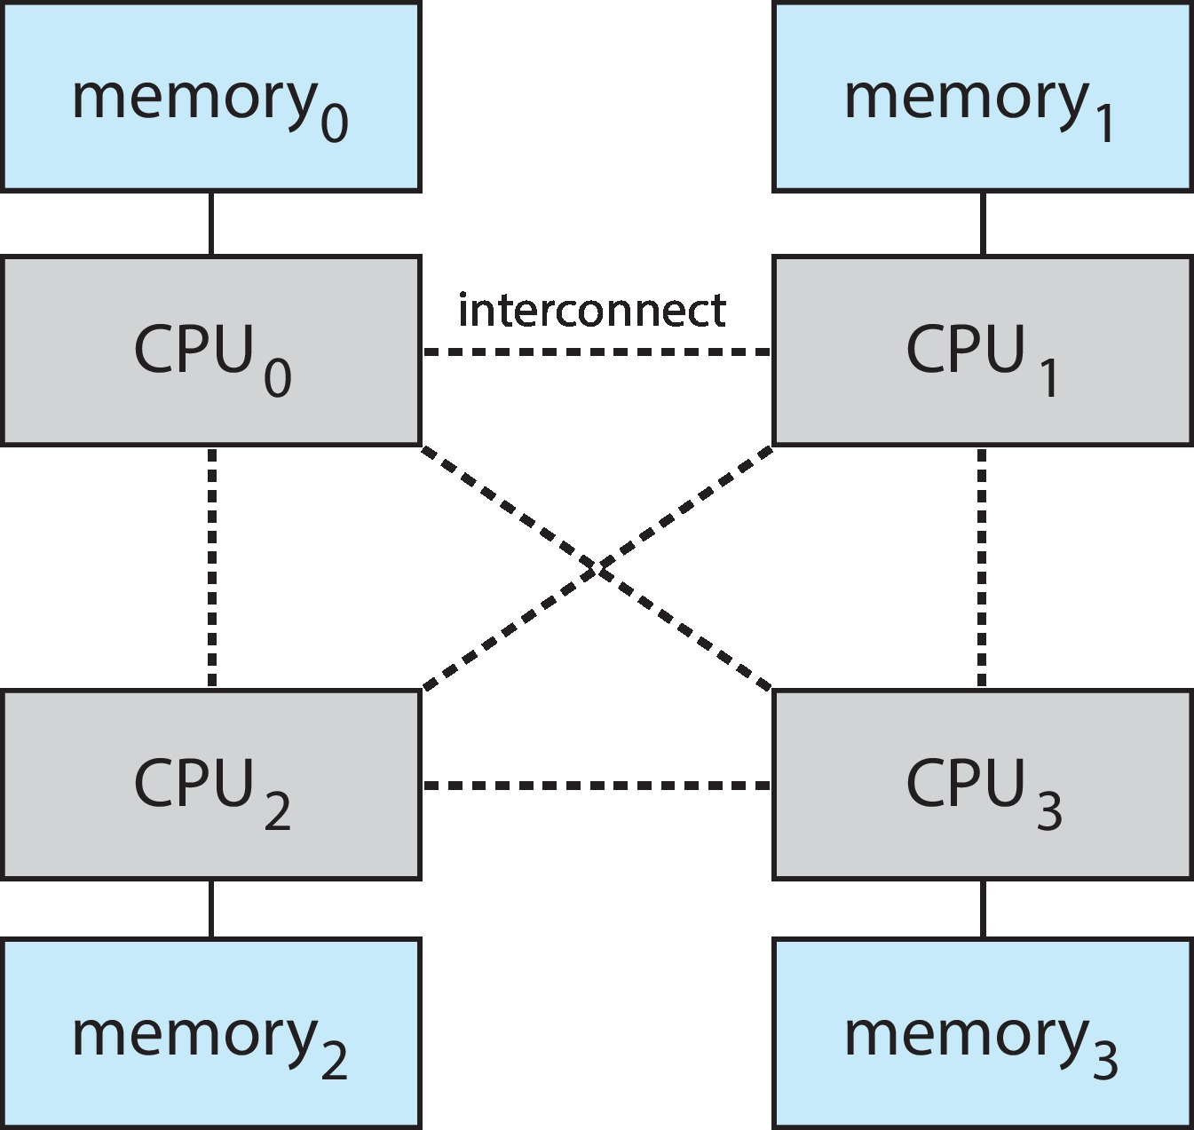
Computer System Architecture
Non-Uniform Memory Access Systems

Slide 36
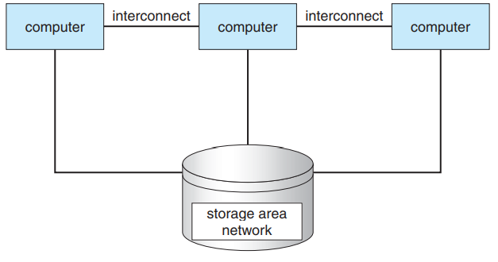
Computer System Architecture
Clustered systems are another type of multiple CPU systems that usually share storage via a storage-area network (SAN). These systems provide high-availability service which survives failures.
  Asymmetric clustering: One machine in hot-standby mode while others are running the applications
  Symmetric clustering : Multiple machines are running the applications as well as monitoring each other
Some clusters are for high-performance computing (HPC) and applications must be written to use parallelization

Slide 37
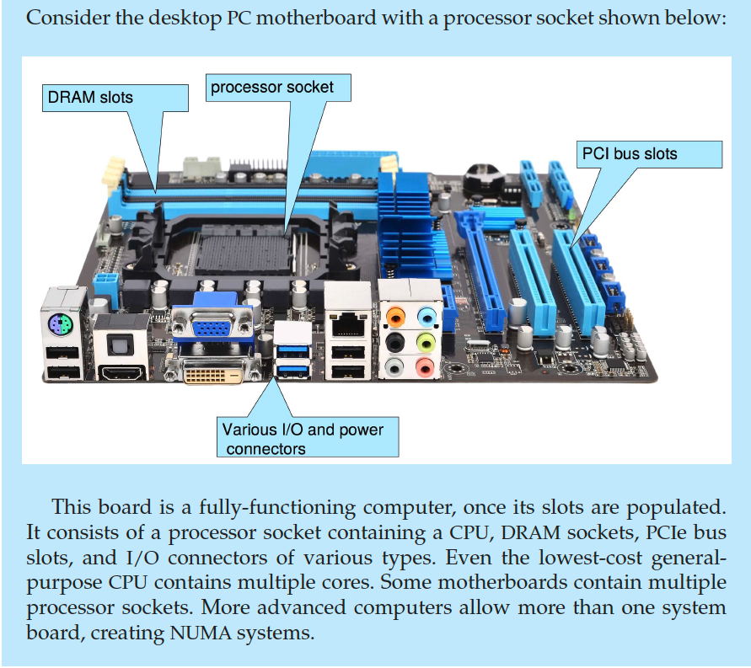
PC Motherboard

Slide 38
Hardware is Evolving
1st Generation (1940s – 1950s): Used vacuum tubes for circuitry and magnetic drums for memory. They were large, expensive, and generated a lot of heat. Machine language was used for programming and operations were carried out using punch cards; e.g. ENIAC and UNIVAC I
2nd Generation (1950s – 1960s): Used transistors making systems smaller, faster, more reliable and energy-efficient. Assembly language was used for programming and high-level programming languages like FORTRAN and COBOL emerged; e.g. IBM 7090 mainframe
3rd Generation (1960s – 1970s): Used integrated circuits (ICs) packing thousands of transistors onto a single chip. This further reduced size and cost while increasing speed and reliability. Operating systems became more sophisticated, and the use of higher-level languages like C became common; e.g. IBM 360 minicomputer.

Slide 39
Hardware is Evolving
4th Generation (1970s – present): Used microprocessors where a single chip that contained the entire CPU, marked the beginning of this generation. This innovation led to the personal computer (PC) revolution. The rise of software ecosystems, with operating systems like MS-DOS, Windows, and Unix, and the development of a wide range of application software.; e.g. Intel 8080, Apple II and IBM PC brought computing to homes and small businesses.
New architectures
  32-bit vs 64-bits
  Multiprocessors
  Multicore

Slide 40
We are Living in Interesting Times …
Processor speed doubles every 18 months. Number of cores per chip doubles every 24 months.
Disk capacity doubles very 12 months
Applications are evolving
  Desktop applications
  Computer games
  WWW (web servers)
  Networked games
  Peer-to-peer
  Web 2.0 (YouTube, social networks)
  Mobile Device applications
Performance/cost “sweet spot” constantly decaying

Slide 41
Is there are perfect OS?
Goals: Fairness, Efficiency, Portability, Interfaces, Security, Robustness, etc.
Conflicting goals
  Fairness vs efficiency
  Efficiency vs portability
  …
Furthermore …

Slide 42
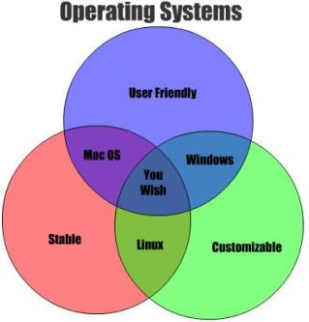
There is no Magic in OS design
Nothing is permanent, high rate of change in hardware and applications
This is Engineering
  Imperfection
  Tradeoffs (performance/functionality)
  Constraints
    Hardware, cost, time, power
Optimizations
Cost/benefit analyses
One good news: Inertia of a few design principles.

Slide 43
Separating Policy from Mechanism
A fundamental design principle in Computer Science
Policy – decisions on what effect should be achieved
  Examples:
    All users treated equally
    All program instances treated equally
    Preferred users treated better
Mechanism – tool/implementation to achieve some effect
Separation leads to flexibility

Slide 44
Evolution of Operating Systems
Early OS: Batch processing, no direct user interaction.
1960s: Multiprogramming and time-sharing introduced.
1970s-1980s: Unix and early personal computer operating systems.
1980s-1990s: Graphical user interfaces (GUIs) become mainstream. Multiprocessor and networked/distributed systems introduced.
2000s-Present: Rise of mobile OS, cloud integration, security, and virtualization.
Future: IoT, edge computing, and AI-driven operating systems continue to evolve.

Slide 45
Types of Operating Systems
Batch OS: Processes jobs in batches, with no user interaction.
Single-User, Single-Tasking OS: Simple systems for single-task operations.
Single-User, Multi-Tasking OS: Allows one user to run multiple tasks simultaneously.
Multi-User OS : Supports multiple users accessing the system concurrently.
Time-Sharing OS: Multiple users share the system resources simultaneously.
Distributed OS: Manages a group of independent computers to work together as a single system.
Network OS: Manages network resources and supports multiple computers on a network.
RTOS: Handles real-time tasks with strict timing constraints.
Embedded OS: Designed for embedded systems within devices.
Mobile OS: Optimized for mobile devices with touch interfaces.
Cloud OS: Manages resources in a cloud computing environment.

Slide 46
Batch Operating Systems
Description: In batch processing systems, tasks are collected and processed in batches without user interaction. Jobs are prepared and queued, then executed sequentially by the operating system.
Use Case: Common in early computing for tasks like payroll processing, scientific calculations, and large-scale data processing.
Example: IBM's early batch processing systems used on mainframes.

Slide 47
Single-User, Single-Tasking Operating Systems
Description: These OSes are designed to manage the computer so that a single user can perform one task at a time. They are simple and require fewer resources compared to multitasking OSes.
Use Case: Older personal computers and devices with very limited resources.
Example: MS-DOS (early versions), Palm OS for early PDAs.

Slide 48
Single-User, Multi-Tasking Operating Systems
Description: The most common type of OS today, these systems allow a single user to run multiple applications simultaneously. The OS manages memory and CPU time among different tasks.
Use Case: General-purpose computing, including desktops, laptops, and mobile devices.
Example: Microsoft Windows, macOS, Linux, Android, iOS.

Slide 49
Multi-User Operating Systems
Description: A multi-user OS allows multiple users to access the computer’s resources simultaneously. It manages user sessions and resources to ensure that each user has fair access.
Use Case: Used in environments where multiple users need to share the same resources, such as servers, mainframes, and cloud environments.
Example: UNIX, Linux, Windows Server, IBM z/OS.

Slide 50
Time-Sharing Operating Systems
Description: Time-sharing systems allow multiple users to share the computer's resources simultaneously. The OS switches between tasks rapidly, giving the illusion that each user has their own dedicated machine.
Use Case: Used in environments where multiple users need to interact with the computer at the same time, like in universities or research labs.
Example: UNIX, Compatible Time-Sharing System (CTSS).

Slide 51
Distributed Operating Systems
Description: In a distributed OS, multiple computers (or nodes) are connected and work together to appear as a single system to the user. Resources are shared across these machines, and the OS manages them to optimize performance and reliability.
Use Case: Used in networked environments like data centers, cloud computing, and distributed databases.
Example: Apache Hadoop, Google’s MapReduce, Amoeba.

Slide 52
Network Operating Systems
Description: A network OS is designed to manage network resources, such as file servers, printers, and other shared devices. It allows multiple computers to communicate and share resources over a network.
Use Case: Common in environments where multiple computers need to communicate over a network, such as in business networks and educational institutions.
Example: Novell NetWare, Microsoft Windows Server, UNIX-based servers.

Slide 53
Real-Time Operating Systems (RTOS)
Description: An RTOS is designed to process data and events in real time with minimal latency. It ensures that tasks are executed within a strict time constraint, often necessary in critical systems.
Use Case: Used in systems where timing is crucial, such as embedded systems, medical devices, automotive systems, and industrial control systems.
Example: VxWorks, FreeRTOS, QNX.

Slide 54
Embedded Operating Systems
Description: Embedded OSes are designed to operate within embedded systems—computers that are part of a larger device. They are optimized for specific tasks and typically have limited resources.
Use Case: Used in devices like smartphones, routers, home appliances, and automotive systems.
Example: Embedded Linux, Windows Embedded, RTOS-based systems.

Slide 55
Mobile Operating Systems
Description: Mobile OSes are designed specifically for mobile devices like smartphones and tablets. They manage resources and user interfaces optimized for touch screens and mobile hardware.
Use Case: Used in smartphones, tablets, and other portable devices.
Example: Android, iOS, Windows Phone (discontinued).

Slide 56
Cloud Operating Systems
Description: Cloud OSes are designed to manage cloud infrastructure, enabling virtualized resources, scalability, and on-demand computing. They often integrate with cloud platforms and services.
Use Case: Used in cloud computing environments, such as data centers and virtualized services.
Example: OpenStack, AWS Cloud OS, Google Cloud Platform.

Slide 57
Computer System Environments
Each type of operating system is tailored to meet the specific requirements of different computing environments and user needs.
  Traditional
  Mobile
  Client Server
  Peer-to-Peer
  Virtualization
  Cloud Computing
  Real-time Embedded

Slide 58
Traditional
Stand-alone general-purpose machines
But blurred as most systems interconnect with others (i.e., the Internet)
Portals provide web access to internal systems
Network computers (thin clients) are like Web terminals
Mobile computers interconnect via wireless networks
Networking becoming ubiquitous – even home systems use firewalls to protect home computers from Internet attacks

Slide 59
Mobile
Handheld smartphones, tablets, etc.
What is the functional difference between them and a “traditional” laptop?
Extra feature – more OS features (GPS, gyroscope)
Allows new types of apps like augmented reality
Use IEEE 802.11 wireless, or cellular data networks for connectivity
Leaders are Apple iOS and Google Android

Slide 60
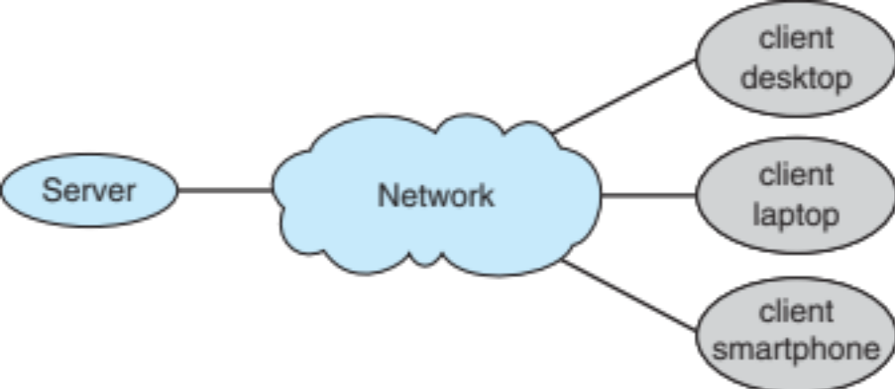
Client-Server
Client-Server Computing: Dumb terminals supplanted by smart PCs. Many systems now servers, responding to requests generated by clients
  Compute-server system provides an interface to client to request services (i.e., database)
  File-server system provides interface for clients to store and retrieve files

Slide 61
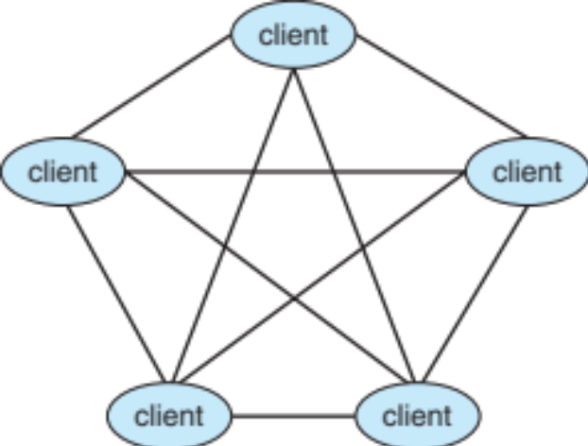
Peer-to-Peer
Another model of distributed system
P2P does not distinguish clients and servers
  Instead, all nodes are considered peers
  May each act as client, server or both
  Node must join P2P network
    Registers its service with central lookup service on network, or
    Broadcast request for service and respond to requests for service via discovery protocol
Examples include Napster and Gnutella, Voice over IP (VoIP) such as Skype

Slide 62
Virtualization
Allows operating systems to run applications within other operating systems
  Vast and growing industry
Emulation used when source CPU type different from target type (i.e. PowerPC to Intel x86)
  Generally slowest method
  When computer language not compiled to native code – Interpretation
Virtualization – OS natively compiled for CPU, running guest OSes also natively compiled
  Consider VMware running WinXP guests, each running applications, all on native WinXP host OS
  VMM (virtual machine Manager) provides virtualization services

Slide 63
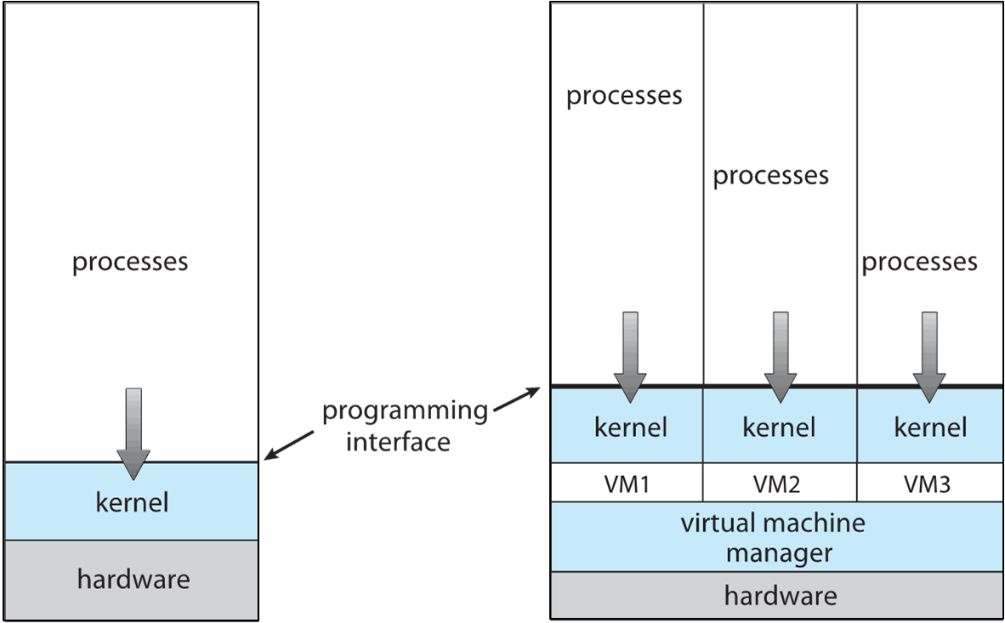
Virtualization (cont.)
Use cases involve laptops and desktops running multiple OSes for exploration or compatibility
  Apple laptop running Mac OS X host, Windows as a guest
  Developing apps for multiple OSes without having multiple systems
  Quality assurance testing applications without having multiple systems
  Executing and managing compute environments within data centers
VMM can run natively, in which case they are also the host
  There is no general-purpose host then (VMware ESX and Citrix XenServer)

Slide 64
Cloud Computing
Delivers computing, storage, even apps as a service across a network
Logical extension of virtualization because it uses virtualization as the base for its functionality.
  Amazon EC2 has thousands of servers, millions of virtual machines, petabytes of storage available across the Internet, pay based on usage
Many types
  Public cloud – available via Internet to anyone willing to pay
  Private cloud – run by a company for the company’s own use
  Hybrid cloud – includes both public and private cloud components
  Software as a Service (SaaS) – one or more applications available via the Internet (i.e., word processor)
  Platform as a Service (PaaS) – software stack ready for application use via the Internet (i.e., a database server)
  Infrastructure as a Service (IaaS) – servers or storage available over Internet (i.e., storage available for backup use)

Slide 65
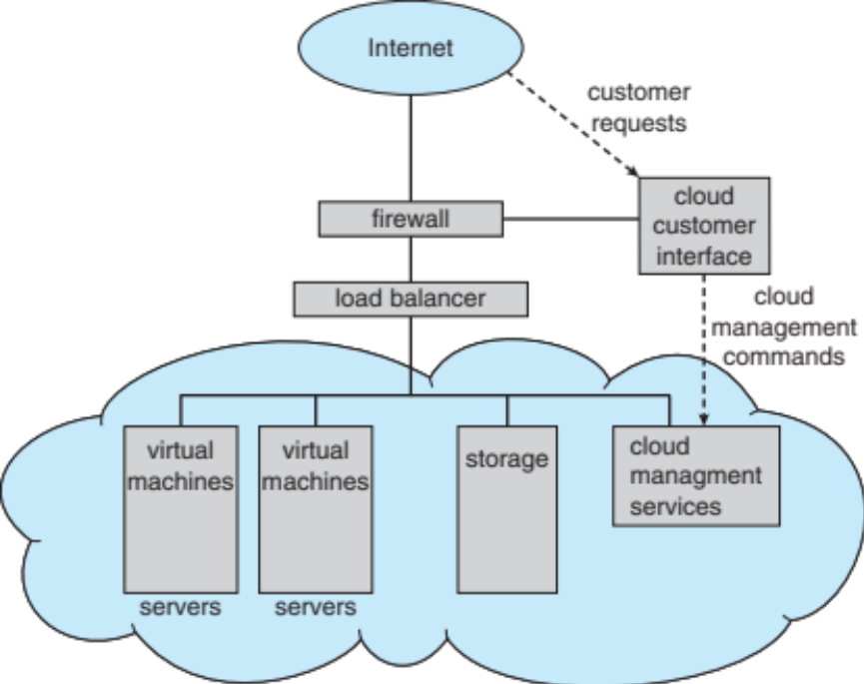
Cloud Computing (cont.)
Cloud computing environments composed of traditional OSes, plus VMMs, plus cloud management tools
  Internet connectivity requires security like firewalls
  Load balancers spread traffic across multiple applications

Slide 66
Real-Time Embedded Systems
Real-time embedded systems most prevalent form of computers
  Vary considerably, special purpose, limited purpose OS, real-time OS
  Use expanding
Many other special computing environments as well
  Some have OSes, some perform tasks without an OS
  Typically, have very little user-interface capability, and no end-user utilities, since the systems will be a "sealed box" when delivered for use (e. g., HDTV receiver and display)
Real-time OS has well-defined fixed time constraints
  Processing must be done within constraint
  Correct operation only if constraints met

Slide 67
Free and Open-Source Operating Systems
Operating systems made available in source-code format rather than just binary closed-source and proprietary
Counter to the copy protection and Digital Rights Management (DRM) movement
Started by Free Software Foundation (FSF), which has “copyleft” GNU Public License (GPL)
  Free software and open-source software are two different ideas championed by different groups of people
    https://www.gnu.org/philosophy/open-source-misses-the-point.en.html
Examples include GNU/Linux and BSD UNIX (including core of Mac OS X), and many more
Can use VMM like VMware Player (Free on Windows), Virtualbox (open source and free on many platforms - http://www.virtualbox.com)
  Use to run guest operating systems for exploration

Slide 68
The Study of Operating Systems
There has never been a more interesting time to study operating systems, and it has never been easier. The open-source movement has overtaken operating systems, causing many of them to be made available in both source and binary (executable) format. The list of operating systems available in both formats includes Linux, BUSD UNIX, Solaris, and part of macOS. The availability of source code allows us to study operating systems from the inside out. Questions that we could once answer only by looking at documentation or the behavior of an operating system we can now answer by examining the code itself.
Operating systems that are no longer commercially viable have been open-sourced as well, enabling us to study how systems operated in a time of fewer CPU, memory, and storage resources. An extensive but incomplete list of open-source operating-system projects is available from https://curlie.org/Computers/Software/Operating_Systems/Open_Source/
In addition, the rise of virtualization as a mainstream (and frequently free) computer function makes it possible to run many operating systems on top of one core system. For example, Vmware (http://www.vmware.com) provides a free “player” for Windows on which hundreds of free “virtual appliances” can run. Virtualbox (http://www.virtualbox.com) provides a free, open-source virtual machine manager on many operating systems. Using such tools, students can try out hundreds of operating systems without dedicated hardware.
The advent of open-source operating systems has also made it easier to make the move from student to operating-system developer. With some knowledge, some effort, and an Internet connection, a student can even create a new operating-system distribution. Just a few years ago, it was difficult or impossible to get access to source code. Now, such access is limited only by how much interest, time, and disk space a student has.

