Slide 1
CSC 323 – Principles of Operating Systems
Instructor: Ms. Mamoona Tasadduq
Lecture# 06: Synchronization

Slide 2
Before we start …: Exercise # 1
count is a global variable initialized to 5
After thread 1 and 2 finishes, what is the value of count?
Thread 1 Thread 2
void foo() void bar()
{ {
count++; count--;
} }

Slide 3
Before we start …: Exercise # 1
count-- could be implemented as:
register2 = count
register2 = register2 – 1
count = register2
count++ could be implemented as:
register1 = count
register1 = register1 + 1
count = register1
Consider this execution interleaving with “count = 5” initially:
  S0: producer execute register1 = count
  S1: producer execute register1 = register1 + 1
  S2: consumer execute register2 = count
  S3: consumer execute register2 = register2 – 1
  S4: producer execute count = register1
  S5: consumer execute count = register2
  {register1 = 5}
  {register1 = 6}
  {register2 = 5}
  {register2 = 4}
  {count = 6 }
  {count = 4}

Slide 4
Atomic Operations
To understand a concurrent program, we need to know what the underlying indivisible operations are!
Atomic Operation: an operation that always runs to completion or not at all
  It is indivisible: it cannot be stopped in the middle and state cannot be modified by someone else in the middle
  Fundamental building block – if no atomic operations, then have no way for threads to work together
On most machines, memory references and assignments (i.e., loads and stores) of words are atomic
  Consequently – weird example that produces “4” on previous slide can’t happen
Many instructions are not atomic
  Double-precision floating point store often not atomic
  VAX and IBM 360 had an instruction to copy a whole array

Slide 5
Synchronization Motivation
Threads cooperate in multithreaded programs
  To share resources, access shared data structures
  To coordinate their execution
For correctness and consistency, we need to control this cooperation
  Thread schedule is non-deterministic (i.e., behavior changes when re-run program)
    Scheduling is not under program control
    Threads interleave executions arbitrarily and at different rate
  Multi-word operations are not atomic
  Compiler/hardware instruction reordering

Slide 6
Shared Resources
We initially focus on controlling access to shared resources
Basic Problem:
  If two concurrent threads (processes) are accessing a shared variable, and that variable is read/modified/written by those threads, then access to the variable must be controlled to avoid erroneous behavior
Over the next couple of lectures, we will look at:
  Mechanisms to control access to shared resources
    Locks, mutexes, semaphores, monitors, condition variables, etc.
  Pattern for coordinating accesses to shared resources
    Bounded buffer, producer-consumer, etc.

Slide 7
Classic Example: Bank Account Balance
TODO: Implement a function to handle withdrawals from a bank account:
Suppose that you and your significant other share a bank account with a balance of $1000.
Then you each go to separate ATM machine and simultaneously withdraw $100 from the account.
withdraw (account, amount) {
balance = get_balance(account);
balance = balance – amount;
put_balance(account, balance);
return balance;
}

Slide 8
Classic Example: Bank Account Balance
We’ll represent the situation by creating a separate thread for each person to do the withdrawals
These threads run on the same bank server:
What’s the problem with this implementation?
  Think about potential schedules of these two threads
withdraw (account, amount) {
balance = get_balance(account);
balance = balance – amount;
put_balance(account, balance);
return balance;
}
withdraw (account, amount) {
balance = get_balance(account);
balance = balance – amount;
put_balance(account, balance);
return balance;
}

Slide 9
Classic Example: Bank Account Balance
The problem is that the execution of the two threads can be interleaved:
What’s the balance of the account now?
Is the bank happy with our implementation?
balance = get_balance(account);
balance = balance – amount;
Execution sequence seen by CPU
balance = get_balance(account);
balance = balance – amount;
put_balance(account, balance);
Context Switch
put_balance(account, balance);

Slide 10
How Interleaved Can It Get?
How contorted can the interleavings be?
We’ll assume that the only atomic operations are instructions
  E.g., reads and writes of words
  The hardware may not even give you that!
We’ll assume that a context switch can occur at any time
We’ll assume that you can delay a thread as long as you like as long as it’s not delayed forever
balance = get_balance(account);
balance = get_balance(account);
balance = balance – amount;
balance = balance – amount;
put_balance(account, balance);
put_balance(account, balance);

Slide 11
Shared Resources
Problem: Concurrent threads accessed a shared resource without any synchronization
  Known as a race condition
Race Condition: The situation where several processes access and manipulate shared data concurrently. The final value of the shared data depends upon which process finishes last.
We need mechanism to control access to these shared resources in the face of concurrency so we can reason about how the program will operate
Our example was updating a shared bank account
Also applies to any shared data structure
  Buffers, queues, lists, hash tables, etc.

Slide 12
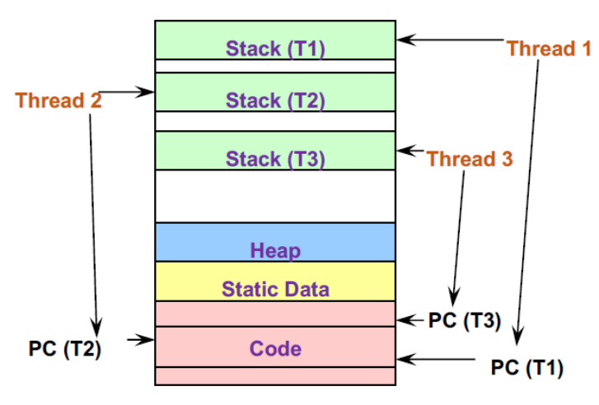
When Are Resources Shared?
Local variables are not shared (private)
  Refer to data on the stack
  Each thread has its own stack
  Never pass/share/store a pointer to a local variable on the stack for thread T₁ to another thread T₂
Dynamic objects and other heap objects are shared
  Allocated from heap with malloc/free or new/delete
Global variables and static objects are shared
  Stored in the static data segment, accessible by any thread

Slide 13
Mutual Exclusion
We want to use mutual exclusion to synchronize access to shared resources allowing us to have larger atomic blocks
Code that uses mutual exclusion to synchronize its execution is called a critical section.
The Critical Section Problem – ensure that when one thread is executing in its critical section, no other thread is allowed to execute in its critical section.
while (TRUE) {
entry section
critical section
exit section
remainder section
}
while (TRUE) {
critical section
remainder section
}
Entry section will allow only one process to enter and execute critical section code.
Notes:
Example: sharing your bathroom with housemates
What requirements would you place on a critical section?

Slide 14
Critical-Section Requirements
Mutual Exclusion – If thread T_{i} is executing in its critical section, then no other threads can be executing in their critical sections
Progress – If some thread T is not in the critical section, then T cannot prevent some other thread S from entering the critical section. A thread in the critical section will eventually leave it.
Bounded Waiting – If some thread is waiting on the critical section, then T will eventually enter the critical section (i.e., no starvation).
  Assume that each process executes at a nonzero speed
  No assumption concerning the relative speed of the n processes
Performance – The overhead of entering and exiting the critical section is small with respect to work being done within it.

Slide 15
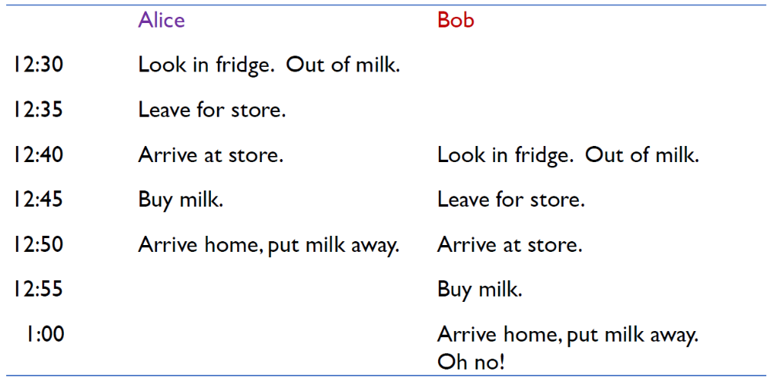
“Too Much Milk” Problem
Great thing about OS’s – analogy between problems in OS & problems in real life
  Help you understand real life problems better
  But computers are much stupider than people
Example: People need to coordinate:

Slide 16
“Too Much Milk” Problem
What are the correctness properties for the “Too much milk” problem???
  Only one person buys milk at a time
  Someone buys milk if you need it
Restrict ourselves to use only atomic load and store operations as building blocks

Slide 17


“Too Much Milk” Problem: Solution #1
Leave a note before buying (a version of “lock”)
Remove note after buying (a version of “unlock”)
Don’t buy any milk if there is note (wait)
Suppose a computer tries this (remember, only memory read/write are atomic):
Does it work?
  Still too much milk but only occasionally!
  Thread context switched after checking milk & note but before buying milk!
Solution makes problem worse since fails intermittently
Thread A if (noMilk & NoNote){ leave Note; buy milk; remove note; } | Thread B if (noMilk & NoNote){ leave Note; buy milk; remove note; }

Slide 18
“Too Much Milk” Problem: Solution #2
How about using labeled notes so we can leave note before checking the milk?
Does it work?
Possible for neither thread to buy milk
  Context switches at exactly the wrong times can lead each to think that the other is going to buy
  Extremely unlikely that this would happen, but will at worse possible time
This kind of lockup is called “starvation!”
Thread A Thread B
leave note A; leave note B;
if (noNote B) { if (noNoteA){
if (noMilk){ if (noMilk){
buy Milk; buy Milk;
} }
} }
remove note A; remove note B;

Slide 19
“Too Much Milk” Problem: Solution #3
Thread A Thread B
leave note A; leave note B;
X: while (note B){ Y: if (noNote A){
do nothing; if (noMilk){
} buy milk;
if (noMilk){ }
buy milk; }
} remove note B;
remove note A;
Does it work?
Yes. Both can guarantee that it is safe to buy, or other will buy, ok to quit
At point X, either there is a note B or not:
  if no note B, safe for A to buy since B has either not started or quit
  otherwise A waits until there is no longer a note B, and either finds milk that B has bought or buys it if needed
At point Y either there is a note A or not:
  if no note A, safe for B to check & buy milk (Thread A not started yet)
  Otherwise, A is either checking & buying milk or waiting for B to quit, so B quits by removing note B.

Slide 20
“Too Much Milk” Problem: Solution #3
Is Solution #3 a good solution?
It is too complicated – it’s hard to convince ourselves this solution works.
It is asymmetrical – thread A and B are different. Thus, adding more threads would require different code for each new thread and modifications to existing threads.
A is busy waiting – A is consuming CPU resources despite any useful work.
The solution relies on loads and stores to be atomic.

Slide 21
Mechanisms For Building Critical Sections
Atomic read/write: Can it be done?
Locks: Primitives, minimal semantics, used to build others
Semaphores: Basic, easy to get the hang of, but hard to program with
Monitors: High-level, requires language support, operations implicit

Slide 22
Mutex with Atomic R/W: Try # 1
int turn = 0;
T₀
T₁
while (TRUE) {
while (turn != 0);
critical section
turn = 1;
outside of critical section
}
while (TRUE) {
while (turn != 1);
critical section
turn = 0;
outside of critical section
}
This is called alternation
Does it satisfy the mutual exclusion requirement?
  Yes
Does it satisfy the progress requirement?
  No. T₀ sets turn = 1 and T₁ is delayed, T₀ is stuck in while loop indefinitely.

Slide 23
Mutex with Atomic R/W: Peterson’s Algorithm
int turn = 1;
boolean Flag[2] = FALSE
Entry Section
T₀
T₁
while (TRUE) {
flag[0] = TRUE;
turn = 1;
while (flag[1] && turn != 0);
critical section
flag[0] = FALSE;
outside of critical section
}
while (TRUE) {
flag[1] = TRUE;
turn = 0;
while (flag[0] && turn != 1);
critical section
flag[1] = FALSE;
outside of critical section
}
Exit Section
Does it satisfy the mutual exclusion requirement?
Does it satisfy the progress requirement?

Slide 24
Mutex with Atomic R/W: Peterson’s Algorithm
A two-process solution
Assume that the load and store machine-language instructions are atomic; that is, cannot be interrupted
The two processes share two variables:
  The variable turn indicates whose turn it is to enter the critical section.
  The flag array is used to indicate if a process is ready to enter the critical section. flag[i] = true implies that process P_{i} is ready.
Provable that the three critical section requirement are met:
  Mutual exclusion is preserved as P_{i} enters critical section only if:
    either flag[j] = FALSE or turn i
  Progress requirement is satisfied
  Bounded waiting requirement is met

Slide 25
Mutex with Atomic R/W: Bakery Algorithm
N process solution
  Before entering its critical section, a process receives a number (like in a bakery). And the holder of the smallest number enters the critical section.
  The numbering scheme here always generates numbers in increasing order of enumeration; i.e., 1,2,3,3,3,3,4,5...
  If processes P_{i} and P_{j} receive the same number, if i < j, then P_{i} is served first; else P_{j} is served first (PID assumed unique).
Choosing a number
  max (a₀,…, a_{n-1}) is a number k, such that k ≥ a_{i} for i = 0, …, n – 1
Notation for lexicographical order (ticket #, PID #)
  (a,b) < (c,d) if a < c or if a == c and b < d

Slide 26
Mutex with Atomic R/W: Bakery Algorithm
  boolean choosing[n] = FALSE; // Is the process choosing its number?
  Integer number[n] = 0; // The ticket number for each process
while (TRUE) {
choosing[i] = TRUE; // Process i is choosing a number
number[i] = 1 + max(number[0], … , number[n – 1]);
choosing[i] = FALSE; // Process i has chosen its number
for (j = 0; j < n; j++) {
// Wait if the other process is choosing its number
while (choosing[j]);
// Wait if the other process has a lower ticket number, or the same number with a lower process ID
while ((number[j] != 0) && ((number[j],j) < (number[i],i)));
}
critical section
number[i] = 0; // Process i is done with the critical section
remainder section
}

Slide 27
Locks
A lock is an object in memory providing mutual exclusion to shared data with two “atomic” operations
acquire() – wait until lock is free, then take it to enter a C.S
release() – release lock to leave a C.S, waking up any thread waiting for it.
Threads pair calls to acquire and release
  Between acquire/release, the thread holds the lock
  acquire does not return until any previous holder releases
  What can happen if the calls are not paired?
Lock can spin (a spinlock) or block (a mutex)

Slide 28
Locks
Rules of using a lock:
  Always acquire the lock before accessing shared data
  Always release the lock after finishing with shared data
  Lock is initially free
  Do not lock again if already locked
  Do not unlock if not locked by you
  Do not spend large amounts of time in critical section

Slide 29
Using Locks
acquire(lock);
balance = get_balance(account);
balance = balance – amount;
withdraw (account, amount) {
acquire(lock);
balance = get_balance(account);
balance = balance – amount;
put_balance(account, balance);
release(lock);
return balance;
}
acquire(lock);
Critical Section
put_balance(account, balance);
release(lock);
balance = get_balance(account);
balance = balance – amount;
put_balance(account, balance);
release(lock);
What happens when green tries to acquire the lock?
Why is the “return” outside the critical section? Is this OK?
What happens when a third thread calls acquire?

Slide 30
“Too Much Milk” Problem: Solution #4
Implementing “Too Much Milk” with locks
The solution is clean and symmetric
How do we make acquire() and release() atomic?
  if two threads are waiting for the lock and both see it’s free, only one succeeds to grab the lock
Once again, section of code between acquire(lock) and release(lock) is called a “Critical Section”
Thread A acquire(lock); if (noMilk){ buy milk; } release(lock); | Thread B acquire(lock); if (noMilk){ buy milk; } release(lock);

Slide 31
Implementing Locks
How do we implement locks? Here is one attempt:
  This is called a spinlock because a thread spins waiting for the lock to be released
  Does this work?
    No. Two independent threads may both notice that a lock has been released and thereby acquire it.
struct lock {
int held = 0;
}
void acquire (lock) {
while (lock→held);
lock→held = 1;
}
void release (lock) {
lock→held = 0;
}
busy-wait (spin wait) for lock to be released
A context switch can occur here, causing a race condition

Slide 32
Implementing Locks
The problem is that the implementation of locks has critical sections, too!
How do we stop the recursion?
The implementation of acquire/release must be atomic
  An atomic operation is one which executes as though it could not be interrupted
  Code that executes “all or nothing”
How do we make them atomic?
Need help from hardware
  Atomic instructions (e.g., test-and-set, compare-and-swap)
  Disable/enable interrupts (prevent context switches)

Slide 33
Atomic Instructions: Test-And-Set
The semantics of test-and-set are:
  Record the old value
  Set the value to indicate available
  Return the old value
Hardware executes it atomically!
When executing test-and-set on “flag”
  What is value of flag afterwards if it was initially False? True?
  What is the return result if flag was initially False? True?
Often used to implement locks. The idea is that if the value is 0 (unlocked), it can be set to 1 (locked), and the calling process obtains the lock. If it is already 1, the process knows the lock is held by another.
bool test_and_set (bool *flag) {
bool old = *flag;
*flag = TRUE;
return old;
}

Slide 34
Using Test-And-Set
Here is the lock implementation with test-and-set:
When will the while return? What is the value of held?
What about multiprocessor?
struct lock {
int held = 0;
}
void acquire (lock) {
while (test_and_set(&lock→held));
}
void release (lock) {
lock→held = 0;
}

Slide 35
Atomic Instructions: Compare-And-Swap
Compare-and-swap is a more flexible atomic operation. It compares the value of a memory location to a given expected value, and if they are equal, it swaps the memory value with a new value. If the values are not equal, it leaves the memory unchanged. The original value of the memory location is returned.
CAS is commonly used in lock-free algorithms, such as in atomic counters or lock-free queues. It ensures that changes are only made if the memory location hasn't been modified by another thread in the meantime, providing stronger concurrency control.
int compare_and_swap (int *value, int expected, int new_value) {
int temp = *value;
if (*value == expected)
*value = new_value;
return temp;
}

Slide 36
Using Compare-And-Swap
Here is the lock implementation with compare-and-swap:
Does it solve the critical-section problem?
struct lock {
int held = 0;
}
void acquire (lock) {
while (compare_and_swap(&lock→held, 0, 1) != 0);
}
void release (lock) {
lock→held = 0;
}

Slide 37
Bounded-waiting with Compare-And-Swap
while (true) {
waiting[i] = true;
key = 1;
while (waiting[i] && key == 1)
key = compare_and_swap(&lock,0,1);
waiting[i] = false;
/* critical section */
j = (i + 1) % n;
while ((j != i) && !waiting[j])
j = (j + 1) % n;
if (j == i)
lock = 0;
else
waiting[j] = false;
/* remainder section */
}

Slide 38
Atomic Variables
Typically, instructions such as compare-and-swap are used as building blocks for other synchronization tools.
One tool is an atomic variable that provides atomic (uninterruptible) updates on basic data types such as integers and booleans.
For example: Let sequence be an atomic variable and let increment() be operation on the atomic variable sequence. Then increment(&sequence) ensures sequence is incremented without interruption.
void increment (atomic_int *v) {
int temp;
do {
temp = *v;
} while (temp != (compare_and_swap(v,temp,temp+1));
}

Slide 39
Problems with Spinlocks
The problems with spinlocks is that they are wasteful
  If a thread is spinning on a lock, then the thread holding the lock cannot make progress (on a uniprocessor)
How did the lock holder give up the CPU in the first place?
  Lock holder calls yield or sleep
  Involuntary context switch
Only want to use spinlocks as primitives to build higher-level synchronization constructs

Slide 40
Disabling Interrupts
Another implementation of acquire/release is to disable interrupts
Note that there is no state associated with the lock
Can two threads disable interrupts simultaneously?
struct lock {
}
void acquire (lock) {
disable interrupts;
}
void release (lock) {
enable interrupts;
}

Slide 41
On Disabling Interrupts
Disabling interrupts blocks notification of external events that could trigger a context switch (e.g., timer)
In a “real“ system, this is only available to the kernel
  Why?
Disabling interrupts is insufficient on a multiprocessor
  Interrupts are only disabled on a per-core basis
  Back to atomic instructions
Like spinlocks, only want to disable interrupts to implement higher-level synchronization primitives
  Don’t want interrupts disabled between acquire and release

Slide 42
Summarize Where We Are
Goal: Use mutual exclusion to protect critical sections of code that access shared resources
Method: Use locks (either spinlocks or disable interrupts)
Problem: Critical sections (CS) can be long
Spinlocks
Threads waiting to acquire lock spin in test-and-set loop
Wastes CPU cycles
Longer the CS, the longer the spin, greater the chance for lock holder to be interrupted
acquire(lock)
...
Critical Section
...
release(lock)
Disabling Interrupts
Disabling interrupts for long periods of time can miss or delay important events (e.g., timer, I/O)

Slide 43
Implementing Locks
Block waiters, interrupts enabled in critical sections
struct lock {
int held = 0;
queue Q;
}
void acquire (lock) {
Disable interrupts;
while (lock→held){
put current thread on lock Q;
block current thread;
}
lock→held = 1;
Enable interrupts;
}
void release (lock) {
Disable interrupts;
if (Q) remove waiting thread;
unblock waiting thread;
lock→held = 0;
Enable interrupts;
}
acquire(lock)
...
Critical Section
...
release(lock)
Interrupts Disabled
Interrupts Enabled
Interrupts Disabled

Slide 44
Higher-Level Synchronization
Spinlocks and disabling interrupts are useful only for very short and simple critical sections
  Wasteful otherwise
  These primitives are “primitive” – don’t do anything besides mutual exclusion
Need higher-level synchronization primitives that:
  Block waiters, leave interrupts enabled within the critical section
  Provide semantics beyond mutual exclusion
All synchronization requires atomicity, so we’ll use our “atomic” locks as primitives to implement them
Two common high-level mechanisms
  Semaphores
  Monitors
Use them to solve common synchronization problems

Slide 45
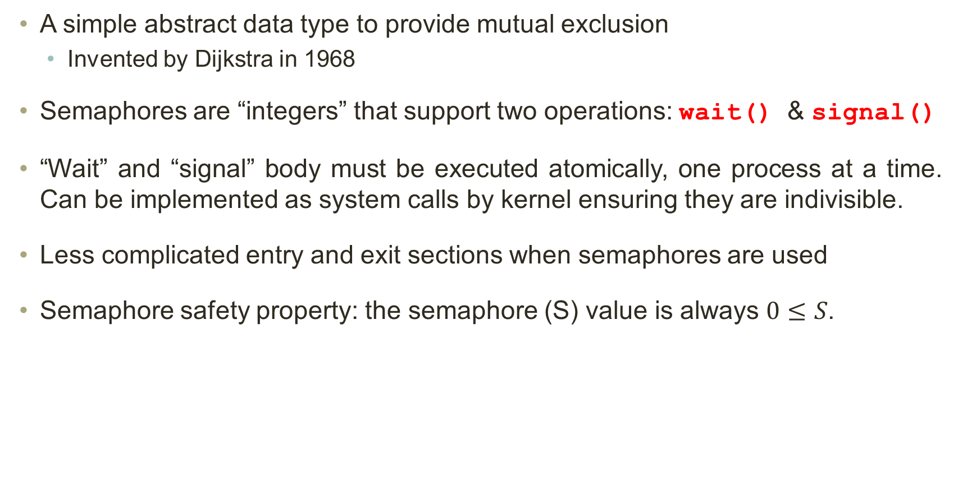
Semaphores
A simple abstract data type to provide mutual exclusion
  Invented by Dijkstra in 1968
Semaphores are “integers” that support two operations: wait() & signal()
“Wait” and “signal” body must be executed atomically, one process at a time. Can be implemented as system calls by kernel ensuring they are indivisible.
Less complicated entry and exit sections when semaphores are used
Semaphore safety property: the semaphore (S) value is always $0≤S$.

Slide 46
Blocking in Semaphores
Associated with each semaphore is a queue of waiting threads
When wait() is called by a thread:
  If semaphore is open, thread continues
  If semaphore is closed, thread blocks on queue
Then signal() opens the semaphore:
  If a thread is waiting on the queue, the thread is unblocked
  If no threads are waiting on the queue, the signal is remembered for the next thread

Slide 47
Semaphore Types
Mutex Semaphore (or binary Semaphore)
  Represents single access to a resource
  Guarantees mutually exclusion to a critical section
  It is initialized to free (value = 1)
Counting Semaphore (or general Semaphore)
  Represents a resource with many units available, or a resource that allows certain kinds of unsynchronized concurrent access (e.g., reading)
  Multiple threads can pass the semaphore
  # of threads determined by the semaphore “count” initialized to # of resources (N)
  Can be used for other synchronization problems; e.g., for resource allocation

Slide 48
Semaphores Implementation
Must guarantee that no two processes can execute the wait() and signal() on the same semaphore at the same time
Thus, the implementation becomes the critical section problem where the wait() and signal() code are placed in the critical section
Busy waiting implementation is not a good solution as many applications may spend lots of time in critical sections
In a no-busy waiting implementation, a waiting queue is associated with each semaphore and each entry in a waiting queue has two data items:
  Value (of type integer)
  Pointer to next record in the list
Two operations:
  block – place the process invoking the operation on the appropriate waiting queue
  wakeup – remove one process from waiting queue and place it in the ready queue

Slide 49
Implementation With No Busy Waiting
Waiting queue:
typedef struct {
int value;
struct process *list;
} semaphore;
wait (semaphore *S) {
S→value--;
if (S→value < 0) {
add this process to S→list;
block();
}
signal (semaphore *S) {
S→value++;
if (S→value <= 0) {
remove a process P from S→list;
wakeup(P);
}

Slide 50
Using Semaphores
Use is similar to locks, but semantics are different
wait(S);
balance = get_balance(account);
balance = balance – amount;
struct Semaphore {
int value;
Queue Q;
}
withdraw (account, amount) {
wait(S);
balance = get_balance(account);
balance = balance – amount;
put_balance(account, balance);
signal(S);
return balance;
}
Threads Block
wait(S);
wait(S);
put_balance(account, balance);
signal(S);
Critical Section
...
signal(S);
...
signal(S);
It is undefined which thread runs after a signal

Slide 51
“Too Much Milk” Problem: Binary Semaphores
Implementing “Too Much Milk” with semaphores
Semaphores can be used for three purposes:
  To ensure mutually exclusive execution of a critical section (as locks do)
  To control access to a shared pool of resources (using a counting semaphore)
  To cause one thread to wait for a specific action to be signaled from another thread.
Thread A wait(S); if (noMilk) buy milk; signal(S); | Thread B wait(S); if (noMilk buy milk; signal(S);

Slide 52
Example: Counting Semaphores
A library has 10 study rooms, to be used by one student at a time. At most 10 students can use the rooms concurrently. Additional students that need to use the rooms need to wait until a room is free.
Students must request a room from the front desk and return to the desk when finished using a room. The clerk doesn’t keep track of which room is occupied or who is using it. Upon a room request, the clerk decreases the count and upon room release, the clerk increases this count. Front desk represents a semaphore, rooms are the resources, and students represent processes. How can we code those processes?
Solution: One of the processes creates and initializes a semaphore to S = 10.
wait (S);
…
….use one instance of the resource…
…
signal (S);
Each process has to be
coded in this manner.

Slide 53
Using Semaphores: Other Synchronization Problems
P0
P1
…
S1;
….
…
S2;
….
Assume we definitely want to
have S1 executed before S2.
semaphore x = 0; // initialized to 0
P0
P1
…
S1;
signal (x);
….
…
wait (x);
S2;
….
Solution:

Slide 54
Semaphore Exercise
X and Y are shared semaphores. The following 3 pseudo-coded threads are started. What is the output and also mention the updated values of X and Y after completion of every Thread? ? X = 0, Y = 1
Thread 1 wait(X) print “A" signal(Y) | Thread 2 wait(X) wait(Y) Print “B" signal(X) | Thread 3 wait(Y) print “C" signal(X) signal(X)
wait(S) { while (S ≤ 0); // busy wait S--; } | signal(S) { S++; }
Answer:
C A B
X = 1, Y = 0

Slide 55
Semaphore Exercise
Write a pseudo code to synchronize processes A, B, C and D by using semaphores so that process B must finish executing before A starts, and process A must finish before process C or D starts. Show your solution. You should assume three semaphores X, Y and Z and all initialized to zero.
Solution:
X = Y = Z = 0
Process A wait(X) Do works of A; signal(Y) signal(Y) | Process B Do works of B; signal(X) | Process C wait(Y) Do works of C; | Process D wait(Y) Do works of D;

Slide 56
Problems with Semaphore
Incorrect use of semaphore operations:
  signal (mutex) …. wait (mutex)
  wait (mutex) … wait (mutex)
  Omitting of wait (mutex) or signal (mutex) (or both)
Starvation (indefinite blocking) – A process may never be removed from the semaphore queue in which it is suspended.
These – and others – are examples of what can occur when semaphores and other synchronization tools are used incorrectly.

Slide 57
Problems with Semaphore
Let S and Q be two semaphores initialized to 1
What is the problem here?
Deadlock – A condition where two or more processes are waiting indefinitely for an event that can only be generated by one of the waiting processes.
Thread A wait(S); Wait(Q); ... signal(S); signal(Q); | Thread B wait(Q); Wait(S); ... signal(Q); signal(S);

Slide 58
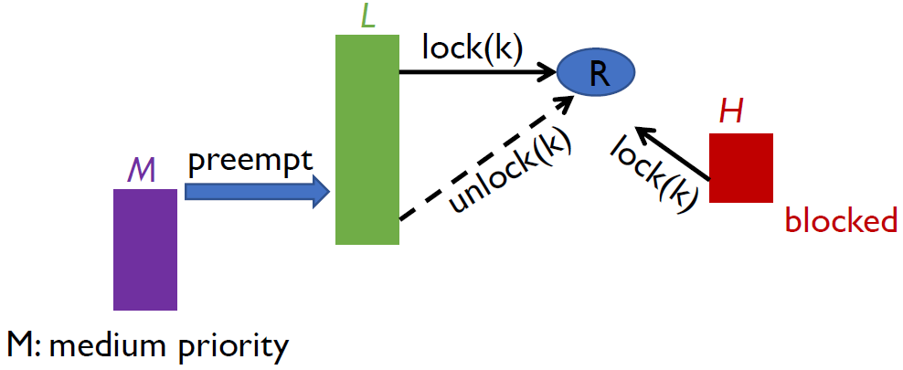
Problems with Semaphore
Priority Inversion – Scheduling problem when lower-priority process L holds a lock needed by higher-priority process H.
  Solved via priority-inheritance protocol
Not just a hypothetical issue, it happened in real-world software!
  The root cause for a famous Mars PathFinder failure in 1997
  Low-priority data gathering task and a medium-priority communications task prevented the critical bus management task from running

Slide 59
Semaphore Summary
Semaphores can be used to solve many traditional synchronization problems
  .
However, they have some drawbacks
  Being shared global variables, they can potentially be accessed anywhere in program
  No connection between semaphore and the data being controlled by the semaphore
  Used both for critical sections (mutual exclusion) and coordination (scheduling)
  No control or guarantee of proper usage
Sometimes hard to use and prone to bugs
  Another approach: Use programming language support

Slide 60
Monitors
Monitor: programming language construct that controls access to shared data
  Synchronization code added by compiler, enforced at runtime
  Why is this an advantage?
A monitor is a module that encapsulates
  Shared data structures
  Procedures that operate on the shared data structures
  Synchronization between concurrent threads that invoke the procedures
A monitor protects its data from unstructured access
It guarantees that threads accessing its data through its procedures interact only in legitimate ways

Slide 61
Monitor Semantics
A monitor guarantees mutual exclusion
  Only one thread can execute any monitor procedure at any time
    The thread is “in the monitor”
  If a second thread invokes a monitor procedure when a first thread is already executing one, it blocks (must maintain a wait queue)
  If a thread within a monitor blocks, another one can enter
What are the implications in terms of parallelism in a monitor?
A monitor invariant is a safety property associated with the monitor
  It’s expressed over the monitored variables
  It holds whenever a thread enters or exits the monitor

Slide 62
Account Example
Monitor account {
double balance;
double withdraw (amount) {
balance = balance – amount;
return balance;
}
}
withdraw(amount);
balance = balance – amount;
Threads Block waiting to get into monitor
withdraw(amount);
withdraw(amount);
return balance;
balance = balance – amount;
return balance;
balance = balance – amount;
return balance;
When first thread exits, another can enter.
Monitor invariant: balance $≥0$

Slide 63
Condition Variables
But what if a thread wants to wait for something inside the monitor?
  If we busy wait, it’s bad
  Even worse, no one can get in the monitor to make changes now!
A condition variable is associated with a condition needed for a thread to make progress once it is in the monitor.
Monitor M {
... monitored variables
condition c;
void enterMonitor (...) {
if (extra property not true) wait(c); //waits outside of the monitor's mutex
do what you have to do
if (extra property true) signal(c); //brings in one thread waiting on condition
}
}

Slide 64
Condition Variables
Condition variables support three operations:
  Wait – release monitor lock, wait for C/V to be signaled
    So condition variables have wait queues, too
  Signal – wakeup one waiting thread
  Broadcast – wakeup all waiting threads
Condition variables are not Boolean objects
  if(num_resources == 0) then wait(resources_available)

Slide 65
Condition Variables != Semaphores
Although their operations have the same names, they have entirely different semantics (such is life, worse yet to come)
However, they each can be used to implement the other
Access to the monitor is controlled by a lock
  wait() blocks the calling thread, and gives up the lock
    To call wait, the thread has to be in the monitor (hence has lock)
    Semaphore::wait just blocks the thread on the queue
  signal() – causes a waiting thread to wake up
    If there is no waiting thread, the signal is lost
    Semaphore::signal increases the semaphore count, allowing future entry even if no thread is waiting
    Condition variables have no history

Slide 66
Signal Semantics
Two flavors of monitors that differ in the scheduling semantics of signal()
Hoare monitors (original)
  signal() immediately switches from the caller to a waiting thread
  The condition that waiter was anticipating is guaranteed to hold when waiter executes
  Signaler must restore monitor invariants before signaling
Mesa monitors (Mesa, Java)
  signal() places a waiter on the ready queue, but signaler continues inside monitor
  Condition is not necessarily true when waiter runs again
    Returning from wait() is only a hint that something changed
    Must recheck conditional case

Slide 67
Hoare vs. Mesa Monitors
Hoare
  if (!condition)
    wait(cond_var);
Mesa
  while (!condition)
    wait(cond_var);
Tradeoffs
Mesa monitors easier to use, more efficient
  Fewer context switches, easier to support broadcast
Hoare monitors leave less to chance
  Easier to reason about the program
condition definitely holds since we just context switched from signal
condition might have been changed, if so, wait again
condition now holds

Slide 68
Condition Variables and Locks
C/Vs are also used without monitors in conjunction with locks
  void cond_init (cond_t *, ...);
  void cond_wait (cond_t *c, mutex_t *m);
    Atomically unlock m and sleep until c signaled
    Then re-acquire m and resume executing
  void cond_signal (cond_t *c);
  void cond_broadcast (cond_t *c);
    Wake one/all threads waiting on c
A monitor ≈ a module whose state includes a C/V and a lock
  Difference is syntactic; with monitors, compiler adds the code
It is “just as if” each procedure in the module calls acquire() on entry and release() on exit
  But can be done anywhere in procedure, at finer granularity
With C/Vs, the module methods may wait and signal on independent conditions

Slide 69
Condition Variables and Locks
Why must cond_wait both release mutex_t and sleep?
  void cond_wait (cond_t *c, mutex_t *m);
Why not separate mutexes and condition variables?
Producer
while(count == BUFFER_SIZE) {
mutex_unlock(&mutex);
cond_wait(&not_full);
mutex_lock(&mutex);
}
Consumer
mutex_lock(&mutex);
... count--;
cond_signal(&not_full);
}

Slide 70
Using Condition Variables and Locks
Alternation of two threads (ping-pong)
Each executes the following:
Lock lock;
Condition cond;
void ping_pong() {
acquire(lock);
while(1) {
printf(“ping or pong\n”);
signal(cond);
wait(cond, lock);
}
release(lock);
}
Must acquire lock before you can wait
Wait atomically releases lock and blocks until signal()
Wait atomically acquires lock before it returns

Slide 71
Monitors and Java
A lock and condition variable are in every Java object
  No explicit classes for locks or condition variables
Every object is/has a monitor
  At most one thread can be inside an object’s monitor
  A thread enters an object’s monitor by
    Executing a method declared “synchronized”
      Can mix synchronized/unsynchronized methods in same class
    Executing the body of a “synchronized” statement
      Supports finer-grained locking than an entire procedure
      Identical to the Modula-2 “LOCK (m) DO” construct
The compiler generates code to acquire the object’s lock at the start of the method and release it just before returning
  The lock itself is implicit, programmers do not worry about it

Slide 72
Monitors and Java
Every object can be treated as a condition variable
  Half of Object’s methods are for synchronization!
Take a look at the Java Object class:
  Object.wait(*) is Condition::wait()
  Object.notify() is Condition::signal()
  Object.notifyAll() is Condition::broadcast()

Slide 73
Desirable Properties of Synchronization
Fair: if several processes waiting, let each in eventually
Efficient: don’t use up substantial number of resources when waiting.
  e.g. no busy waiting
Simple: should be easy to use
  e.g. just bracket the critical sections

Slide 74
Summary
Semaphores
  wait()/signal() implement blocking mutual exclusion
  Also used as atomic counters (counting semaphores)
  Can be inconvenient to use
Monitors
  Synchronizes execution within procedures that manipulate encapsulated data shared among procedures
    Only one thread can execute within a monitor at a time
  Relies upon high-level language support
Condition variables
  Used by threads as a synchronization point to wait for events
  Inside monitors, or outside with locks

Slide 75
Concurrency Bugs Cause Serious Consequences
Cooperating threads are inherently non-deterministic and non-reproducible hence, multithreaded programs must work for all interleavings. Really hard to debug unless carefully designed!
Example: Race condition in the Therac-25 radiation therapy machine caused massive overdose and resulted in patient deaths and serious injuries
  A dual mode, software-controlled machine fired beams of low energy electron and high energy Xray photons.
  The software consists of several routines running concurrently.
  The Data Entry and Keyboard Handler routines share a variable, which recorded whether the technician had completed entering commands.
  A race condition bug of this shared variable cause the UI to display the wrong mode to operators
  Incident report, horrible tragedies.
Exercise extra cautions when dealing with concurrency

Slide 76
Concurrency Bugs Cause Serious Consequences
Example: Space Shuttle launch aborted 20 minutes before scheduled launch. Shuttle has five computers, four run “Primary Avionics Software System” (PASS) and the fifth run the “Backup Flight System” (BFS).
  PASS runs all of the control systems asynchronously and in real-time. Results synchronized and compared every 3 to 4 ms.
  BFS stays synchronized in case it is needed and is written by completely different team than PASS
Countdown aborted because BFS disagreed with PASS
  A 1/67 chance that PASS was out of sync one cycle
  Bug due to modifications in initialization code of PASS
    A delayed init request placed into timer queue
    As a result, timer queue not empty at expected time to force use of hardware clock
  Bug not found during extensive simulation
PASS
BFS

