Slide 1
CSC 323 – Principles of Operating Systems
Instructor: Ms. Mamoona Tasadduq
Lecture# 08: Deadlock

Slide 2
Deadlock
Synchronization is a live gun
  We can easily shoot ourselves in the foot
  Incorrect use of synchronization can block all processes
If one process tries to access a resource that a second process holds, and vice-versa, they can never make progress
We call this situation deadlock, and we will look at:
  Definition and conditions necessary for deadlock
  Representation of deadlock conditions
  Approaches to dealing with deadlock

Slide 3
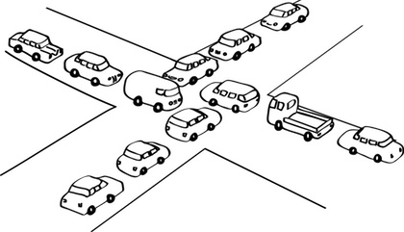
Deadlock Definition
Deadlock is a problem that can arise:
  When processes compete for access to limited resources
  When processes are incorrectly synchronized
Definition – A condition where a set of processes are waiting indefinitely for an event that can be caused only by another process in the set. Deadlocks can occur via system calls, locking, etc.
Let S and Q be two semaphores initialized to 1
Thread A wait(S); Wait(Q); ... signal(S); signal(Q); | Thread B wait(Q); Wait(S); ... signal(Q); signal(S);

Slide 4
Deadlock Characterization
Four conditions are necessary for deadlock to occur:
Mutual Exclusion – at least one resource must be held in a non-sharable mode
Hold and Wait – at least one process holds a resource and is waiting for additional resource(s) to become available, held by other processes
No Preemption – a resource can be released only voluntarily by the process holding it, after it has completed its task
Circular Wait – there must exist a set {P₀, P₁, …, P_{n}} of waiting processes such that P_{i} is waiting for P_{i+1} (i = 1 to n), and P_{n} is waiting on P₀ etc.

Slide 5
Dealing with Deadlocks
There are four approaches for dealing with deadlock:
  Ignore it – How lucky do you feel?
  Prevention: Make it impossible for deadlock to happen
  Avoidance: Control allocation of resources
  Detection and Recovery: Look for a cycle in dependencies

Slide 6
Deadlock Prevention
Invalidate one of the four necessary conditions for deadlock:
Mutual Exclusion – not required for sharable resources (e.g., read-only files); must hold for non-sharable resources
Hold and Wait – must guarantee that whenever a process requests a resource, it does not hold any other resources. Require processes to request and be allocated all its resources before it begins execution or allow process to request resources only when the process has none allocated to it. Low resource utilization and starvation possible.
No Preemption – if a process holding some resources requests another resource that cannot be immediately allocated to it, then all resources currently being held are released. Preempted resources are added to the list of resources for which the process is waiting. Process will be restarted only when it can regain its old resources, as well as the new ones that it is requesting (Problem: not all resources can be easily preempted, like printers.)
Circular Wait – impose a total ordering of all resource types, and require that each process requests resources in an increasing order of enumeration

Slide 7
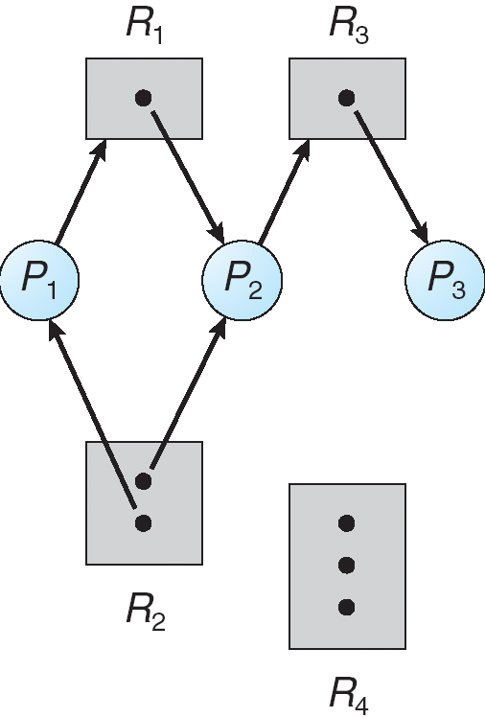
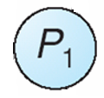

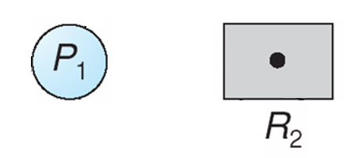
Resource Allocation Graph
View system as a graph
  Processes and resources are vertices
  Resource Requests and Assignments are edges
Process:
Resource with 3 instances:
Request Edge – P₁ requesting R_{2,}
Assignment Edge – P₁ holding instance of R₂

Slide 8
Cycles and Deadlock
If the graph has no cycles, no deadlock exists
If the graph contains a cycle, deadlock might exist
  if only one instance per resource type, then definitely deadlock
  if several instances per resource type, possibility of deadlock
If any instance of a resource involved in the cycle is held by a process not in the cycle, then we can make progress when the resource is released

Slide 9
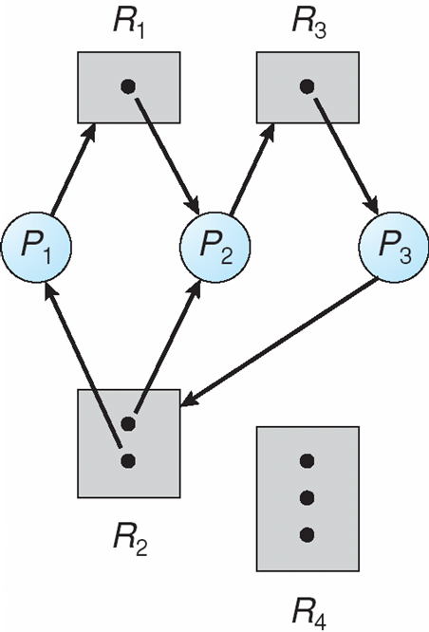
Example: Resource Allocation Graph
DEADLOCK !
P₃ → R₂ (1st instance) → P₂ → R₃ → P₃
P₃ → R₂ (2nd instance)->P₁ → R₁ → P₂ → R₃ → P₃

Slide 10

Example: Resource Allocation Graph
NO DEADLOCK !
P₂ may release R₁ after completion
P₄ may release R₂ after completion

Slide 11
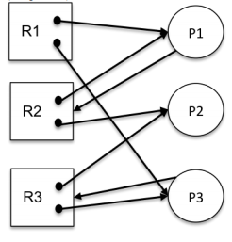
Example: Resource Allocation Graph
A system has three processes (P₁, P₂, P₃) and three reusable resources (R₁, R₂, R₃). There are two instances of R₁, R₂ and R₃. P₁ holds an R₁ and an R₂ and is requesting another instance of an R₂. P₂ holds an R₂ and an R₃. P₃ holds an R₁ and an R₃ and is requesting another instance of R₃.
Draw the resource allocation graph for this situation.

Slide 12
Example: Resource Allocation Graph
Does the allocation graph in (a) contain a deadlock? If yes, write all the cycles in the graph.
Now assume that P₂ also demands resource R₁. Does this allocation graph contain a deadlock? If yes, write all the cycles in the graph.
Assume the allocation graph at point (c), and, in addition, assume that R₂ has now three instances. Does this allocation graph contain a deadlock? If yes, write all the cycles in the graph.
Add to the original allocation graph an additional process P4 that demands an instance of R1. Does this allocation graph contain a deadlock? If yes, write all the cycles in the graph.

Slide 13
Deadlock Avoidance
Provide information in advance about what maximum number of resources of each type will be needed by processes to guarantee that deadlock will not happen
System only grants resource requests if it knows that the process can obtain all resources it needs in future requests
Ensures that a system will never enter an unsafe state.
Avoid circularities (wait dependencies)
Tough
  Hard to determine all resources needed in advance
  Good theoretical problem, not as practical to use

Slide 14
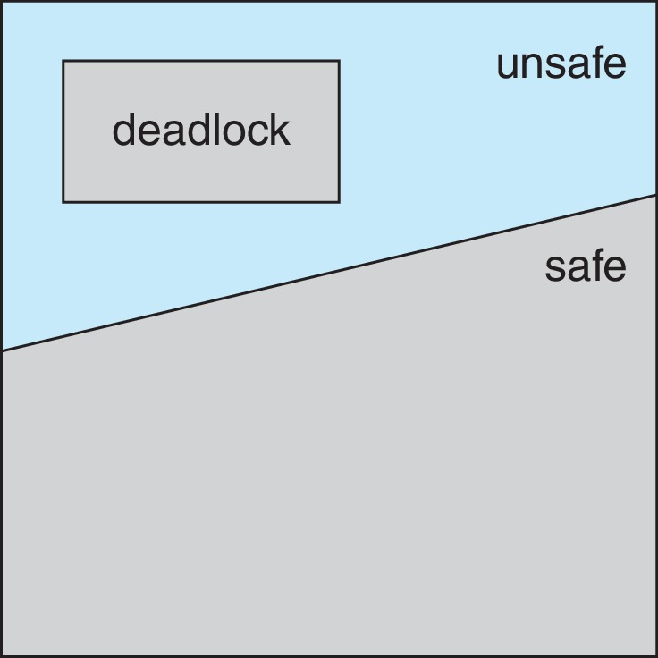
Safe State
When a process requests an available resource, system must decide if immediate allocation leaves the system in a safe state
System is in safe state if there exists a sequence <P₁, P₂, …, P_{n}> of ALL the processes in the systems such that for each P_{i}, the resources that P_{i} can still request can be satisfied by currently available resources plus the resources held by all the P_{j}, with j < i
If a system is in safe state ➔ no deadlocks
If a system is in unsafe state ➔ possibility of deadlock
Grant a resource to a process if the new state is safe. If the new state is unsafe, process must wait even if the resource is currently available
This ensures no circular-wait condition exists

Slide 15
Deadlock Avoidance Algorithms
Single instance of a resource type
  Use a resource-allocation graph
Multiple instances of a resource type
  Use the banker’s algorithm

Slide 16
Resource-Allocation Graph Scheme
Claim edges P_{i} → R_{j} indicates that process P_{i} may request resource R_{j} in the future; represented by a dashed line
Claim edge converts to request edge when a process requests a resource
Request edge converts to an assignment edge when the resource is allocated to the process
When a resource is released by a process, assignment edge reconverts to a claim edge
Resources must be claimed a priori in the system
This solution does not work for multiple instances of the same resource.

Slide 17
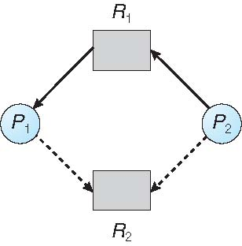
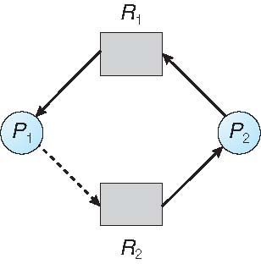
Resource-Allocation Graph Scheme
Suppose process P₂ requests resource R₂
The request can only be granted if converting the claim edge to an assignment edge does not result in the formation of a cycle in the resource allocation graph
Although R₂ is currently available, we cannot allocate it to P₂ as it may create a cycle in the graph which indicates an unsafe state

Slide 18
Banker’s Algorithm
The Banker’s algorithm is the classic approach to deadlock avoidance for resources with multiple units
Each process must a priori claim maximum use
The resources requested may not exceed the total available in the system
When a process requests a resource, the system must determine whether the allocation will leave the system in a safe state.
If it will, the resources are allocated, otherwise, the process must wait until some other process releases enough resources.
When a process gets all its resources it must return them in finite amount of time

Slide 19
Data Structures for the Banker’s Algorithm
Let n = number of processes, and m = number of resources types.
Available: Vector of length m. If Available[j] = k, there are k instances of resource type R_{j} available
Max: n x m matrix. If Max[i][j] = k, then process P_{i} may request at most k instances of resource type R_{j}
Allocation: n x m matrix. If Allocation[i][j] = k, then process P_{i} is currently allocated k instances of resource type R_{j}
Need: n x m matrix. If Need[i][j] = k, then process P_{i} may need k more instances of resource type R_{j} to complete its task
Need[i][j] = Max[i][j] – Allocation[i][j]
Request_{i}: Vector of length m. If Request[j] = k, k instances of resource type R_{j} is requested by the process P_{i}

Slide 20
Safety Algorithm
Let Work and Finish be vectors of length m and n, respectively.
Initialize:
      Work = Available
      Finish [i] = false for i = 0, 1, …, n – 1
Find an i such that both:
  (a) Finish [i] = false
  (b) Need_{i} ≤ Work
  If no such i exists, go to step 4
Work = Work + Allocation_{i}
Finish[i] = true
go to step 2
If Finish [i] == true for all i, then the system is in a safe state

Slide 21
Resource-Request Algorithm for Process P_{i}
  If Request_{i} ≤ Need_{i} go to step 2. Otherwise, raise error condition, since process has exceeded its maximum claim
  If Request_{i} ≤ Available, go to step 3. Otherwise, P_{i} must wait, since resources are not available
  Pretend to allocate requested resources to P_{i} by modifying the state as follows:
      Available = Available – Request_{i};
      Allocation_{i} = Allocation_{i} + Request_{i};
      Need_{i} = Need_{i} – Request_{i};
    If safe ⇒ the resources are allocated to P_{i}
    If unsafe ⇒ P_{i} must wait, and the old resource-allocation state is restored

Slide 22
Example: Banker’s Algorithm
5 processes P₀ through P₄;
3 resource types: A (10 instances), B (5 instances), and C (7 instances)
Snapshot at time T₀:
 | Allocation | Max | Available
 | A B C | A B C | A B C
P₀ | 0 1 0 | 7 5 3
P₁ | 2 0 0 | 3 2 2
P₂ | 3 0 2 | 9 0 2
P₃ | 2 1 1 | 2 2 2
P₄ | 0 0 2 | 4 3 3
3 3 2

Slide 23
Example: Banker’s Algorithm
5 processes P₀ through P₄;
3 resource types: A (10 instances), B (5 instances), and C (7 instances)
Snapshot at time T₀:
 | Allocation | Max | Available | Need
 | A B C | A B C | A B C | A B C
P₀ | 0 1 0 | 7 5 3 | 3 3 2
P₁ | 2 0 0 | 3 2 2
P₂ | 3 0 2 | 9 0 2
P₃ | 2 1 1 | 2 2 2
P₄ | 0 0 2 | 4 3 3
7 4 3
1 2 2
6 0 0
0 1 1
4 3 1

Slide 24

Example: Banker’s Algorithm Safety Check
5 processes P₀ through P₄;
3 resource types: A (10 instances), B (5 instances), and C (7 instances)
Snapshot at time T₀:
P₀?
Need $≤\text{Available}$
 | Allocation | Max | Available | Need
 | A B C | A B C | A B C | A B C
P₀ | 0 1 0 | 7 5 3 | 3 3 2
P₁ | 2 0 0 | 3 2 2
P₂ | 3 0 2 | 9 0 2
P₃ | 2 1 1 | 2 2 2
P₄ | 0 0 2 | 4 3 3
7 4 3
1 2 2
6 0 0
0 1 1
4 3 1

Slide 25
Example: Banker’s Algorithm Safety Check
5 processes P₀ through P₄;
3 resource types: A (10 instances), B (5 instances), and C (7 instances)
Snapshot at time T₀:
P₁?
Need $≤\text{Available}$
 | Allocation | Max | Available | Need
 | A B C | A B C | A B C | A B C
P₀ | 0 1 0 | 7 5 3
P₁ |  | 3 2 2
P₂ | 3 0 2 | 9 0 2
P₃ | 2 1 1 | 2 2 2
P₄ | 0 0 2 | 4 3 3
3 3 2
7 4 3
2 1 0
3 2 2
2 0 0
0 0 0
1 2 2
6 0 0
0 1 1
4 3 1

Slide 26
Example: Banker’s Algorithm Safety Check
5 processes P₀ through P₄;
3 resource types: A (10 instances), B (5 instances), and C (7 instances)
Snapshot at time T₀:
P₁?
Need $≤\text{Available}$
 | Allocation | Max | Available | Need
 | A B C | A B C | A B C | A B C
P₀ | 0 1 0 | 7 5 3
P₁ |  | 3 2 2
P₂ | 3 0 2 | 9 0 2
P₃ | 2 1 1 | 2 2 2
P₄ | 0 0 2 | 4 3 3
5 3 2
7 4 3
0 0 0
0 0 0
6 0 0
0 1 1
4 3 1

Slide 27
Example: Banker’s Algorithm Safety Check
5 processes P₀ through P₄;
3 resource types: A (10 instances), B (5 instances), and C (7 instances)
Snapshot at time T₀:
P₂?
Need $≤\text{Available}$
 | Allocation | Max | Available | Need
 | A B C | A B C | A B C | A B C
P₀ | 0 1 0 | 7 5 3
P₁ |  | 3 2 2
P₂ | 3 0 2 | 9 0 2
P₃ | 2 1 1 | 2 2 2
P₄ | 0 0 2 | 4 3 3
5 3 2
7 4 3
0 0 0
0 0 0
6 0 0
0 1 1
4 3 1

Slide 28
Example: Banker’s Algorithm Safety Check
5 processes P₀ through P₄;
3 resource types: A (10 instances), B (5 instances), and C (7 instances)
Snapshot at time T₀:
P₃?
Need $≤\text{Available}$
 | Allocation | Max | Available | Need
 | A B C | A B C | A B C | A B C
P₀ | 0 1 0 | 7 5 3
P₁ |  | 3 2 2
P₂ | 3 0 2 | 9 0 2
P₃ |  | 2 2 2
P₄ | 0 0 2 | 4 3 3
5 3 2
7 4 3
5 2 1
0 0 0
0 0 0
6 0 0
2 2 2
2 1 1
0 0 0
0 1 1
4 3 1

Slide 29
Example: Banker’s Algorithm Safety Check
5 processes P₀ through P₄;
3 resource types: A (10 instances), B (5 instances), and C (7 instances)
Snapshot at time T₀:
P₃?
Need $≤\text{Available}$
 | Allocation | Max | Available | Need
 | A B C | A B C | A B C | A B C
P₀ | 0 1 0 | 7 5 3
P₁ |  | 3 2 2
P₂ | 3 0 2 | 9 0 2
P₃ |  | 2 2 2
P₄ | 0 0 2 | 4 3 3
7 4 3
7 4 3
0 0 0
0 0 0
6 0 0
0 0 0
0 0 0
4 3 1

Slide 30
Example: Banker’s Algorithm Safety Check
5 processes P₀ through P₄;
3 resource types: A (10 instances), B (5 instances), and C (7 instances)
Snapshot at time T₀:
P₄?
Need $≤\text{Available}$
 | Allocation | Max | Available | Need
 | A B C | A B C | A B C | A B C
P₀ | 0 1 0 | 7 5 3
P₁ |  | 3 2 2
P₂ | 3 0 2 | 9 0 2
P₃ |  | 2 2 2
P₄ |  | 4 3 3
7 4 3
7 4 3
3 1 2
0 0 0
0 0 0
6 0 0
0 0 0
0 0 0
0 0 0
4 3 3
4 3 1
0 0 2

Slide 31
Example: Banker’s Algorithm Safety Check
5 processes P₀ through P₄;
3 resource types: A (10 instances), B (5 instances), and C (7 instances)
Snapshot at time T₀:
P₄?
Need $≤\text{Available}$
 | Allocation | Max | Available | Need
 | A B C | A B C | A B C | A B C
P₀ | 0 1 0 | 7 5 3
P₁ |  | 3 2 2
P₂ | 3 0 2 | 9 0 2
P₃ |  | 2 2 2
P₄ |  | 4 3 3
7 4 5
7 4 3
0 0 0
0 0 0
6 0 0
0 0 0
0 0 0
0 0 0
0 0 0

Slide 32
Example: Banker’s Algorithm Safety Check
5 processes P₀ through P₄;
3 resource types: A (10 instances), B (5 instances), and C (7 instances)
Snapshot at time T₀:
P₀?
Need $≤\text{Available}$
 | Allocation | Max | Available | Need
 | A B C | A B C | A B C | A B C
P₀ |  | 7 5 3
P₁ |  | 3 2 2
P₂ | 3 0 2 | 9 0 2
P₃ |  | 2 2 2
P₄ |  | 4 3 3
7 4 5
0 0 0
0 1 0
7 4 3
7 5 3
0 0 2
0 0 0
0 0 0
6 0 0
0 0 0
0 0 0
0 0 0
0 0 0

Slide 33
Example: Banker’s Algorithm Safety Check
5 processes P₀ through P₄;
3 resource types: A (10 instances), B (5 instances), and C (7 instances)
Snapshot at time T₀:
P₀?
Need $≤\text{Available}$
 | Allocation | Max | Available | Need
 | A B C | A B C | A B C | A B C
P₀ |  | 7 5 3
P₁ |  | 3 2 2
P₂ | 3 0 2 | 9 0 2
P₃ |  | 2 2 2
P₄ |  | 4 3 3
0 0 0
7 5 5
0 0 0
0 0 0
0 0 0
6 0 0
0 0 0
0 0 0
0 0 0
0 0 0

Slide 34
Example: Banker’s Algorithm Safety Check
5 processes P₀ through P₄;
3 resource types: A (10 instances), B (5 instances), and C (7 instances)
Snapshot at time T₀:
P₂?
Need $≤\text{Available}$
 | Allocation | Max | Available | Need
 | A B C | A B C | A B C | A B C
P₀ |  | 7 5 3
P₁ |  | 3 2 2
P₂ |  | 9 0 2
P₃ |  | 2 2 2
P₄ |  | 4 3 3
0 0 0
7 5 5
0 0 0
1 5 5
0 0 0
0 0 0
0 0 0
3 0 2
6 0 0
9 0 2
0 0 0
0 0 0
0 0 0
0 0 0

Slide 35
Example: Banker’s Algorithm Safety Check
5 processes P₀ through P₄;
3 resource types: A (10 instances), B (5 instances), and C (7 instances)
Snapshot at time T₀:
P₂?
Need $≤\text{Available}$
 | Allocation | Max | Available | Need
 | A B C | A B C | A B C | A B C
P₀ |  | 7 5 3
P₁ |  | 3 2 2
P₂ |  | 9 0 2
P₃ |  | 2 2 2
P₄ |  | 4 3 3
0 0 0
10 5 7
0 0 0
0 0 0
0 0 0
0 0 0
0 0 0
0 0 0
0 0 0
0 0 0
0 0 0
The system is in a safe state as sequence < P₁, P₃, P₄, P₀, P₂> satisfies safety criteria

Slide 36
Example: Banker’s Algorithm Resource Request
5 processes P₀ through P₄;
3 resource types: A (10 instances), B (5 instances), and C (7 instances)
Snapshot at time T₀:
P1 Request (1,0,2) = ?
 | Allocation | Max | Available | Need
 | A B C | A B C | A B C | A B C
P₀ | 0 1 0 | 7 5 3 | 3 3 2
P₁ | 2 0 0 | 3 2 2
P₂ | 3 0 2 | 9 0 2
P₃ | 2 1 1 | 2 2 2
P₄ | 0 0 2 | 4 3 3
7 4 3
1 2 2
6 0 0
0 1 1
4 3 1

Slide 37
Example: Banker’s Algorithm Resource Request
 | Allocation | Max | Available | Need
 | A B C | A B C | A B C | A B C
P₀ | 0 1 0 | 7 5 3
P₁
P₂ | 3 0 2 | 9 0 2
P₃ | 2 1 1 | 2 2 2
P₄ | 0 0 2 | 4 3 3
P1 Request (1,0,2) = ?
Check that Request ≤ Available (that is, (1,0,2) ≤ (3,3,2) ➔ true
Executing safety algorithm shows that sequence < P₁, P₃, P₄, P₀, P₂> satisfies safety requirement
2 3 0
7 4 3
3 3 2
2 0 0
3 0 2
3 2 2
1 2 2
0 2 0
6 0 0
0 1 1
4 3 1

Slide 38
Example: Banker’s Algorithm Resource Request
 | Allocation | Max | Available | Need
 | A B C | A B C | A B C | A B C
P₀ | 0 1 0 | 7 5 3
P₁
P₂ | 3 0 2 | 9 0 2
P₃ | 2 1 1 | 2 2 2
P₄ | 0 0 2 | 4 3 3
Can request for (3,3,0) by P₄ be granted?
Can request for (0,2,0) by P₀ be granted?
Can request for (0,0,2) by P₃ be granted?
2 3 0
7 4 3
3 0 2
3 2 2
0 2 0
6 0 0
0 1 1
4 3 1

Slide 39
Exercise 1: Banker’s Algorithm
5 processes P₀ through P₄;
3 resource types: A (13 instances), B (8 instances), and C (10 instances)
Snapshot at time T₀:
Is the following system safe, under banker's algorithm? Justify your answer?
Show the safe sequence.
 | Allocation | Max | Available | Need
 | A B C | A B C | A B C | A B C
P₀ | 1 1 0 | 2 8 0
P₁
P₂ | 1 1 7 | 4 3 9
P₃ | 2 1 1 | 2 2 3
P₄ | 2 0 0 | 2 1 3
4 1 1
5 2 2

Slide 40
Exercise 2: Banker’s Algorithm
 | Allocation | Max | Available | Need
 | A B C D | A B C D | A B C D | A B C D
P₀ | 0 1 1 0 | 0 2 1 0
P₁
P₂ | 1 3 6 5 | 2 3 6 6
P₃ | 0 6 3 2 | 0 6 5 2
P₄ | 0 0 1 4 | 0 6 5 6
Is the following system safe, under banker's algorithm? Justify your answer?
Show the safe sequence.
1 5 2 0
1 2 3 1
1 6 5 2

Slide 41
Deadlock Detection and Recovery
If we don’t have deadlock prevention or avoidance, then deadlock may occur
In this case, we need to detect deadlock and recover from it
To do this, we need two algorithms
  One to determine whether a deadlock has occurred
  Another to recover from the deadlock
Possible, but expensive (time consuming)
  Implemented in VMS
  Run detection algorithm when resource request times out

Slide 42
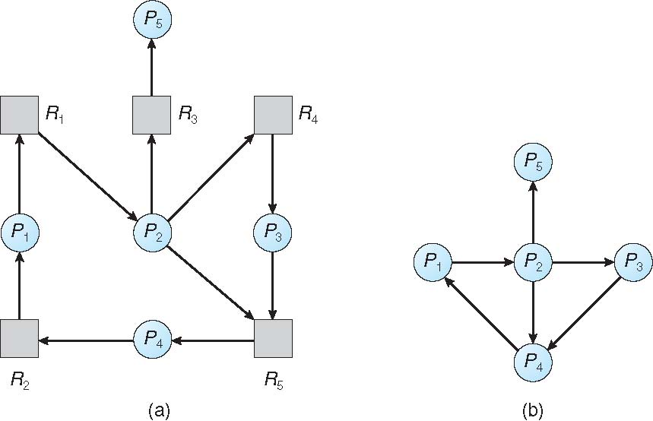
Deadlock Detection
For problems involving single instance of each resource type
Maintain wait-for graph
  Nodes are processes
  P_{i} → P_{j} if P_{i} is waiting for P_{j}
Periodically traverse the graph looking for cycles. If a cycle is found, there exists a deadlock. Preempt resource (force a process to release resource)
An algorithm to detect a cycle in a graph requires an order of n² operations, where n is the number of vertices in the graph
Resource-Allocation Graph
Corresponding wait-for graph

Slide 43
Deadlock Detection
For problems involving multiple instances of each resource type
Available[m]: A vector indicating number of available resources of each type
Allocation[n, m]: A matrix defining the number of resources of each type currently allocated to each process
Request[n, m]: A matrix indicating the current request of each process. If Request [i, j] = k, then P_{i} is requesting k more instances of resource type R_{j}.

Slide 44
Deadlock Detection Algorithm
Let Work and Finish be vectors of length m and n, respectively
Initialize:
  Work = Available
  for i = 1,2, …, n,
  if Allocation_{i} ≠ 0,
  Finish[i] = false;
  else
  Finish[i] = true
// Find a process i that can complete its work now:
  while (Finish[i] == false && Request_{i} ≤ Work)
  Work = Work + Allocation_{i}
  Finish[i] = true
if (Finish[i] == false, for some i)
return false; //system is in deadlock state, P_{i} is deadlocked
Algorithm requires an order of O(m x n²) operations to detect whether the system is in deadlocked state

Slide 45
Example: Deadlock Detection Algorithm
5 processes P₀ through P₄;
3 resource types: A (7 instances), B (2 instances), and C (6 instances)
Snapshot at time T₀:
Sequence <P₀, P₂, P₃, P₁, P₄> will result in Finish[i] = true for all i
 | Allocation | Request | Available
 | A B C | A B C | A B C
P₀ | 0 1 0 | 0 0 0
P₁ | 2 0 0 | 2 0 2
P₂ | 3 0 3 | 0 0 0
P₃ | 2 1 1 | 1 0 0
P₄ | 0 0 2 | 0 0 2
0 0 0

Slide 46
Example: Deadlock Detection Algorithm
 | Allocation | Request | Available
 | A B C | A B C | A B C
P₀ | 0 1 0 | 0 0 0
P₁ | 2 0 0 | 2 0 2
P₂ | 3 0 3 | 0 0 1
P₃ | 2 1 1 | 1 0 0
P₄ | 0 0 2 | 0 0 2
P₂ requests an additional instance of type C
State of system?
  Can reclaim resources held by process P₀, but insufficient resources to fulfill other processes; requests
  Deadlock exists, consisting of processes P₁, P₂, P₃, and P₄
0 0 0

Slide 47
Detection-Algorithm Usage
Detecting cycles in a graph takes O(n²) time, where n is |P| + |R|. When, and how often should we execute this algorithm?
  Just before granting a resource, check if granting it would lead to a cycle? O(n²)
  Whenever a resource request can’t be filled? (Each failed request is O(n²).)
  On a regular schedule (hourly or …)? (May take a long time to detect deadlock)
  When CPU utilization drops below some threshold? (May take a long time to detect deadlock)
When, and how often, to invoke depends on:
  How often a deadlock is likely to occur?
  How many processes will need to be rolled back?
    one for each disjoint cycle
If detection algorithm is invoked arbitrarily, there may be many cycles in the resource graph and so we would not be able to tell which of the many deadlocked processes “caused” the deadlock.

Slide 48
Deadlock Recovery
Once a deadlock is detected, we have two options:
Abort processes
  Abort all deadlocked processes
    Processes need to start over again
  Abort one process at a time until the deadlock cycle is eliminated
    System needs to rerun detection after each abort
Preempt resources (force their release)
  Need to select a victim process and resource to preempt
  Need to rollback process to previous state
  Need to prevent starvation

Slide 49
Deadlock Recovery
In which order should we choose to abort?
  Priority of the process
  How long process has computed, and how much longer to completion
  Resources the process has used
  Resources process needs to complete
  How many processes will need to be terminated
  Is process interactive or batch?

Slide 50
Deadlock Summary
Deadlock occurs when processes are waiting on each other and cannot progress
  Cycles in the Resource Allocation Graph (RAG)
Deadlock requires four conditions
  Mutual exclusion, hold and wait, no resource preemption, circular wait
Four approaches to dealing with deadlock:
  Ignore it – Living life on the edge
  Prevention: Make one of the four conditions impossible
  Avoidance: Banker’s Algorithm (control allocation of resources)
  Detection and Recovery: Look for a cycle, preempt or abort

