Slide 1
Sustainable Technology

Slide 2

Presented by
Abdullah
Sharjeel
Zain

Slide 3
The saddest aspect of life right now is that science gathers knowledge faster than society gathers wisdom.
~ Isaac Asimov

Slide 4
From Stones to Silicon

Slide 5
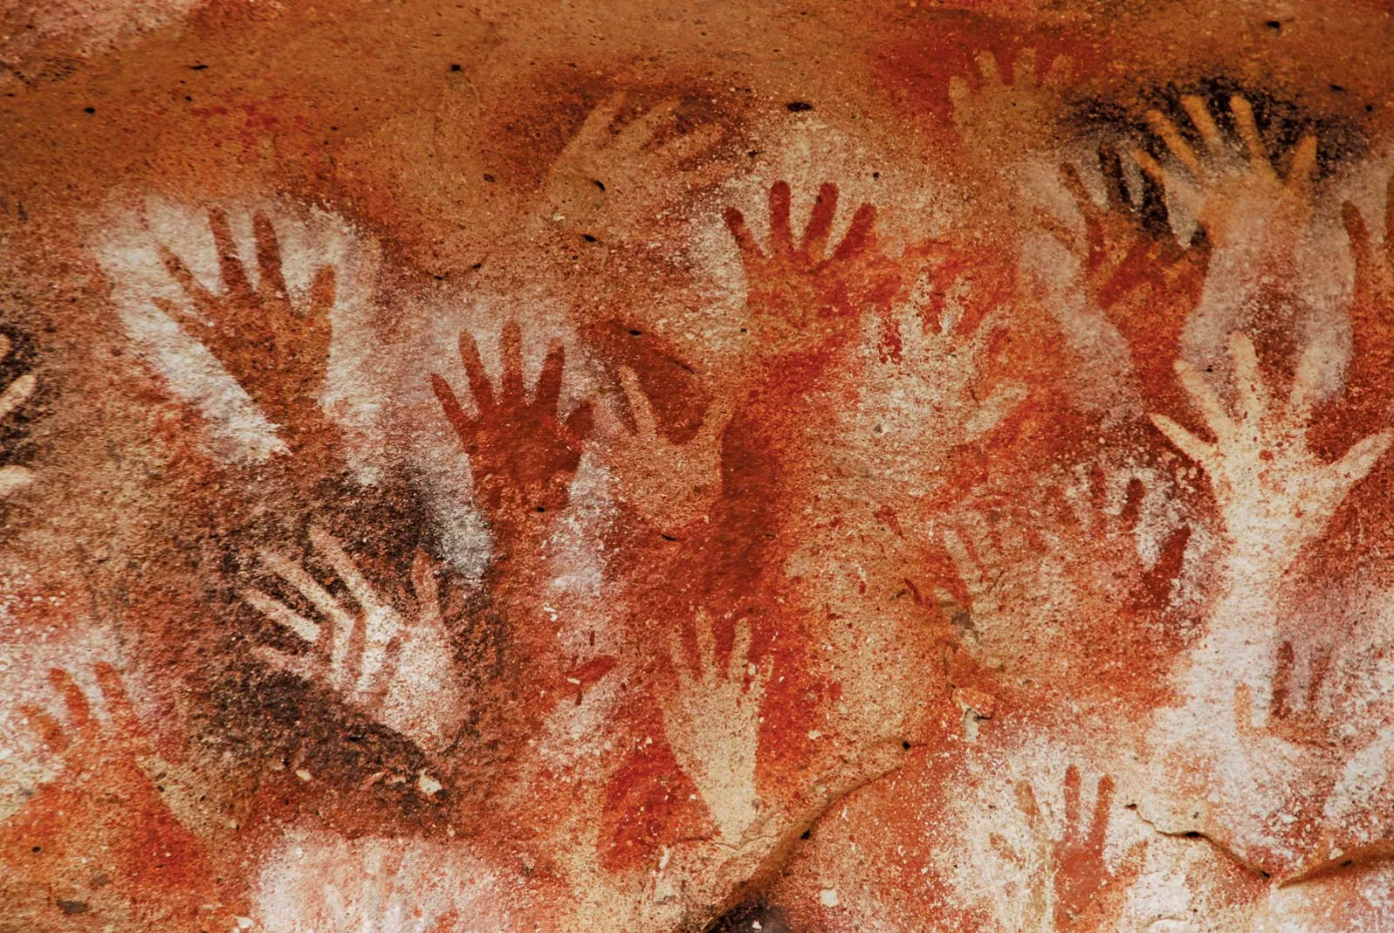
Ancient Foundations
2.5 million years ago
Stone tools, control of fire
~3500 BC
Invention of the wheel, bronze tools
Creations like aqueducts, levers, and pulleys demonstrated early engineering.
Cueva de las Manos

Slide 6
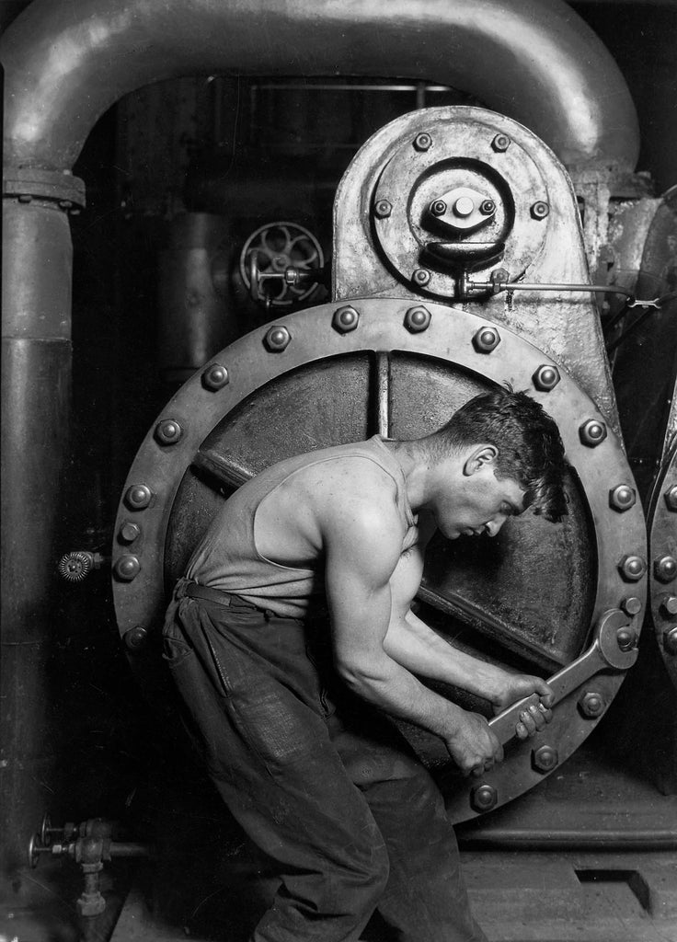
Leap towards better future
Industrial Age (1760–1840)
Steam-powered factories enable mass production and urban growth.
Early Modern Age (19th–20th Century):
Efficiency and industrial expansion prioritized over environmental impact.
Power House Mechanic by Hine

Slide 7
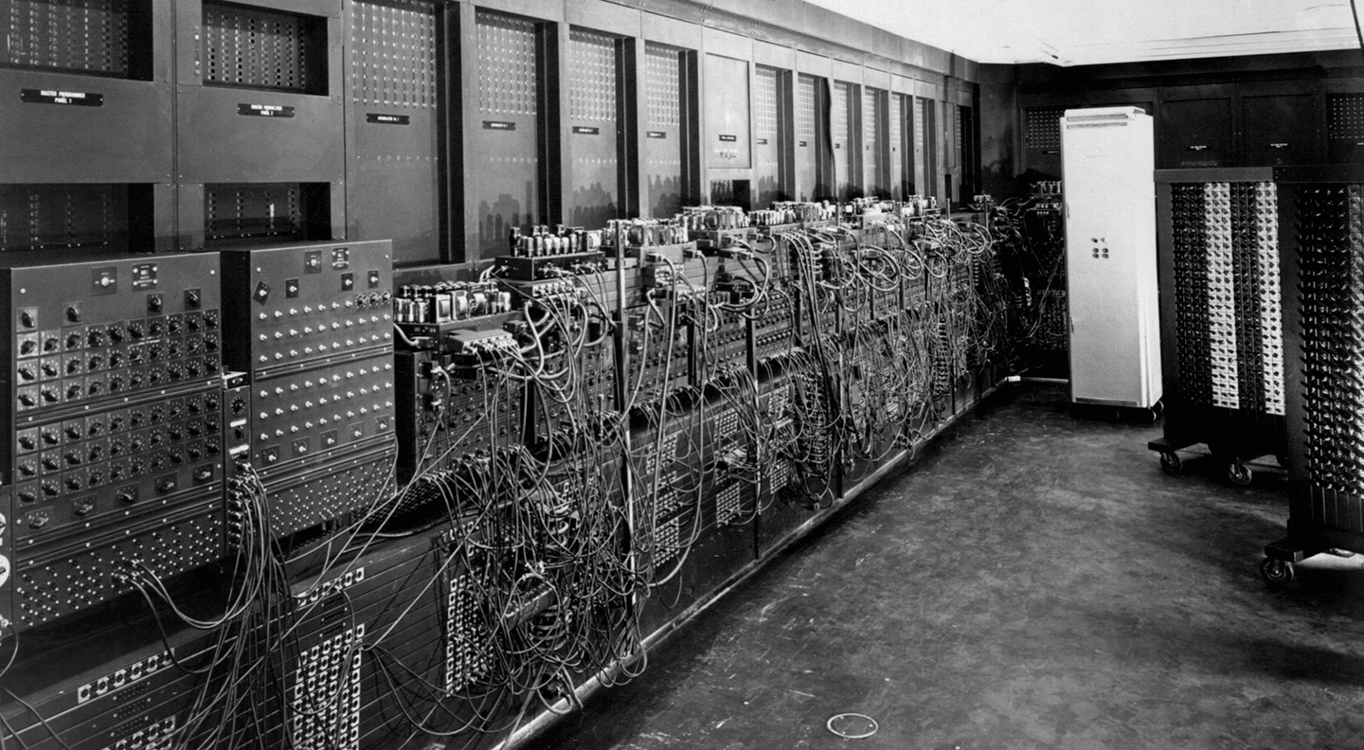
Post-Tech
Digital Age (1950s–2000s):
Electricity, early computers, and personal computing transform industry and daily life.
21st Century & Post-AI Era:
  AI, automation, and smart technologies accelerate innovation but increase energy use and e-waste.
ENIAC

Slide 8
Cost we pay
Do you know that while preparing this presentation, how much water and energy I wasted on my digital prompts and searches?

Slide 9

Responsible Future ??
Definition:
Technology designed to meet present needs without compromising the future
Because every choice in technology today is a choice for the world we leave behind

Slide 10
There is no planet ‘B’…
~ Mike Berners

Slide 11
Why Sustainable Technology Matters now..

Slide 12
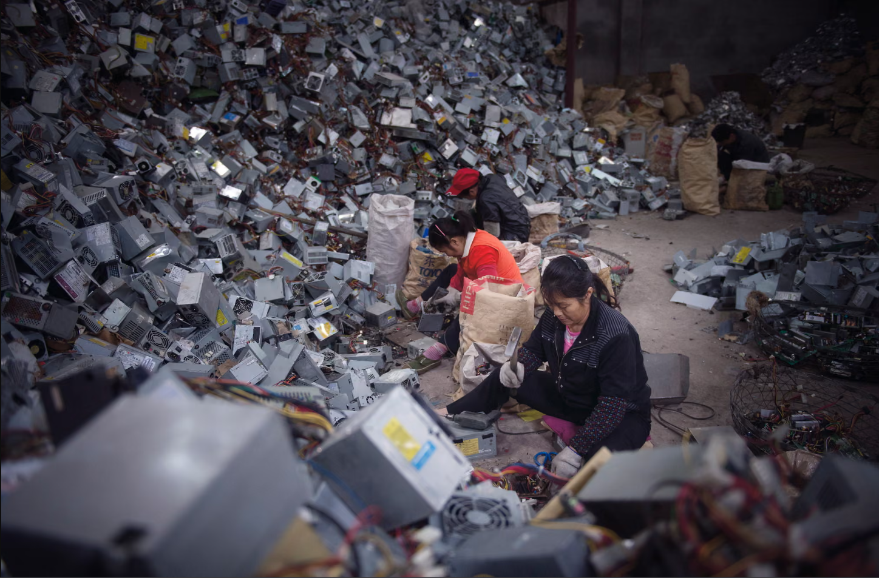
Exploding E-Waste Crisis
In 2022, 62 million tones of e-waste were generated globally, projected to rise to 82 million tones by 2030.
Only ~22% is formally recycled, creating supply chain vulnerabilities and toxic pollution risks.
From The Guardian

Slide 13
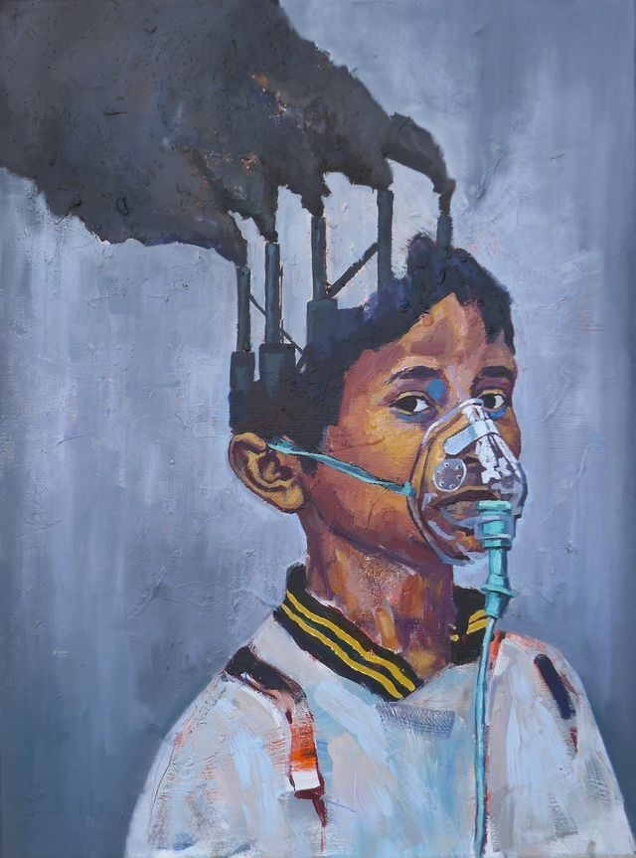
Carbon Footprint and Emissions
Carbon Costs of Tech & AI:
The tech sector’s emissions rival aviation, with AI systems alone projected to produce ~33–80 million tones of CO₂ by 2025, often powered by fossil fuels.
Professional Impact:
Rising emissions lead to ESG regulations, investor scrutiny, and reputational risks for companies and engineers.

Slide 14

oh mother earth…
Mother Earth by Diana Cheren Nygren
Depleting Minerals for AI & Electronics
AI systems and modern devices rely heavily on lithium, cobalt, and rare earths, with supply risks and projected shortages by 2030.
Professional Impact
Engineers and companies face higher costs, innovation delays, and pressure for ethical sourcing in AI development.

Slide 15

Moment to Reflect
Three Challenges, One Question
E-waste, carbon emissions, and mineral depletion show that technology’s cost is often hidden, not absent
Can innovation still be called progress if it exhausts the planet that sustains it?

Slide 16
The Stone Age did not end because humans ran out of stones. It ended because it was time to rethink about how we live now.
~ William McDonough

Slide 17
Pathways to Sustainable Technology

Slide 18
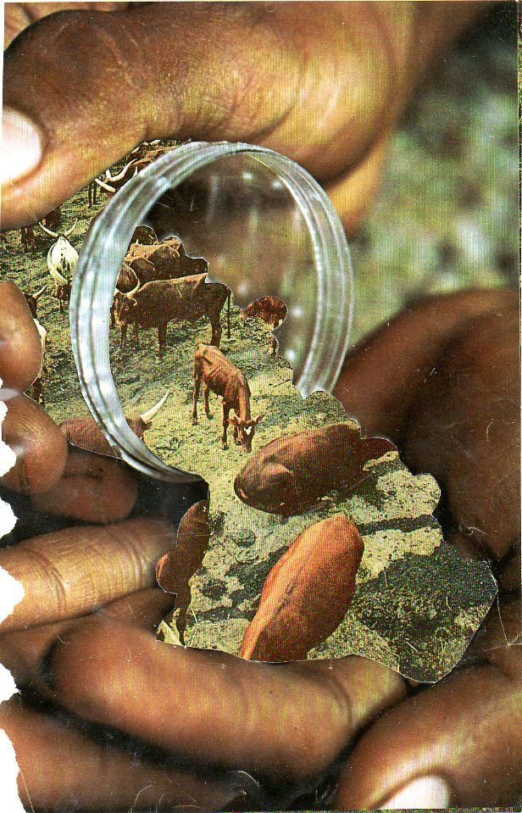
Reducing Digital Energy Waste
Green Coding: Reducing Digital Energy Waste:
Optimized algorithms and carbon-aware computing can cut compute energy use by 30–50%
Professional Practice
Developers audit, refactor, and design software for efficiency, following green software standards

Slide 19
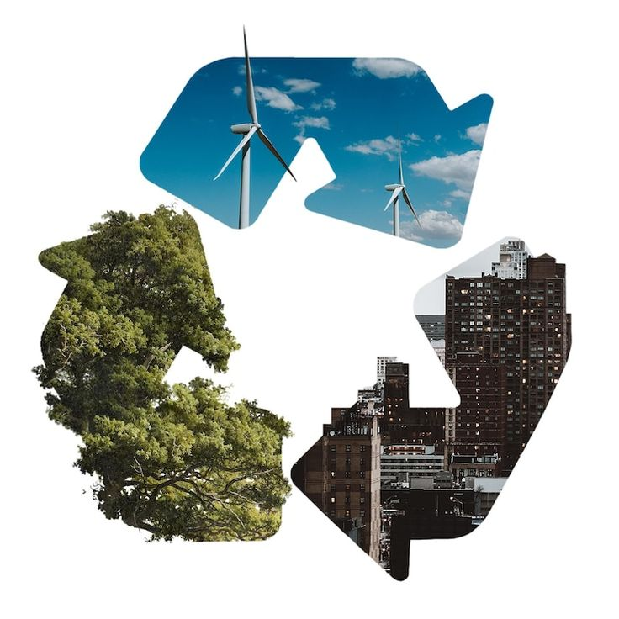
Circular Economy & Modular Design
Extending Device Lifecycles
Modular, repairable devices and recycled materials reduce e-waste and resource extraction
Professional Practice
Engineers design for longevity, repairability, and recyclability from day one

Slide 20
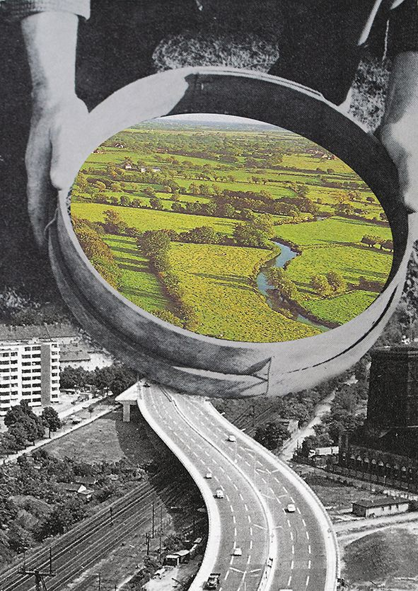
Renewable Infrastructure & Responsible AI
Renewable-powered data centers, low-power chips, and AI optimization reduce emissions and energy waste
IT leaders select sustainable providers and deploy efficient AI models

Slide 21

Call to Action
Our Role as Technology Professionals
Every design choice, line of code, and system decision shapes environmental impact
Way Forward
Embed sustainability from the start — not as an afterthought…

Slide 22
“Let’s build technology that meets today’s needs — and preserves tomorrow’s world.”

Slide 23
Thank You

