Slide 1
Computer Organization & Assembly Language
Lecture 1

Slide 2
Outline
About this Course
Basic Structure of Computer
What is Computer Organization?
About Assembly Language

Slide 3
Course Objectives
To learn the organization of computer hardware components.
To gain knowledge about the internal architecture and working of microprocessors.
To understand working of memory devices, interrupt controllers and I/O devices.
Develop skills to analyze and optimize performance at the machine level.
To understand syntax, semantics, and structure of assembly language.
Notes:
Microprocessor -> CPU (processor) on a single chip

Slide 4
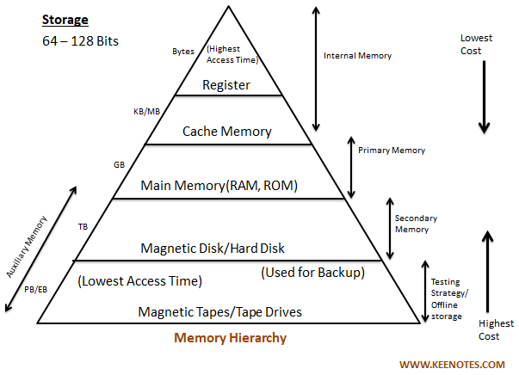
Course Contents
Computer Architecture
Assembly Language Fundamentals
Data Representation
Memory Hierarchy
Input/Output Systems

Slide 5
Real World Applications
Embedded Systems
Home Automation (Smart Homes)
Automotive Systems (Vehicles)
Missile Guidance Systems
Home Appliances
Medical Devices
Consumer Electronics (Smartphones)
Robotics

Slide 6
Why Assembly Language?
Direct Hardware Control
Performance Optimization
Understanding Computer Architecture
Embedded Systems Expertise (low cost)
Real-Time Processing
Foundation for Other Languages

Slide 7
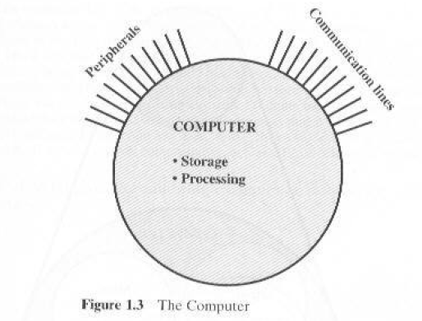
Structure
Structure is the way in which components relate to each other

Slide 8
Difference in Peripherals & Communication Lines
When data is received from or delivered by a device that is directly connected to the computer, process is called Input-Output (I/O).
When data are moved over longer distance, to or from a remote device, the process is known as Data Communication.

Slide 9
Computer Architecture
Computer Architecture refers to those attributes of a system visible to a programmer
Those attributes that have direct impact on logical execution of a program.
Architectural attributes include:
the instruction set,
no. of bits used to represent various data types (numbers, characters etc),
I/O mechanisms and technology for addressing memory.
Example: Architectural design issue whether a computer will have multiple instruction or not.
Notes:
Architecture = Logical aspects
Explain the terms underlined

Slide 10
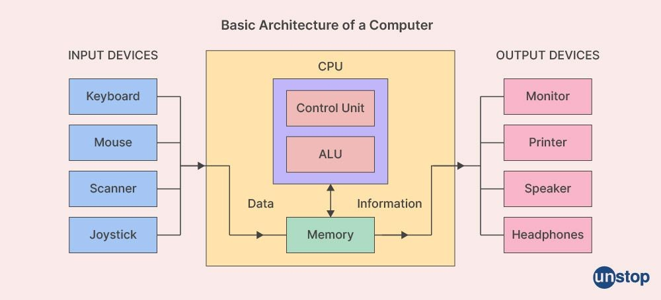
Computer Architecture
Processor-Memory-I/O Model
Components
CPU
Memory
I/O Devices
Data Flow
System Interconnect
Basic Instruction Cycle (Fetch-> Execute)
Notes:
Architecture = Logical aspects
Explain the terms underlined

Slide 11
Structure - Top Level
Peripherals
Computer
Central
Processing
Unit
Main
Memory
Computer
Systems
Interconnection
Input
Output
Communication
lines

Slide 12
Structure - The CPU
CPU
Computer
Arithmetic
and
Login Unit
I/O
Registers
System
Bus
CPU
Internal CPU
Interconnection
Memory
Control
Unit

Slide 13
What is a Bus?
A communication pathway connecting two or more devices
Often grouped
A number of channels in one bus
e.g. 32 bit data bus is 32 separate single bit channels
Address Bus
Data Bus
CPU
Memory
I/O
Control Bus

Slide 14
Data Bus
Carries data
Remember that there is no difference between “data” and “instruction” at this level
Width is a key determinant of performance
8, 16, 32, 64 bit
Bidirectional

Slide 15
Address bus
Identify the source or destination of data
e.g. CPU needs to read an instruction (data) from a given location in memory
Bus width determines maximum memory capacity of system
e.g. 8080 has 16 bit address bus giving 64k address space

Slide 16
Control Bus
Control and timing information
Memory read/write signal
Interrupt request
Timing signals

Slide 17
Programming Languages
High-Level Languages (HLL)
Assembly Language
Machine Language

Slide 18
High-Level Language
Allow programmers to write programs that look more like natural language.
Examples: C++, Java, C#, .NET etc
A program called Compiler is needed to translate a high-level language program into machine code.
Each statement usually translates into multiple machine language instructions.

Slide 19
Machine Language
The "native" language of the computer
Numeric instructions and operands that can be stored in memory and are directly executed by computer system.
Each ML instruction contains an op code (operation code) and zero or more operands.
Examples:
Opcode Operand Meaning
-------------------------------------------------
40 increment the AX register
05 0005 add 0005 to AX

Slide 20
Assembly Language
Use instruction mnemonics that have one-to-one correspondence with machine language.
An instruction is a symbolic representation of a single machine instruction
Consists of:
label always optional
mnemonic always required
operand(s) required by some instructions
comment always optional

Slide 21
Sample Program

Slide 22
CPU
Brain of Computer; controls all operations
Uses Memory Circuits to store information
Uses I/O Circuits to communicate with I/O Devices
Executes programs stored in memory
System programs
Application programs
Instruction Set: Instructions performed by CPU
Two main components:
Execution Unit (EU)
Bus Interface Unit (BIU)

Slide 23
Intel 8086 Microprocessor
Introduced in 1978
One of the first 16-bit microprocessors.
It laid the foundation for the x86 architecture, which remains prevalent today.

Slide 24
Execution Unit (EU)
Purpose: Execute instructions
Contains ALU (Arithmetic & Logic Unit)
To perform arithmetic (+, -, x,/) and logic (AND, OR, NOT) operations.
The data for the operations are stored in circuits called Registers.
A register is like a memory location except that it is referred by a name not a number (address).
EU uses registers for:
Storing data.
Holding operands for ALU
To reflect result of a computation – FLAG register
Notes:
Register details covered in later slides

Slide 25
Bus Interface Unit (BIU)
Facilitates communication between the EU and the memory or I/O circuits.
Responsible for transmitting address, data and control signals on the buses.

Slide 26
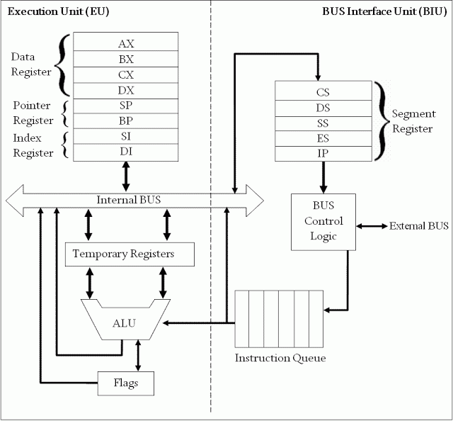
Intel 8086 Microprocessor Organization

Slide 27
Bits, Bytes and Double words
Each 1 or 0 is called a bit.
Group of 8 bits = Byte
Group of 16 bits = Word
Group of 32 bits = Double words

Slide 28
Registers
Registers are high-speed storage locations inside the microprocessor.
Designed to be accessed at much higher speed than conventional memory.
Registers are classified according to the functions they perform.
General Types of Registers:
Data Registers: To hold data for an operation.
Address Registers: To hold the address of an instruction or data.
Status/Flag Register: keeps the current status of the processor or result of an arithmetic operation.

Slide 29
8086 Internal registers 16 bits (2 bytes each)
AX, BX, CX and DX are two
bytes wide and each byte can
be accessed separately
These registers are used as
memory pointers.
6 status; 3 control ; 7 unused
Segment registers are used
as base address for a segment

Slide 30
General Purpose/Data Registers
Following four registers are available to the programmer for general data manipulation:
AX (Accumulator): Used in arithmetic, logic and data transfer instructions. Also required in multiplication, division and input/output operations.
BX (Base): It can hold a memory address that points to a variable.
CX (Counter): Act as a counter for repeating or looping instructions. These instructions automatically repeat and decrement CX and quit when equals to 0.
DX (Data): It has a special role in multiply and divide operations. Also used in input/output operations.

Slide 31
Segment Registers
Store addresses of instruction and data in memory.
These values are used by the processor to access memory locations.
CS (Code): Defines the starting address of the section of memory holding code.
DS (Data): Defines the section of memory that holds most of the data used by programs.
ES (Extra): This is an additional data segment that is used by some of the string instructions.
SS (Stack): It defines the area of the memory used for stack

Slide 32
Pointers and Index Registers
IP - instruction pointer: Always points to next instruction to be executed. IP register always works together with CS segment register.
SI - source index register: Can be used for pointer addressing of data. Works together with DS segment register.
DI - destination index register: Can be used for pointer addressing of data. Works together with ES segment register.
BP - base pointer: Primarily used to access parameters passed via the stack. Works together with SS segment register.
SP – stack pointer: Always points to top item on the stack. Works together with SS segment register.

Slide 33
Thank You

