Slide 1
Computer Organization & Assembly Language
Lecture 3

Slide 2
Programming Model x8086
How software interacts with the hardware of x86-based systems
How data is organized
How instructions are executed
How memory is accessed

Slide 3
Architecture
The x86 architecture is a family of instruction set architectures (ISAs) based on the Intel 8086 microprocessor and its descendants.
It supports both 16-bit, 32-bit (x86), and 64-bit (x86-64) computing environments.
Next – Registers (already discussed)

Slide 4
Memory
The x86 architecture uses a segmented memory model, allowing programs to use larger address spaces by dividing memory into segments.
Memory is divided into segments, with each segment defined by a base address and a limit. This enables different data types and instructions to be stored in separate memory areas.

Slide 5
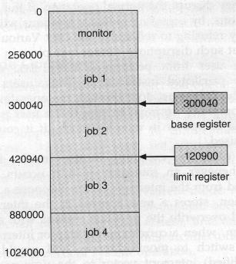
Memory

Slide 6
Instruction Set
Data Movement: Move data between registers, memory, and I/O ports.
Arithmetic Operations: Perform calculations like addition, subtraction, multiplication, and division.
Logical Operations: Perform bitwise operations (AND, OR, NOT, XOR).
Control Flow: Manage the flow of the program using jumps, calls, and loops.
String Operations: Special instructions for handling string data.

Slide 7
Assembler Directives
Pseudo-ops
Instructions in assembly language that are not converted into machine code
Instructions that tell the assembler how to process the source code, define data segments, manage memory, and control the program's structure.
They help organize code, define data structures, and manage memory
Emu8086 = assembler + emulator

Slide 8
Data Definition Directives
DB (Define Byte): Allocates space for a byte (8 bits) or initializes it with a value.
Value DB 10 (value is name of variable initialize to 10)
DW (Define Word): Allocates space for a word (usually 16 bits) or initializes it with a value.
Num DW 1234
DD (Define Doubleword): Allocates space for a doubleword (usually 32 bits) or initializes it with a value.
largeNum DD 100000
DQ (Define Quadword): Allocates space for a quadword (usually 64 bits) or initializes it with a value.
bigNum DQ 123456789012345
DT (Define Ten Bytes): Allocates space for ten bytes.
myArray DT 1, 2, 3, 4, 5

Slide 9
Section Directives
SECTION or SEGMENT: Begins a new section in the program (like .text for code or .data for initialized data).
SECTION .text
; code goes here
END: Marks the end of the assembly file. Indicates the end of the program.

Slide 10
Code Control Directives
LABEL: Marks a location in the code for use as a reference.
Labels can be any valid identifier and are typically used to indicate where certain operations or blocks of code begin.
start: MOV AX, 1

Slide 11
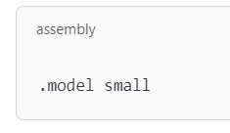
.model
Specifies the memory model used by the program, which affects how the program accesses memory.
Small: Single segment for code and data. Suitable for small programs. Code and data are located in a single 64 KB segment. Well-suited for small programs that fit within the 64 KB limit.
Medium: One segment for code and one segment for data, allowing more code than the small model. Code and data have their own separate 64 KB segments. Suitable for larger programs, providing more flexibility.
Large: Multiple separate segments for code and data, allowing large programs with extensive data structures. Supports multiple code and data segments, each up to 64 KB in size. Useful for even larger programs, but with increased complexity.

Slide 12
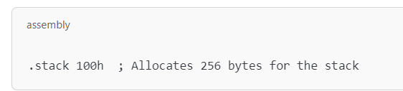
.stack
Defines the size of the stack segment. The stack is used for storing temporary data, function parameters, return addresses, and local variables.
100h in hexadecimal is equal to 256 in decimal
; is used for comment just as // in C++

Slide 13
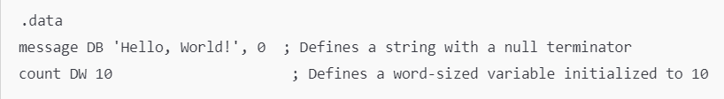
.data
Marks the beginning of the data segment, where initialized data is defined.
This is where you can declare variables that hold values that your program will use.
Message and count are just like variable names.

Slide 14
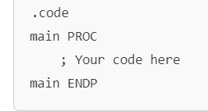
.code
Indicates the beginning of the code segment, where the actual instructions (the executable part of the program) are written.

Slide 15
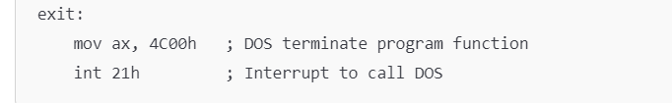
.exit
.exit or .end
Marks the end of the program or code segment. It can signal to the assembler or the linker that there are no more instructions or data to process.
Marks the point in the code where the program will perform the termination process
Notes:
AX is set to 4C00h, calling int 21h with this value will terminate the program and return control to the operating system (DOS).

Slide 16
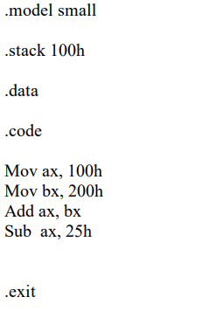
First Assembly Language Program
Notes:
.model small
.stack 100h
.data
.code
mov ax, 100h
mov bx, 200h
add ax, bx
sub ax, 25h
.exit

Slide 17
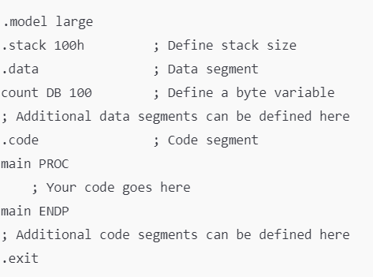
Example

Slide 18
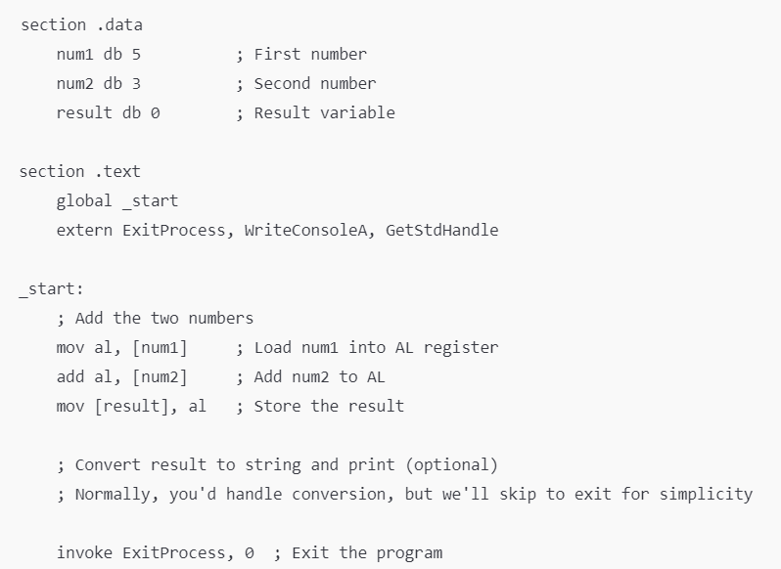
Program to add 2 numbers

Slide 19
Summary
Structure of an Assembly Language Program
.model small ; Select a memory model.
.stack stack_size ; Define the stack size
.data ; Variable and array declarations
Declare variables at this level
.code
main proc ; Write the program main code at this level
main endp ; End of program

Slide 20
MOV Instruction
Transfer data from one location to another
Between registers, between a register and memory, or between a register and an immediate (constant) value
Mov AL, [num1] or Mov AL, 5
Does not perform any arithmetic operation
It simply copies the value from the source to the destination.

Slide 21
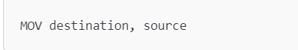
MOV Instruction – Syntax
The basic syntax of MOV instruction is:
Destination: The location where the data will be copied to (this can be a register or a memory address).
Source: The location from which the data will be copied (this can also be a register, memory address, or an immediate value).

Slide 22
Data Movement Among Registers
Moving Data Between General-Purpose Registers
MOV AX, BX ; Move the value in BX to AX
Moving Immediate Values into Registers
MOV CX, 10 ; Move the immediate value 10 into CX
Mov 10, CX (Is that valid?)

Slide 23
Machine Instruction Elements
Each instruction must have elements that contain the information required by the CPU for execution.
These elements can be:
Operation code: Specifies the operation to be performed (e.g.. ADD, I/O). The operation is specified by a binary code, known as the operation code, or opcode.
ADD, SUB, MOV, or JMP translate to opcodes in machine language

Slide 24
Machine Instruction Elements
Source operand reference: The operation may involve one or more source operands, that is, operands that are inputs for the operation.
Result operand reference: The operation may produce a result. Also called destination operand.
Next instruction reference: This tells the CPU where to fetch the next instruction from.

Slide 25
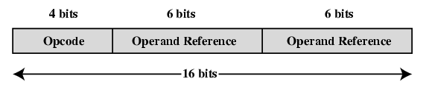
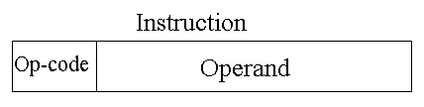
Instruction Representation
Within the computer, each instruction is represented by a sequence of bits.
16 bits instruction
4 bit opcode, 6 bit operand 1, 6 bit operand 2
4 bit opcode, 12 bit operand
32 bits instruction
64 bits instruction
Figure: A Simple Instruction Format

Slide 26
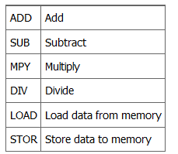
Cont.
Binary representations of machine instructions is difficult to remember.
Use a symbolic representation of machine instructions.
Opcodes are represented by abbreviations, called mnemonics, that indicate the operation. Common examples include:

Slide 27
Some Rules To Follow
Both source and destination operands should be the same size.
Both operands cannot be segment registers simultaneously
MOV DS, SS
Using two segment registers as operands in an operation could create ambiguity about which segment of memory is being referenced.
The destination operand cannot be a CS or an IP register
MOV CS, AX
Changing the CS register directly could disrupt the flow of program execution
If the destination operand is a segment register, the source operand cannot be an immediate (constant) value. Instead, copy it from some other register like AX.
MOV ES, [num1] is not valid.
No direct memory-to-memory moves.
mov [var1], [var2]
Use register as intermediate:
mov al, [var1] and mov [var2], al

Slide 28
Addressing Modes
Addressing modes are techniques used in assembly language to specify how the operand of an instruction is accessed.
They determine the method of obtaining the data for the operation, whether from a constant, register, memory address, or a combination of these.

Slide 29
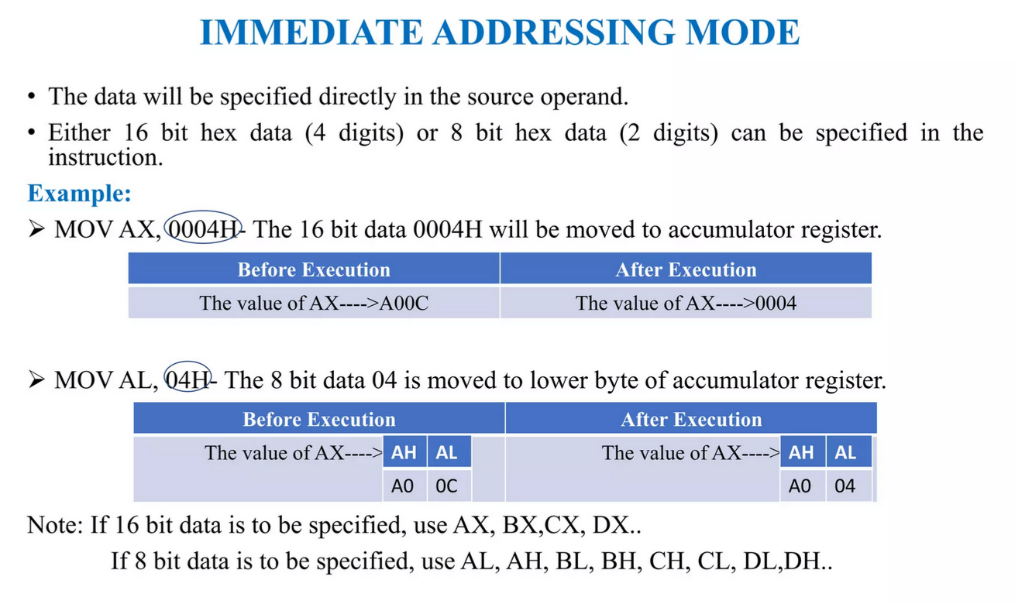

Slide 30
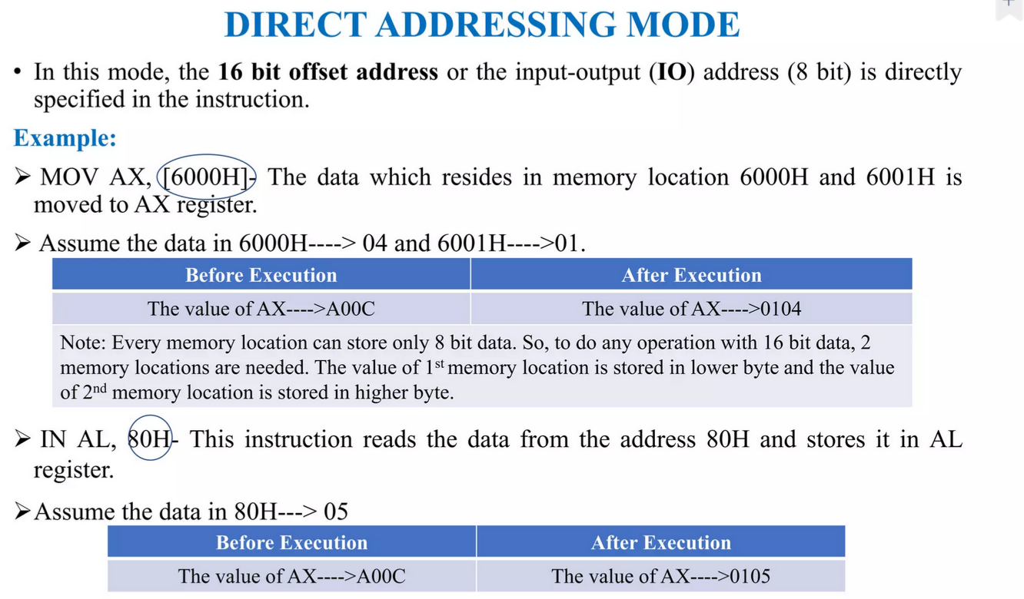

Slide 31
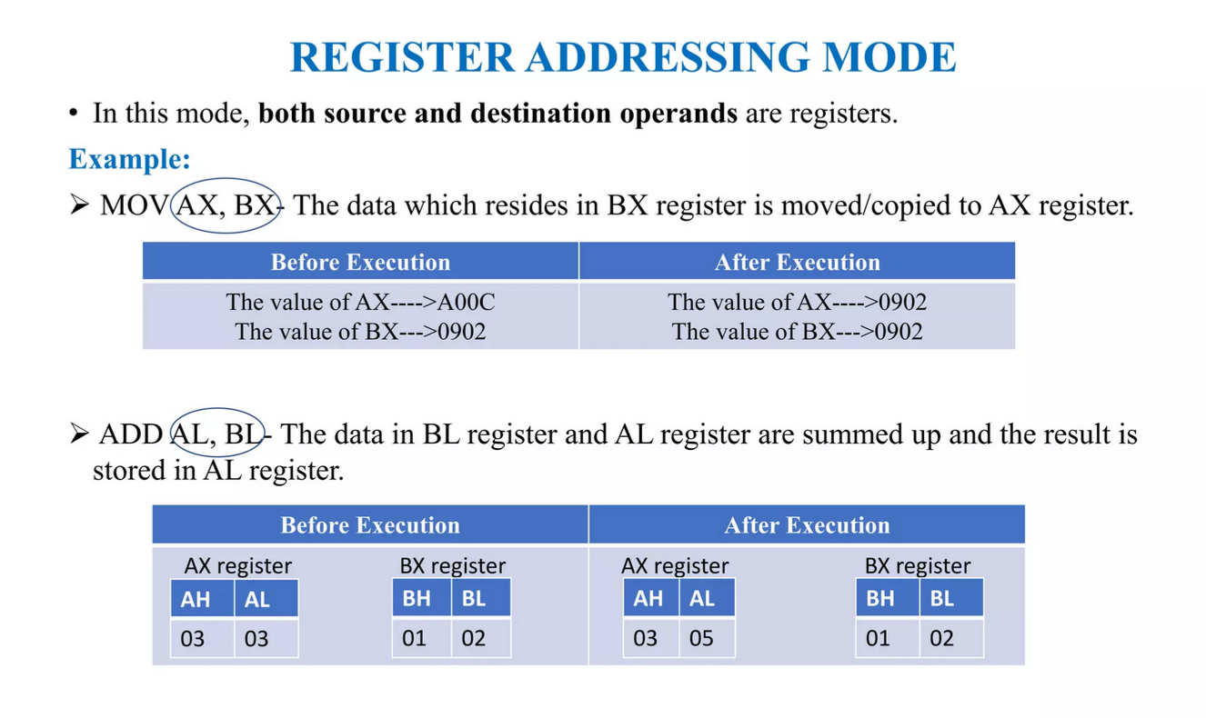

Slide 32
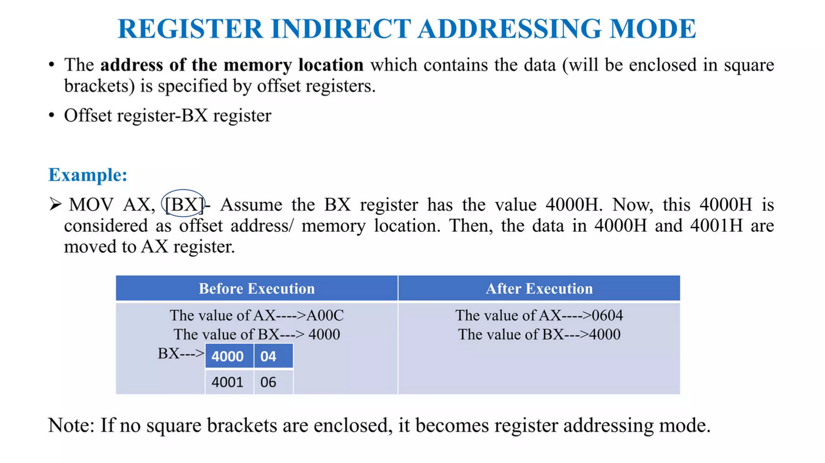

Slide 33
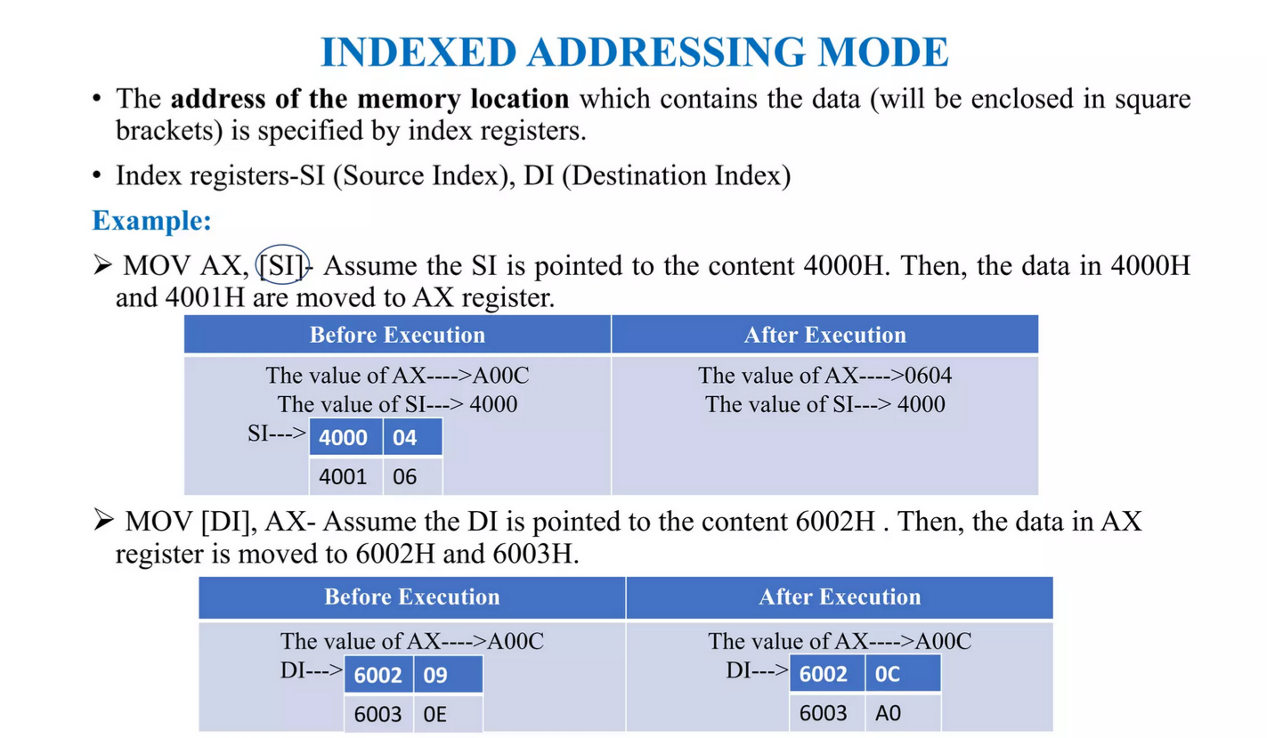

Slide 34
Physical Address to Logical Address
Logical Address: An address generated by the CPU during program execution, consisting of a segment and an offset.
Physical Address: The actual location in physical memory (RAM) where data is stored.
Physical address will be calculated by Segment address and Offset
Both Segment address and Offset size is 16 bits.
So Physical address is calculated by Segment * 10h + offset address
10h = 16

Slide 35
Example
Segment: 0x1234
Offset: 0x5678
Step 1: Convert the Segment to a Physical Address
Base Physical Address=Segment×16
0x1234 = 4660 (decimal)
4660×16=74560 = 0x12340
Base Physical Address=0x12340

Slide 36
Example
Step 2: Add the Offset
Physical Address=Base Physical Address + Offset
0x5678 = 22136
Physical Address=74560+22136=96696
96696 = 0x179B8
Physical Address=0x179B8

Slide 37
Practice Questions
0x2000:0x0050 segment:offset
0x3000:0x00C0
0x1234:0x00A0
0x4000:0x0100
0x1A2B:0x0005

