Slide 1
Lecture 4
ALU Instructions

Slide 2
ALU Instructions
ALU (Arithmetic Logic Unit): A critical component of the CPU, performing all arithmetic and logical operations.
Role in Computer Architecture: Executes instructions that manipulate data, directly impacting processing speed and efficiency.

Slide 3
Types of ALU Instructions
Arithmetic Instructions
Addition (ADD): Adds two operands.
Subtraction (SUB): Subtracts one operand from another.
Multiplication (MUL)
Division (DIV)
NEG (Negate): Changes the sign of an operand by multiplying with -1
ADC (Add with Carry)
SBB (Subtract with Borrow)

Slide 4
ADD
Performs addition of two operands
Operands can be registers, immediate values, or memory locations.
ADD destination, source
ADD AX, BX
AX and BX will be added and result will be stored in AX

Slide 5
SUB
Performs binary subtraction of one operand from another.
Operands can be registers, immediate values, or memory locations.
SUB destination, source
SUB AX, BX
Subtracts value in BX from that of AX and stores the result in AX

Slide 6
MUL
Performs multiplication of two operands, yielding a product.
Single-operand instruction (can’t be immediate value)
Destination will always be AX along with DX (in case of overflow)
DX will be used if result exceeds 16 bits.
MUL source e.g. MUL CX
Same as MUL AX, CX

Slide 7
DIV
Performs division of two operands.
The instruction divides an implicit dividend in AX by the specified operand (usually a register or memory location).
DIV divisor
DIV CX divides value of AX by CX
Quotient is stored in AX and remainder in DX

Slide 8
ADC
Performs addition of two operands, including the carry flag.
ADC destination, source
ADC AX, BX
If AX contains 10 and BX contains 5
Check for CF; is 1
After execution AX is 10+5+1 = 16

Slide 9
SBB
Performs subtraction of two operands, considering the borrow flag from a previous operation.
SBB destination, source
SBB AX, BX
If AX contains 10 and BX contains 3
Check for CF; is 1
After execution AX is 10-3-1 = 6
Carry flag acts as borrow flag

Slide 10
NEG
Negates (inverts) the value of the specified operand, effectively performing multiplication by -1.
NEG operand (NEG AX)
Before execution AX is 5
After execution AX is -5 (FFFB)

Slide 11
Types of ALU Instructions
Logic Instructions
Perform bitwise logical operations on binary values.
AND
OR
NOT
XOR

Slide 12
AND
Performs a bitwise AND operation.
AND destination, source
AND AX, BX
AX = 0b1100 0011 and BX = 0b1010 1111
After execution AX will be 0b1000 0011

Slide 13
OR
Performs a bitwise OR operation.
OR destination, source
OR AX, BX
AX = 0b1100 1010, BX = 0b1010 1111
After execution AX will be AX = 0b1110 1111

Slide 14
XOR
Performs a bitwise exclusive OR operation.
XOR destination, source
XOR AX, BX
AX = 0b1100 1010, BX = 0b1010 1111
After execution, AX = 0b0110 0101

Slide 15
NOT
Performs a bitwise NOT operation (bitwise complement).
Inverts all bits of the operand.
NOT operand
NOT AX
AX = 0b1100 1010
After execution, AX = 0b0011 0101

Slide 16
Flag Register
16-bit register in the Intel 8086 microprocessor
Contains information about the state of the processor after executing an instruction
Also known as status register
The various flags in the flag register are set or cleared based on the result of arithmetic, logic, and other instructions executed by the processor.

Slide 17
Format of Flag Register
Total 16 bits
9 used by flags
6 are unused to provide flexibility for future use (set to 0)
9 used bits
6 status/conditional flags
3 control flags

Slide 18
Status Flags
Set to 1 or cleared to 0 after execution of each instruction
Sign flag (SF)
Zero flag (ZF)
Auxiliary carry flag (ACF)
Parity flag (PF)
Overflow flag (OF)
Carry flag (CF)

Slide 19
Sign Flag
Indicates the sign of the result of the last arithmetic or logical operation
It helps determine whether the result of an operation is positive or negative
The Sign Flag is the most significant bit (MSB) of the result in binary representation.
SF = 1; MSB = 1
SF = 0; MSB = 0

Slide 20
Example
AX = 0b1000 0001 (129) + 0b1000 0001 (129)
AX = 0b0001 0000 (256)
SF = 0 (positive result)
AX = 0b0000 0001 (1) - 0b0000 0010 (2)
AX = 0b1111 1111 (255) (in two's complement, represents -1)
SF = 1 (negative result)

Slide 21
Zero Flag
Indicates whether the result of the last arithmetic or logical operation was zero.
ZF = 1: Indicates the result of the last operation is zero.
ZF = 0: Indicates the result is non-zero.
AX = 0b0000 0000 (0) + 0b0000 0000 (0)
AX = 0b0000 0000 (0); ZF is set to 1
AX = 0b0000 0001 (1) + 0b0000 0001 (1)
AX = 0b0000 0010 (2); ZF is set to 0

Slide 22
Auxiliary Carry Flag
This flag is used in BCD (Binary-coded Decimal) operations.
Indicates whether a carry occurred from the lower nibble (the least significant 4 bits) to the upper nibble during an arithmetic operation.
29H = 0010 1001
+4CH = 0100 1100
75H = 0111 0101
AF is set to 1
0000 1001 (9)
+ 0000 0001 (1)
------------
0000 1010 (10)
AF is set to 0

Slide 23
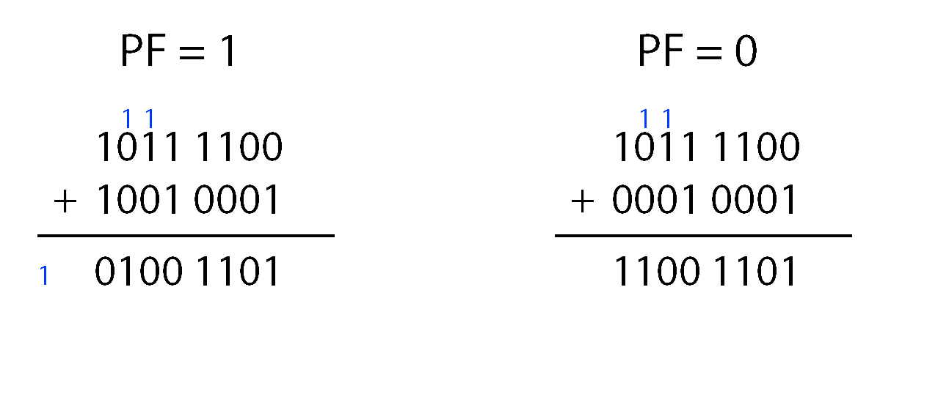
Parity Flag
Indicates whether the number of set bits (1s) in the result of the last arithmetic or logical operation is even or odd.
PF = 1: Indicates an even number of 1s in the result (even parity).
PF = 0: Indicates an odd number of 1s in the result (odd parity).

Slide 24
Overflow Flag
This flag is set when the result of a signed operation goes beyond limits of the data type.
The OF is set (1) when:
Two positive numbers are added and the result is negative (indicating overflow).
Two negative numbers are added and the result is positive (indicating overflow).
OF = 1
OF = 0
0111 1111 (127)
+ 0000 0001 (1)
--------------------
1000 0000 (-128)
1000 0001 (-127)
0000 0001 (1)
--------------------
0111 1110 (126)
0000 0001 (1)
+ 0000 0010 (2)
------------------
0000 0011 (3)

Slide 25
Carry Flag
The CF is set (1) if there is a carry out from the MSB during addition.
The CF is set (1) if there is a borrow from MSB in a subtraction operation
CF = 1
1111 1111
+ 0000 0001
--------------------
1 0000 0000
CF = 1
0000 0000
- 0000 0001
------------------- (1)1111 1111
CF = 0
0000 1110
+ 0000 1111
-------------------- …0001 1101
CF = 0
0000 0010
- 0000 0001
-------------------- …0000 0001

Slide 26
Control Flags
Dictate how the operations will be performed by the processor
How certain instructions are executed
Interrupt flag (IF)
Trap Flag (TF)
Directional flag (DF)

Slide 27
Directional Flag
Determines the direction in which string operations will be processed in memory
DF = 0 (Forward Direction):
String operations will increment the index registers
Data is processed from lower memory addresses to higher memory addresses
DF = 1 (Backward Direction):
String operations will decrement the index registers.
This means data is processed from higher memory addresses to lower memory addresses.
CLD and STD

Slide 28
Trap Flag
Enables single-step debugging by generating an interrupt after each instruction execution.
TF = 1 (Trap Mode):
When set, it allows a debugger to take control after each instruction, facilitating step-by-step execution.
TF = 0 (Normal Mode):
When cleared, the CPU executes instructions normally without generating interrupts after each instruction.

Slide 29
Interrupt Flag
Controls whether the computer can respond to important signals (interrupts) from peripheral devices, like the keyboard or mouse
IF = 1 (Interrupts Enabled):
If you’re typing in Word, the computer registers each keypress instantly because interrupts are enabled.
IF = 0 (Interrupts Disabled):
The CPU ignores outside signals temporarily.
During an update, interrupts might be disabled to ensure the update isn’t interrupted by other tasks.

Slide 30
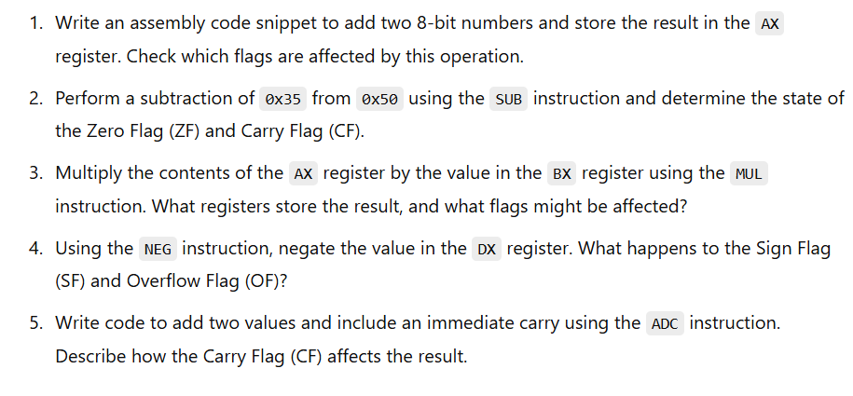
Practice Questions

