Slide 1
COAL
Lecture 5

Slide 2
Data Types
DB (Define Byte): Allocates space for a byte (8 bits) or initializes it with a value.
Value DB 10 (value is name of variable initialize to 10)
DW (Define Word): Allocates space for a word (usually 16 bits) or initializes it with a value.
Num DW 1234
DD (Define Doubleword): Allocates space for a doubleword (usually 32 bits) or initializes it with a value.
largeNum DD 100000
DQ (Define Quadword): Allocates space for a quadword (usually 64 bits) or initializes it with a value.
bigNum DQ 123456789012345

Slide 3
Variable Declaration and Initialization
Defines a variable and reserves memory for it in the data segment.
Syntax: <variable_name> <directive> <value>
Assigns an initial value to the variable.
The ? symbol is used when you want to reserve memory for a variable but do not assign a value initially. The reserved space will contain undefined (garbage) values until assigned later in the program.
<variable_name> <directive> ?

Slide 4
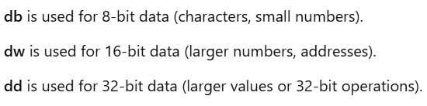
Examples
message db 'Hello’, 0
number dw 5
buffer db 10 ?
count dd 1000
data dw ?

Slide 5
Data Segment Handling
.data
; declare and initialize variables
.code
MOV AX, @data ; Load data segment address into AX
MOV DS, AX ; Set DS to point to the data segment
; rest of the code
.exit

Slide 6
ALU Operations on Variables
ADD AX, num1
SUB CX, num2
INC counter
XOR AX, data
AND AX, mask
MUL num1
NEG abc

Slide 7
Arrays
An array is a collection of data elements of the same type, stored in consecutive memory locations.
In 8086 assembly, arrays are typically defined in the .data segment.
Base address: The address of the first element of the array.
Element size: The size of each element (byte, word, etc.).
Indexing: Elements are accessed using an index (offset) relative to the base address.

Slide 8
Defining Arrays in 8086
Use DB to define array
.data
array DB 10, 20, 30, 40, 50
Use DW to define array
.data
array DW 100, 200, 300, 400

Slide 9
Accessing Array Elements
To access array elements, you must calculate the memory address (offset) based on the array’s base address and the index.
Byte array (first element)
MOV SI, 0 ; Set SI to index 0
MOV AL, [array + SI] ; AL = array[0]
INC SI ;move to second element
Word array (second element)
MOV SI, 2 ; Set SI to index 1 (word = 2 bytes)
MOV AX, [array + SI] ; AX = array[1] (word)
ADD SI, 2 ;move to third element

Slide 10
Cont.
Accessing Multiple Elements
MOV SI, 0
MOV AL, [array + SI] ; AL = array[0]
INC SI
MOV AL, [array + SI] ; AL = array[1]

Slide 11
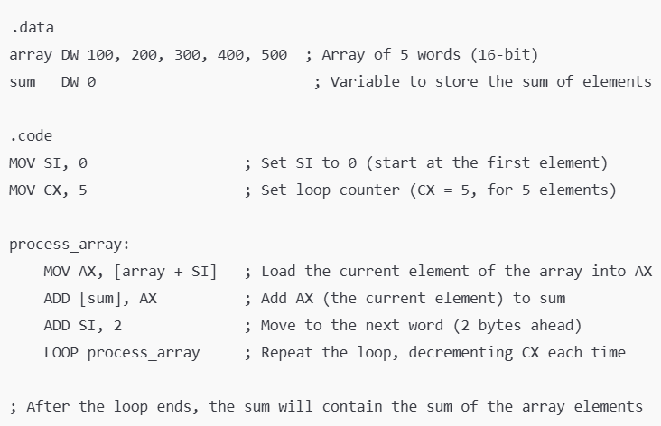
Using Loop to Process Arrays

Slide 12

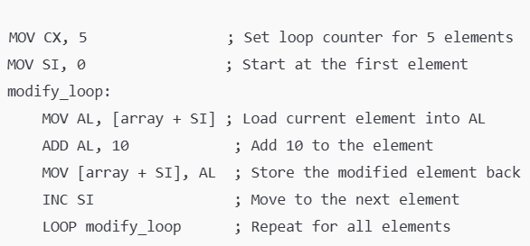
Modifying Array Elements

Slide 13
Jump Instruction
Jump instructions alter the sequence of program execution by causing a branch to a different instruction in the program.
Unconditional Jump: Always jumps to the target.
Conditional Jump: Jumps based on meeting a certain condition (like comparison results; if/else).

Slide 14
Unconditional Jump
These instructions always jump to a target address or label, regardless of any conditions.
Syntax: JMP label
Will jump to the specified label regardless of any condition

Slide 15
Distance wise JMP
JMP short
Jumps to a nearby address
Used for small distances in code.
JMP near
Jumps within a range of 32K bytes (nearby memory addresses)
JMP far
Used to jump to a different segment. It specifies both a segment and an offset.
JMP FAR [segment:offset]

Slide 16
CMP Instruction
Compares two operands by subtracting the second operand from the first but does not store the result
Only updates status flags after the execution
Typically used to set the condition flags for conditional jumps
CMP destination, source
CMP AX, BX ; Compare AX and BX (sets flags based on AX - BX)
AX will remain unaffected after execution

Slide 17
Test Instruction
Performs a bitwise AND operation between two operands but does not store the result. It only sets or clears the status flags based on the result.
Commonly used to check if specific bits in a register or memory location are set.
TEST destination, source
TEST AL, 1 ; Test if the least significant bit of AL is set (sets flags based on AL AND 1)
AL will remain unaffected after execution

Slide 18
Conditional Jumps
Conditional jump instructions evaluate a specific condition (based on flags set by previous instructions like CMP or TEST before jumping.
Syntax: J<condition> label

Slide 19
JE / JZ
Jump if equal
Jump if zero
ZF = 1 in both cases
Example:
CMP AX, BX ; Compare AX with BX
JE equal ; Jump to “equal” if AX equals BX (ZF=1)
JNE / JNZ

Slide 20
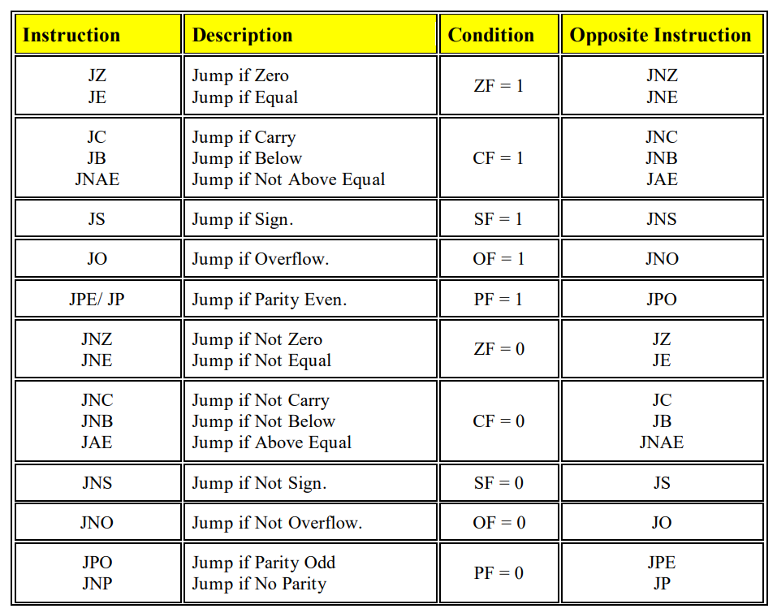
Jump – Single Flag

Slide 21
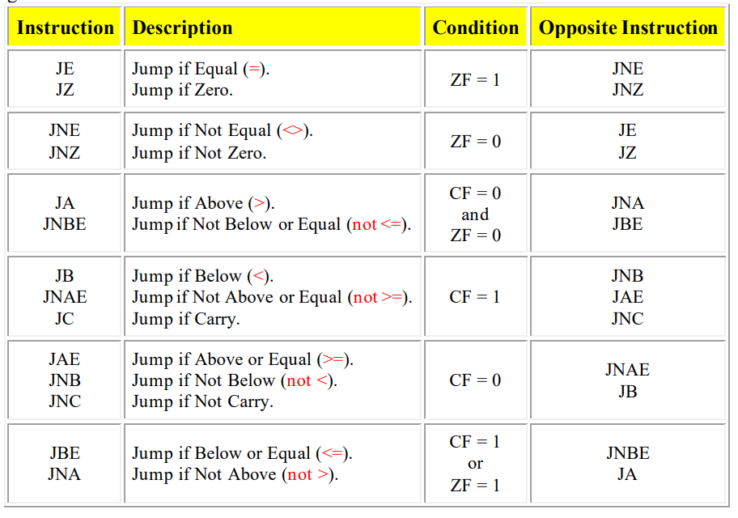
Jump – Unsigned Comparison

Slide 22
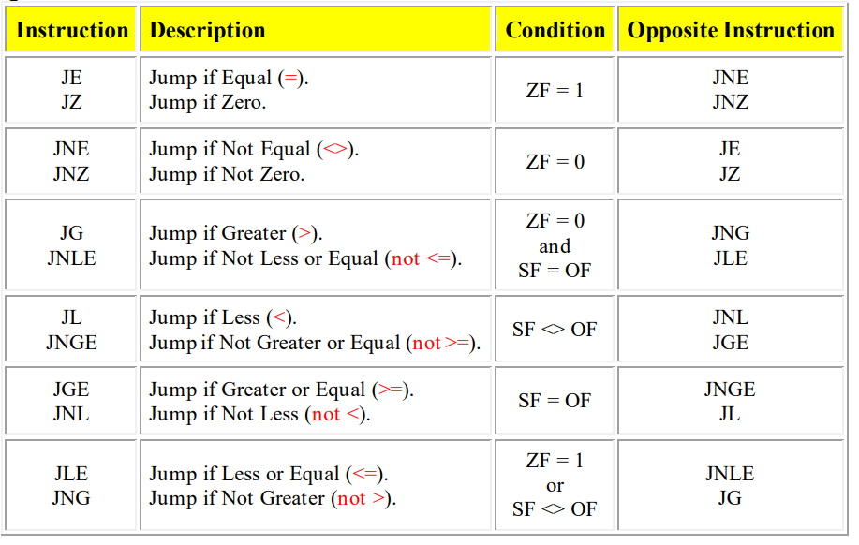
Jump – Signed Comparison

Slide 23
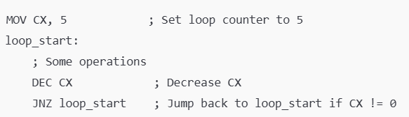
Looping with Conditional Jumps

Slide 24
Bit Manipulation
Bit manipulation involves operations that directly modify individual bits of a binary number.
Flipping bits (0 to 1 and vice versa)
Combine bits in different ways
Shifting bits left or right
Purpose: enhance efficiency and performance

Slide 25
Basic Bitwise Operators
AND (&): Sets each bit to 1 if both corresponding bits are 1
OR (|): Sets each bit to 1 if at least one of the corresponding bits is 1
XOR (^): Sets each bit to 1 if only one of the corresponding bits is 1
NOT (~): Inverts all bits (flips 0 to 1 and 1 to 0)

Slide 26
Shift Operators
Left Shift Operation (<<)
Moves all bits in a number to the left by a certain number of positions
Zeros are added to the right side as the bits are shifted left
The leftmost bits are discarded if they go beyond the fixed size of the bit representation
For example:
5 << 1 = 1010 (mul 2¹)
3<< 2 = 1100 (mul 2²)
65535 << 1 = 11111111111111110 (leftmost 1 is discarded because of overflow)
Multiplication by power of 2

Slide 27
Logical Right Shift
Done in unsigned numbers
Bits are moved to the right
Zeros are added on the left
For example:
FF00 >> 1: 1111111100000000 >> 1 = 01111111100000000 = 7F00
18 >> 3: 10010 >> 3 = 00010 = 2
5 >> 2: 101 >> 2 = 001 = 1
Division by powers of 2

Slide 28
Arithmetic Right Shift
For signed numbers only
Leftmost 1 is preserved to maintain the sign in negative numbers
1s are added at left side instead of 0s
For example:
-5 >> 2: 1011 >> 2 = 1110 = -2 1110 - -
-1000 >> 3: 1011100000 >> 3 = 1 1 1 1011100 = -125 - - -
0xA0 >> 2: 10100000 >> 2 = 11101000 = 0xE8 1 1 101000 - -

Slide 29
Rotations
Rotate Left (ROL):
Shifts all bits of a value to the left
The leftmost bit (the most significant bit) is moved into the rightmost bit position (the least significant bit)
The other bits are shifted one position to the left
For Example:
0001 1101 (29) = 0011 1010 (58) 0011 1010
0101 1100 (92) = 1011 1000 (184)
1100 1011 (203) = 1001 0111 (151)

Slide 30
Rotations
Rotate Right (ROR):
Shifts all bits of a value to the right
The rightmost bit (the least significant bit) is moved into the leftmost bit position (the most significant bit)
The other bits are shifted one position to the right
For Example:
0001 1101 (29) = 1000 1110 (142) 1000 1110 1000 1110
0110 0101 (101) = 1011 0010 (178)
1111 0001 (241) = 1111 1000 (232)

