Slide 1
COAL
Lecture 6

Slide 2
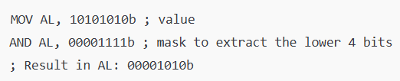
Bit Masking
Bit masking involves using binary masks to manipulate specific bits within a binary number through bitwise operations.
Type of bit manipulation
Binary masks are the bitwise operations
AND, OR, NOT, XOR

Slide 3
Bit masking
Selective set -> set a specific bit (1)
Selective clear -> clear a specific bit (0)
Selective compliment -> Compliment of a specific bit (1->0, 0 ->1)

Slide 4
Selective Set
A selective set operation sets specific bits to 1 in a binary value without changing the other bits.
OR operation is used with mask to set bits in original value to 1.
Rest of bits remain 0.
Let’s set the 2nd and 4th bits of a binary number 1010 0000b, by using mask 00001010b
10100000b | 00001010b -> 10101010b

Slide 5
Selective Set
Identify mask to set 2nd and 6th bit in 10010000b.
00100010b
Identify mask to set 1st, 3rd and 4th bit in 00000000b.
00001101b
Which bits will be set in the binary number 00111100b, using mask 01001000b?
7th bit

Slide 6
Selective Clear
A selective clear operation clears specific bits (sets them to 0) without changing the other bits.
AND operation is used with the mask to clear bits to 0.
Rest of the bits remain 1.
To clear the 3rd and 6th bits of a binary number 11101111b, use a mask 11011011b
11101111b & 11011011b -> 11001011b

Slide 7
Selective Clear
Identify mask to clear 3rd and 7th bit in 11101111b.
10111011b
Identify mask to clear 1st, 6th and 8th bit in 10101011b.
01011110b
Which bits will be cleared in the binary number 10101100b, using mask 01111011b?
8th bit and 3rd bit

Slide 8
Selective Compliment
Flipping the bits( 0 to 1 and 1 to 0) at specific positions in a binary number, based on a mask.
Selectively inverts bits according to where the mask has 1.
XOR operation (^) is used with value and mask.
Flip 1st, 5th, 7th and 8th bit in 10101100b, using mask 11010001b
01111101b 1->1 = 0; 0->0 = 0 ; 1->0=1, 0->1=1

Slide 9
Selective Compliment
Identify mask to flip 3rd, 5th and 7th bit in 11101111b.
01010100b
Identify mask to flip 1st, 6th and 8th bit in 10101011b.
10100001b
Which bits will be flipped in the binary number 10101100b, using mask 01111011b?
1, 2, 4, 5, 6, 7

Slide 10
Stack
Stack is a data structure used for managing function calls, local variables, and control flow.
Last in First Out (LIFO)
Last item pushed onto the stack is the first one to be popped off.
.stack directive is used to reserve a block of memory for stack. (.stack 100h)
SS (Stack Segment) Register: Holds stack Segment Address
The stack pointer (SP) register is used to keep track of the top of the stack.

Slide 11
Operations on Stack
Push: Adds an item to the top of the stack.
Pop: Removes the top item from the stack.
Peek: Views the top item without removing it.

Slide 12
Push and PushF
Push: Used to add a new source (16-bit register or memory word) on stack
Syntax:
PUSH source
Execution of PUSH causes:
SP is decreased by 2 (stack grows downward in memory)
A copy of source contents is moved to the address specified by SS:SP.
Source remains unchanged
PUSHF has no operand and it pushes the contents of FLAG register onto the stack.

Slide 13
PUSH - Example
Offset
Stack
Offset
Stack
Offset
Stack
00F8
00FA
00FC
00FE
0100
00F8
00FA
00FC
00FE | 1234
0100
00F8
00FA
00FC | 5678
00FE | 1234
0100
SP
SP
SP
SP
0100
SP
00FE
SP
00FC
AX
1234
AX
1234
AX
1234
BX
5678
BX
5678
BX
5678
INITIAL STACK
After PUSH AX
After PUSH BX

Slide 14
POP And POPF
POP: Used to remove top item from stack to destination (i.e. a 16-bit register or memory word).
Syntax:
POP destination
Execution of POP causes:
The contents of SS:SP (top of the stack) is moved to the destination.
SP is increased by 2
POPF has no operand and pops the top of the stack into FLAG register.

Slide 15
POP - Example
Offset
Stack
Offset
Stack
Offset
Stack
00F8
00FA
00FC | 5678
00FE | 1234
0100
00F8
00FA
00FC
00FE | 1234
0100
00F8
00FA
00FC
00FE
0100
SP
SP
SP
SP
00FC
SP
00FE
SP
0100
CX
FFFF
CX
5678
CX
5678
DX
0001
DX
0001
DX
1234
Before POP
After POP CX
After POP DX (Stack Empty)

Slide 16
Uses of Stack
Function Calls: When a function is called, the return address is pushed onto the stack, and local variables are stored there.
Interrupts: The state of the CPU (registers) is saved onto the stack when an interrupt occurs, allowing the program to resume afterward.
Context Switching: In multitasking systems, the stack saves the state of a process before switching to another process.
To reverse an input

Slide 17

Example
PUSH: Decreases the stack pointer and stores data.
POP: Increases the stack pointer and retrieves data.
Notes:
; Initial setup
MOV AX, 5 ; Load value 5 into AX register
PUSH AX ; Push AX onto the stack, SP decreases
MOV BX, 10 ; Load value 10 into BX register
PUSH BX ; Push BX onto the stack, SP decreases again
; Now, let's pop the values back
POP CX ; Pop top value from stack into CX, SP increases
POP DX ; Pop next value from stack into DX, SP increases

Slide 18
Saving and Restoring Variable in Stack
Technique used to:
Manage function calls
Local variables
Preserve register values
Allows the program to save the current state before making changes and restore it afterward, ensuring that the program can continue execution as if nothing was altered.

Slide 19
How it works?
Saving a Variable:
Before modifying a register or variable, you push its value onto the stack. This ensures you can restore it later.
Restoring a Variable:
After you're done using the register or modifying the variable, you pop the value back from the stack, restoring the original state.

Slide 20
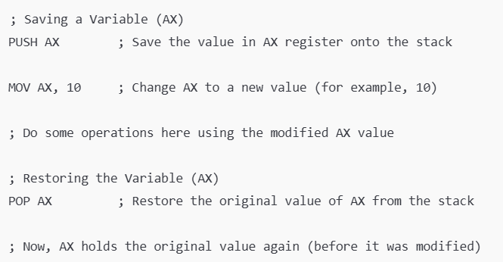
Example
Notes:
; Initial setup
MOV AX, 5 ; Load value 5 into AX register
PUSH AX ; Push AX onto the stack, SP decreases
MOV BX, 10 ; Load value 10 into BX register
PUSH BX
; Push BX onto the stack, SP decreases again
mov AX, 7
mov bx, 6
; Now, let's pop the values back
POP BX ; Pop top value from stack into CX, SP increases
POP AX ; Pop next value from stack into DX, SP increases

Slide 21
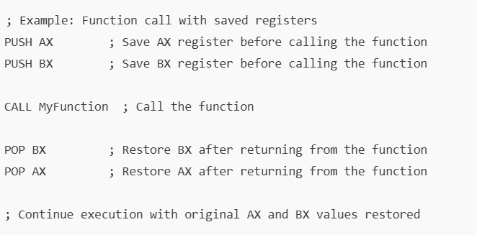
Example
Notes:
; Initial setup
MOV AX, 5 ; Load value 5 into AX register
PUSH AX ; Push AX onto the stack, SP decreases
MOV BX, 10 ; Load value 10 into BX register
PUSH BX
; Push BX onto the stack, SP decreases again
mov AX, 7
mov bx, 6
; Now, let's pop the values back
POP BX ; Pop top value from stack into CX, SP increases
POP AX ; Pop next value from stack into DX, SP increases

Slide 22
Accessing Stack with BP
Base Pointer Register – points towards the stack base
No pop instruction is required
Contents of the SP register are moved to the BP register to gain access to the top of the stack.
Then, using register indirect mode, the value anywhere in the stack can be read or written.

Slide 23
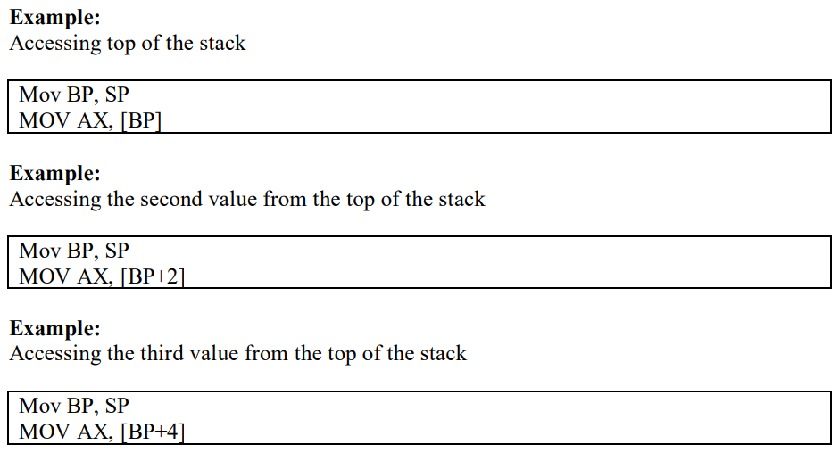
Example

