Slide 1
COAL
Lecture 7

Slide 2
Subroutines/Procedures
Used almost interchangeably with Procedures
Block of code designed to perform a specific task that can be reused multiple times within a program
Allow for modular programming, making code more organized and easier to manage
Allows you to avoid repeating code by allowing common functionality to be called from different places within the program.
When a subroutine is called, control is transferred to the subroutine, and after it finishes, control is returned to the calling code.

Slide 3
Calling a Subroutine
A procedure is the assembly equivalent of a Java or C function
CALL instruction is used to call a subroutine.
When a subroutine is called, the return address is pushed onto the stack, so after the subroutine finishes, the program can jump back to where it was called from.
RET instruction is used to return control to the calling function.
sample PROC
.
.
ret
sample ENDP

Slide 4
Procedure Call and Return
MAIN PROC
CALL PROC1
First instruction
PROC1 PROC
First instruction
RET

Slide 5
CALL and RET Instructions
The CALL instruction calls a procedure
Pushes offset of next instruction on the stack
Copies the address of the called procedure into IP (Note: IP=Instruction Pointer)
The RET instruction returns from a procedure
Pops top of stack into IP

Slide 6
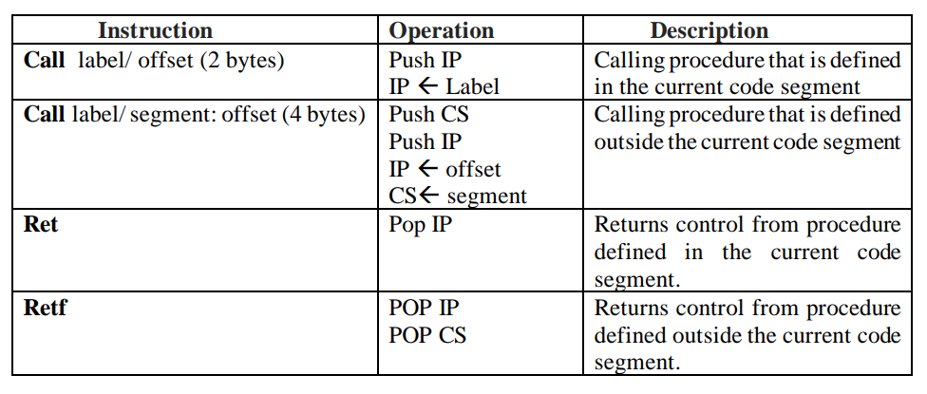
CALL and RET Instructions

Slide 7
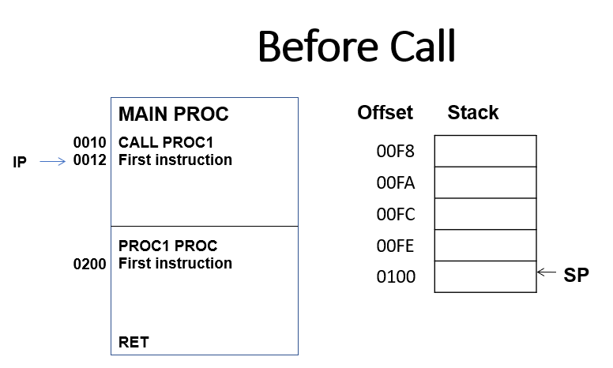
Stack Representation

Slide 8
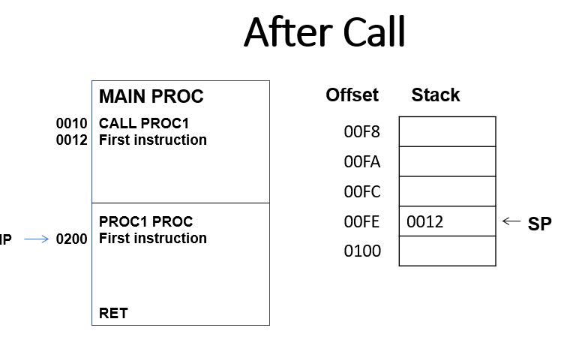
Stack Representation

Slide 9
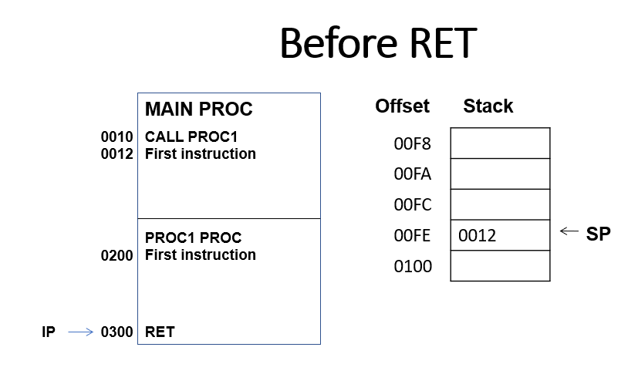
Stack Representation

Slide 10
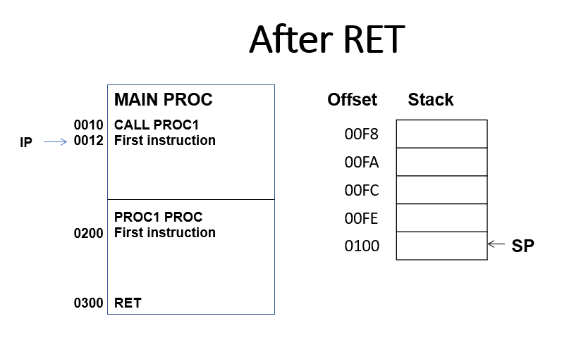
Stack Representation
Notes:
; Caller Code
PUSH 5 ; Push parameter
CALL SUB ; Call subroutine
ADD SP, 2 ; Clean stack
; Subroutine
SUB:
MOV AX, [SP] ; Access parameter
; Perform tasks
RET

Slide 11
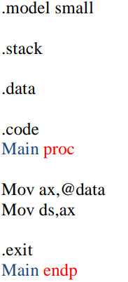
Main Procedure
Called by operating system
Notes:
.model small
.stack
.data
.code
Main proc
Mov ax,@data
Mov ds,ax
.exit
Main endp

Slide 12
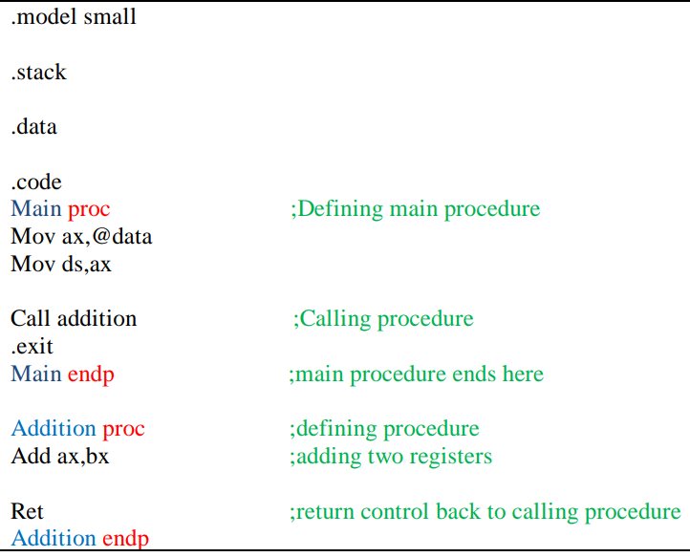
Addition Procedure
Notes:
.model small
.stack
.data
.code
Main proc ;Defining main procedure
Mov ax,@data
Mov ds,ax
Call addition ;Calling procedure
.exit
Main endp ;main procedure ends here
Addition proc ;defining procedure
Add ax,bx ;adding two registers
Ret ;return control back to calling procedure
Addition endp

Slide 13
Stack Management in Subroutines
Subroutines typically use the stack to save and restore registers.
This ensures that the calling program’s state is preserved across the subroutine call.
The CALL instruction automatically pushes the return address onto the stack.
The RET instruction pops the return address from the stack and jumps to it.

Slide 14
Use of Stack for Parameters
Temporary storage during function execution.
Allows multiple nested calls without conflict.
Efficient parameter handling in assembly.

Slide 15
Steps for Parameter Passing
Push Parameters: Caller pushes arguments onto the stack.
CALL Instruction: Control jumps to the subroutine.
Access Parameters: Subroutine accesses parameters via the stack.
Perform Operations: Subroutine uses parameters to execute tasks.
Clean Up: Caller removes parameters after execution.

Slide 16
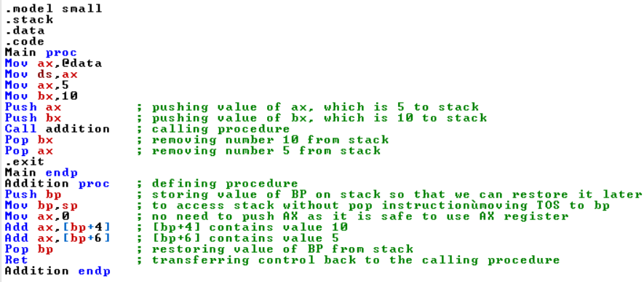
Addition Proc with Stack
Notes:
.model small
.stack
.data
.code
Main proc
Mov ax,@data
Mov ds,ax
Mov ax,5
Mov bx,10
Push ax ; pushing value of ax, which is 5 to stack
Push bx ; pushing value of bx, which is 10 to stack
Call addition ; calling procedure
Pop bx ; removing number 10 from stack
Pop bx ; removing number 5 from stack
.exit
Main endp
Addition proc ; defining procedure
Push bp ; storing value of BP on stack so that we can restore it later
Mov bp,sp ; to access stack without pop instruction—moving TOS to bp
Mov ax,0 ; no need to push AX as it is safe to use AX register
Add ax,[bp+4] ; [bp+4] contains value 10
Add ax,[bp+6] ; [bp+6] contains value 5
Pop bp ; restoring value of BP from stack
Ret ; transferring control back to the calling procedure
Addition endp

Slide 17
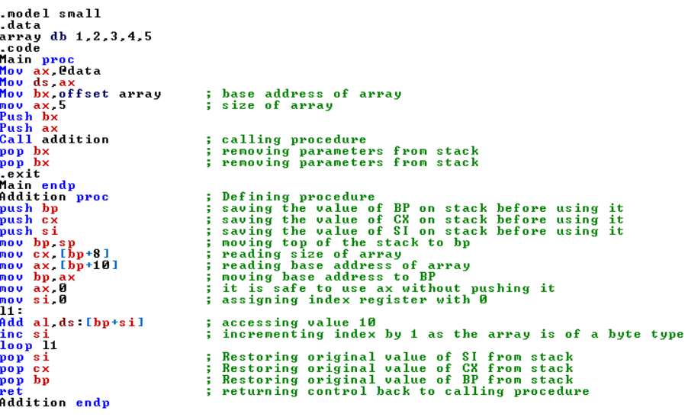
Passing Array in Proc
Notes:
.model small
.data
array db 1,2,3,4,5
.code
Main proc
Mov ax,@data
Mov ds,ax
Mov bx,offset array ; base address of array
mov ax,5 ; size of array
Push bx
Push ax
Call addition ; calling procedure
pop bx ; removing parameters from stack
pop bx ; removing parameters from stack
.exit
Main endp
Addition proc ; Defining procedure
push bp ; saving the value of BP on stack before using it
push cx ; saving the value of CX on stack before using it
push si ; saving the value of SI on stack before using it
mov bp,sp ; moving top of the stack to bp
mov cx,[bp+8] ; reading size of array
mov ax,[bp+10] ; reading base address of array
mov bp,ax ; moving base address to BP
mov ax,0 ; it is safe to use ax without pushing it
mov si,0 ; assigning index register with 0
l1:
Add al,ds:[bp+si] ; accessing value 10
inc si ; incrementing index by 1 as the array is of a byte type
loop l1
pop si ; Restoring original value of SI from stack
pop cx ; Restoring original value of CX from stack
pop bp ; Restoring original value of BP from stack
ret ; returning control back to calling procedure
Addition endp

Slide 18
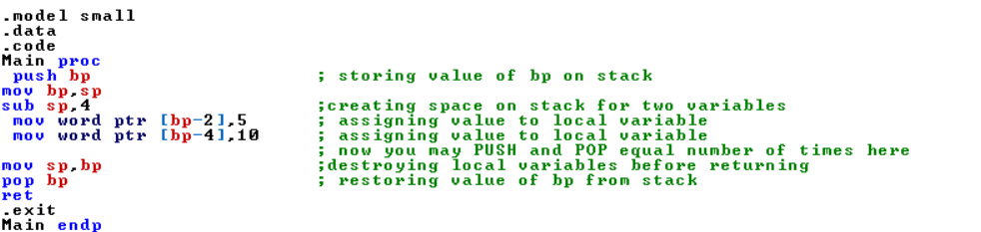
Creating Local Variables
Notes:
.model small
.data
.code
Main proc
push bp ; storing value of bp on stack
mov bp,sp
sub sp,4 ;creating space on stack for two variables
mov word ptr [bp-2],5 ; assigning value to local variable
mov word ptr [bp-4],10 ; assigning value to local variable
; now you may PUSH and POP equal number of times here
mov sp,bp ;destroying local variables before returning
pop bp ; restoring value of bp from stack
ret
.exit
Main endp

Slide 19
Methods of Returning Values
Via Registers: Common method, uses AX, BX, etc.
Via Stack: Push result onto the stack before RET.
Direct Memory: Store result in a memory location.

Slide 20
Returning Values via Registers
Example: AX register
SUB:
MOV AX, 10 ; Return value in AX
RET
Fast and simple for single values.

Slide 21
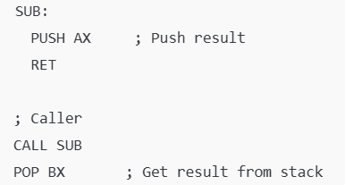
Returning Values via Stack
Steps:
Push result onto the stack in subroutine.
Caller pops the result after RET.

Slide 22

Returning Values via Memory
Useful for large or complex data.
Subroutine writes directly to a pre-defined memory address.

Slide 23
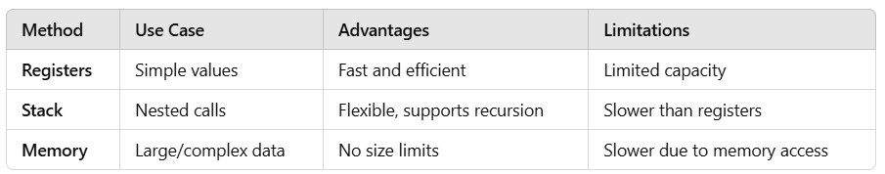
Comparison of Methods

