Slide 1
Lecture 8
Software Interrupts

Slide 2
Interrupts
Interrupts are mechanisms that allow programs to temporarily stop and transfer control to a special procedure (ISR) for handling specific tasks, such as hardware events or system services.
Used for services such as I/O operations, system calls, and other OS-level tasks.
Executed using an interrupt instruction, like INT in x86 assembly.

Slide 3
Types of Interrupts
There are two main types of interrupts:
Hardware Interrupts: Triggered by hardware devices (e.g., keyboard input, I/O devices).
Software Interrupts: Triggered by software instructions to request services (e.g., operating system functions).

Slide 4
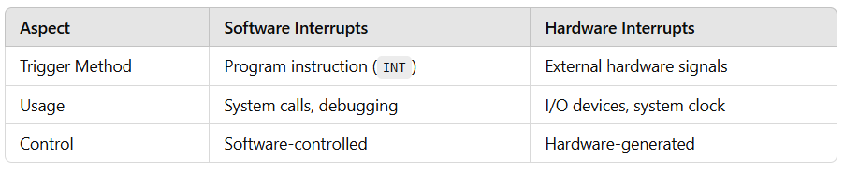
Software vs. Hardware Interrupts
For example, to read a file from disk or a character from the keyboard.
For example, whenever a key is pressed, the 8086 must be notified to read a key code from the keyboard buffer

Slide 5
How Software Interrupts Work
Execution of INT Instruction: For example, INT 21h in x86 for DOS services.
Interrupt Vector Table (IVT): CPU looks up the ISR (Interrupt Service Routine) address in the IVT.
ISR is a special type of Procedure
Switch to ISR: Control passes to the specified ISR.
Return to Program: After ISR execution, control returns to the original program.

Slide 6
Interrupts – Changing Program Flow
Mechanism by which other modules (e.g. I/O) may interrupt normal sequence of processing
Program
e.g. overflow, division by zero (Exceptions)
Timer
Generated by internal processor timer
Used in Pre-Emptive Multi-Tasking
I/O
From I/O controller
Hardware failure

Slide 7
Interrupt Cycle
Added to instruction cycle
Processor checks for interrupt
Indicated by an interrupt signal
If no interrupt, fetch next instruction
If interrupt pending:
Suspend execution of current program
Save context in stack
Set Program Counter to start address of interrupt handler routine
Process interrupt
Restore context from stack and continue interrupted program

Slide 8
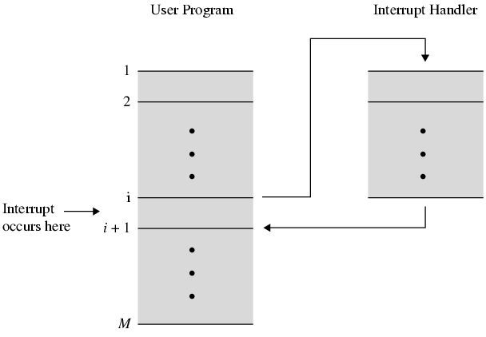
Transfer of Control via Interrupts

Slide 9
Multiple Interrupts
Disable interrupts
Processor will ignore further interrupts whilst processing one interrupt
Interrupts remain pending and are checked after first interrupt has been processed
Interrupts handled in sequence as they occur
Define priorities
Low priority interrupts can be interrupted by higher priority interrupts
When higher priority interrupt has been processed, processor returns to previous interrupt

Slide 10
Interrupt Numbers
Total 256 interrupts
0x00 to 0xFF
0 – 255
Not all interrupt numbers are used in the same way or assigned to specific services

Slide 11
Interrupt Numbers Categories
Interrupts 0x00 to 0x1F (0 to 31 in decimal)
Reserved for system-level interrupts (e.g. Int 10h)
Interrupts 0x20 to 0x3F (32 to 63 in decimal)
Hardware Interrupts (Int 21h)
Interrupts 0x40 to 0x7F (64 to 127 in decimal)
System-level services
Interrupts 0x80 to 0xFF (128 to 255 in decimal)
Used for software interrupts (Int 80h for system calls)

Slide 12
Common Interrupt Examples
INT 10h: Video services (BIOS interrupt for screen operations).
INT 16h: Keyboard services (BIOS interrupt for reading keyboard input).
INT 21h: DOS services (used for input/output operations, file management, exit program etc.).

Slide 13
Interrupt Vector Table (IVT)
Structure: Array of pointers to ISR addresses.
Location: Typically, in low memory (e.g., 0000:0000 in x86).
IVT resides in memory at physical address 0x00000
Each entry stores the logical address of ISR, which is 4 bytes (2 for segment, 2 for offset).
Total size of the IVT is 256 x 4B = 1024B (approx. 1 KB)
To index the IVT, the processor multiplies the interrupt number by 4 to get the physical address of the entry against that interrupt number.
Notes:
INT 21h = interrupt number 21h (hex) = 33 (decimal).
IVT entry address = interrupt_number × 4
So:
21h → 33
33 × 4 = 132 decimal = 84h
✔ Physical address of INT 21h’s IVT entry = 0000:0084h (physical address 0x00084)
That location holds the 4-byte pointer (offset:segment) of the INT 21h handler.

Slide 14
BIOS Interrupts
The Basic Input/Output System (BIOS) is firmware that provides low-level control over computer hardware, including keyboard, display, and disk operations.
BIOS interrupts are used for direct interaction with hardware components.
Provides services like video display, keyboard input, print character, and system control.
Low-level, hardware-focused services like printing on the screen and reading keyboard input.

Slide 15
DOS Interrupts
Disk Operating System (DOS) is a family of operating systems that provide a command-line interface for interacting with the computer.
DOS interrupts provide software services to manage tasks like file operations, print string, and program termination.
DOS interrupts are higher-level services compared to BIOS interrupts.
They offer more abstracted functionality for easier application development.
Higher-level, system-related services like printing strings and managing files.

Slide 16
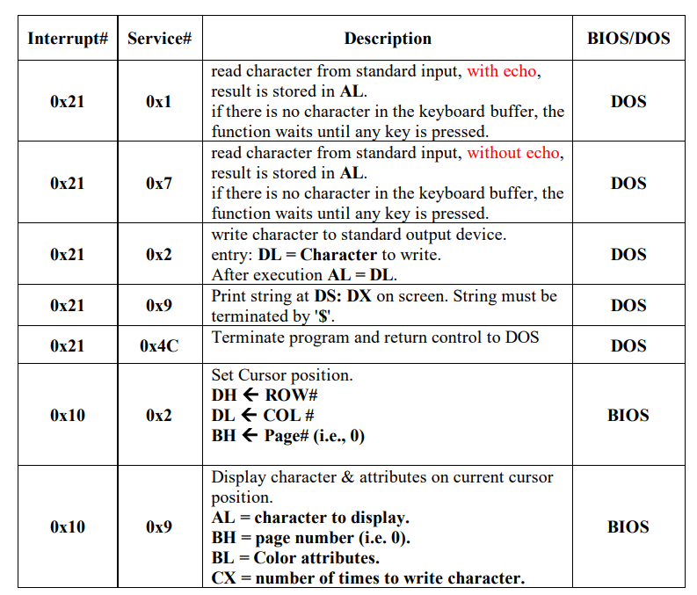
BIOS and DOS Interrupts

Slide 17
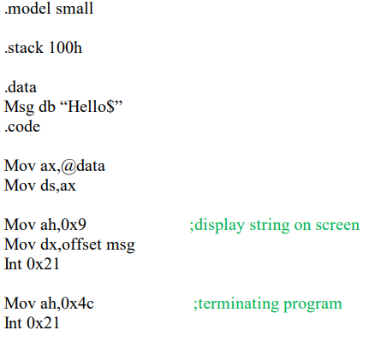
Example 1
Notes:
.model small
.stack 100h
.data
Msg db "Hello$"
.code
Mov ax,@data
Mov ds,ax
Mov ah,0x9 ;display string on screen
Mov dx,offset msg
Int 0x21
Mov ah,0x4c ;terminating program
Int 0x21

Slide 18
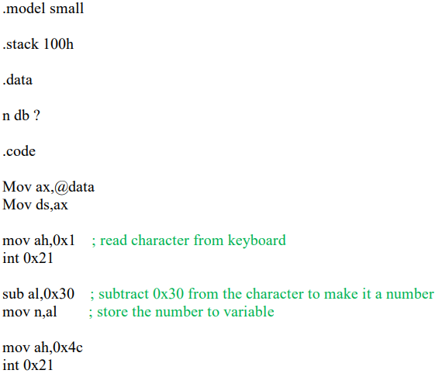
Example 2
Notes:
.model small
.stack 100h
.data
n db ?
.code
Mov ax,@data
Mov ds,ax
mov ah,0x1 ; read character from keyboard
int 0x21
sub al,0x30 ; subtract 0x30 from the character to make it a number
mov n,al ; store the number to variable
mov ah,0x4c
int 0x21

