Slide 1
Lecture 9
COAL

Slide 2
Interrupt Vector Table (IVT)
The IVT is a table of addresses the CPU uses to locate the handler for different types of interrupts and exceptions.
The processor uses the interrupt number to index the Interrupt Vector Table (IVT) to get the address of a special type of procedure called an Interrupt Service Routine (ISR).
There are 256 entries in IVT.
IVT resides in memory at physical address 0x00000.
Each entry stores the logical address, which is 4 bytes; the total size of the IVT is 256 x 4B = 1 KB
Total Size is 1024B

Slide 3
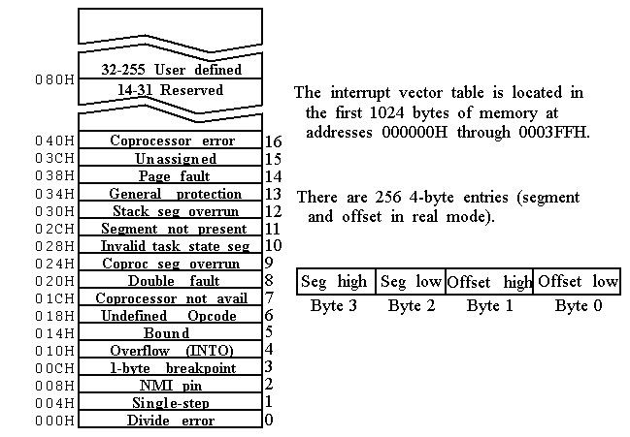

Slide 4
Exception Handling
Unexpected events disrupting program execution (e.g., divide-by-zero, invalid memory access).
Common Exceptions: Divide Error, Page Fault, General Protection Fault
Handling Steps:
Detection: CPU or program identifies the exception.
IVT Lookup: Determines the handler.
Execution: Handler resolves or logs the issue.
Resolution: Program continues or terminates.

Slide 5
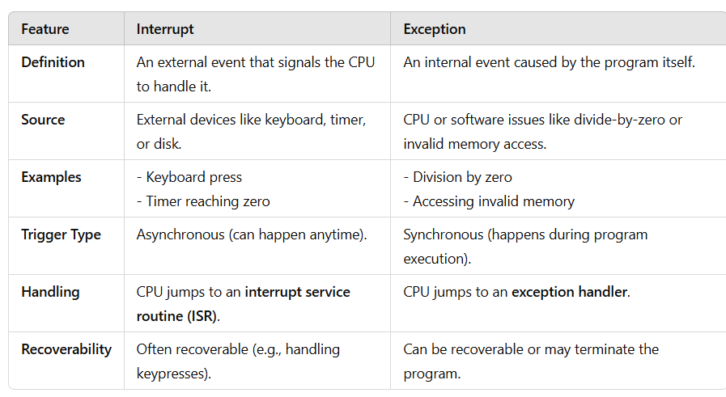
Interrupt vs Exception

Slide 6
Hooking
The process of modifying or replacing an existing entry in the Interrupt Vector Table to redirect the handling of a specific interrupt to a custom Interrupt Service Routine (ISR).
This technique is commonly used in low-level programming to intercept or extend the functionality of system interrupts.

Slide 7
Purpose of Hooking
Customizing system behavior.
Adding new functionality or debugging.
Creating hooks for software or hardware interrupts.

Slide 8
Process of Hooking
Locate the IVT entry for the desired interrupt (e.g., using its interrupt number).
Save the original ISR address (optional, for restoration).
Replace the IVT entry with the address of the custom ISR.

Slide 9
Risks and Applications
Risks:
Incorrect modifications can crash the system.
Can cause conflicts if multiple programs attempt to hook the same interrupt.
Applications:
Debugging tools.
Enhancing keyboard or mouse input.
Implementing custom OS-level features.

Slide 10
IRET Instruction
Used to return from an interrupt service routine (ISR) to the interrupted program.
Pops the flags, CS and IP registers from the stack.
Restores the processor state to what it was before the interrupt occurred.
The IRET instruction also pops the flag register from the stack, whereas the RET instruction does not

Slide 11
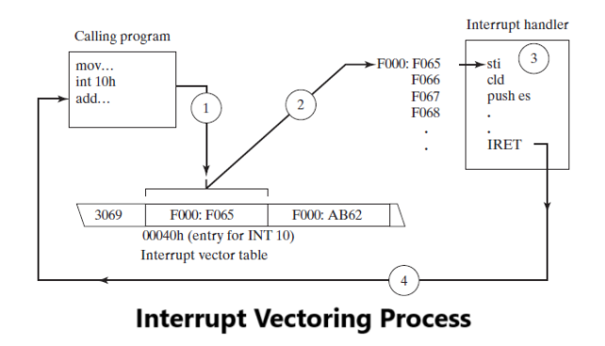

Slide 12
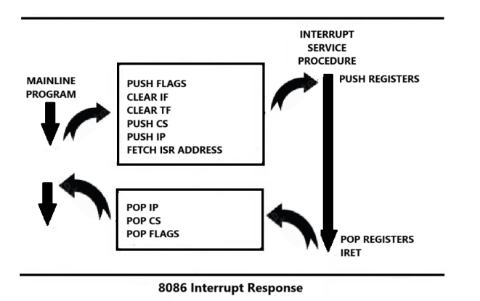

Slide 13
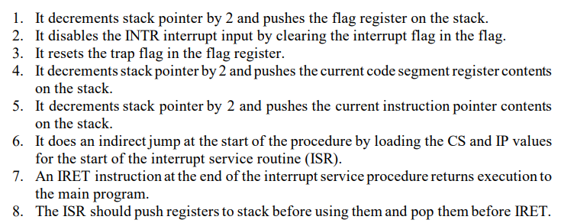
Step by Step Execution of ISR

Slide 14
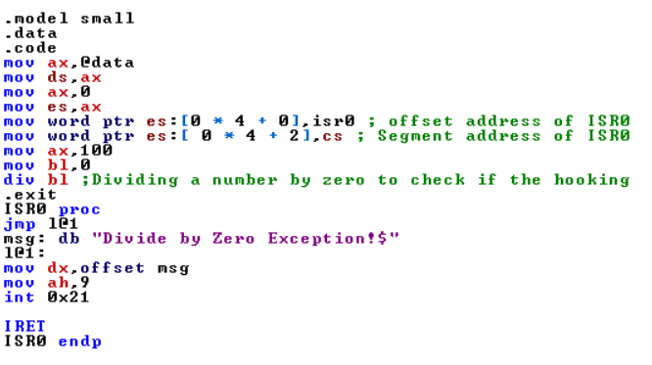
Hook INT#0h
Notes:
.model small
.data
.code
mov ax,@data
mov ds,ax
mov ax,0
mov es,ax
mov word ptr es:[0 * 4 + 0],isr0 ; offset address of ISR0
mov word ptr es:[ 0 * 4 + 2],cs ; Segment address of ISR0
mov ax,100
mov bl,0
div bl ;Dividing a number by zero to check if the hooking
.exit
ISR0 proc
jmp l@1
msg: db "Divide by Zero Exception!$"
l@1:
mov dx,offset msg
mov ah,9
int 0x21
IRET
ISR0 endp

Slide 15
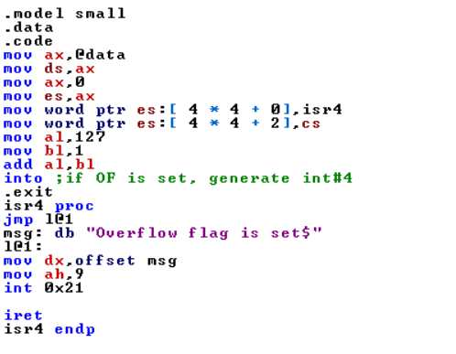
Hook INT#4h
Notes:
.model small
.data
.code
mov ax,@data
mov ds,ax
mov ax,0
mov es,ax
mov word ptr es:[ 4 * 4 + 0],isr4
mov word ptr es:[ 4 * 4 + 2],cs
mov al,127
mov bl,1
add al,bl
into ;if OF is set, generate int#4
.exit
isr4 proc
jmp l@1
msg: db "Overflow flag is set$"
l@1:
mov dx,offset msg
mov ah,9
int 0x21
iret
isr4 endp

Slide 16
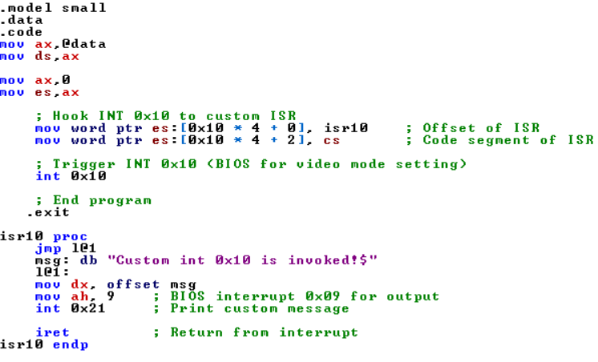
Hook INT#10h
Notes:
.model small
.data
.code
mov ax,@data
mov ds,ax
mov ax,0
mov es,ax
; Hook INT 0x10 to custom ISR
mov word ptr es:[0x10 * 4 + 0], isr10 ; Offset of ISR
mov word ptr es:[0x10 * 4 + 2], cs ; Code segment of ISR
; Trigger INT 0x10 (BIOS for video mode setting)
int 0x10
; End program
.exit
isr10 proc
jmp l@1
msg: db "Custom int 0x10 is invoked!$"
l@1:
mov dx, offset msg
mov ah, 9 ; BIOS interrupt 0x09 for output
int 0x21 ; Print custom message
iret ; Return from interrupt
isr10 endp

Slide 17
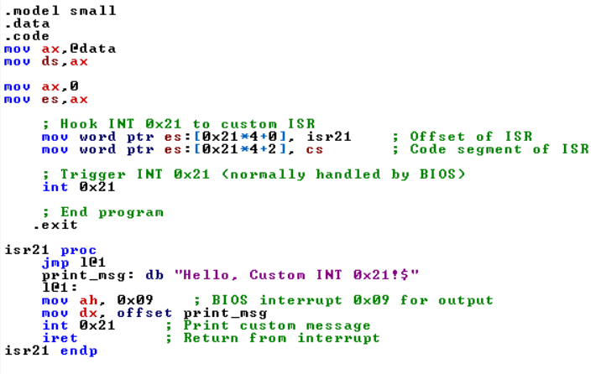
Hook INT#21h
Notes:
.model small
.data
.code
mov ax,@data
mov ds,ax
mov ax,0
mov es,ax
; Hook INT 0x21 to custom ISR
mov word ptr es:[0x21*4+0], isr21 ; Offset of ISR
mov word ptr es:[0x21*4+2], cs ; Code segment of ISR
; Trigger INT 0x21 (normally handled by BIOS)
int 0x21
; End program
.exit
isr21 proc
jmp l@1
print_msg: db "Hello, Custom INT 0x21!$"
l@1:
mov ah, 0x09 ; BIOS interrupt 0x09 for output
mov dx, offset print_msg
int 0x21 ; Print custom message
iret ; Return from interrupt
isr21 endp

Slide 18
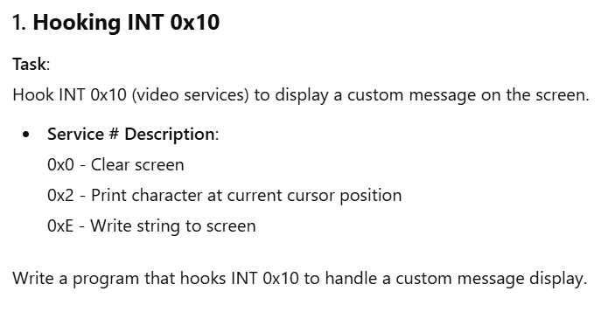
Practice Questions

Slide 19
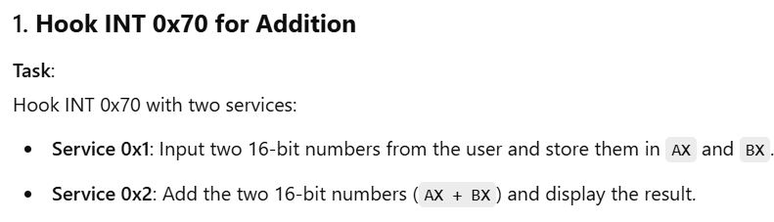
Practice Questions

