Slide 1
COAL
Lecture 10

Slide 2
Video Memory
Definition: Video memory (VRAM) is a portion of system memory used to store data for display.
Purpose: Holds characters, pixels, and attributes that define how the screen content appears.
Location:
Text mode video memory starts at physical address 0xB8000
Commonly used in assembly for direct screen manipulation.

Slide 3
Text Mode Video Memory Layout
Memory Mapping:
Example for an 80x25 screen resolution:
There are 25 rows, and each row has 80 characters
Total cells = 80 columns × 25 rows = 2000 cells
Each cell = 2 bytes, so total memory = 4000 bytes
Structure:
Each character cell consists of two bytes:
Byte 1: ASCII code for the character
Byte 2: Attribute byte (defines colors and effects)

Slide 4

Attribute Byte Details
Structure:
4 least significant bits (first nibble) for foreground color.
4 most significant bits (second nibble) for background color.
Each character's background and foreground colors can be set or obtained by reading a specific byte from memory.
RGB are red, green, and blue colors. ‘I’ is the intensity of the color, and ‘B’ is for blink.

Slide 5
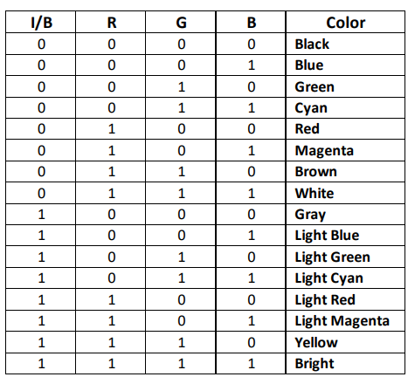
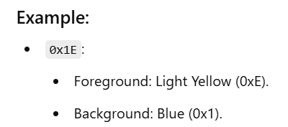
Attribute Color Codes
0x0
0x1
0x2
0x3
0x4
0x5
0x6
0x7
0x8
0x9
0xA
0xB
0xC
0xD
0xE
0xF

Slide 6
Direct Accessing Video Memory
Register Setup:
ES: Segment register pointing to video memory (usually 0xB8000 in text mode)
SI/DI: Offset within the segment for a specific character cell.
Basic Steps:
Load video memory segment into ES
Calculate offset for desired screen position
Write ASCII and attribute bytes

Slide 7
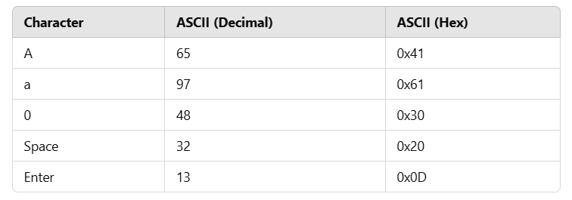
Common ASCII Codes

Slide 8
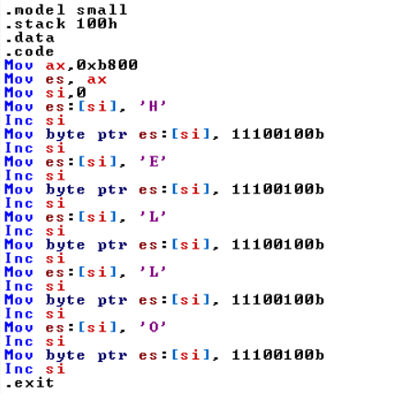
Example
Notes:
.model small
.stack 100h
.data
.code
Mov ax,0xb800
Mov es, ax
Mov si,0
Mov es:[si], 'H'
Inc si
Mov byte ptr es:[si], 11100100b
Inc si
Mov es:[si], 'E'
Inc si
Mov byte ptr es:[si], 11100100b
Inc si
Mov es:[si], 'L'
Inc si
Mov byte ptr es:[si], 11100100b
Inc si
Mov es:[si], 'L'
Inc si
Mov byte ptr es:[si], 11100100b
Inc si
Mov es:[si], 'O'
Inc si
Mov byte ptr es:[si], 11100100b
Inc si
.exit

Slide 9
Screen Coordinates
The screen is two-dimensional, having rows and columns,
While the memory containing the screen's contents is linear.
Each character on a screen has a row and column address,
Which is represented as (row, column)
It can be translated to a linear memory address by using the following equations:

Slide 10
Equations
Equation 1 finds the linear address of the memory location where the ASCII code of the character to be shown on screen will be stored.
Linear Address (ASCII) = 2 * (Row address * Columns per Row + Column address)
Equation 2 finds the linear address of the memory location where the character's screen attributes will be stored.
Linear Address (Attributes) = 2 * (Row address * Columns per Row + Column address) + 1
This linear address will be added to the base address, i.e., 0xB8000, to form the physical address.
Here, Number of rows = 25; Columns per Row = 80

Slide 11
Example
To display a text on the middle of the screen, we need to know its screen coordinates which are (12,40).
These coordinates can be translated into physical address by using equation 1 as shown below.
Memory Address (ASCII) = 2 * (12 * 80 + 40) = 2000
Similarly, the offset address of the attributes of center character is:
Memory Address (Attribute) = 2 * (12 * 80 + 40) +1 = 2000 + 1 = 2001

Slide 12
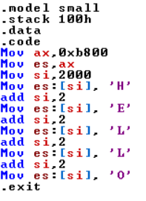
Example
Notes:
.model small
.stack 100h
.data
.code
Mov ax,0xb800
Mov es,ax
Mov si,2000
Mov es:[si], 'H'
add si,2
Mov es:[si], 'E'
add si,2
Mov es:[si], 'L'
add si,2
Mov es:[si], 'L'
add si,2
Mov es:[si], 'O'
.exit

Slide 13
Defining Strings
A sequence of characters stored in consecutive memory locations.
Strings are defined using a byte array as shown below
Msg db “Hello World”
A string is terminated by a character which can be NULL or ‘$’ so that the procedure handling string could know that the string has been ended.
We will place 0, i.e., NULL character at the end of a string as shown below
Msg db “Hello World”,0

Slide 14
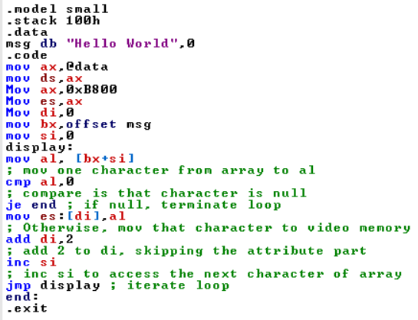
Example – with Jump
Notes:
.model small
.stack 100h
.data
msg db "Hello World",0
.code
mov ax,@data
mov ds,ax
Mov ax,0xB800
Mov es,ax
Mov di,0
mov bx,offset msg
mov si,0
display:
mov al, [bx+si]
; mov one character from array to al
cmp al,0
; compare is that character is null
je end ; if null, terminate loop
mov es:[di],al
; Otherwise, mov that character to video memory
add di,2
; add 2 to di, skipping the attribute part
inc si
; inc si to access the next character of array
jmp display ; iterate loop
end:
.exit

Slide 15
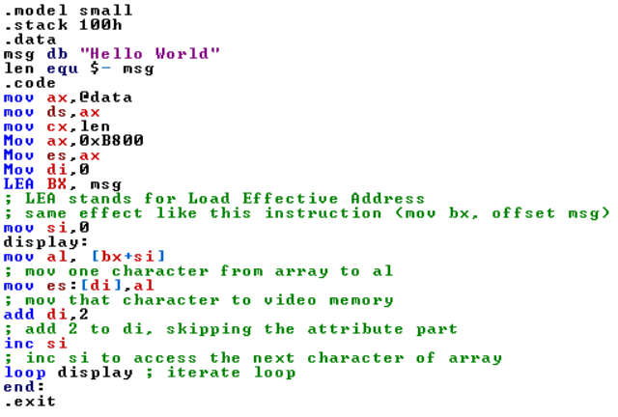
Example – with Loop
Notes:
.model small
.stack 100h
.data
msg db "Hello World"
len equ $- msg
.code
mov ax,@data
mov ds,ax
mov cx,len
Mov ax,0xB800
Mov es,ax
Mov di,0
LEA BX, msg
; LEA stands for Load Effective Address
; same effect like this instruction (mov bx, offset msg)
mov si,0
display:
mov al, [bx+si]
; mov one character from array to al
mov es:[di],al
; mov that character to video memory
add di,2
; add 2 to di, skipping the attribute part
inc si
; inc si to access the next character of array
loop display ; iterate loop
end:
.exit

Slide 16
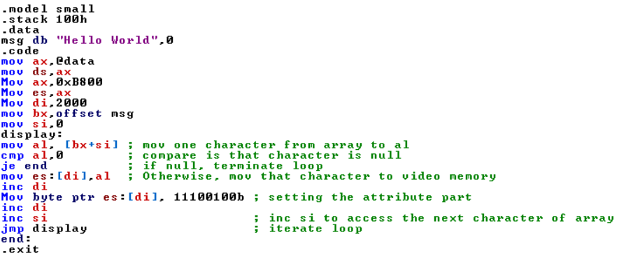
Combining Color Code, Screen Attributes and String Display
Notes:
.model small
.stack 100h
.data
msg db "Hello World",0
.code
mov ax,@data
mov ds,ax
Mov ax,0xB800
Mov es,ax
Mov di,2000
mov bx,offset msg
mov si,0
display:
mov al, [bx+si] ; mov one character from array to al
cmp al,0 ; compare is that character is null
je end ; if null, terminate loop
mov es:[di],al ; Otherwise, mov that character to video memory
inc di
Mov byte ptr es:[di], 11100100b ; add 2 to di, skipping the attribute part
inc di
inc si ; inc si to access the next character of array
jmp display ; iterate loop
end:
.exit

Slide 17
Practice Problem
Write an assembly program to display your name at the center of the screen in red text with a white background.

Slide 18
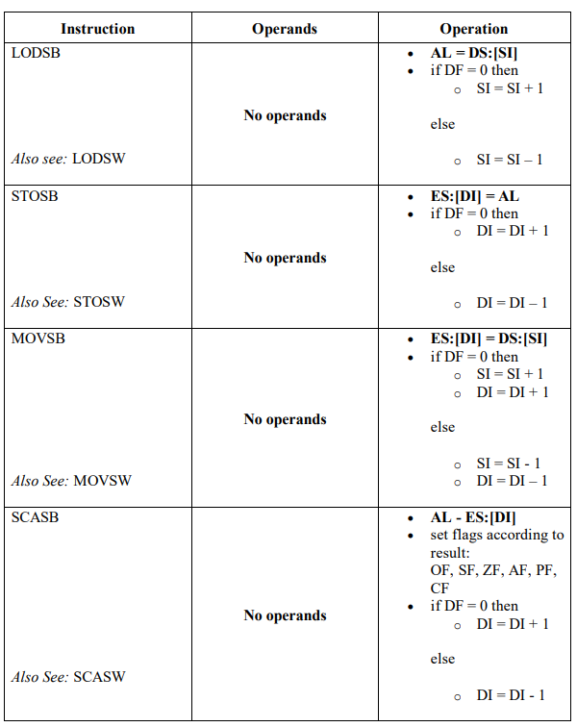
String Instructions

Slide 19
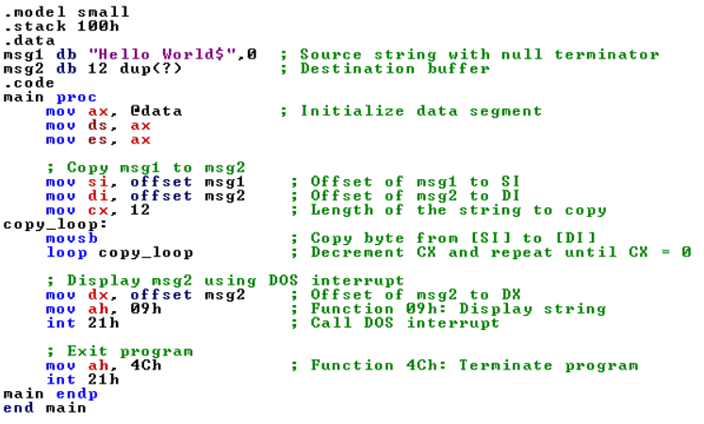
Example
Notes:
.model small
.stack 100h
.data
msg1 db "Hello World$",0 ; Source string with null terminator
msg2 db 12 dup(?) ; Destination buffer
.code
main proc
mov ax, @data ; Initialize data segment
mov ds, ax
mov es, ax
; Copy msg1 to msg2
mov si, offset msg1 ; Offset of msg1 to SI
mov di, offset msg2 ; Offset of msg2 to DI
mov cx, 12 ; Length of the string to copy
copy_loop:
movsb ; Copy byte from [SI] to [DI]
loop copy_loop ; Decrement CX and repeat until CX = 0
; Display msg2 using DOS interrupt
mov dx, offset msg2 ; Offset of msg2 to DX
mov ah, 09h ; Function 09h: Display string
int 21h ; Call DOS interrupt
; Exit program
mov ah, 4Ch ; Function 4Ch: Terminate program
int 21h
main endp
end main

