Slide 1
COAL
Lecture 11

Slide 2
2D Array
A 2D array is a matrix of rows and columns.
Stored in a memory as a linear array
Can be accessed using base plus index addressing mode
Base register (BX) will hold the base address of the array
While the index address will be incremented as the linear array is accessed
[BX + SI]

Slide 3
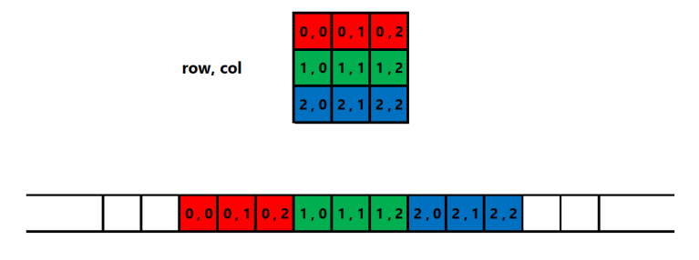
2D Array

Slide 4
Linear Address Calculation
linear_address = base_address + (row_index * num_columns + column_index) * element_size
For (1,2), the linear address will be calculated by this equation.
Please note that this address will be the offset part of logical address
Whereas, the segment part will be from DS register.
If row_index = 1
num_columns = 3
column_index = 2
element_size = 1
then, Linear_address = base_address + (1 * 3 + 2) * 1

Slide 5
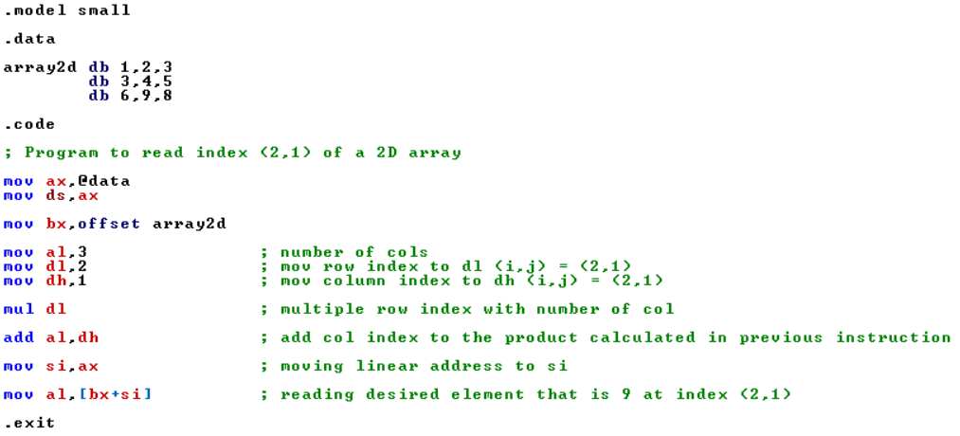
Example
Notes:
.model small
.data
array2d db 1,2,3
db 3,4,5
db 6,9,8
.code
; Program to read index (2,1) of a 2D array
mov ax,@data
mov ds,ax
mov bx,offset array2d
mov al,3 ; number of cols
mov dl,2 ; mov row index to dl (i,j) = (2,1)
mov dh,1 ; mov column index to dh (i,j) = (2,1)
mul dl ; multiple row index with number of col
add al,dh ; add col index to the product calculated in previous instruction
mov si,ax ; moving linear address to si
mov al,[bx+si] ; reading desired element that is 7 at index (2,1)
.exit

Slide 6
32-bit Registers
Intel 80386 was the first 32-bit processor of the Intel family of microprocessors.
It has 32-bit addresses and data buses.
The protected mode was also introduced in this processor that limits the operation of user programs.
It doesn’t allow user programs to go beyond their memory limits assign to them and directly access IO devices.
The size of existing registers, except the segment registers, were extended to 32-bit.

Slide 7
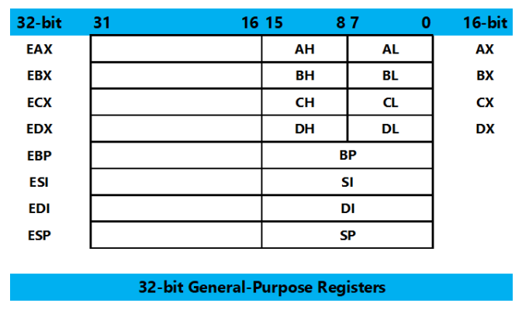
32-bit Registers

Slide 8
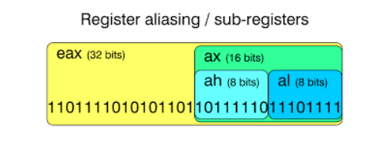
Register Aliasing

Slide 9
32-bit Addressing Modes
The addressing modes are the same.
In 80386 and above, any 32-bit register may be used in register indirect addressing mode.
The MOV [EDX], CL instruction copies the byte sized contents of register CL into the data segment memory location addressed by EDX
Any two registers from the above may be combined to generate the memory address.
The MOV [EAX+EBX], CL instruction copies the byte sized contents of register CL into the data segment memory location addressed by EAX plus EBX.
Use any 32-bit register except ESP to address memory

Slide 10
32-bit Addressing Modes
Register Direct Addressing (EAX, EBX)
Register Indirect Addressing ([EBX], [EAX +4])
Register Offset Addressing ([EBX + EAX], [EDX + ECX * 4])
Base + Offset Addressing ([EBX + 10], [EAX + 0x20])
Immediate Addressing (32-bit immediate value)
Segment : Offset Addressing ([CS:1234], [DS:2000])

Slide 11
Inline Assembly Language
Assembly language serves many purposes:
Improving program speed
Reducing memory needs
Controlling hardware when writing kernel modules
You can use the inline assembler to embed assembly-language instructions directly in your C and C++ source programs without extra assembly and link steps.

Slide 12
Inline Assembly Language
The inline assembler is built into the compiler, so you don't need a separate assembler
Because the inline assembler doesn't require separate assembly and link steps, it is more convenient than a separate assembler
Inline assembly code can use any C or C++ variable or function name that is in scope, so it is easy to integrate it with your program's C and C++ code.

Slide 13
__asm Keyword
The__asm keyword invokes the inline assembler and can appear wherever a C or C++ statement is legal.
It cannot appear by itself.
It must be followed by an assembly instruction, a group of instructions enclosed in braces, or, at the very least, an empty pair of braces.

Slide 14
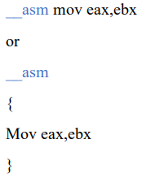
Example

Slide 15
Using and Preserving Registers in Inline Assembly
A register will not have a given value when an __asm block begins.
Register values are not guaranteed to be preserved across separate __asm blocks.
If you end a block of inline code and begin another, you cannot rely on the registers in the second block to retain their values from the first block.

Slide 16
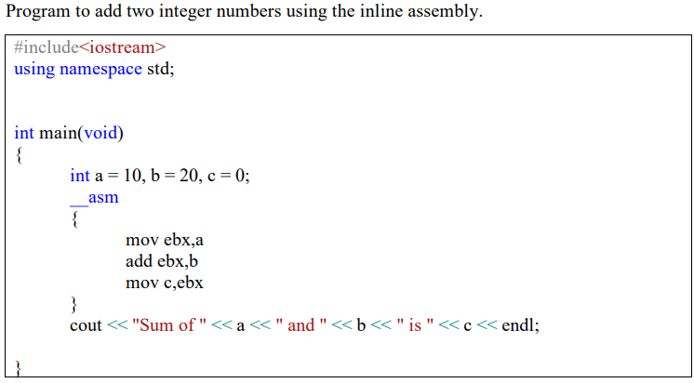
Example
Notes:
#include<iostream>
using namespace std;
int main(void)
{
int a = 10, b = 20, c = 0;
__asm
{
mov ebx,a
add ebx,b
mov c,ebx
}
cout << "Sum of " << a << " and " << b << " is " << c << endl;
}

Slide 17
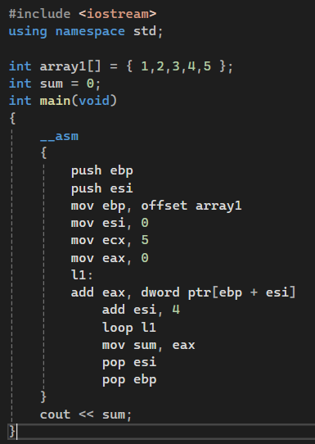
Example – Sum of Array V1
Notes:
#include <iostream>
using namespace std;
int array1[] = { 1,2,3,4,5 };
int sum = 0;
int main(void)
{
__asm
{
push ebp
push esi
mov ebp, offset array1
mov esi, 0
mov ecx, 5
mov eax, 0
l1:
add eax, dword ptr[ebp + esi]
add esi, 4
loop l1
mov sum, eax
pop esi
pop ebp
}
cout << sum;
}

Slide 18
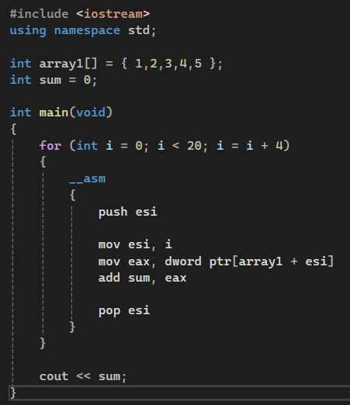
Example – Sum of Array V2
Notes:
#include <iostream>
using namespace std;
int array1[] = { 1,2,3,4,5 };
int sum = 0;
int main(void)
{
for (int i = 0; i < 20; i = i + 4)
{
__asm
{
push esi
mov esi, i
mov eax, dword ptr[array1 + esi]
add sum, eax
pop esi
}
}
cout << sum;
}

Slide 19
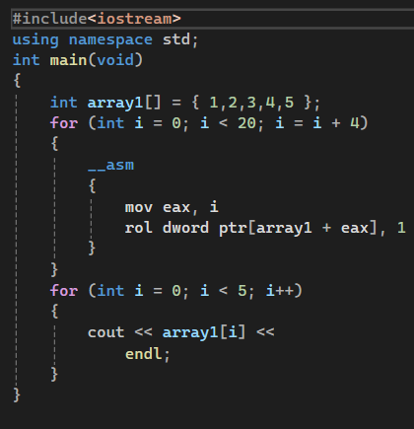
Example – Rotate Left
Notes:
#include<iostream>
using namespace std;
int main(void)
{
int array1[] = { 1,2,3,4,5 };
for (int i = 0; i < 20; i = i + 4)
{
__asm
{
mov eax, i
rol dword ptr[array1 + eax], 1
}
}
for (int i = 0; i < 5; i++)
{
cout << array1[i] <<
endl;
}
}

Slide 20
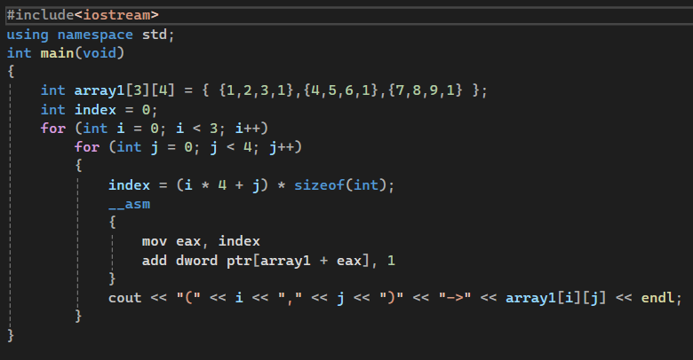
Example – 2D Array
Notes:
#include<iostream>
using namespace std;
int main(void)
{
int array1[3][4] = { {1,2,3,1},{4,5,6,1},{7,8,9,1} };
int index = 0;
for (int i = 0; i < 3; i++)
for (int j = 0; j < 4; j++)
{
index = (i * 4 + j) * sizeof(int);
__asm
{
mov eax, index
add dword ptr[array1 + eax], 1
}
cout << "(" << i << "," << j << ")" << "->" << array1[i][j] << endl;
}
}

